Slide 1
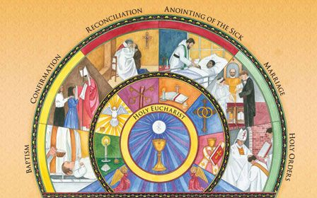
Read Church’s Story 3 Pages 80-83

Slide 2
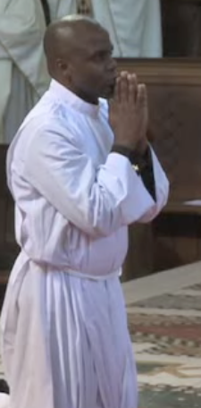
The Calling.
When a man feels that God is calling him to be a priest, he will need to pray and seek guidance from an experienced priest, who will see if he is serious about the choice and suitable for taking on such a great responsibility.
If the man still feels that God is calling him, he will need to be accepted by a Bishop, then he will begin many years of training in a seminary.
He will pray, learn more about his Faith, communicate the Good News and have experience of living and serving in the parish community.
At the end of the training, he will make promises of celibacy and obedience to their bishop.

Slide 3
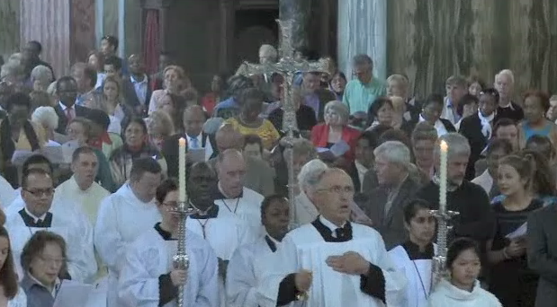
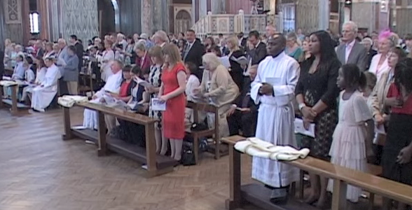
Holy Orders.
At the end of his training, if the man is still committed to being a priest and is sure God is calling him to this life and if the bishop accepts him, he will be ordained – that is he receives the sacrament of Holy Orders or Ordination.
This sacrament is celebrated during Mass and it is the bishop who ordains. The man being ordained is called an ‘ordinand’. The ordinand’s family and friends gather for the celebration.

Slide 4
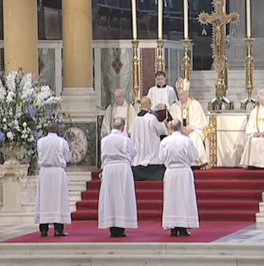
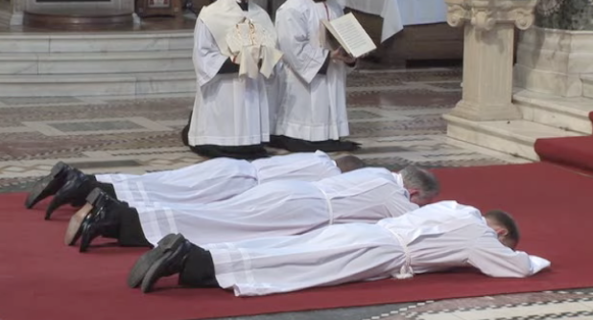
Gospel and Litany.
After the Gospel and homily, the ordinand is called forward from the parish family to stand in front of the bishop who asks him if he has freely chosen to be ordained and will promise to be a good and faithful priest.
The ordinand lies flat on the ground in front of the altar while the Litany of the Saints is sung.

Slide 5
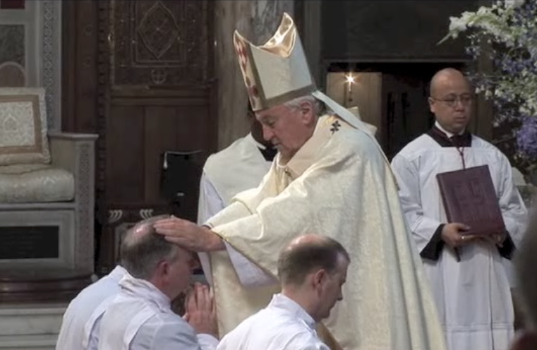
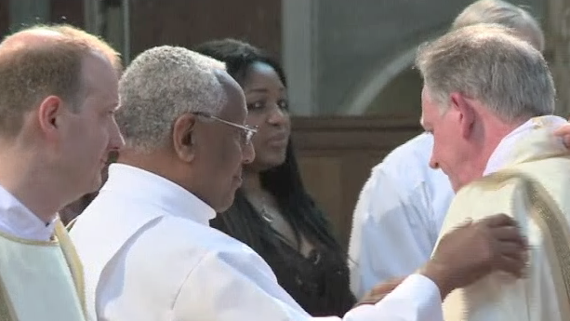
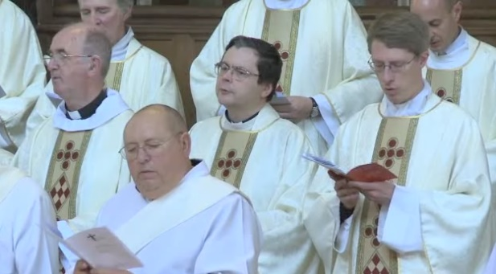
The Laying on of Hands.
The bishop lays his hands on the head of the ordinand and prays the prayer of consecration (a prayer asking God to bless and make holy the ordinand, to help him be a faithful witness and co-worker with the bishop.)
The man is now ordained as a priest.
The newly ordained priest receives his stole, (the garment that goes round his neck) and the chasuble, which is the top coloured vestment worn for the celebration of Mass.

Slide 6
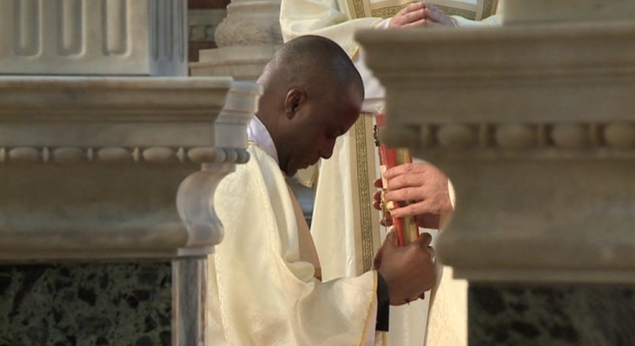
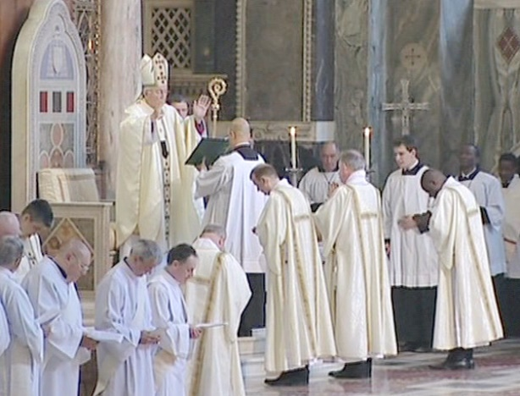
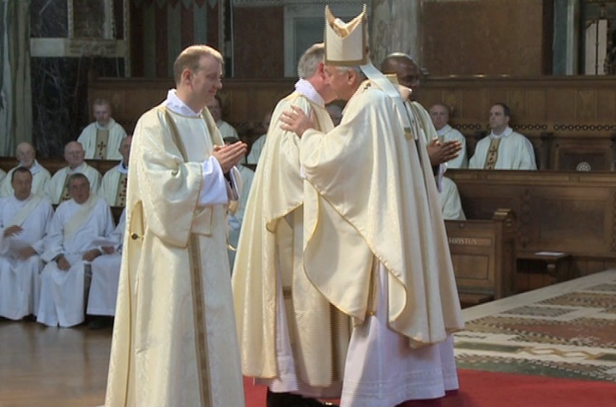
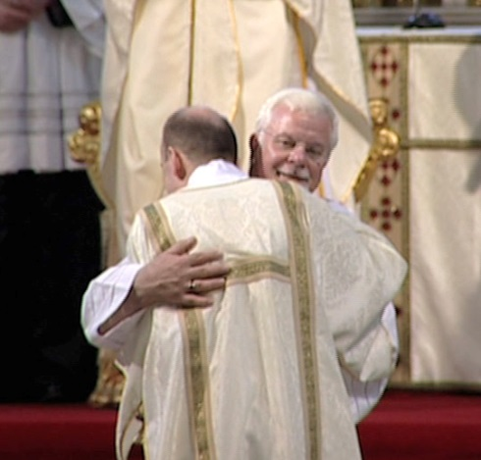
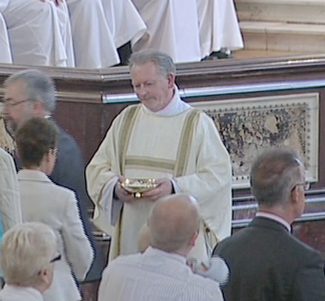
Anointing and Welcome
The bishop anoints the priest’s hands with the Oil of Chrism to make them holy.
He is given a paten with a host on it and a chalice with wine in it. The bishop says, ‘Accept from the holy people of God, the gifts to be offered to him’.
The bishop and all the other priests present give the new priest a sign of peace to welcome and congratulate him.
The newly ordained priest is now prepared to serve the family of God in the parish to which the bishop has appointed him.

Slide 7
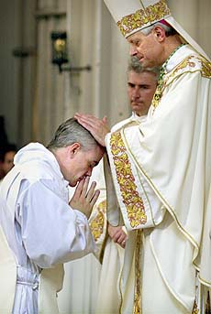
Q How do you think a man knows that God is calling him to
be a priest?
Q Why do you think the ordinand lies on the floor at the beginning of the Sacrament of Ordination?
Q Why do you think the priest is given the paten with the
host and the chalice with the wine?
Q In what other sacraments is anointing used and why?
Q What signs and symbols are used throughout the
Sacrament? Why are they chosen?

