Slide 1

Social Media Advice for Parents
Digital Leader Presentation

Slide 2

What are the risks of an underage social networking account?
The risks of an underage social networking accounts are that there is a risk of them being scammed and another risk of children being cyberbullied.

Slide 3


13 Years and Up
TikTok, Facebook, Instagram, Snapchat, Twitter, YouTube (if they have a Channel in it), Houseparty, KiK, Bebo, Younow, Habbo, Reddit, Youbo, Whisper, Discord, Twitch, Omegle, Askfm.

Slide 4


16 Years and Up
WhatsApp, LinkedIn, Flickr, Vimeo, MySpace, Periscope, Tumblr.
This Photo by Unknown author is licensed under CC BY-SA.

Slide 5

Top social networks for kids
The top social networks made for children are:
Spotlite (formerly Kudos)
Play-Kids Talk
Go-Bubble
Grom Social
Popjam - (11-13)

Slide 6

Spotlight
(Age 6 -10)
Spotlight is a kids friendly app with the main aim to teach preteens tweens and teens the manners of being online. The spotlite app focuses on the importance of a fun and safer social platform/experience for kids, tweens and teens. On this app kids are able to share videos, pictures, join groups for sharing with other similar interests and reacting and commenting on posts from others The platform is 100% COPPA compliant. All accounts require a parent or carer to provide email authentication and approval. No friends can be added until a parent approves the account.

Slide 7
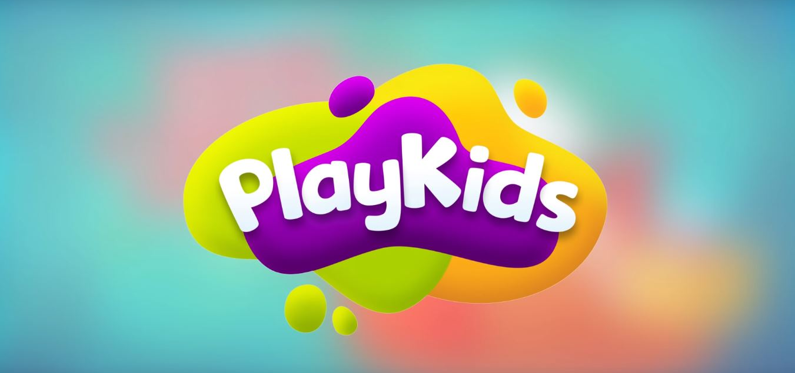
Playkids Talk
(Age 6 -10)
Play-kids talk is an internationally-acclaimed platform with cartoons, books, and activities. In this app To set up the child’s account parents are required to go through age-verification. Parents can control all aspects of the child’s account such as contacts and profile. Parent has access to the account on their phones as well to keep an eye on what is being shared in real-time

Slide 8
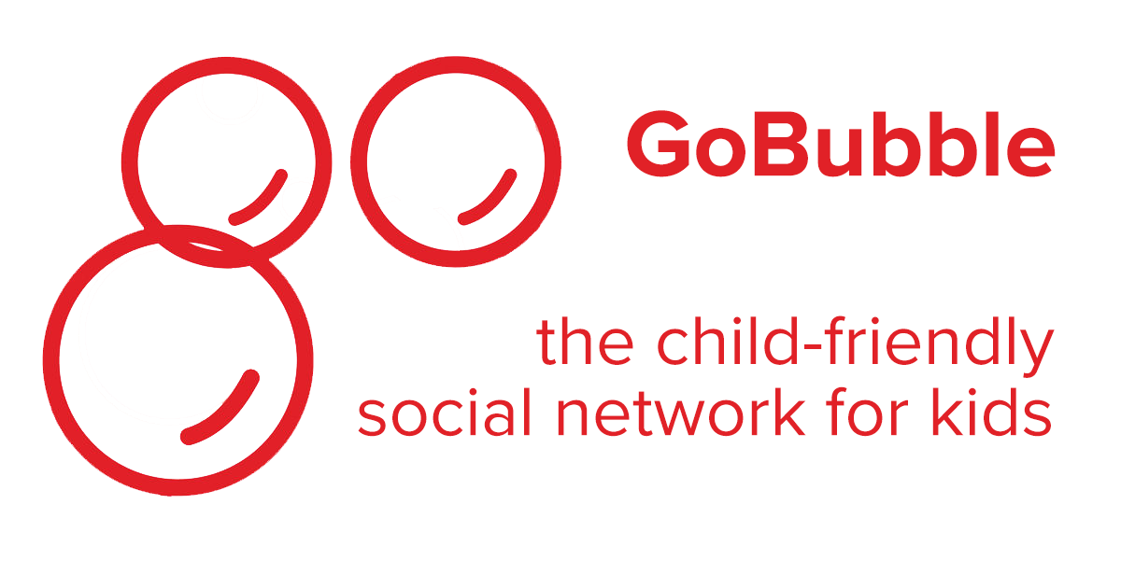
Go Bubble
(Age 6 -10)
Go Bubble helps and allows children to chat, collaborate on school projects, learn about new cultures, develop pen pals, and send parents messages all in a safe environment.
There is a Live moderation team who review flagged messages.
It is Advert free.
All content is always checked before it appears.

Slide 9
Grom Social
(Age 6 -10)
Grom social is an app that connects kids to meet others like them. They can do that by connecting via chat messaging, creating videos, sharing their posts and watching others posts too.
Grom TV kids can steam safe, curated video content.
The app has filters to remove any appropriate and abusive language.
Requires email verification from parent to open an account.
Parents can monitor a child’s activity with the MamaBear companion app.

Slide 10

PopJam
(Age 11 -13)
In pop-jam kids you can join communities, create art, follow influencers, play games, try quizzes, use filters and stickers and connect with other who have similar interests.
Dedicated moderators monitor Pop-Jam 24 hours a day and are active members of the community.
Messages can only be sent to someone if you are both following each other.
Under 13s need a parent or guardian’s permission to use any app or platform including Pop-Jam.
All post are monitored.

