Slide 1

St Gwynno Parent Information
Mrs D. Houston

Slide 2

Croeso / Welcome
Please let us begin our Parent information meeting as a faith community with a prayer to support the children in our care spiritually, socially and academically.

Slide 3

Religious Education
Come and See is the teaching scheme used and is provided by the Archdiocese to ensure children have a wide breadth of knowledge on the Catholic beliefs and teachings.
We will be covering three topics this term.
Topic 1: People
Topic Two: Called
Topic Three: Loving
Other Faiths: The children will focus for one week each on two other faiths namely Judaism and Hinduism.
Children will attend Mass in church, present a class Mass and an assembly to which parents will be invited.

Slide 4

Literacy, Language and Communication
Bug Club / Reading at home: parents are encouraged to listen to their children read using the Bug Club Online programme. Books will be allocated shortly. Please note that the book will be registered as unread if the children do not complete the learning tasks to test their comprehension of what has been read. If your child does not have login details, please leave your name with me at the end of this meeting.
‘Letter join’ is used as the handwriting scheme in Dosbarth Gwynno.
Spelling is a weekly activity. However, individual mistakes within writing are recorded in children’s books and they are required to complete their corrections FOUR time. These are frequently sent home for homework as some parents will already have experienced.

Slide 5
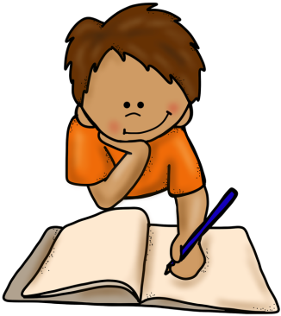

Literacy, Language and Communication
GGR: Guided group reading is an activity the children participate in every week. This term it is based on non – fiction texts linked to the context for learning project ‘Plastic Fantastic’
The main text being read as a class is ‘The Iron Man’ by Ted Hughes. This is the stimulus to enable children to produce a variety of independent writing for a variety of audiences. These genres of writing will include:
Letter writing Descriptive Writing
Creative writing Writing from the point of view of a character
Comparative writing Reading comprehensions
Newspaper article writing Writing a book review

Slide 6

Literacy, Language and Communication – Welsh / Cymraeg
Welsh as a second language now falls into this area of learning, Literacy, language and Communication
The school uses the Welsh schemes of work provided by the authority.
It is our intention to go for the bronze award in this area of learning.
70% of time allocation for this subject is on oracy.
15% 0f time allocation for this subject is on reading.
15% of time allocation for this subject is on oracy
Helpwr Heddiw: tem minutes a day is allocated to developing oracy skills.
Dosbarth Gwynno will focus on the following topics this term?
Gwersyllfa – camping and Beth sy’n bod gyda ti? Salwch – What is the matter with you? Illness.

Slide 7

Mathematics and Numeracy
Complete Maths: A brand new, whole school approach to Mathematics that is being implemented this year.
Mental Maths commences each mathematics lesson – where children show their answers to questions on whiteboards. It is a means of consolidating previous learning.
Mathematics homework is set weekly and books are sent home for the completion of these tasks. This term Mrs Houston’s mathematics class will focus on the following areas of learning:
Place Value, multiples, product, prime numbers, odd and even, the four process of number (+, -, X and division.) 2 D shape linked to angle, parallel lines and symmetry, time, area and perimeter.
Developing an excellent mental recall of multiplication facts to 10.
Reasoning: This is a weekly activity where children apply their learning in a problem solving context.
Mathletics: Is the online provision for additional homework in this area of learning. If parents d not have access to this platform, please give me your names at the end of the presentation.

Slide 8

Humanities
Humanities is the focus upon history and geography. This term my focus will be on geography and will be delivered through the topic of ‘Plastic fantastic’ It is also used as a platform for developing numeracy, literacy and IT skills in different contexts. The children will develop the following skills:
Compass direction using the eight points
Using 2 figure coordinates to record position and identify position
Map reading skills
The use of atlases
Interpreting geographical data
Using keys to identify location
To use simple scales to calculate distances between different locations.

Slide 9

Health and Well-Being
TenTen: This scheme covers the Health and Well-Being area of learning (not including PE) and teaches children about themselves and their physical, mental, emotional and spiritual health. These lessons will be taught by Ms Westgarth during Mrs Houston’s PPA time
GetSet4PE – Scheme of Work
Our PE topics for this Term are ‘Fundamentals’ and ‘Gymnastics’. These lessons will be taught by Ms Beynon during Mrs Houston’ s PPA time.
PE takes place on a Wednesday afternoon.

Slide 10

Science and Technology
The children will undertake a series of investigations during the second half of the autumn term. They will develop the skills of identifying a success criteria for an investigation, to make predictions about the outcome of an investigation, how to conduct a fair test, to describe, their method, how they will record their results in charts, and a variety of graphs, to draw conclusions from their data . To explain what they have learned and to assess whether the success criteria for the investigation has been achieved.
Let’s investigate Physics - How things work
1.Describes How things work
2. forces of different kinds
3. the ways in which forces can affect movement and how forces can be compared
Describes Sustainable Earth
The properties of materials related to their uses

Slide 11
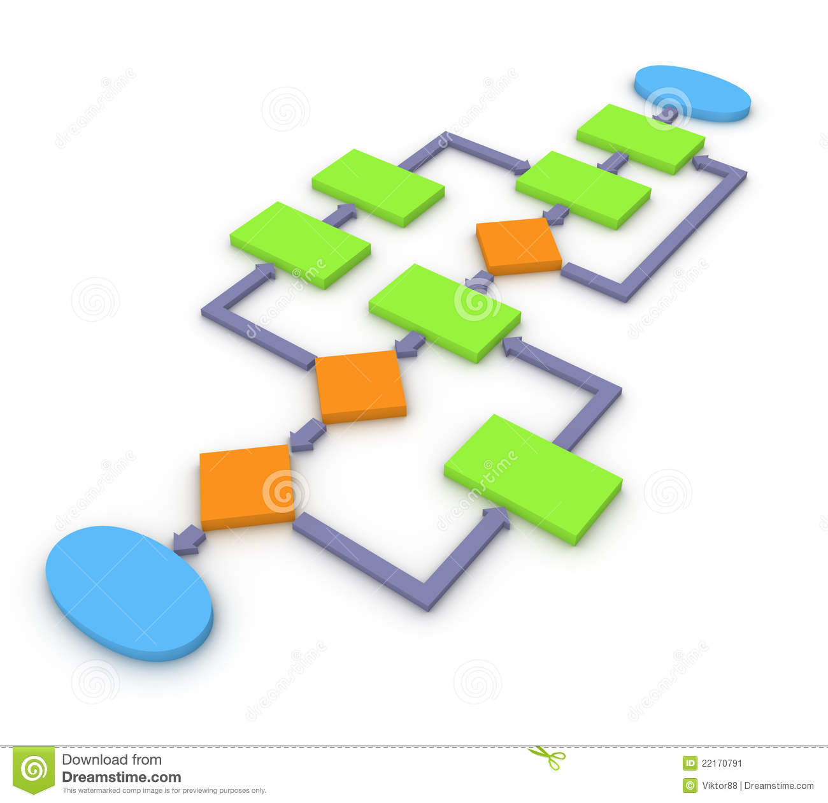
Science and Technology
Computation
Learning objectives:​
To understand how selection is represented in flowcharts.​
To understand and use decision boxes.​
To create flowcharts algorithms.

Slide 12
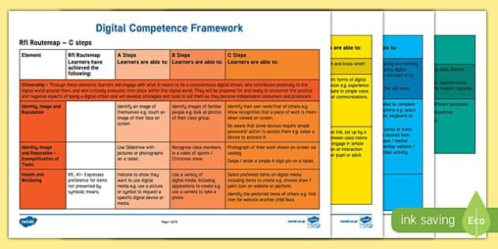
DCF: Digital Competency Framework
DCF
understand how to protect themselves from online identity theft,
understand that information put online leaves a digital footprint or trail,
identify benefits and risks of installing software, installing free and paid for software.
identify the positive and negative influences of technology on the environment,
explain the importance of balancing game and screen time with other parts of their lives

Slide 13
.
Digital Homework for 2022-23
Flip and Reading Progress Homework Timetable for
2022-23
Flip is a video discussion and video sharing app. Children are expected to record short video responses to a range of different topics throughout the year. All topics can be accessed by clicking the ‘Flip’ tab in Microsoft Teams.
Flip and Reading Progress homework activities must be completed by children in the following classes:
• St. Teilo 2
• St. Gwynno 3
• St. Tydfil 3
• St. Dwynwen 3

Slide 14
.
Digital Homework for 2022-23 - Timetable
Flip and Reading Progress homework activities must be completed by children in the following classes:
• St. Teilo 2
• St. Gwynno 3
• St. Tydfil 3
• St. Dwynwen 3
You need to record a response on the following topics: | Where can you find it? | You need to record your response by:
My Rights! | Go to Hwb and select ‘Office 365’. Click on Microsoft Teams and select ‘Flip’ in the tabs. Choose the correct topic and record your response. Remember to ‘Join with Microsoft’. | Monday 24th October 2022
My Voice! |  | Monday 24th October 2022
Compassionate and Loving |  | Monday 24th October 2022
Four Purposes |  | Monday 12th December 2022
Faith-filled and Hopeful |  | Monday 12th December 2022
Eloquent and Truthful |  | Monday 13th February 2023
Learned and Wise |  | Monday 27th March 2023
Curious and Active |  | Monday 22nd May 2023
Intentional and Prophetic |  | Monday 17th July 2023
My Journey with micro:bit! |  | Monday 17th July 2023

Slide 15
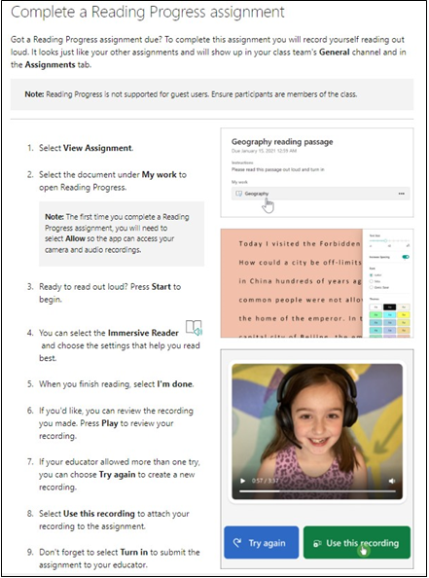
.
Homework Timetable for 2022-23
Reading Progress is a free tool built into Microsoft Teams designed to support and track reading fluency. Students record their reading on camera and submit it to their teacher.

Slide 16
.
Homework Timetable for 2022-23
Reading Progress is a free tool built into Microsoft Teams designed to support and track reading
fluency. Students record their reading on camera and submit it to their teacher.

Slide 17
School Website and Communication
Website
www.stjosephsprm.cardiff.sch.uk
Twitter
@StJosephsRCPri2
School Email
stjosephsprm@cardiff.gov.uk
School Phone Number
02920 621625

Slide 18
Thank you for attending

