Slide 1
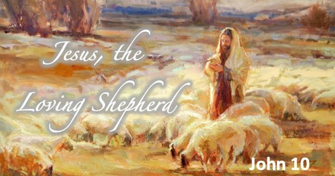
Jesus’s love for us all is unconditional
Jesus is the Good Shepherd
We are God’s People

Slide 2
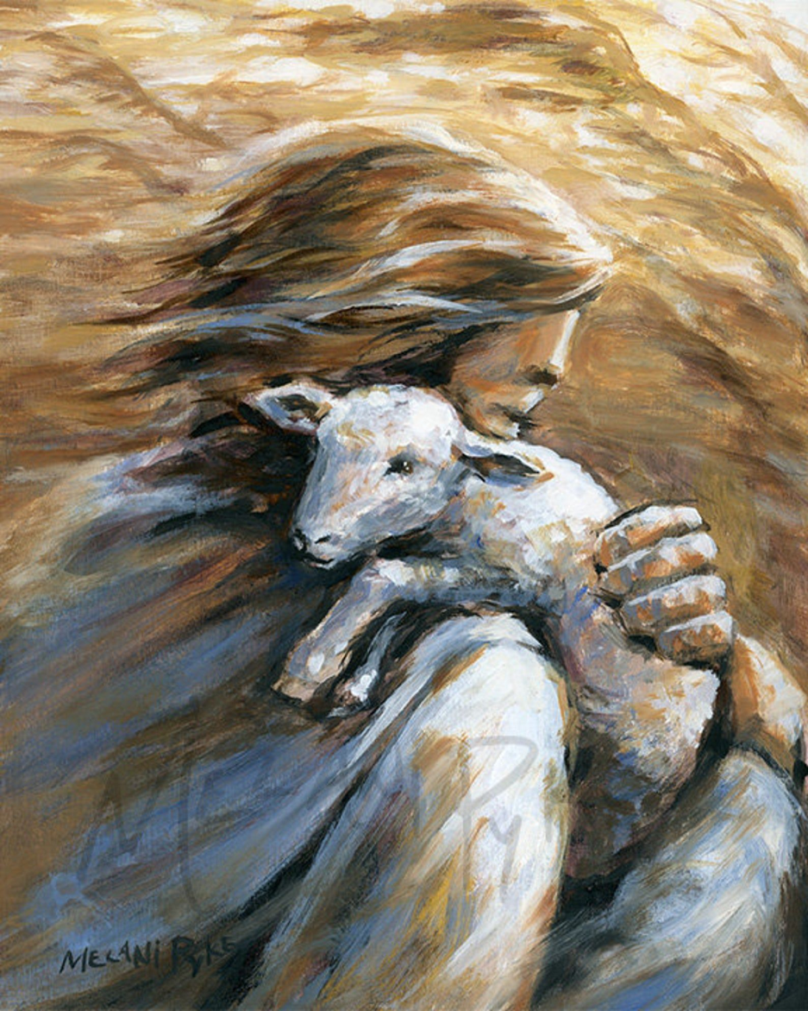
Jesus’s love for us all is unconditional
Jesus is the Good Shepherd
We are God’s People
Gather / Cynull
Hymn: Let there be loved shared among us
Mrs Houston: Croeso pawb i’r gwasanaeth – Welcome everybody to the assembly

Slide 3
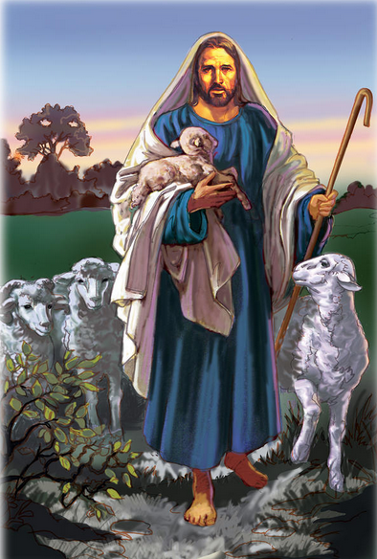
Jesus’s love for us all is unconditional
Jesus is the Good Shepherd
We are God’s People
Opening Prayer / Gweddi Agoriadol
Let us begin our collective worship by making a good sign of God’s love.
All: Yn enw’r Tad, a Mhab, a Ysbryd Glan. Amen.
Dear God,
Thank you that your love is for everyone.
Thank you that your love never runs dry.
Help us to receive your love and also to share your love with others.
Amen.
Yn enw’r Tad, a Mhab, a Ysbryd Glan. Amen.

Slide 4
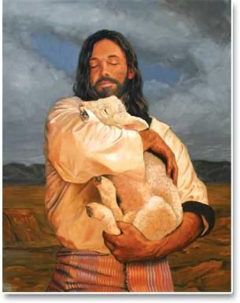
Jesus’s love for us all is unconditional
Jesus is the Good Shepherd
We are God’s People
Gather / Meditation / Reflection
Mrs Houston: We will now reflect on our Christian Virtues that we discussed at Friday’s assembly. As the music plays I want you to think about the times that you have been compassionate and loving to others.
Music plays.

Slide 5
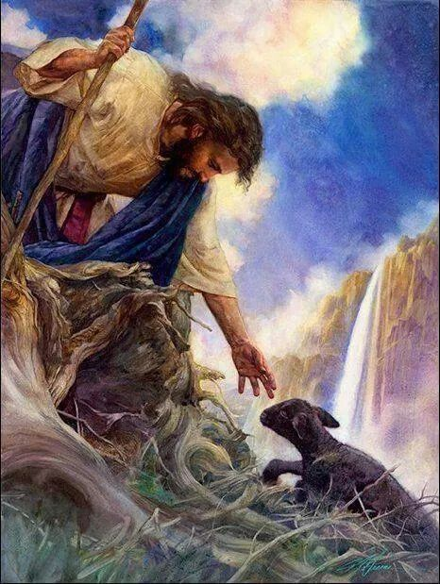
Jesus’s love for us all is unconditional
Jesus is the Good Shepherd
We are God’s People
TheWord of God / Gair Duw
Mrs Houston: The Lord be with you
All: And with your Spirit
Mrs Houston: A reading from the Holy Gospel of Luke.
All: Glory to you O Lord. (Cross your head, mouth and heart)

Slide 6
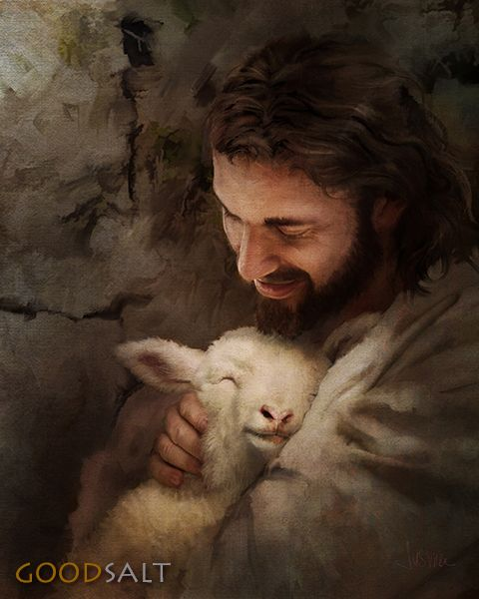
Jesus’s love for us all is unconditional
Jesus is the Good Shepherd
We are God’s People
One day some of Jesus’ followers began discussing which people were the most important in the kingdom of God. “Who is the greatest in the kingdom of heaven?” Were kings and queens the most important? Maybe only good people were important to God. So they asked Jesus, “Who is the greatest in the kingdom?” Jesus did not answer in the way they expected. To Jesus each and every person is important in the kingdom of God. Even the littlest child is important in the kingdom of God. Even someone who is not doing right things is important.

Slide 7
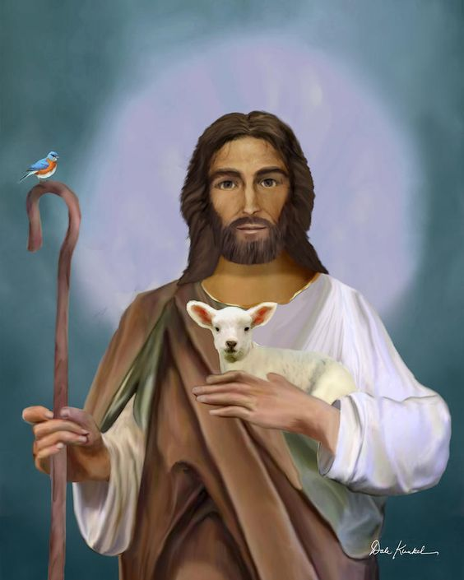
Jesus’s love for us all is unconditional
Jesus is the Good Shepherd
We are God’s People
He wants everyone to follow him. To help everyone understand this Jesus decided to tell them a story.
Jesus began. Once a shepherd had a flock of 100 sheep. Shepherds love their sheep. Sometimes they even have names for the sheep. A shepherd leads his sheep to nutritious green grass to eat. He looks for nice clean water so his sheep could have a drink when they were thirsty. A shepherd watches after every sheep and takes care of them. Sometimes dangerous animals like bears and lions would come and try to hurt his sheep. The shepherd protects the sheep and chases all of the dangerous animals away from them.

Slide 8
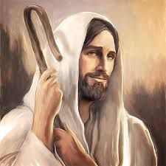
Jesus’s love for us all is unconditional
Jesus is the Good Shepherd
We are God’s People
At other times the sheep would wander away from the rest of the sheep and the shepherd had to call out the sheep’s name. When the sheep heard the shepherd’s voice he would run back to the shepherd. The shepherd loved every one of his sheep. He even had names for his sheep. Every night he would count his sheep to make sure that all 100 were there.

Slide 9
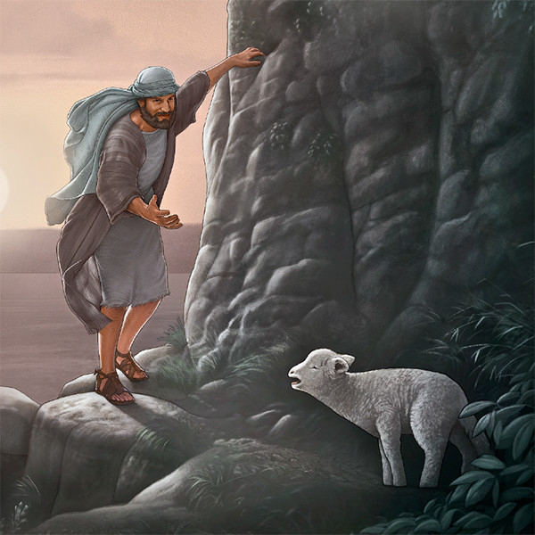
Jesus’s love for us all is unconditional
Jesus is the Good Shepherd
We are God’s People
On e day the shepherd counted his sheep and found that there were only 99 sheep instead of 100. The shepherd was so worried. One of the sheep must be lost. Even though 99 of the sheep were safe the shepherd was so concerned about the 1 sheep that was lost.

Slide 10
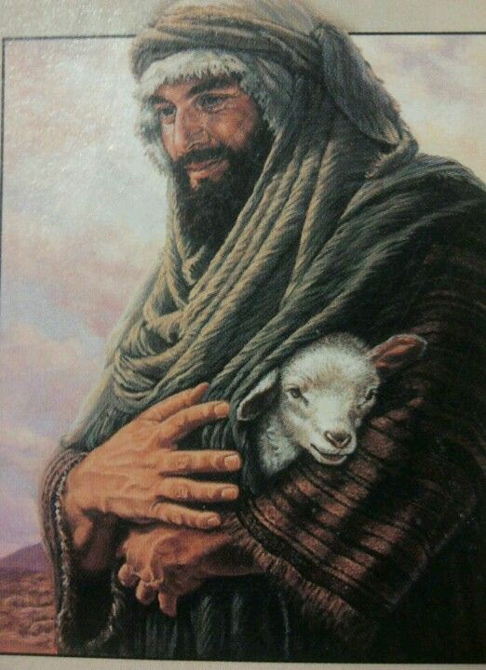
Jesus’s love for us all is unconditional
Jesus is the Good Shepherd
We are God’s People
Immediately, he left the other sheep in a safe place and set off looking for the lost sheep. The shepherd searched everywhere. What if the sheep was hurt? What if some wild animals had attacked it? Finally, he found the lost sheep! The shepherd was so relieved and happy. The shepherd lifted the sheep up onto his shoulders and carried him all the way back to join the rest of the flock.
PAUSE
Mrs Houston: The Gospel of the Lord
All: Praise to you Lord Jesus Christ.

Slide 11
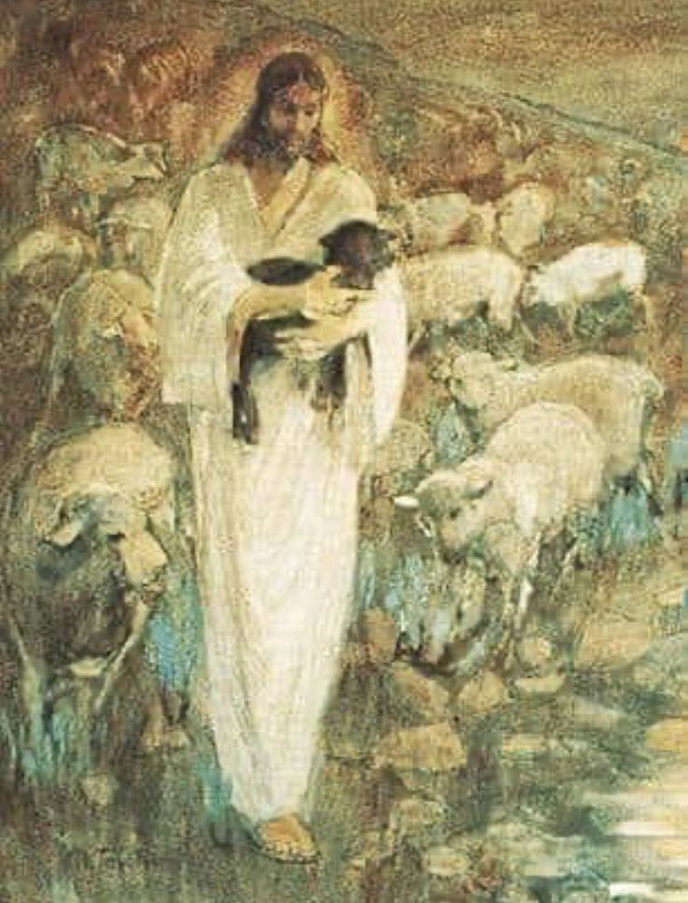
Jesus’s love for us all is unconditional
Jesus is the Good Shepherd
We are God’s People
Reflection on the meaning of the Gospel Reading
Mrs Houston: The parable that Jesus told helped the people understand. Every sheep is important to the shepherd. Even if only one is lost he will search everywhere to find it. In the same way people are important to God. He does not want anyone to be lost either. Every person is important to God.

Slide 12
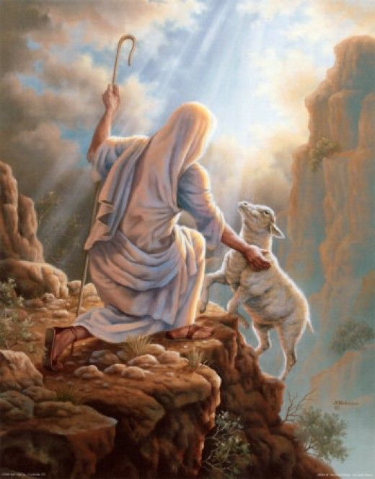
Jesus’s love for us all is unconditional
Jesus is the Good Shepherd
We are God’s People
Response to the Word of God
Mrs Houston: Father God I thank you for this new day. I thank you that you love me and are with me today. Lord in your mercy,
All: Clywed ein gweddi (Hear our prayer.)
Mrs Houston: Father God, please be with me today in everything I will face. Help me to learn well at school. I pray that I would be a good friend to those around me today. Lord in your mercy,
All: Clywed ein gweddi (Hear our prayer.)

Slide 13
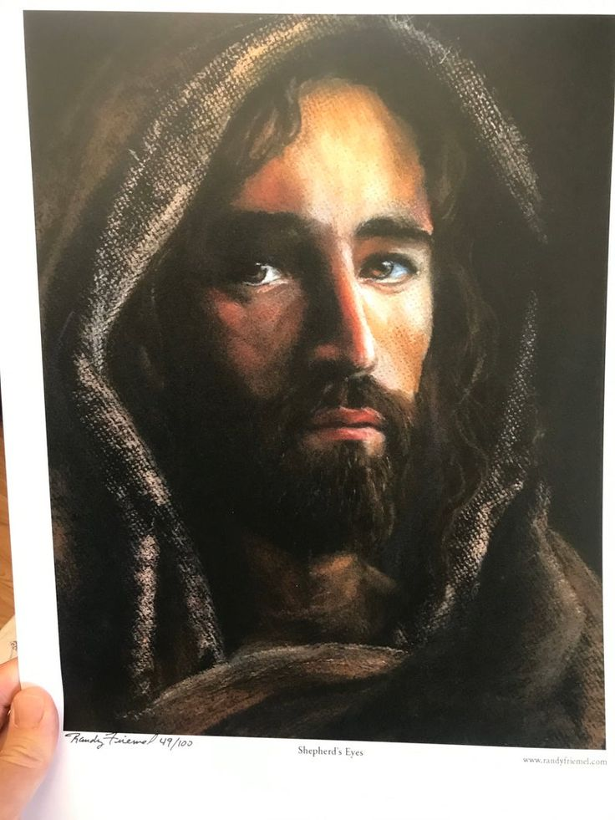
Jesus’s love for us all is unconditional
Jesus is the Good Shepherd
We are God’s People
Mrs Houston: Father God, I thank you for everything you have done for me. I thank you for my family and my friends. I thank you that you love me so much that you sent your son Jesus for me. Lord in your mercy,
All: Clywed ein gweddi (Hear our prayer.)

Slide 14
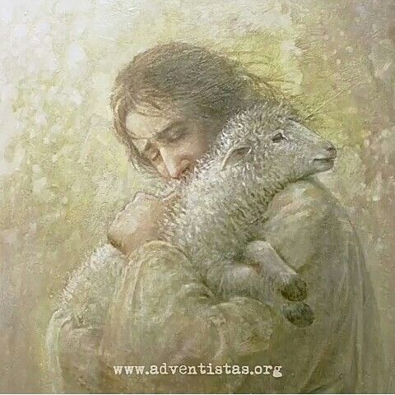
Jesus’s love for us all is unconditional
Jesus is the Good Shepherd
We are God’s People
Going Forth
Closing Prayer
Mrs Houston: Dwylo gyda gilydd a llygaid ar gau os gwelwch yn dda.
All: Yn enw’r Tad, a Mhab, a Ysbryd Glan. Amen
Father God I thank you for being with me today. I thank you that you were alongside me in everything I face today. Please help me in the week ahead. I thank you that you will never leave me. Father God I thank you for everything you have blessed me with today. Thank you for my friends and family. Thank you for keeping me safe. I thank you that you love me and care for me. Amen
All: Yn enw’r Tad, a Mhab, a Ysbryd Glan. Amen

Slide 15
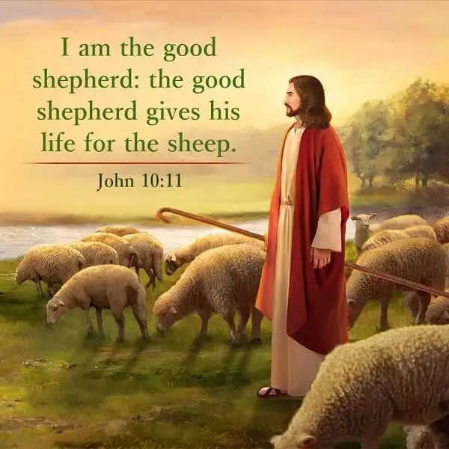
Jesus’s love for us all is unconditional
Jesus is the Good Shepherd
We are God’s People
Rejoice
Let us close our collective worship by singing the hymn, ‘Let there be love shared among us.’

