Slide 1
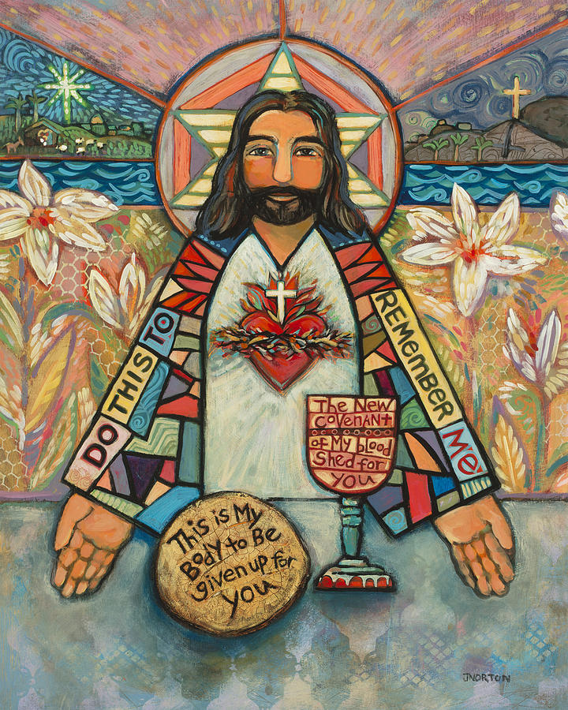
Who is this man? Who is Jesus to me?
Addoli ar y cyd erbyn blwyddyn chwech
Collective Worship by Year Six

Slide 2
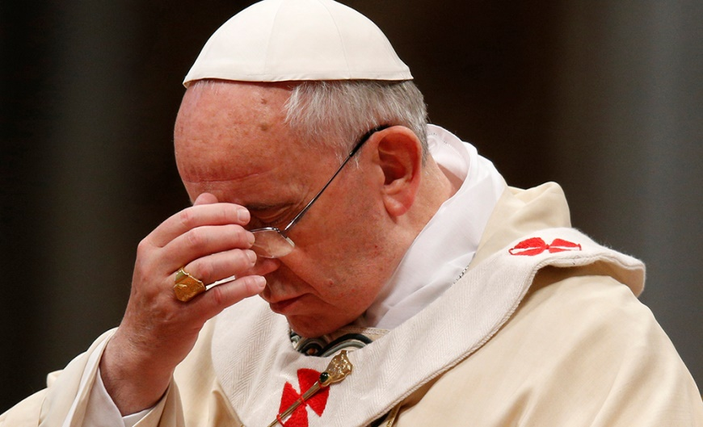
Gather
Croeso and welcome i’r gwasanaeth / to the assembly.
Let us begin our collective worship today by making a good sign of God’s Love as a faith community.
Yn enw’r Tad a Mhab a Ysbryd Glan Amen.

Slide 3
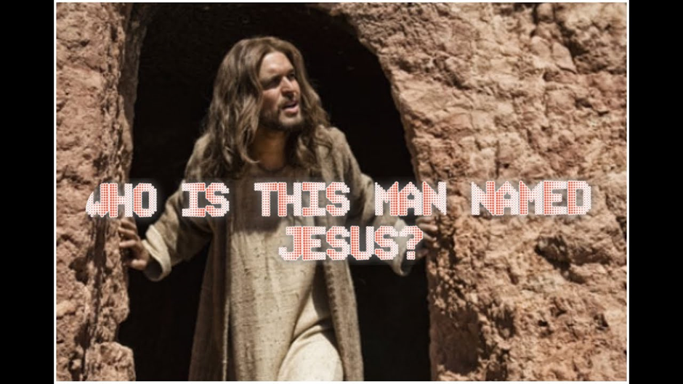
Gather
Today we will be exploring this question from the Gospel of Matthew chapter 8, verses 23 – 27 where the disciple Matthew asks these two questions of us.
Who is this man? Who is Jesus to me?

Slide 4
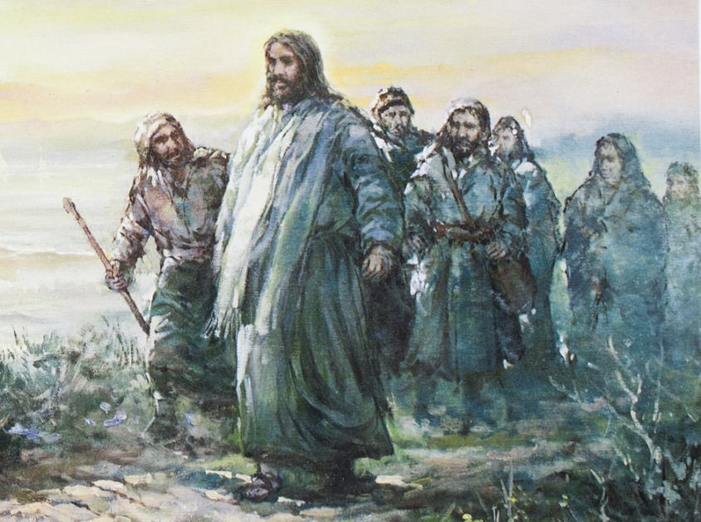
Gather
As Catholics and Christians we are asked upon to follow the teachings and example of our Lord and Saviour. We are asked to follow him.
Let us gather as a school community and sing the hymn ‘Follow me, follow me!’

Slide 5
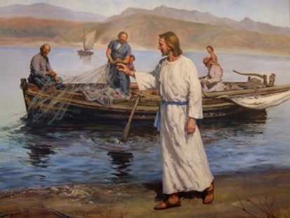
Gather
Chorus
Follow me, follow me, leave your home and family,
Leave your fishing nets and boats upon the shore.
Leave the seed that you have sown, leave the crops that you have grown, leave the people you have known and follow me.
1. The foxes have their holes,
and the swallows have their nests,
but the son of man
has no place to lay down.
I do not offer comfort,
I do not offer wealth,
but in me will all happiness be found.
Chorus
Follow me, follow me, leave your home and family,
Leave your fishing nets and boats upon the shore.
Leave the seed that you have sown, leave the crops that you have grown, leave the people you have known and follow me.

Slide 6
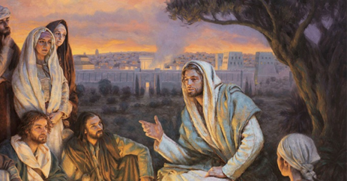
Gather
2. If you would follow me,
you must leave old ways behind.
You must take my cross
and follow on my path.
You may be far from loved ones,
you may be far from home,
but my father will welcome you at last.
Chorus
Follow me, follow me, leave your home and family,
Leave your fishing nets and boats upon the shore.
Leave the seed that you have sown, leave the crops that you have grown, leave the people you have known and follow me.

Slide 7
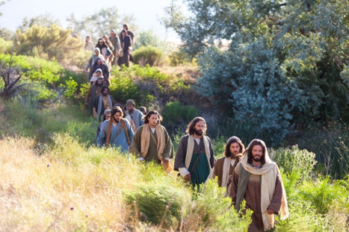
Gather
3. Although I go away
you will never be alone.
for the spirit will be
there to comfort you.
Though all of you may scatter,
each follow his own path,
still the spirit of love will lead you home.
Chorus
Follow me, follow me, leave your home and family,
Leave your fishing nets and boats upon the shore.
Leave the seed that you have sown, leave the crops that you have grown, leave the people you have known and follow me.

Slide 8
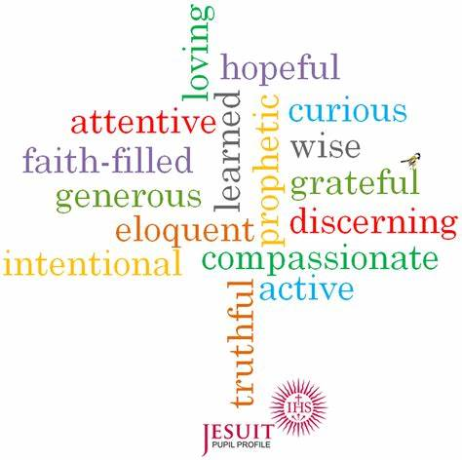
Gather
A key part of our learning that is imbedded in the culture of Saint Peter’s School are the …
VIRTUES
Have you ever thought why they are so important?

Slide 9
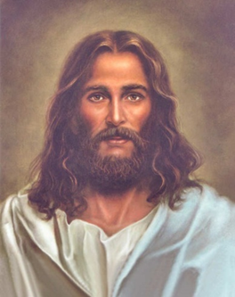
Gather
Answer:
They help us to understand who Jesus is and what he means to us if we follow his example. Let us remind ourselves of the Virtues that are demonstrated in our Lord and Saviour’s example and teaching and how if we follow the Virtues we too can get closer to knowing God our Father and as a result live out His example in our daily lives and develop a closer relationship with him – get to know him better.

Slide 10
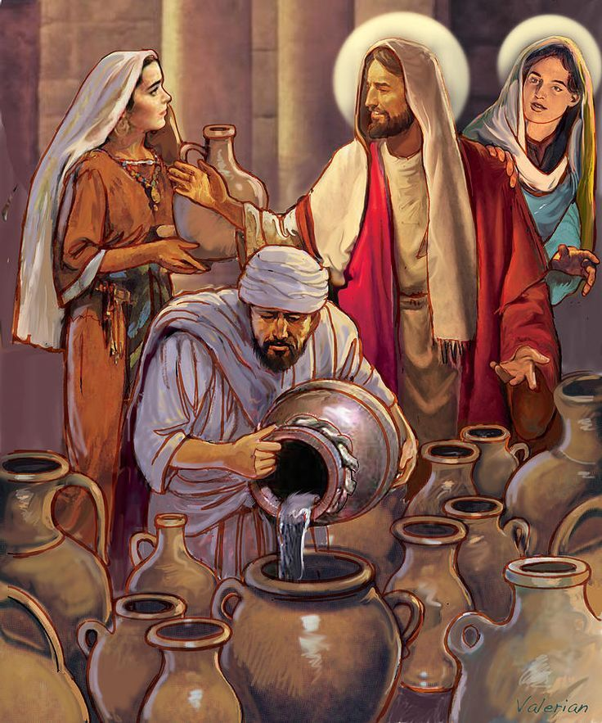
Gather
Attentive (paying close attention to something.) and Discerning (showing good judgement.)
Pause for a moment and think how will I follow Jesus’s example and be attentive and discerning.
Jesus demonstrated these virtues by his actions in the miracle at the Wedding Feast at Cana (John 2:1-12) where he changed water into wine.

Slide 11
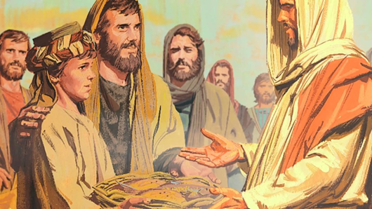
Gather
Compassionate (feeling or showing sympathy and concern for others) and Loving (showing great care for another person)
Pause for a moment and think how will I follow Jesus’s example and be compassionate and loving.
Jesus demonstrated these pair of virtues to us at the ‘Feeding of the five thousand’ (Matthew 14:13-21)

Slide 12
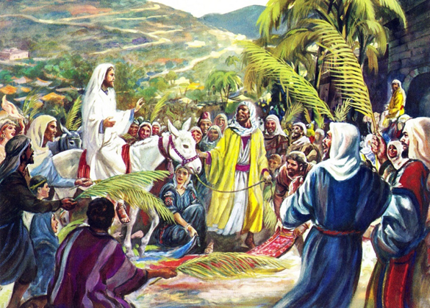
Gather
Generous (giving more of yourself than you need to) and Grateful (feeling or showing an appreciation for something done or received)
Pause for a moment and think how will I follow Jesus’s example and be generous and grateful. Jesus demonstrated these virtues at the start of Holy Week on Palm Sunday when he entered Jerusalem on a donkey.

Slide 13
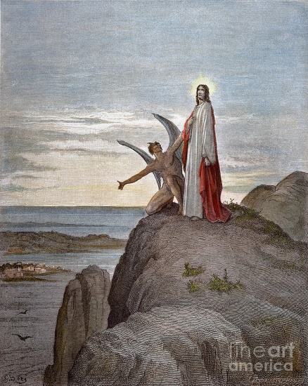
Gather
Learned (having a great knowledge of many things) and wise (using your knowledge to make good judgements.)
Pause for a moment and think how will I follow Jesus’s example and be learned and wise. Jesus demonstrated these virtues when he used them not to be tempted by the devil in the wilderness.

Slide 14
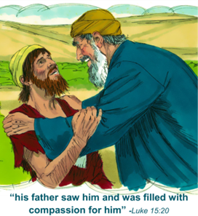
Gather
Eloquent (being a persuasive speaker) and truthful (being honest)
Pause for a moment and think how will I follow Jesus’s example and be eloquent and truthful.
Jesus demonstrated these virtues in the parable of the Prodigal Son in Matthew 21: 28-31

Slide 15
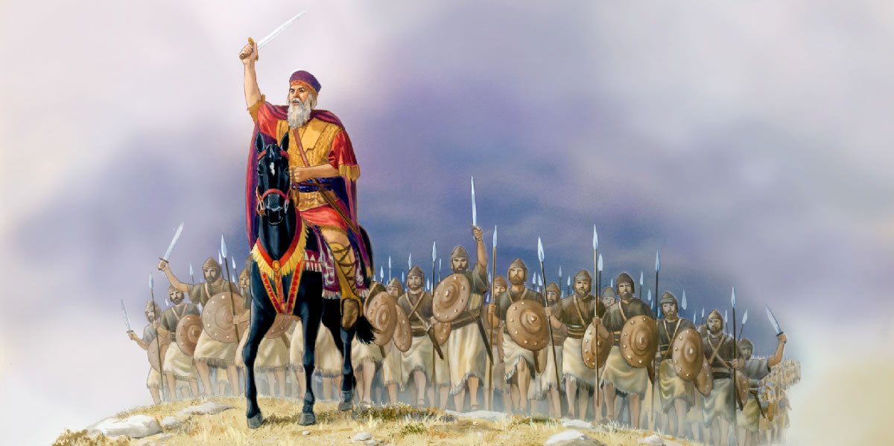
Gather
Intentional (doing something deliberately to achieve a purpose or an aim) and prophetic (predicting what will happen in the future )
Pause for a moment and think how will I follow Jesus’s example and be intentional and prophetic. These Virtues are demonstrated in Jesus’s story of a King Going to Battle because he has a love of war and does not understand that if we do not love one another then we hurt and destruct one another. Luke 14: 25, 31-32

Slide 16
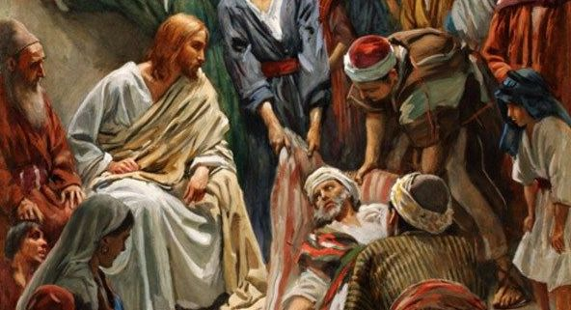
Gather
Faith filled (living a life that demonstrates belief in God and His son Jesus) and hopeful ( feeling positive about the future and the belief that God our Father is always there with us and guiding us)
Pause for a moment and think how will I follow Jesus’s example and be faith filled and hopeful. Jesus demonstrated these Virtues when he healed a paralysed man – Mark 12:1-12

Slide 17
Gather
Learned (having a great knowledge of many things) and wise (using your knowledge to make good judgements.)
Pause for a moment and think how will I follow Jesus’s example and be learned and wise. Jesus demonstrated these virtues when he used them not to be tempted by the devil in the wilderness.

Slide 18
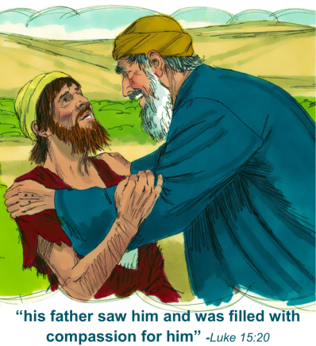
Gather
Eloquent (being a persuasive speaker) and truthful (being honest)
Pause for a moment and think how will I follow Jesus’s example and be eloquent and truthful.
Jesus demonstrated these virtues in the parable of the Prodigal Son in Matthew 21: 28-31

Slide 19
Gather
Intentional (doing something deliberately to achieve a purpose or an aim) and prophetic (predicting what will happen in the future )
Pause for a moment and think how will I follow Jesus’s example and be intentional and prophetic. These Virtues are demonstrated in Jesus’s story of a King Going to Battle because he has a love of war and does not understand that if we do not love one another then we hurt and destruct one another. Luke 14: 25, 31-32

Slide 20
Gather
Faith filled (living a life that demonstrates belief in God and His son Jesus) and hopeful ( feeling positive about the future and the belief that God our Father is always there with us and guiding us)
Pause for a moment and think how will I follow Jesus’s example and be faith filled and hopeful. Jesus demonstrated these Virtues when he healed a paralysed man – Mark 12:1-12

Slide 21
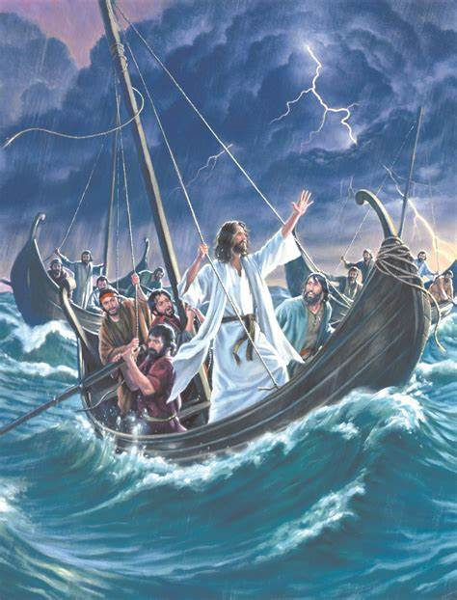
The Word
Who is this man?
Matthew Chapter Eight
In this reading we will learn about who Jesus is and how His example teaches us about the importance of our Catholic Virtues.
Jesus Calms a Storm
23 And when he got into the boat, his disciples followed him. 24 And behold, there arose a great storm on the sea, so that the boat was being swamped by the waves; but he was asleep. 25 And they went and woke him, saying, “Save us, Lord; we are perishing.” 26 And he said to them, “Why are you afraid, O you of little faith?” Then he rose and rebuked the winds and the sea, and there was a great calm. 27 And the men marvelled, saying, “What sort of man is this, that even winds and sea obey him?”

Slide 22

Response to the Word
This reading tells us about the power of Jesus and that for Him anything is possible. Jesus shows his divine power by stopping the storm, he is not afraid. He reminds the disciples about being faith filled and hopeful and that with trust in God anything is possible. He shows love and compassion for His disciples when they are afraid, His words are eloquent and wise and when the disciples say ‘what sort of man is this’ we know he is our Lord and if we believe in him and follow his example we too will receive the gift of eternal life demonstrated by His dying on the cross where he showed his unending and unconditional love for us.

Slide 23
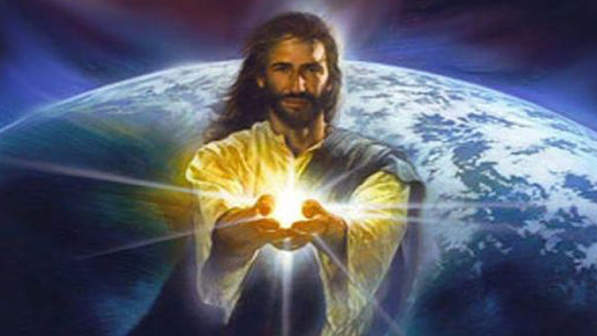
Response to the Word
Who is Jesus?
He is our loving Father.

Slide 24

Response to the Word
The response to our bidding prayers is ‘hear our prayer.’
All:’Hear our prayer.’
Lord, teach me to be generous:
to serve you as you deserve;
to give and not to count the cost;
to fight and not to heed the wounds;
to toil and not to seek to rest;
to labour and to ask for no reward
save that of knowing I do your will.
Lord in your mercy,
All: ‘Hear our prayer.’

Slide 25
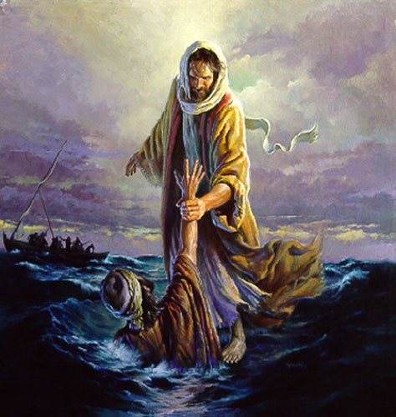
Response to the Word
Lord, we come to you before we begin our day's work:
we ask you to bless this day.
May we find whatever is good in the tasks we are set
and the time that we share.
Help us when we find some things too hard to understand;
Teach us to be fair and generous with one another;
So may we thank you for a day well spent.
Lord in your mercy,
All: ‘Hear our prayer.’

Slide 26
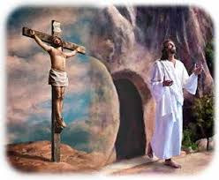
Response to the Word
Lord, guide me, teach me, strengthen me,
‘till I become such a person as thou would have me be;
pure and gentle,
truthful and high-minded,
brave and able,
courteous and generous,
dutiful and useful.
Lord in your mercy,
All: ‘Hear our prayer.

Slide 27
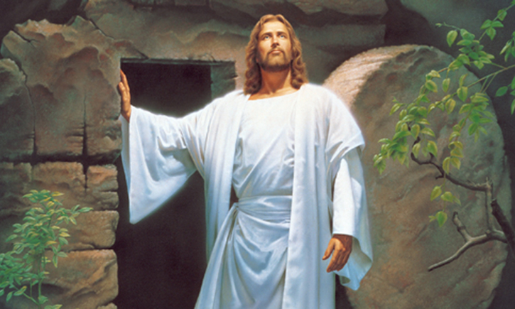
Response to the Word
Compassionate and loving God,
you created a beautiful world for us to share:
Give us the desire to live simply,
so that our lives show your generosity.
You made us responsible for the earth:
guide us so that those who come after us may enjoy your creation.
Lord in your mercy,
All: ‘Hear our prayer.’

Slide 28

Response to the Word
Father in heaven,
you have given us a mind to know you,
a will to serve you,
and a heart to love you.
Be with us today in all that we do,
so that your light may shine out in our lives.
Lord in your mercy,
All: ‘Hear our prayer.

Slide 29
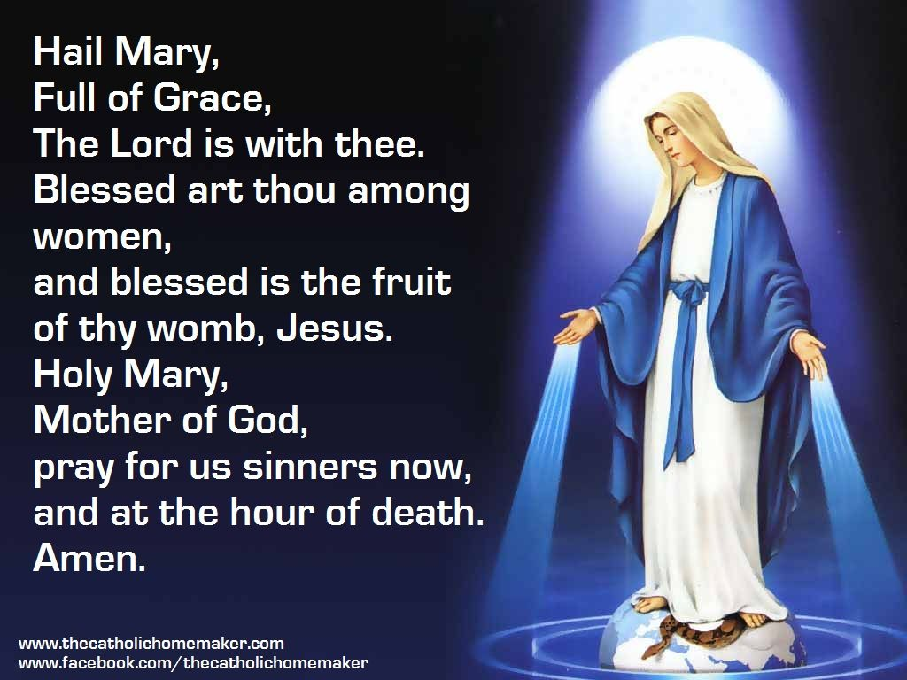
Response to the Word
Let us turn to Our Lady and remember that she was the embodiment of the Christian virtues and helped us to understand who Jesus was and I in our lives. Help us to follow her example of faith, love, compassion, judgement, eloquence and generosity of spirit as we say:
All: Hail Mary ….

Slide 30
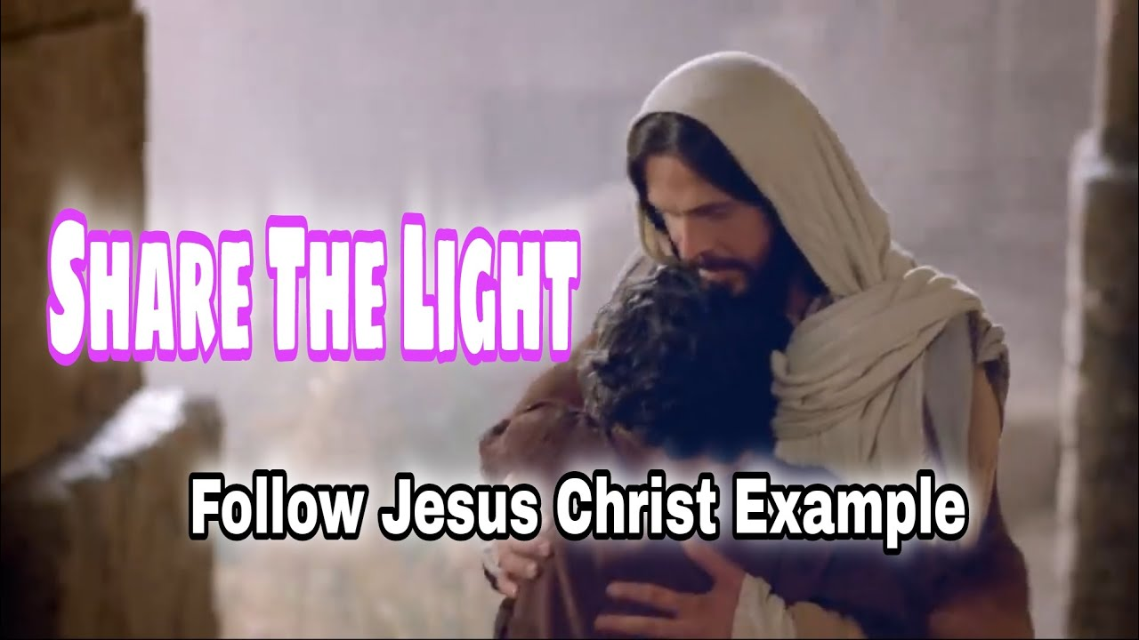
Rejoice / Mission
Going Forth
Let our challenge today, to go forth and live out the Virtues so that we can help others in our community understand who Jesus is. Let us work hard to follow his example in our thoughts, our actions and our words and make Saint Peter’s a community where God our loving Father is known and celebrated in all that we do and say.

Slide 31
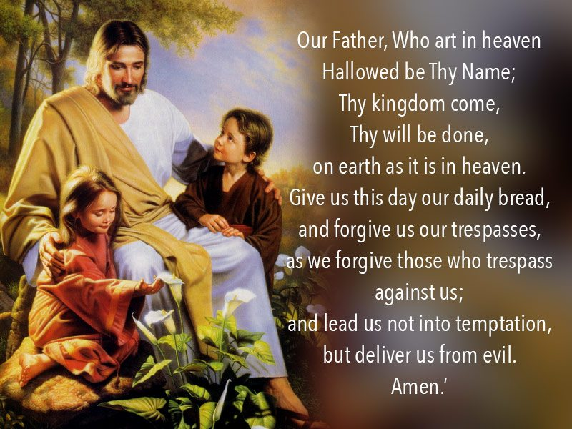
Rejoice / Mission
Going Forth
We ask God our father to intercede for us as we go Forth from our collective worship today.
Our Father ...

Slide 32

Rejoice / Mission
Going Forth
Let us end by singing the hymn ‘When I needed a neighbour were you there?’ to help us to live out the Virtues so that others can learn who Jesus is and all about His unconditional love for us.

Slide 33
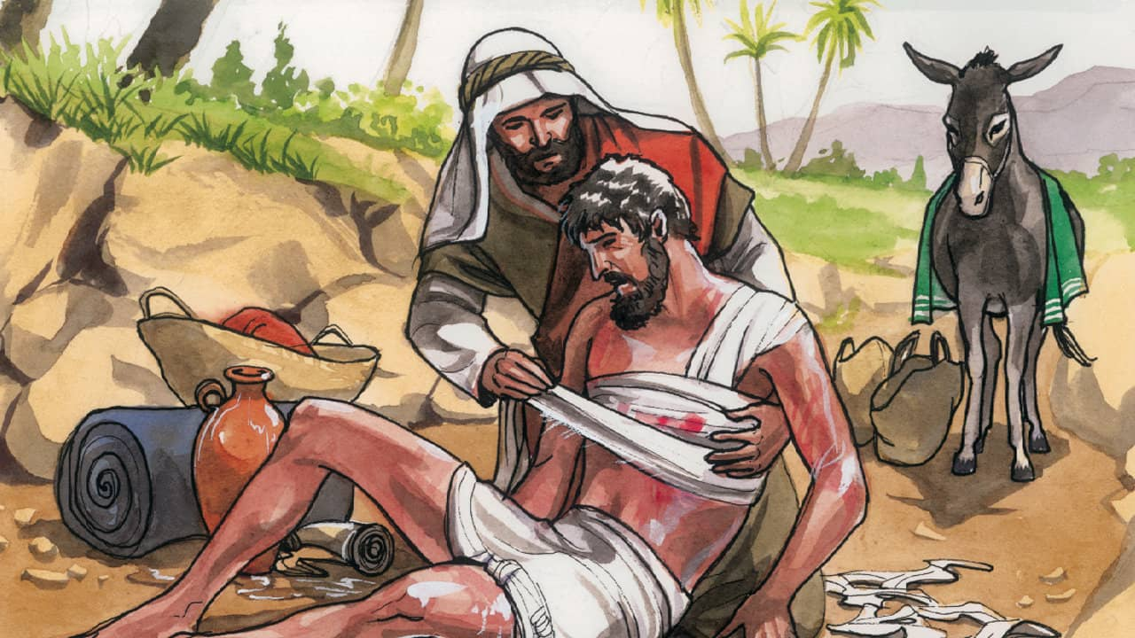
Rejoice / Mission
Going Forth
When I needed a Neighbour https://www.youtube.com/watch?v=B7a7LdgRh-k
When I needed a neighbour
Were you there, were you there?
When I needed a neighbour
Were you there?
And the creed and the colour
And the name won't matter
Were you there?

Slide 34
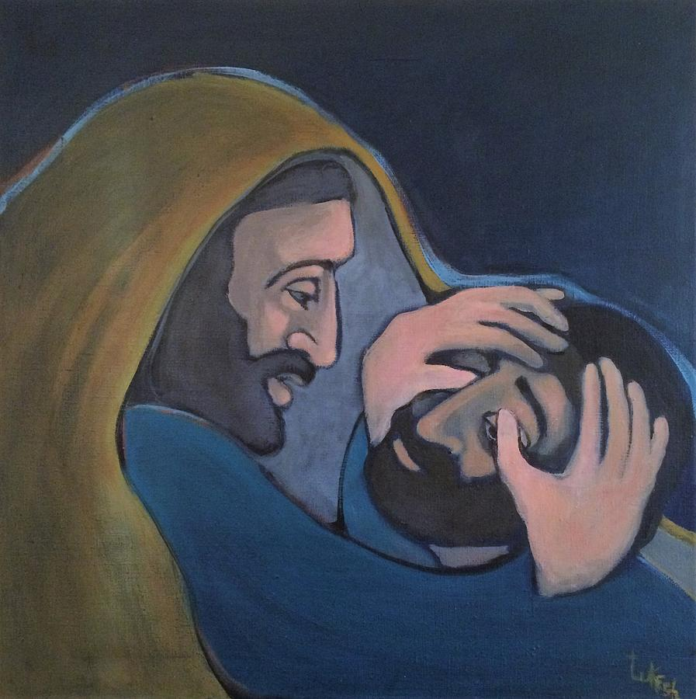
Rejoice / Mission
Going Forth
I was hungry and thirsty
Were you there, were you there?
I was hungry and thirsty
Were you there?
And the creed and the colour
And the name won't matter
Were you there?

Slide 35
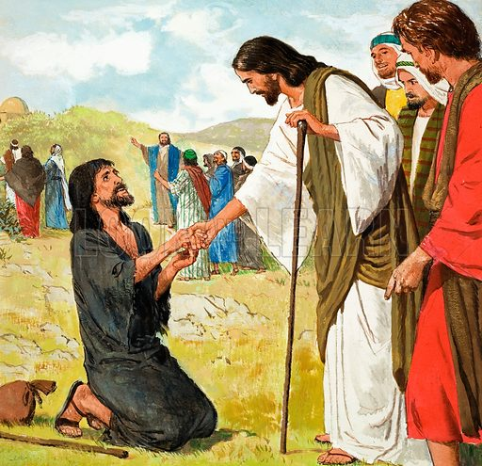
Rejoice / Mission
Going Forth
I was cold, I was naked
Were you there, were you there?
I was cold, I was naked
Were you there?
And the creed and the colour
And the name won't matter
Were you there?

Slide 36
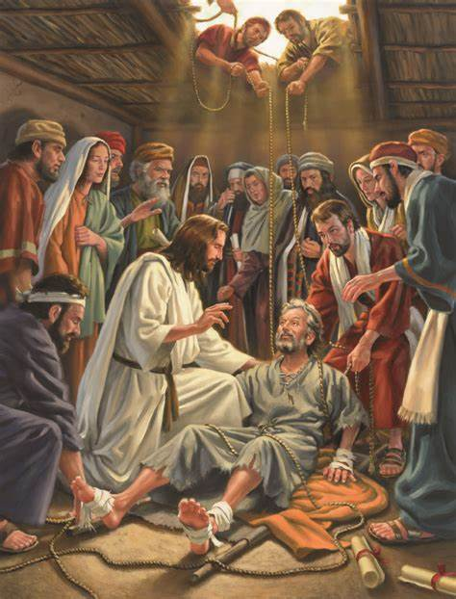
Rejoice / Mission
Going Forth
When I needed a shelter
Were you there, were you there?
When I needed a shelter
Were you there?
And the creed and the colour
And the name won't matter
I'll be there

Slide 37
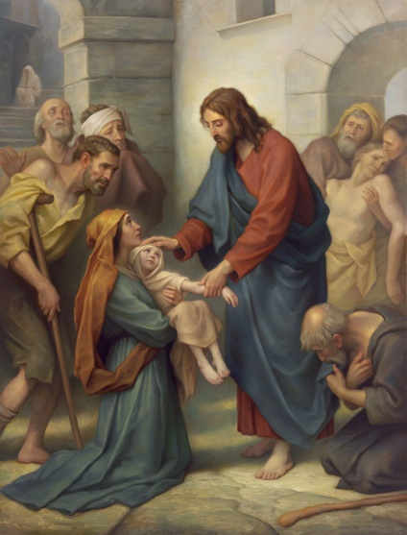
Rejoice / Mission
Going Forth
When I needed a healer
Were you there, were you there?
When I needed a healer
Were you there?
And the creed and the colour
And the name won't matter
Were you there?

Slide 38
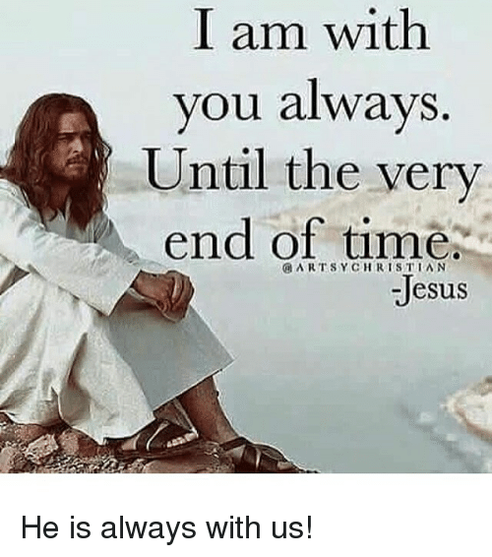
Rejoice / Mission
Going Forth
Wherever you travel
I'll be there, I'll be there
Wherever you travel
I'll be there
And the creed and the colour
And the name won't matter
I'll be there

