Slide 1
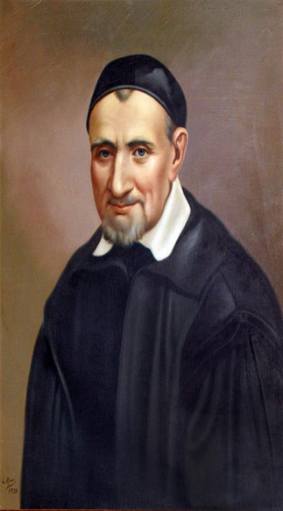
Collective Worship
Gather / Cynnull
Bore da pawb a croseo i’r
gwasanaeth.
Welcome everyone to the
Assembly.
Today is a very special day as we
Celebrate the feast day of
Saint Vincent de Paul.

Slide 2
Collective Worship
Gather
Hymn: Love, love, Jesus is love. https://www.youtube.com/watch?v=ZN4JE0GL2Ls

Slide 3
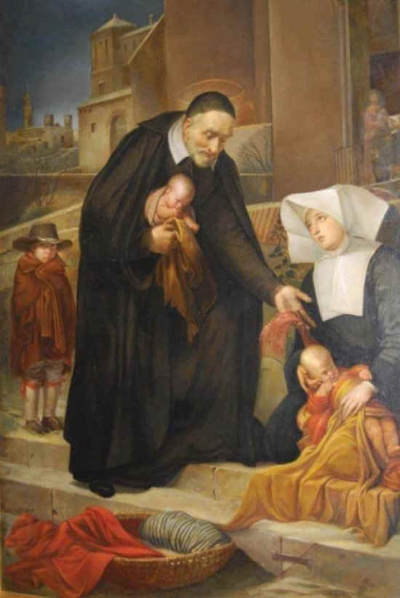
Collective Worship
Gather / Cynnull
Let us begin by making a
good sign of God’s love.
Gadewch i ni ddechrau drwy
wneud arwydd da o gariad
Duw.

Slide 4
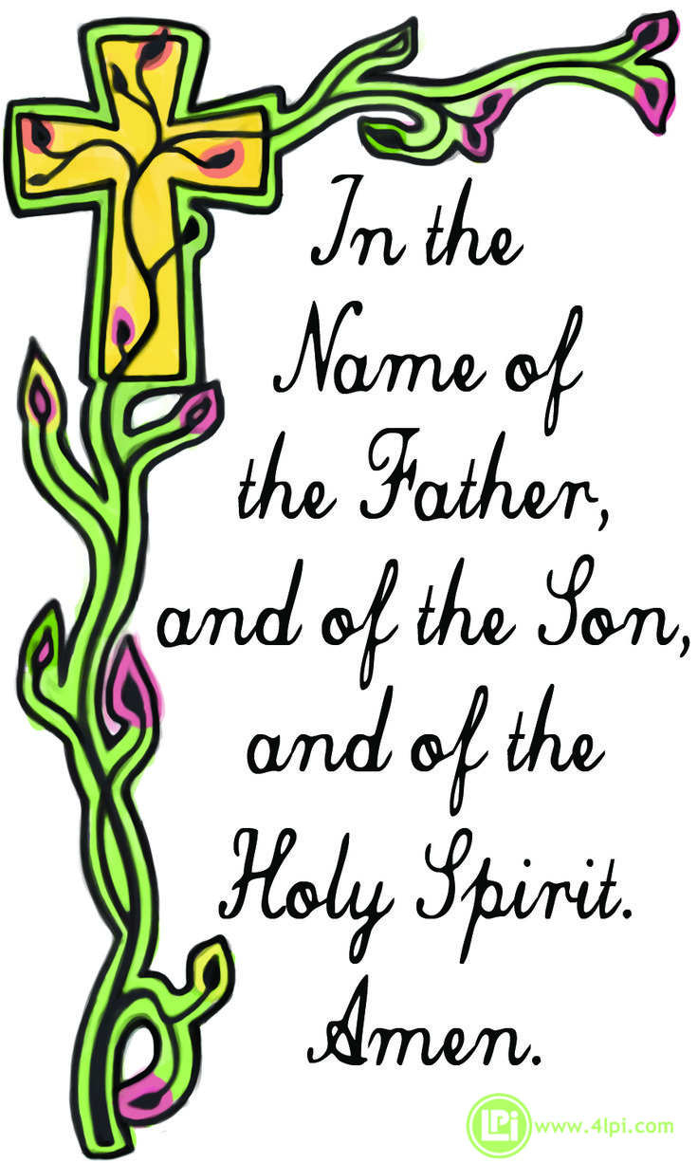
Collective Worship
Gather / Cynnull
Yn enw’r Tad a Mhab a
Ysbryd Glan. Amen.
We will pray a prayer given to us by saint Vincent de Paul himself.

Slide 5
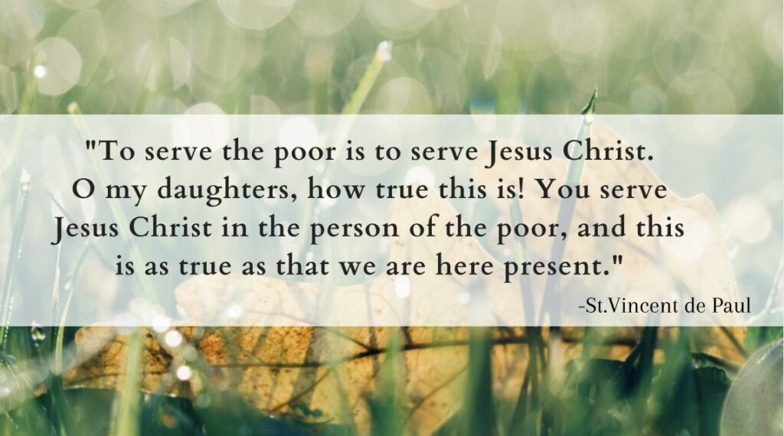
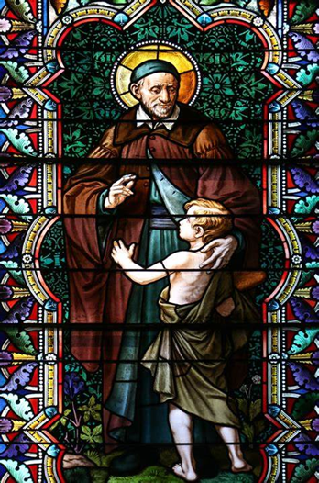
Collective Worship
Gather / Cynnull

Slide 6
Collective Worship
Gather / Cynnull
Yn enw’r Tad a Mhab a
Ysbryd Glan. Amen.

Slide 7
Collective Worship
The Word of God / Gair Duw
Alleluia
Mk 10:45
All / Pawb:
Alleluia, alleluia.
The Son of Man came to serve
and to give his life as a ransom for many.
Alleluia, alleluia.

Slide 8

Collective Worship
The Word of God / Gair Duw
Mrs Houston:
The Lord be with you.
All / Pawb:
And with your Spirit.
Mrs Houston:
A reading from the Holy
Gospel of Luke.
All / Pawb
Glory to you O Lord.
(Cross your forehead, mouth
and heart.)

Slide 9
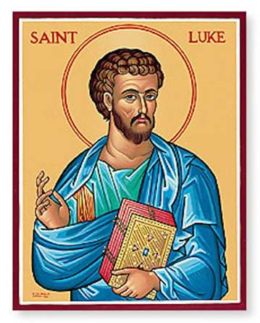
Collective Worship
The Word of God / Gair Duw
The Gospel Reading / Darllen yr Efengyl
An argument arose among the disciples about which of them was the greatest. Jesus realized the intention of their hearts and took a child and placed it by his side and said to them,
“Whoever receives this child in my name receives me, and whoever receives me receives the one who sent me. For the one who is least among all of you is the one who is the greatest.”
Then John said in reply,
“Master, we saw someone casting out demons in your name
and we tried to prevent him because he does not follow in our company.”Jesus said to him,
“Do not prevent him, for whoever is not against you is for you.”

Slide 10

Collective Worship
The Word of God / Gair Duw
Mrs Houston: The Gospel of the Lord
All / Pawb: Praise to you Lord Jesus Christ.

Slide 11
Collective Worship
Response to the Word of God
Christian Virtues / Rhinweddau Cristnogol
As a school we are focusing on how we can be compassionate and loving. Remember that we cannot be loving until we are compassionate. To be compassionate we need to understand people’s worries, concerns, fears and sadness. Only then can we be loving and show support, care, true interest in order to support one another. How did Saint Vincent de Paul live out these Christian examples in his life and teach us through his example to be compassionate and loving?

Slide 12
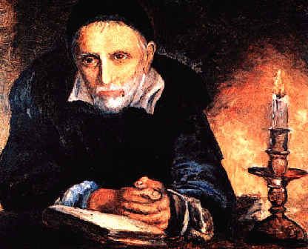
Collective Worship
Response to the Word of God
Christian Virtues / Rhinweddau Cristnogol
How was Saint Vincent de Paul Compassionate and loving?

Slide 13
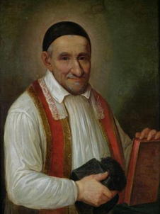
Collective Worship
Response to the Word of God
The life of Saint Vincent de Paul
Can you imagine being captured by pirates, and then taken into slavery? That’s just what happened to St. Vincent de Paul.
St. Vincent was born in Ranquine, France, the son of a peasant farmer. He was able to study and become a priest in 1600. He was travelling by sea when Barbary pirates captured him; he survived two hard years as a slave, but escaped to Rome and later, Paris. It was there that he met Cardinal Pierre de Berulle, who influenced Vincent to devote his life to charitable works.

Slide 14
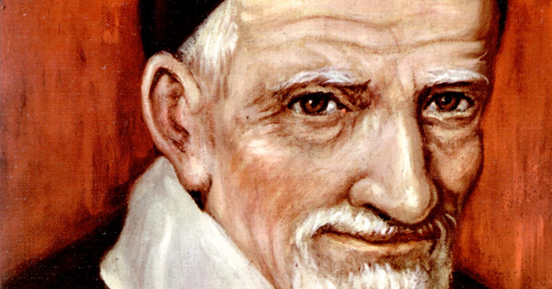
Collective Worship
Response to the Word of God
.
He established organizations of men and women to provide aid to the poor and sick. He depended on the donations of the wealthy, who made it possible for him to found hospitals and an orphanage.

Slide 15
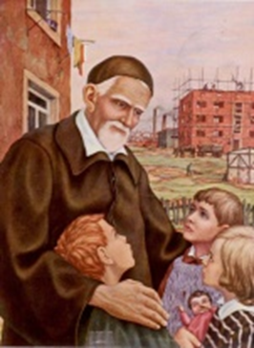
Collective Worship
Response to the Word of God
In 1625, in Paris, Vincent founded the Congregation of the Missions, called the Lazarites or Vincentians, a society of priests charged with missionary efforts, the training of clergy, and preaching among the country people. In 1633, with St. Louise de Marillac, he founded the Sisters of Charity, the first congregation of women to care for the sick and poor outside of the convent. During Vincent’s life, the Vincentians increased in number and spread across the world.

Slide 16
Collective Worship
Response to the Word of God
In 1625, in Paris, Vincent founded the Congregation of the Missions, called the Lazarites or Vincentians, a society of priests charged with missionary efforts, the training of clergy, and preaching among the country people. In 1633, with St. Louise de Marillac, he founded the Sisters of Charity, the first congregation of women to care for the sick and poor outside of the convent. During Vincent’s life, the Vincentians increased in number and spread across the world.

Slide 17
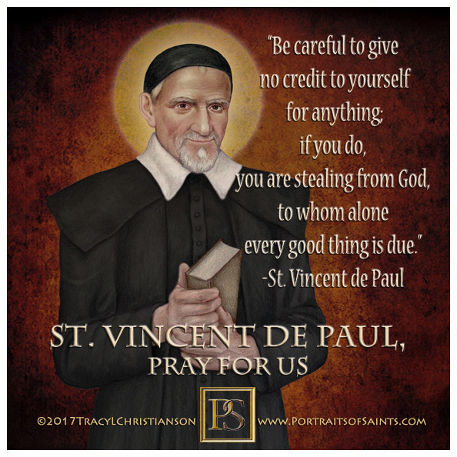
Collective Worship
Response to the Word of God
In response to the Gospel, let us read together this prayer by Saint Vincent de Paul.
All / Pawb: Yn enw’r Tad a Mhab a Ysbryd Glan. Amen.
All / Pawb: Yn enw’r Tad a Mhab a Ysbryd Glan. Amen.

Slide 18
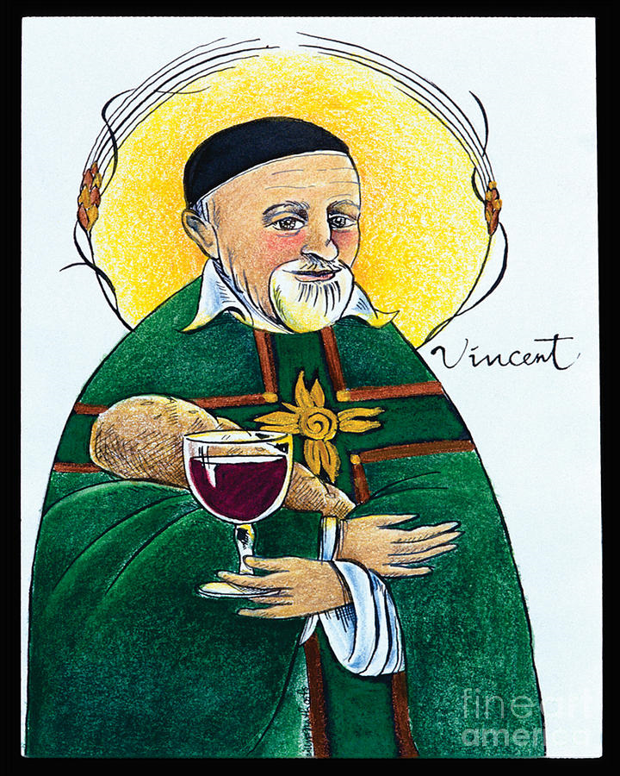
Collective Worship
Response to the Word of God
Bidding Prayers / Cynigion Gweddïau
Noble Saint Vincent de Paul,
beloved servant of the poor,
may we follow your example and do good works
among those whom society has abandoned,
enslaved, or forgotten.
Lord in your mercy
All / pawb: Clywed ein gweddi (Hear our prayer)
Inspire us to feed the hungry,
to love a child,
to provide comfort and medicine to the sick,
to clothe those whose garments are threadbare,
and to offer hope and our Lord’s words
to all who need respite.
Lord in your mercy
All / pawb: Clywed ein gweddi (Hear our prayer)

Slide 19
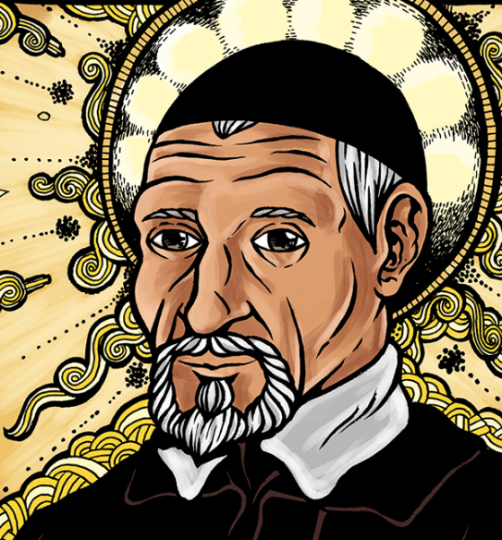
Collective Worship
Response to the Word of God
Who are the Minnie Vinnies in Saint Peter’s School?
What do they do?
Mini Vinnies are 7 to 11 year olds based in schools and parishes across England and Wales, and in several other countries across the world. They come together to form a part of the St. Vincent de Paul Society England and Wales, a voluntary organisation dedicated to tackling poverty in all its forms. Mini Vinnies meet to pray, discuss and support however they can to help make a difference in their communities.

Slide 20

Collective Worship
Rejoice / Mission
Who are the Minnie Vinnies in Saint Peter’s School?
What do they do?
They ‘see, think and do!’
Mini Vinnies truly turn concern into action as they use the simple formula of ‘see, think, do’ to find people in need and help them. They might help by:
Visiting local care homes to sing or play games with the residents.
Running food collections for a local food bank.

Slide 21

Collective Worship
Rejoice / Mission
Mini Vinnies is about doing good works in the community that benefit people facing social injustice. It is also about young people meeting to talk, share ideas and concerns, to have fun and support each other.
Would you like to be part of such a vital group to our school in order to celebrate our Christian Virtues of Love and Compassion?

Slide 22
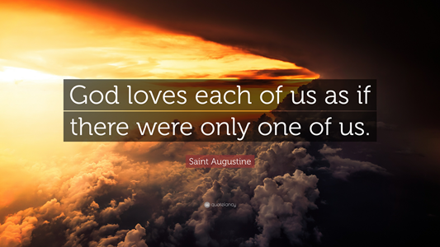
Collective Worship
Go Forth
How can we follow Saint Vincent de Paul’s example of being Compassionate and Loving?
Let us as a Saint Joseph’s community make an extra effort in the playground, at home and in our classrooms to adopt a behaviour where we think about the needs of others and to strive to be the best that we can be. We will end our assembly with the words God our Father gave us, a prayer that demonstrates to us all God’s LOVE and COMPASSION for each of us.

Slide 23
Collective Worship
Go Forth
Yn enw’r Tad a Mhab a
Ysbryd Glan. Amen.

Slide 24
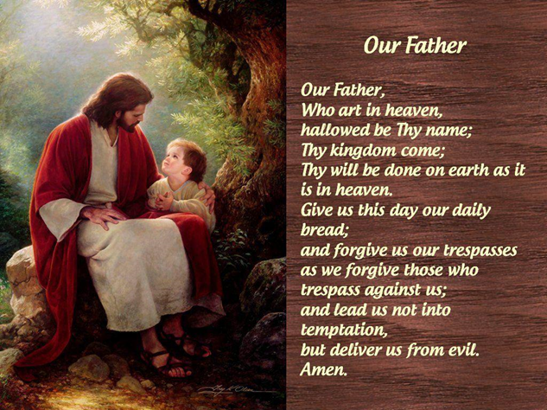
Collective Worship
Go Forth

Slide 25
Collective Worship
Go Forth
Yn enw’r Tad a Mhab a
Ysbryd Glan. Amen.

Slide 26
Collective Worship
Go Forth
Hymn: Love, love, Jesus is love. https://www.youtube.com/watch?v=ZN4JE0GL2Ls

