Slide 1
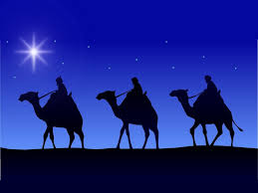
Epiphany
6th January 2023

Slide 2
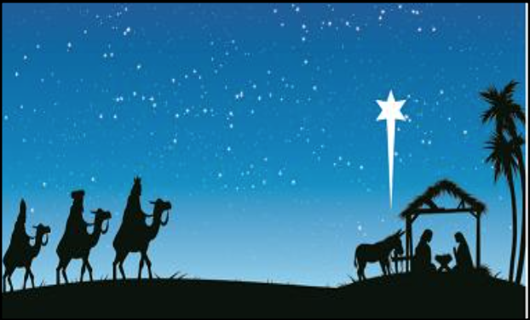
The Epiphany: January 2023
Gather: Opening Hymn
We Three Kings of Orient are …

Slide 3
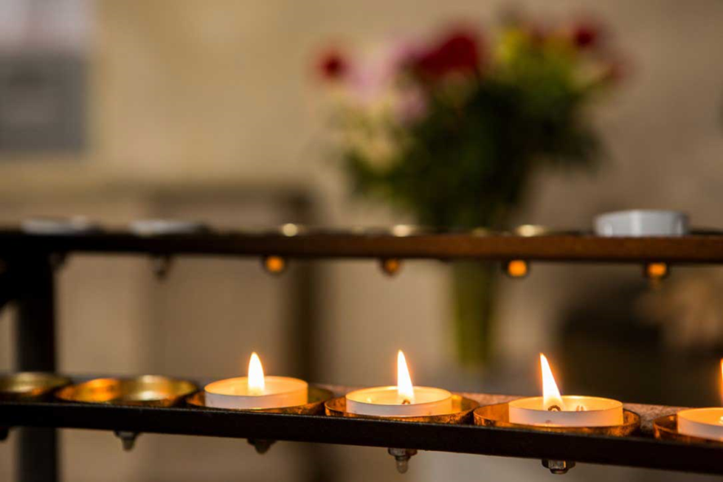
The Epiphany: January 2023
We gather…
The light of Christ has come into the world!

Slide 4
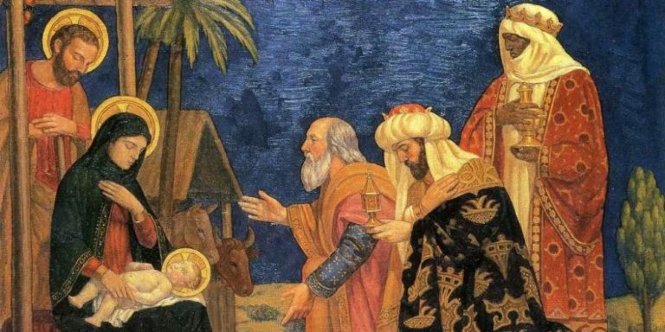
The Epiphany: January 2023
Gather: Opening Prayer
“God of surprises and gifts, you revealed yourself as a newborn baby and, with a star, you led the peoples of earth to worship Jesus, your only Son: lead us to see you face-to-face, and help us to discover our gifts and talents so that we may offer them up to you and your service. Let us be Jesus’s light in the world today. Amen.”

Slide 5
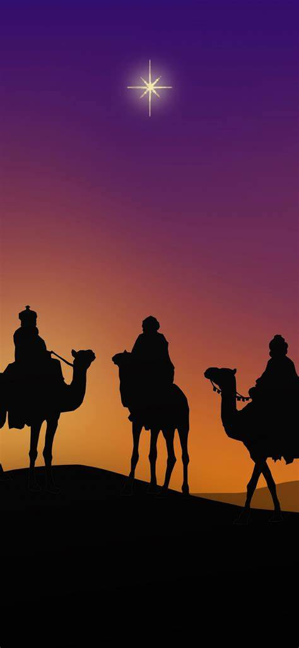
What is the feast of the Epiphany?
Epiphany: ‘a church festival that celebrates the visit of the wise men to Bethlehem to see the baby Jesus’.
The word ‘epiphany’ comes from a Greek word which means ‘making known’; the birth of Jesus was the beginning of God making known who Jesus is and God’s plan for the world.
Notes:
Recap over definitions from start of PPT

Slide 6
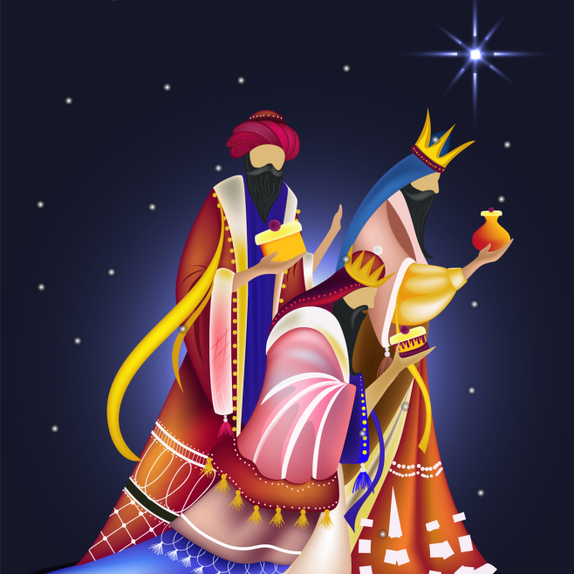
The Epiphany: January 2023
The Word of God
Leader: The Lord be with you.
All: And with your Spirit.
Leader: A reading from the Holy Gospel of Matthew.
All: Glory to you o Lord. (place a cross on your head, mouth and lips.)

Slide 7
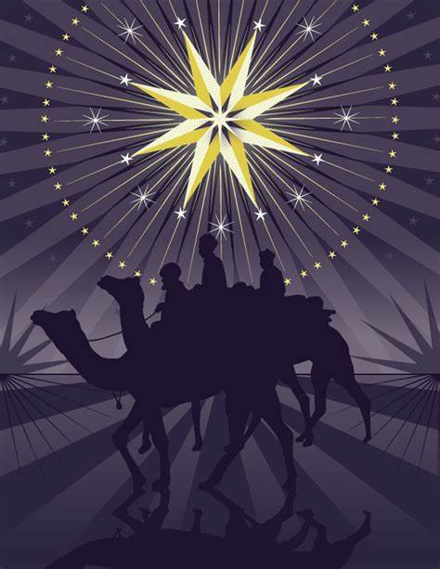
The Epiphany: January 2023
The Word of God
Reader: In the Gospel of Matthew, we hear the story of how some wise men from another part of the world were led by a star and travelled the long journey to Bethlehem, looking for Jesus. They found him in a stable.
Reader: A reading from the Gospel of Mark: “After Jesus had been born at Bethlehem in Judaea during the reign of King Herod, some wise men came to Jerusalem from the east... And suddenly the star they had seen rising went forward and halted over the place where the child was. The sight of the star filled them with delight and going into the house they saw the child with his mother Mary and falling to their knees they did him homage. Then, opening their treasures, they offered him gifts of gold, frankincense and myrrh.” PAUSE
The Gospel of the Lord
All: Praise to you Lord Jesus Christ.
(Matthew 2:1, 9-12)

Slide 8
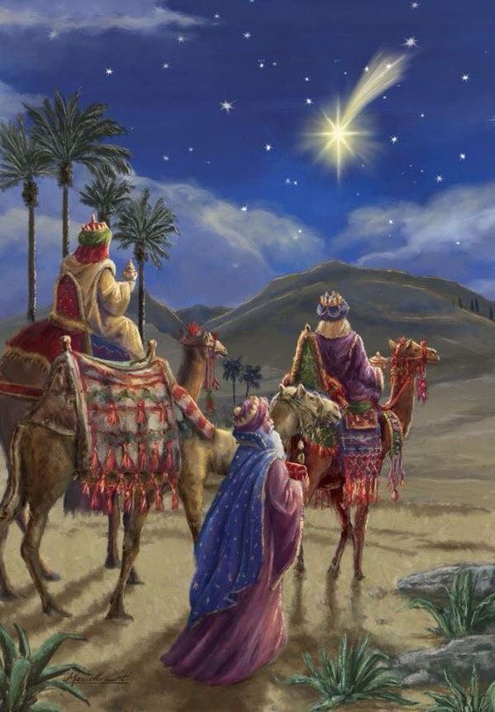
The Epiphany: January 2023
Response to the Word of God
Reader: The Son of God, Jesus, came into the world, to give life to every member of the human race. No matter what our race, nationality, colour or religion, each of us is made in the image and likeness of God. For all of us, this is a day of real celebration – we, too, are chosen.

Slide 9
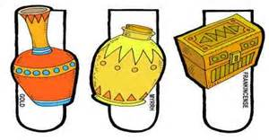
Reflection on the Gospel
The wise men brought special gifts for Jesus.
These gifts were: gold, frankincense and myrrh.
Christians believe that the three gifts all had a meaning.

Slide 10
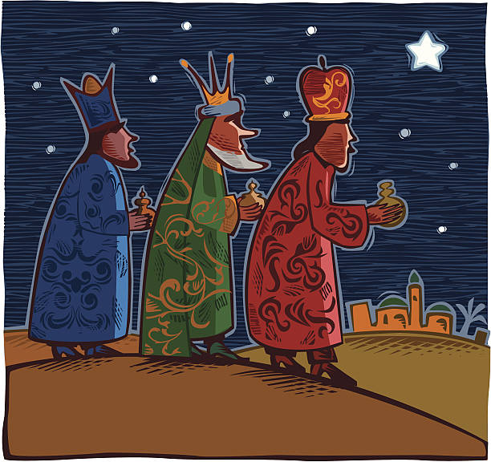
What did the gifts from the Wise Men mean?
Gold is a gift fit for a king. It recognized that Jesus was a great king, the king of the world.
Frankincense is a special kind of fragrance that was used by a priest.
Myrrh was a sweet-smelling liquid that was rubbed gently into the skin of someone who had died. It indicated that Jesus’ death would be important.

Slide 11

Epiphany
At the time Jesus was born Jews and Gentiles (non-Jews) never mixed. It would have been a hugely surprising revelation that God wanted Gentiles (the wise men) to see Jesus (who was a Jew). One of the things that the festival of Epiphany reveals is that God doesn’t have favourites but welcomes people from any background and any nationality.
Notes:
Recap over definitions from start of PPT

Slide 12
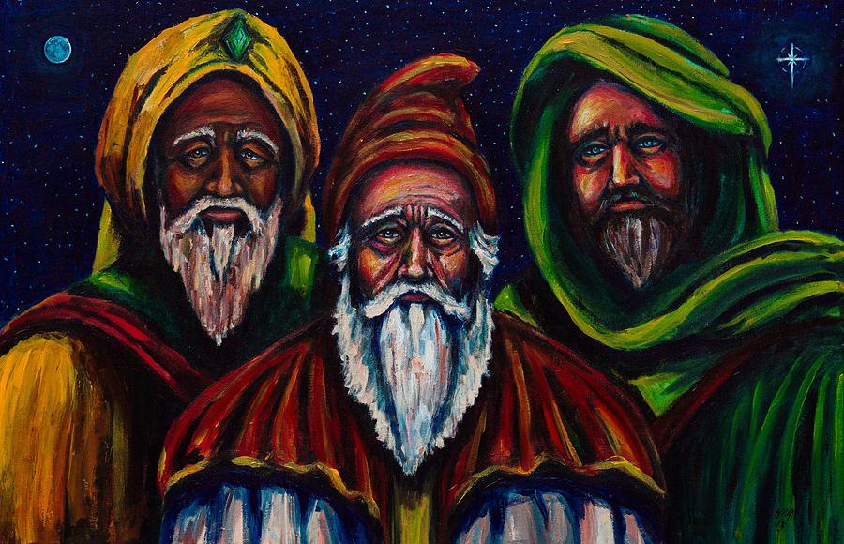
The Epiphany: January 2023
Response to the Word
Reader: Jesus, Guide on our journey, let us see with your eyes, so that we may recognise you in every person of every race, nationality and colour. (Response: Diolch i ti o Dduw.)
Reader: Jesus, Light of the world, may we be a light for those whose lives we share; may our kindness and care bring courage and hope to those who are sad. (Response: Diolch i ti o Dduw.)
Reader: Jesus, bringer of comfort, help us to realise that we have gifts to offer to you through your people every day, and these gifts are precious to you.) (Response: Diolch i ti o Dduw.)

Slide 13
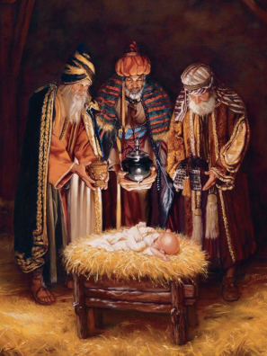
Closing Prayer – Going Forth
Let us join together to say our closing prayer. “Yn Enw’r Tad …
Dear God,
We thank you that you wanted both rich and poor to see baby Jesus. We thank you for Christmas, and for the holidays you gave us to enjoy with our friends and families.
As we think about Epiphany, we are reminded that every person is important to you. Help us to do the same, to welcome people from all backgrounds and religions.
Please help us to enjoy all the gifts that you have given to us.
Amen.

Slide 14
The Epiphany: January 2023
Gather: Opening Hymn
We Three Kings of Orient are …

