Slide 1
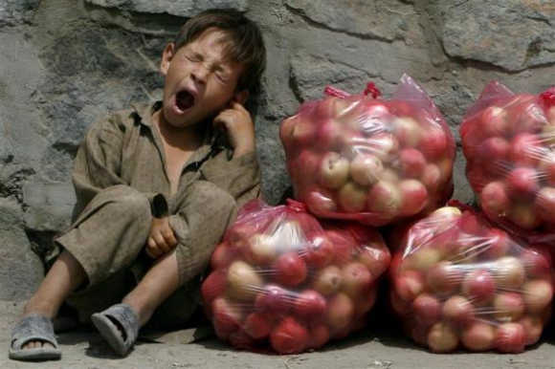
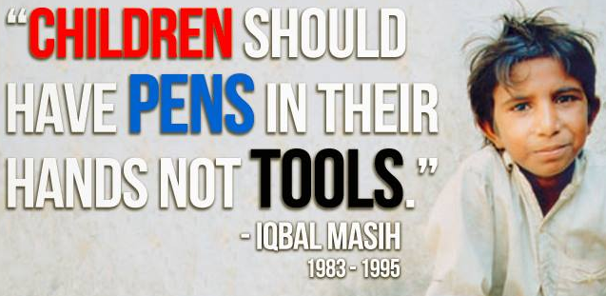
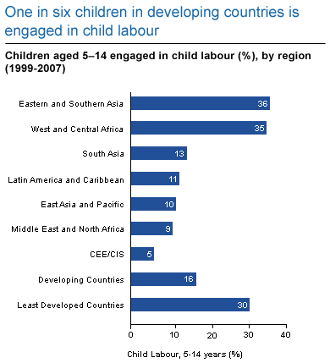

How would you label this graph?
Please respond to my marking then:
What is todays lesson about?
Write down one question you'd like to answer today based on these pictures

Slide 2
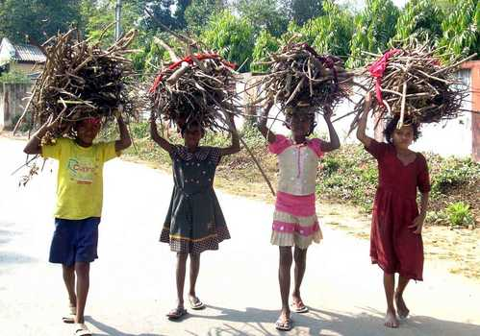
Child Labour
24/12/2022
What is your target?
L3: To explain what child labour is and ways to stop it
L4 – L5: To evaluate the impact child labour has on global inequality
L6+: To evaluate deeper issues of child labour considering pros and cons
What are the rights of the child?
In shoulder pairs, using the whiteboard, write a list of rights children have
Now… Share you ideas with your face pair – tick anything you both have and add what you don’t have
Homework: Create a poster to persuade others to help stop child labour

Slide 3
Now you know what the lesson is about… how would you label this graph?
Title:
What does this graph tell us about child labour?
Y axis:
X axis:

Slide 4
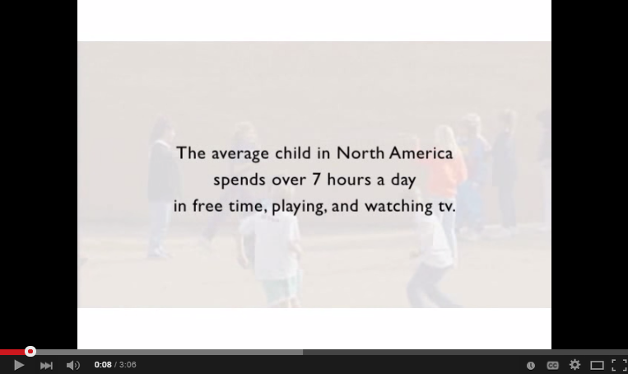
What’s the issue?
Watch the clip – in your pairs write a definition of child labour down
Stop at 2.45
On your table there is a case study. One person is to read the case study to their table then all of you should discuss the following questions:
What is an example of child labour?
How do you think child labour contributes to global inequality?
What are some good and bad points about child labour?
Remember to give reasons for your responses using examples
Write down one sentence that answers your coloured question

Slide 5

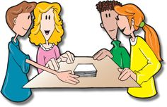
One Stray
Number 3’s to go to the next table (clockwise) and share their tables child labour story. Then discuss these questions:
How could you stop child labour?
Is child labour a big issue when looking at global inequality?
Is child labour always a bad thing?
Remember to give reasons for your responses using examples
Write down one sentence that answers your coloured question

Slide 6

Pair Task: Plan a Campaign
A successful campaign to stop child labour will:
Be persuasive about stopping child labour
Consider how stopping child labour would reduce global inequality
Explain why child labourers have to work but also why they shouldn’t
What is the issue?
Why is it an important issue?
What will happen if we don’t make change happen?
Create a plan on a piece of A4 paper to show how your campaign would work. You should include:
What's your key message or slogan?
What examples can you use to persuade others?
Can you link in the rights of children?
What types of media will be used?
What’s your goal? To raise money/raise awareness?

Slide 7
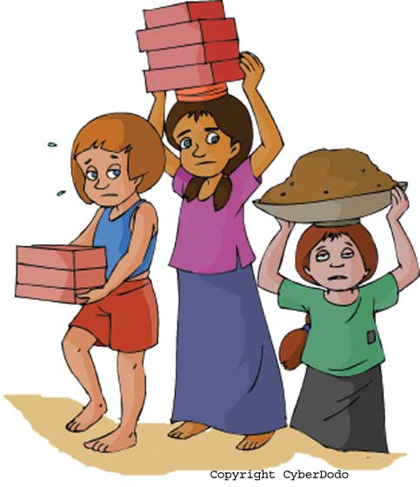
What have you learnt today?
L3: To explain what child labour is and ways to stop it
L4 – L5: To evaluate the impact child labour has on global inequality
L6+: To evaluate deeper issues of child labour considering pros and cons
Answer the question you wrote at the beginning of the lesson in your book – if you don’t know it yet then find out for homework
Which objective did you achieve? Hold up the colours of the objectives achieved

Slide 8
Resources

Slide 9
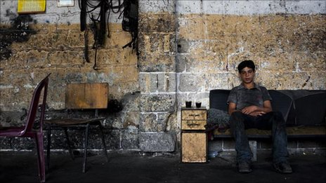
Case Study 1
Raed Ahmed Moussa, 14, mechanic, Gaza City
Raed Ahmed Moussa has been working at a Gaza workshop fixing car engines since he was 13. As his father is unemployed, Raed supports his extended family of eight brothers and sisters from his father's two wives.
"I quit school right after the war in January 2009 and I'm not even thinking of going back. Frankly I'm fed up with school. The teachers used to cane me across the palms of my hands because I wasn't a good student.
"My father has been out of work for years now. I'm the only breadwinner. One of my younger brothers quit school a year ago to work but he is doing nothing because there aren't any jobs in Gaza.
"I make 70 shekels a week (£12) and give all the money I make to my father. He gives me 10 shekels a week, which isn't even enough to pay my transport to and from work each day.
"My salary is really low, but I'm sure it will get better. I love my job but I dream that one day I'll travel abroad to work in a foreign country."

Slide 10
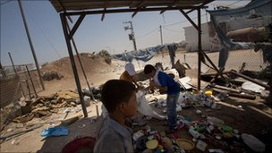
Case Study 2
Moussa Suhail Obeid, 13, rubbish collector, Gaza City
Moussa Suhail Obeid collects plastic and steel at Gaza's main landfill, near the Gaza-Israel border. He is paid half a shekel for every kilogram of scrap he gathers, making him 5 (80p) to 8 shekels a day.
"I left school this year and I'm not going back. I was never a good student and I know I'm not going to be a doctor or a teacher, so I decided to quit because I'm convinced it's a waste of time.
"But that's not the only reason - my dad is unemployed and I have nine brothers and sisters who badly need food and money for school. My brother works in a factory that makes plastic pipes for agriculture but he works only when they have raw material.
"I search all day through rubbish bags for plastic, copper and aluminium. Anything I find, I sell to a man here who collects the scrap for the factories - I'm sure he rips us off.
"I would work anywhere to provide my family with food. We are not refugees so we don't receive food aid from anyone.
"I feel so bad when I see other children playing and going to school while I'm working here in the heart of garbage. This is our life - we can't have everything we want."

Slide 11
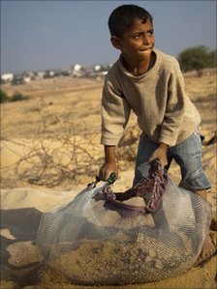
Case Study 3
Sobhiya Bassal, nine, street peddler, Gaza City
When not at school, Sobhiya Bassal works as a street peddler at Gaza's main intersection, alongside her seven-year-old sister Alaa. She has three brothers and four sisters.
"I have been working at this crossroad for four years now. My young sister Alaa has worked here since she was four years old.
"I started working with my mother who also works here as a street seller. We were young and she couldn't leave us home alone, so she decided to take us with her.
"Now I work to help my destitute family. I sell chewing gum and sweets. My father is old and he can't work at all. I have only two brothers aged 17 and 15 who also work as peddlers in the market.
"I love both my work and the school. I'm a good student. I get the highest marks in school. When I come to the street corner, I dedicate my time and effort to my work, and when I'm at school I don't even think about my work.
"I feel I own this intersection. I work here for six hours every day after I finish my classes. Now we've finished school for the summer, I work for 12 hours.
"But I'm satisfied with everything I have, and thank God the money we make is enough to feed us and that aid agencies are here to pay for our education and health care."

Slide 12
1
2
Kagan mat to place on tables for the numbers
3
4

