Slide 2

History Hackers: Victorian Venture
In the story ‘History Hackers: Victorian Venture’, Tilda and Charlie Hacker travel back in time to the Victorian era. The pair befriend two Victorian children but soon find themselves in trouble. While Charlie and Joseph go on the run, Tilda and her new friend, Alice, are trapped in the workhouse!
Extracts from this exciting story give us some ideas about what life was like in Victorian Britain.
To find out what happens to Charlie, Tilda and their new friends, read ‘History Hackers: Victorian Venture’.☺
Click on this icon to switch between the slide and the extract.

Slide 3
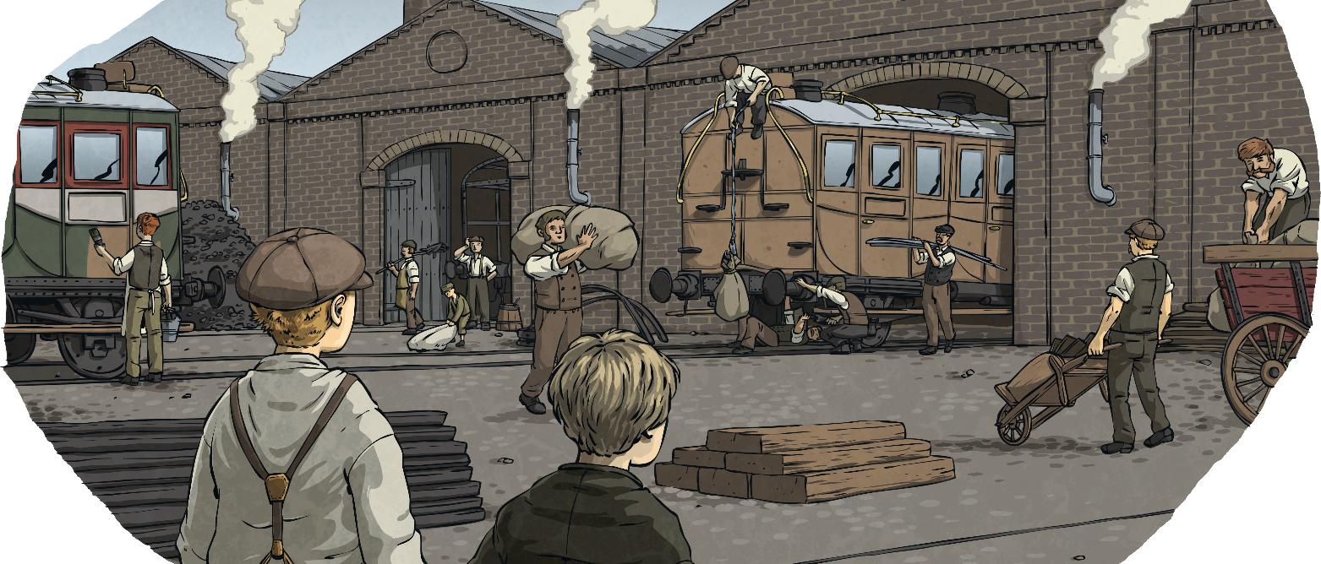
Victorian Britain
‘The Victorian era’ describes the time during which Queen Victoria reigned in Britain (1837-1901). Queen Victoria was only 18 years old when she became queen and she ruled Britain for 64 years.
During this time in history, there was a great contrast between the ways in which the rich and poor lived, and many developments took place which changed the lives of the people in Britain.

Slide 4
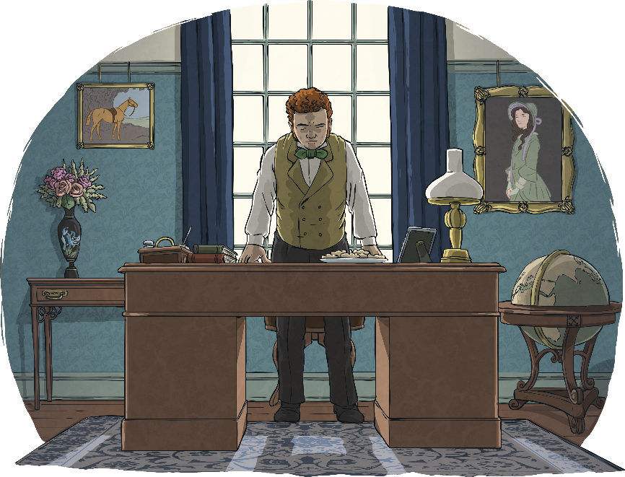
Homes for the Rich
Large Victorian homes were filled with beautiful furniture and ornate decoration. Victorian styles included floral wallpaper patterns, thick curtains, detailed rugs and elaborate ornamental décor. They also featured polished wooden floors, beautifully carved furniture and elaborately framed paintings.
Upper class homes might have large grounds or a garden.
These homes were often lucky enough to
have flushing toilets, inside bathrooms
and running water.
Wealthy households could even
have gas lighting!

Slide 5

Homes for the Rich
The two boys rested their chins on the top of the chin-high stone walls and gazed up at a beautiful three-storey house. A shallow roof of dark slate sat like a cap atop broad walls made from blocks of Yorkshire stone. Sunlight reflected against the glass
of large sash windows, each framed in painted white stone which matched the corners of the building.

Slide 6

Servants and Opulence
Wealthy families living in large houses might have even had servants or staff to cook and clean for them.
Often, in larger homes, the staff would have lived in the house that they worked in. Servant quarters might be in the attic or top floor with much less luxury.

Slide 7
Servants and Opulence
With their arms stacked high with the freshly dried clothes, the two servant girls were the perfect shield for Charlie and Joseph as they sneaked through the back door. Charlie ran his hand across the heavy, wooden door, which looked like it might once have belonged in a castle. As his eyes lingered on the solid stone archway that framed the doorway, he tried to imagine the skill and effort that had gone into making it. The craftsmanship reminded him that buildings certainly weren’t made to these standards back in the twenty-first century.

Slide 8
Homes for the Poor
Unlike wealthier families, poorer families lived in much smaller houses.
As many people were moving to towns and cities for work, rows of
back-to-back terraced houses were built for the poor, with many people living closely together.
Inside these houses, the conditions would have been much more basic without elaborate decoration.
These houses didn’t have gardens; sometimes, they would have
small yards.
In these yards, there would also be an outdoor toilet which would be shared with the neighbours.

Slide 9
Homes for the Poor
The walls themselves were undecorated and bare, save for a couple of precariously hung shelves holding a few pots and tins. Tilda’s gaze bounced around the room before finally settling onto a large iron pot strung above the room’s small grated fire.

Slide 10
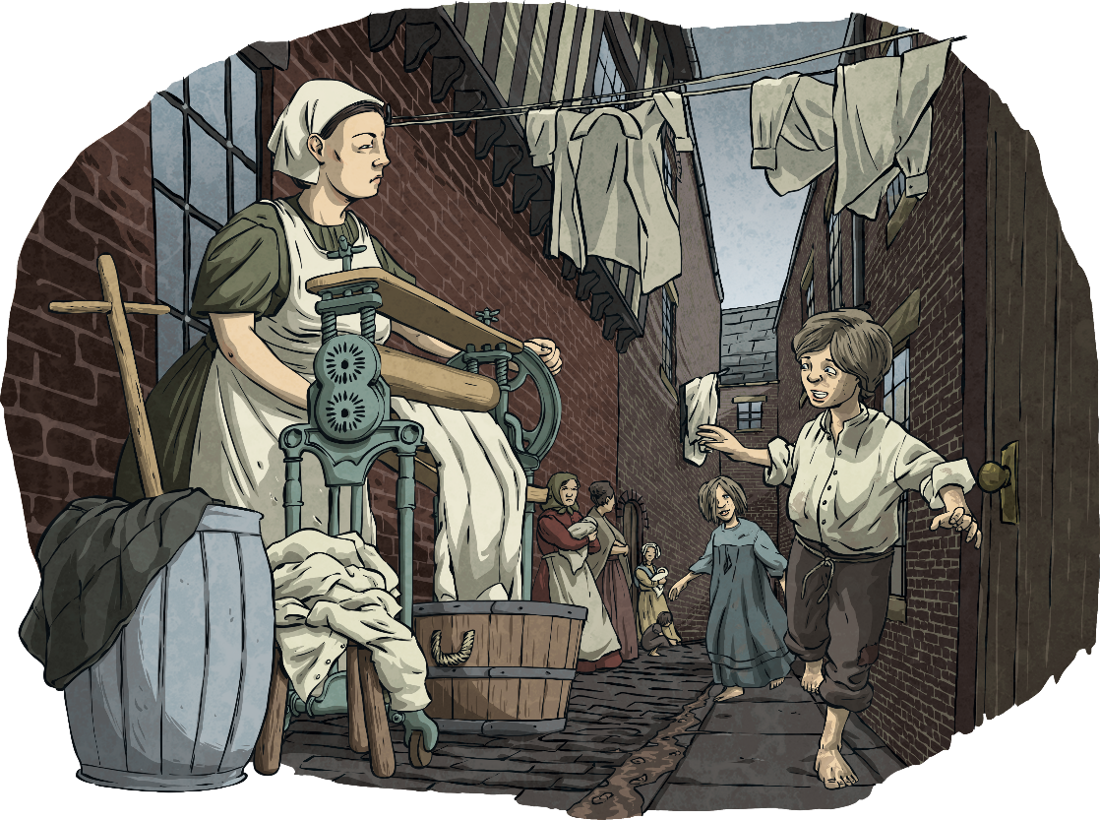
Slum Streets
For those living in slums, life could be very hard.
It was not uncommon to find more than one family living in the same house.
Streets were dirty and contained sewage
because there were no underground sewers.

Slide 11
Slum Streets
The same dirt and grime seemed to cover every surface – windows were unwashed, smeared by countless handprints, and an unhealthy crust sat beneath their feet.

Slide 12
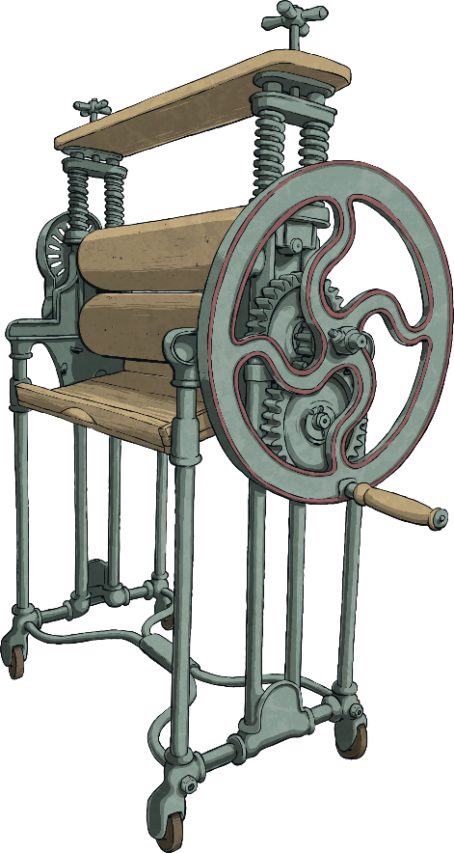
Clothes
Wealthy Victorian women would have worn long dresses or skirts with hoops and petticoats, while the men would have worn suits, waistcoats and bowler hats.
Poor families did not have the luxury of new clothes
and would often wear practical, hard-wearing items
that would last for a long time.
Some children in the slums might not have been able
to afford shoes.
In Victorian times, there were no washing machines
or driers to wash clothes with. Instead, water was
pumped into buckets and washed with soap by hand.
This was a job requiring lots of effort. A mangle
would be used for drying clothes by hand, also
requiring a great deal of time and effort.

Slide 13
Clothes
Their dark clothing was dirty and unkempt. The boys’ trousers looked either too short, as if they had been outgrown, or several sizes too big. Although some of the dresses worn by the girls might once have been pretty, many sported tears and rips that were past the point of repair.

Slide 14
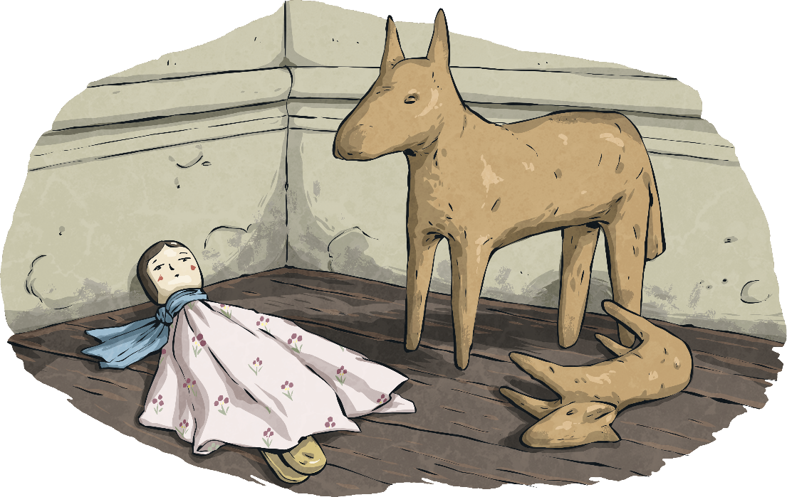
Toys
Children from poorer families would often make their own toys, such as peg dolls.
Children from wealthy families would have toys such as rocking horses, dolls’ houses or train sets.
‘Hoop and stick’ and skipping were popular outdoor games.

Slide 15
Toys
In a corner, she spotted what might have been toys. They were little more than crudely carved wooden animals – she could see something the same shape as a dog or a horse. Next to those was a collection of wooden pegs decorated with small pieces of cloth. Waves of sadness washed over her as she realised that these were some little girl’s dollies.
The boy glanced over his shoulder, towards the open door of what was clearly a bedroom. Inside, the floor was awash with all kinds of brightly coloured wooden toys. Charlie saw envy colour Joseph’s cheeks as they both stared at a small army of beautifully painted toy soldiers, carved spinning tops and what looked like an entire clockwork train set. There was even a rocking horse standing taller than Joseph.

Slide 16
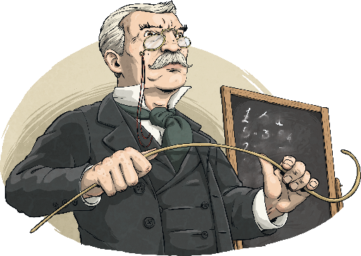
Going to School
In the early Victorian period, only rich boys went to school.
Poorer boys would be expected to begin working to support the family from a very early age. Girls were not educated but
learned to look after the home or serve richer families.
Both the teachers and children wrote with chalk
or slate pencils onto a blackboard or slate.
School punishments were very harsh and could include
being struck with a cane or made to stand wearing a ‘dunce’ hat.
Learning was done by chanting or copying out facts many times until they had been remembered.
The most important lessons were the three Rs: reading, writing and arithmetic. Lessons such as music, art or PE were not taught like they are today. Drill was physical exercise performed at the side of the desks in the classroom.

Slide 17
Going to School
“Slates and chalk at the ready,” the teacher grizzled. “We will recount yesterday’s history lesson.”
Nathaniel lifted the top of his desk and retrieved what looked like a miniature blackboard and a worn stick of chalk. Charlie remembered that the children used this instead of a pen and paper. The boys cleaned their slates by spitting on the previous day’s scribbles then wiped it clean with their coat sleeve.

