Slide 1

St Gwynno Parent Information
Mrs D. Houston

Slide 2

Croeso / Welcome
Please let us begin our Parent information meeting as a faith community with a prayer to support the children in our care spiritually, socially and academically.

Slide 3

Children should wear appropriate school uniform daily with the exception of PE days.
It is the responsibility of all class teachers to communicate on their class pages when PE takes place. See class page.
We ask you to look at the website regularly so that you are fully informed of the learning and activities your children are engaging in. In particular ‘My Week’ on class pages, the school gallery and information for parents. Comments on Twitter pictures and videos of children’s learning are warmly invited.
All classes will update proposed learning for the term and parents will be invited to attend a class meeting to share proposed learning at the beginning of each academic year.
Children should wear black shoes as part of the school uniform policy.
It is the responsibility of all parents to use parent pay to book dinners in good time to ensure that their children receive the meal their child wants at lunch times. This applies to school trips, pantomimes etc.

Slide 4
As part of the healthy schools policy, children should bring in water only. There are water stations throughout the school so that children have access to water whenever they require it.
If parents / guardians have reason to be on the school premises we ask that you santise your hand upon entry in the interests of staff and pupil well – being. This also applies when attending mass, assemblies and other celebrations within the school.
If parents choose to provide a snack for their child at break times, this must be a vegetable or fruit. Crisps, sweets etc. are not permitted as part of the healthy schools policy of Saint Joseph’s School.
If a child forgets their packed lunch it is the responsibility of the parent to bring a meal in for their child for lunch as food cannot be sources from the canteen as meals are prepared in accordance with the numbers who have pre - paid on the parent pay site.
It is the responsibility of parents to ensure the school is informed of child absence in good time. This is a requirement of the Welsh Assembly Government and prevents staff being engaged in locating the reasons for children’s absence when they can be utilised more effectively in supporting the learning of children.
The school day commences at 8.55 and children are expected to be in their classrooms at this time. Access doors are closed at 8.55 am.

Slide 5
Sustained absence, lateness or failure to book school meals are recorded as required by the authority. If sustained the appropriate authorities take action in accordance with the policies that adhere to all schools within the county and are not actioned by the school.
If your child has a medical / dentist / optician appointment, the school secretary MUST receive written notice of this with a card / letter showing the appointment so it can be copied and passed on to attendance authorities as part of the Welsh Assembly policy. There are no exceptions. In the case of an emergency appointment, then it is required a copy of attendance of this appointment is brought in so it can be copied and uploaded to the appropriate files.
Holidays should take place outside term time. If this happens or there should be a personal day required for the families of children then parents must complete the appropriate forms at the office with Mrs Ekstrom - Gabb. Again, there can be no exceptions.
Data: It is the responsibility of parents / guardians to inform the school of changes of phone number and address as appropriate to ensure that in the event of an accident or ‘issue’ that parents can be contacted without any delay and ensure the well – being of all children. We have sent out various communications with regard to this health and safety issue and the majority of parents and guardians comply. In the interest of all children’s well – being we respectfully ask that any change in personal details are communicated immediately.

Slide 6
Only children are allowed to access the school premises. If you wish to enter the school, this must be strictly to the office. Access to all other areas of the school are strictly denied. If you need to speak to your child’s class teacher this needs to be forwarded to Ms. Ekstrom – Gabb in the office and arrangements will be made as soon as is possible.
Reasons for lateness have to be recorded and the duration of the lateness recorded. This information is then submitted as appropriate and applies to all schools within the county.
It is the responsibility of the school to contact parents / guardians first thing in the morning if no reason has been submitted and I am sure you will agree this is time consuming and deprives this resources from supporting children’s learning in the classroom.

Slide 7
Medication: All medication was sent home at the end of the autumn term. It is the responsibility of parents and guardians that this medication is cleaned and updated for the return to school in January. The medication needs to be labelled with the child’s name and instructions for the administering of medication. This requisite is vital in order that the well – being of children is ensured.
Social media platforms: We do NOT want images or videos of assemblies, masses etc. shared on any social media platforms. It is the responsibility of all parents and guardians to adhere to this policy of the school. There are parents who do not wish, for a variety of reasons, for images of their children to be shared on social media platforms. We do permit videos and pictures of key moments in your children’s lives to be recorded, BUT it is for personal use only.
Conduct: It is essential that staff, children and parents are treated with respect. Any confrontational, rude or inappropriate behaviour of any kind will NOT be tolerated on the school premises and immediate action through appropriate authorities will be implemented.
All school trips payments are to be directed to parent pay. Staff do not take in any monies unless related to PA activities.

Slide 8

Religious Education
‘Come and See’ is the teaching scheme used and is provided by the Archdiocese to ensure children have a wide breadth of knowledge on the Catholic beliefs and teachings.
We will be covering three topics this term.
Topic 4: People
Topic 5: Self - discipline
Topic 6: Giving and receiving
Children will attend Mass in church, present a class Mass and an assembly to which parents will be invited. Parents and guardians will be notified on the class page ‘My Week’ of Dosbarth Gwynno services.

Slide 9

Literacy, Language and Communication
Bug Club / Reading at home: parents are encouraged to listen to their children read using the Bug Club Online programme. Books will be allocated shortly. Please note that the book will be registered as unread if the children do not complete the learning tasks to test their comprehension of what has been read. If your child does not have login details, please leave your name with me at the end of this meeting.
‘Letter join’ is used as the handwriting scheme in Dosbarth Gwynno.
Spelling is a weekly activity. However, individual mistakes within writing are recorded in children’s books and they are required to complete their corrections FOUR time. These are frequently sent home for homework as some parents will already have experienced.

Slide 10


Literacy, Language and Communication
GGR: Guided group reading is an activity the children participate in every week. This term it is based on non – fiction texts linked to the context for learning project ‘Child of the 2000s’ (A comparison of rights enjoyed by some children in the present day and those in the past. This learning will be linked to ‘Street Child’, a true story by B. Dohgerty.
These genres of writing will include:
Letter writing Descriptive Writing
Creative writing Writing from the point of view of a character
Comparative writing Reading comprehensions
Newspaper article writing Writing a book review

Slide 11

Literacy, Language and Communication/ health and Well - being
Literacy and Health and well – being across the curriculum
Lesson One: What are rights, needs and wants?
LO: To work collaboratively to determine from a series of cards what a want, a need or a right is
Introduction: Watch PPT to introduce the Rights of the Child.
Task - RIGHTS, WANTS OR NEEDS?
Relate to learning in Context and learning across the curriculum.

Slide 12
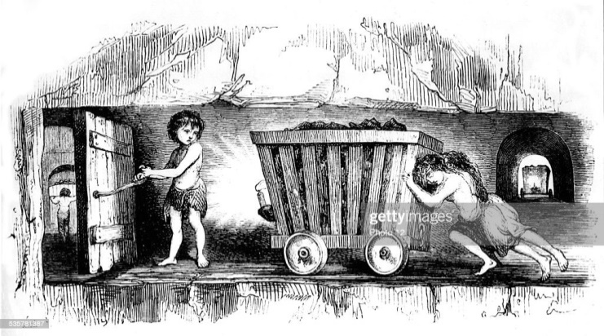
Literacy, Language and Communication – Welsh / Cymraeg
Humanities / History
How have my rights evolved? Does every child have access to these rights?
LO: To apply my collaborative learning skills to classify rights.
LO: To work collaboratively to determine whether rights are a basic need, those who protect us from harm or to express themselves.
How have my rights evolved? Does every child have access to these rights?
How have my rights evolved? Does every child have access to these rights?
Lesson Three: Have the rights of children in the 2000s always enjoyed rights?
Welsh Link

Slide 13
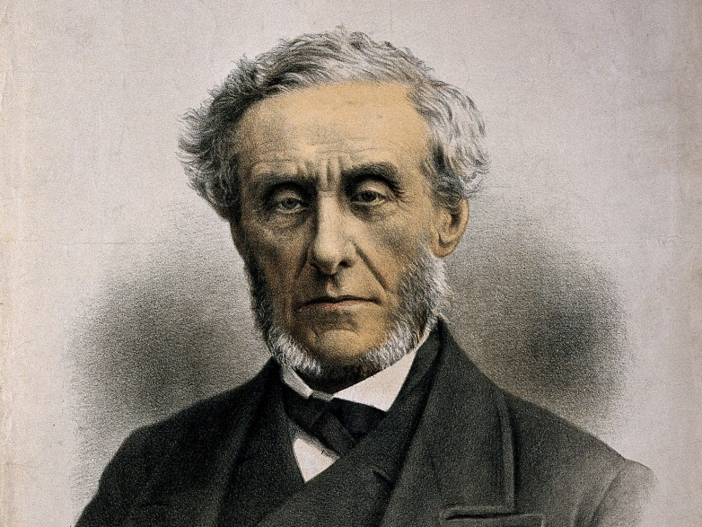
Literacy, Language and Communication – Welsh / Cymraeg. Humanities: History.
Introduction: Watch a BBC Bitesize video on children working in the mines
Discuss what you found interesting.
Make a mind map of your learning.
Write an account of life in Welsh mines for children.
Lesson Four: Have the rights of children in the 2000s always enjoyed rights? Research the work of Lord Shaftesbury who was a pioneer in allowing us to enjoy the rights we have in 2000s’
The Rights Protector: Lord Shaftesbury – How did he help children working in Welsh mines?
Task: To create a timeline of the actions taken to improve the rights of children in the Victorian era.

Slide 14
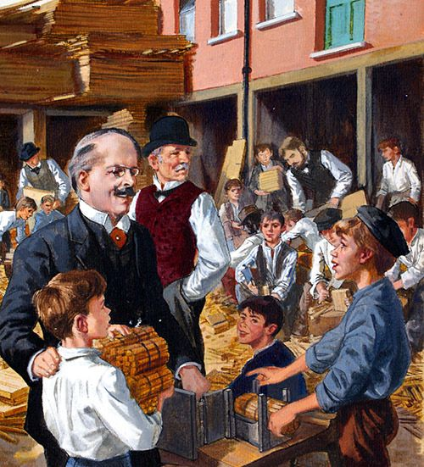
Literacy, Language and Communication – Welsh / Cymraeg
Humanities - History
How did Doctor Banardo contribute to the rights we enjoy today
Link to Class reader: Street child
Task: Biographical Writing. - Doctor Banardo GGR:
The Life of Doctor Banardo
Summary writing
Improving the rights of children in the Victorian Period
LO: To use my literacy skills to interrogate a non – fiction text on the life
and work of Doctor Banardo.

Slide 15
Literacy, Language and Communication/ GGR: Guided Group Reading Texts
Texts to be studied:
Class book: Street Child by Bernie Dogherty
Disseminating information contained in the cover of a book. Narrative.
Modern Day Child Labour? What is it? – Non – fiction
Causes and consequences of child labour. – Non- fiction.
Pit Girl the story of a Welsh child miner – Non – Fiction
Prologue: What is it? Narrative
Biographical Text: Doctor Banardo
Historical Text: The Reforms of Lord Shaftesbury
Comparative Texts: Rights of children past and present.
Descriptive Texts: The Stick Man and Mrs Sissons – character profiles (Street Child) Narrative.
Historical Text: The conditions in Victorian Workhouses for children in the Victorian period.
Historical Text: The industrial Revolution: causes and consequences of child labour.

Slide 16

Literacy, Language and Communication – Welsh / Cymraeg
Welsh as a second language now falls into this area of learning, Literacy, language and Communication
The school uses the Welsh schemes of work provided by the authority.
It is our intention to go for the bronze award in this area of learning.
70% of time allocation for this subject is on oracy.
15% 0f time allocation for this subject is on reading.
15% of time allocation for this subject is on oracy
Helpwr Heddiw: tem minutes a day is allocated to developing oracy skills.
Dosbarth Gwynno will focus on the following topics this term?
Dyma fi – Here is me Yr Ysgol -School – Dillad - Clothes

Slide 17

Mathematics and Numeracy
Complete Maths: A brand new, whole school approach to Mathematics that is being implemented this year.
Mental Maths commences each mathematics lesson – where children show their answers to questions on whiteboards. It is a means of consolidating previous learning.
Mathematics homework is set weekly and books are sent home for the completion of these tasks. This term Mrs Houston’s mathematics class will focus on the following areas of learning (Whilst consolidating previous learning through mental maths so learning is maintained.)
Topics: Data (Venn diagrams, Carroll Diagrams, bar charts, scatter graphs and line graphs) Children will be required to construct data graphs and diagrams. They nee to develop the skills to interrogate data and to apply their numeracy skills to interrogate and draw conclusions from data. Decimals: tenths, hundreths – some children who are able enough will progress on to thousandths, Measures, Fractions, Symmetry and Properties of 2D and 3D Shape
Reasoning: This is a weekly activity where children apply their learning in a problem solving context related to a particular learning topic in mathematics.
Mathletics: Is the online provision for additional homework in this area of learning. If parents d not have access to this platform, please give me your names at the end of the presentation.

Slide 18

Context for learning: Child of the 2000s’. How have the rights of the child changed and remained the same in different countries? Comparing the past with the present.
Humanities is the focus upon history and geography. This term my focus will be also be on expressive arts and will be delivered through the topic of ‘Child of the 2000s’; It is also used as a platform for developing numeracy, literacy and IT skills in different contexts where children apply skills acquired in these areas of learning. The children will develop the following skills:
Compass direction using the eight points
Using 2 figure coordinates to record position and identify position
Map reading skills
The use of atlases
Interpreting geographical data
Using keys to identify location
To use simple scales to calculate distances between different locations.

Slide 19
Context for learning: Child of the 2000s’. How have the rights of the child changed and remained the same in different countries? Comparing the past with the present.
Humanities is the focus upon history and geography. This term my focus will be also be on expressive arts and will be delivered through the topic of ‘Child of the 2000s’; It is also used as a platform for developing numeracy, literacy and IT skills in different contexts where children apply skills acquired in these areas of learning. The children will develop the following skills:
Compass direction using the eight points
Using 2 figure coordinates to record position and identify position
Map reading skills
The use of atlases
Interpreting geographical data
Using keys to identify location
To use simple scales to calculate distances between different locations.

Slide 20
Humanities : Child of the 2000s’ rights past and present – child labour.’
Humanities is the focus upon history and geography. This term my focus will be on geography and history and will be delivered through the topic of ‘Child of the 2000s’ rights past and present – child labour.’ It is also used as a platform for developing numeracy, literacy and IT skills in different contexts. The children will continue to develop the following skills:
Compass direction using the eight points
Using 2 figure coordinates to record position and identify position
Map reading skills
The use of atlases
Interpreting geographical data
Using keys to identify location
To use simple scales to calculate distances between different locations.

Slide 21

Health and Well-Being
TenTen: This scheme covers the Relationships, Health and Well-Being area of learning (not including PE) and teaches children about themselves and their physical, mental, emotional and spiritual health. These lessons will be taught by Ms Westgarth during Mrs Houston’s PPA time.
GetSet4PE – Scheme of Work
Our PE topics for this Term are ‘Dance’ and ‘Gymnastics’. These lessons will be taught by Ms Beynon during Mrs Houston’ s PPA time.
PE takes place on a Wednesday afternoon. )Children muust come to scholl on PE
Kit on a Wednesday unless otherwise instructed.

Slide 22
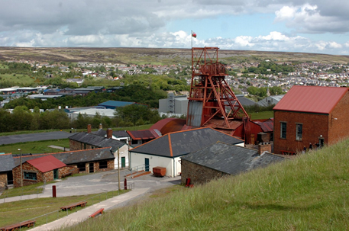
School Trip: Big Pit (Curriculum Cymreig)
The children will be taken to ‘Big Pit’ The aim of the visit is to give children an experience of what life was like for children in Wales who were forced to work down the mines. The date for the educational visit will be announced as soon as possible. I very much hope parents are able to volunteer to help me supervise the children on the excursion.

Slide 23

Science and Technology
The children will undertake a series of investigations during the second half of the spring term. They will develop the skills of identifying a success criteria for an investigation, to make predictions about the outcome of an investigation, how to conduct a fair test, to describe, their method, how they will record their results in charts, and a variety of graphs, to draw conclusions from their data . To explain what they have learned and to assess whether the success criteria for the investigation has been achieved.
Describes Sustainable Earth
The properties of materials related to their uses.

Slide 24
Technology: This work will be taught and conducted in class by Mrs Houston.
Learning objectives:​
To understand how selection is represented in flowcharts.​
To understand and use decision boxes.​
To create flowcharts algorithms.
To create own flow charts and algorithms.
Make PPTs about learning.
Make flipgrids (Videos) to evaluate learning
Use Microbit coding – including Sea Turtles, Flashing Emotions
Your child’s work is on Teams and many of the flipgrid videos completed so far have also been placed on the school gallery and the class page under ‘My Week’.

Slide 25
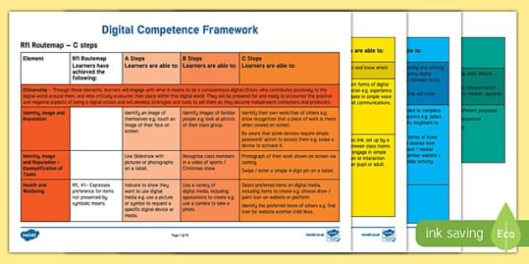
DCF: Digital Competency Framework
DCF
understand how to protect themselves from online identity theft,
understand that information put online leaves a digital footprint or trail,
identify benefits and risks of installing software, installing free and paid for software.
identify the positive and negative influences of technology on the environment,
explain the importance of balancing game and screen time with other parts of their lives

Slide 26
.
Digital Homework for 2022-23
Flip and Reading Progress Homework Timetable
for 2022-23
Flip is a video discussion and video sharing app. Children are expected to record short video responses to a range of different topics throughout the year. All topics can be accessed by clicking the ‘Flip’ tab in Microsoft Teams.
Flip and Reading Progress homework activities must be completed by children in the following classes:
• St. Teilo 2
• St. Gwynno 3
• St. Tydfil 3
• St. Dwynwen 3

Slide 27
.
Digital Homework for 2022-23 - Timetable
This work will be taught and
conducted in class by Mrs Houston.
Flip and Reading Progress homework activities must be completed by children in the following classes:
• St. Teilo 2
• St. Gwynno 3
• St. Tydfil 3
• St. Dwynwen 3
You need to record a response on the following topics: | Where can you find it? | You need to record your response by:
My Rights! | Go to Hwb and select ‘Office 365’. Click on Microsoft Teams and select ‘Flip’ in the tabs. Choose the correct topic and record your response. Remember to ‘Join with Microsoft’. | Monday 24th October 2022
My Voice! |  | Monday 24th October 2022
Compassionate and Loving |  | Monday 24th October 2022
Four Purposes |  | Monday 12th December 2022
Faith-filled and Hopeful |  | Monday 12th December 2022
Eloquent and Truthful |  | Monday 13th February 2023
Learned and Wise |  | Monday 27th March 2023
Curious and Active |  | Monday 22nd May 2023
Intentional and Prophetic |  | Monday 17th July 2023
My Journey with micro:bit! |  | Monday 17th July 2023

Slide 28
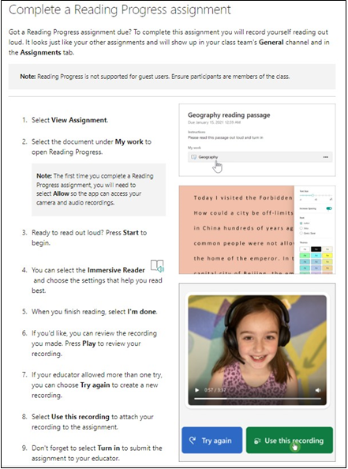
.
Homework Timetable for 2022-23
Reading Progress is a free tool built into Microsoft Teams designed to support and track reading fluency. Students record their reading on camera and submit it to their teacher.

Slide 29
.
Homework Timetable for 2022-23 – Technology – This work will be taught and
conducted in class by Mrs Houston.
Reading Progress is a free tool built into Microsoft Teams designed to support and
track reading fluency. Students record their reading on camera and submit it to
their teacher.

Slide 30
School Website and Communication
Website
www.stjosephsprm.cardiff.sch.uk
Twitter
@StJosephsRCPri2
School Email
stjosephsprm@cardiff.gov.uk
School Phone Number
02920 621625

Slide 31
Thank you for attending

