Slide 1
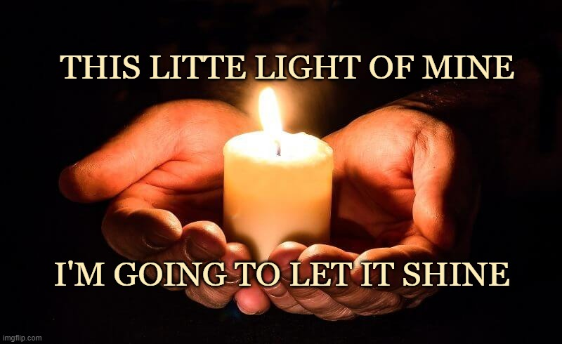
We are made in the image of God.
He bestowed upon us many talents.
How will we use these gifts to spread the Good News of Jesus?
Gather
Opening Hymn: This little light of mine, I’m going to let it shine.

Slide 2
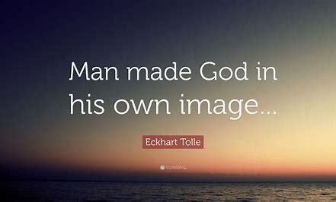
We are made in the image of God.
He bestowed upon us many talents.
How will we use these gifts to spread the Good News of Jesus?
Gather
Welcome to our collective worship. The theme of our assembly is ‘TALENTS’. We are all made s in God our Father’s image and we all share his eternal love that He has for each one of us.

Slide 3
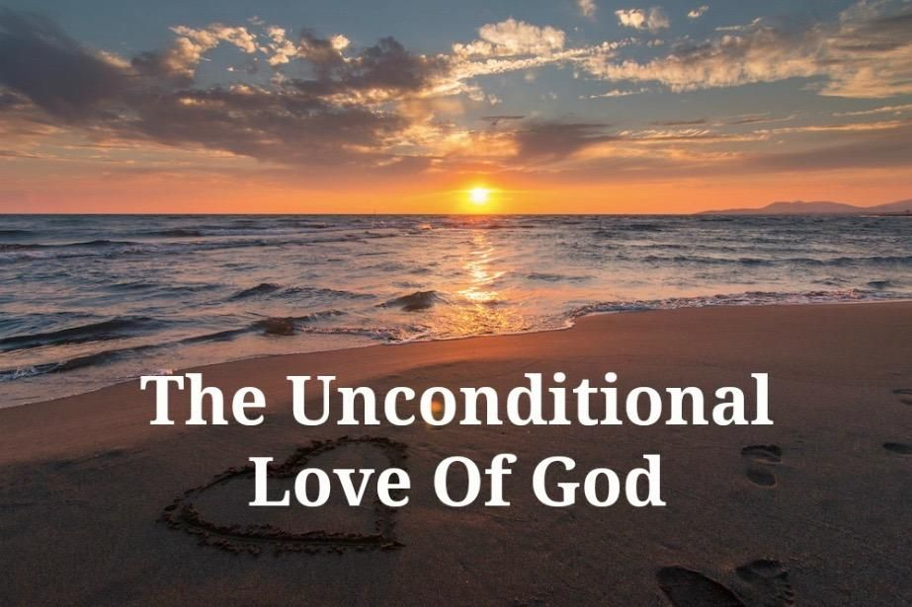
We are made in the image of God.
He bestowed upon us many talents.
How will we use these gifts to spread the Good News of Jesus?
Gather
Opening Prayer
The sign of the cross reminds us of God’s love so let’s begin our prayer in the name of Father….
All: Almighty God, who makes light shine in darkness,
And who sent his Son Jesus Christ that we might
know your unfailing love and constant hope;
All: kindle within us a deeper love for you;
grant us your compassion for the children in our care.

Slide 4
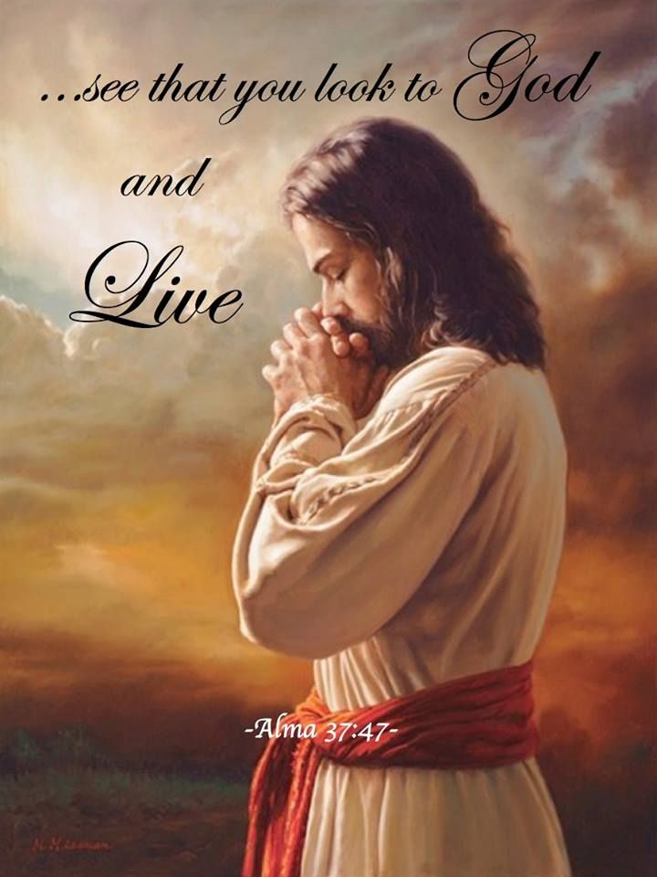
We are made in the image of God.
He bestowed upon us many talents.
How will we use these gifts to spread the Good News of Jesus?
Gather
All: Banish the fear from the hearts of our children
and enable us to see your image in the face of every child;
that guided by your presence and peace,
we may impart your joy to them,
through Jesus Christ, our Lord,
Amen.

Slide 5
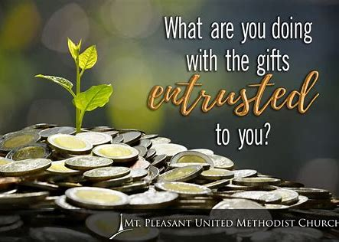
We are made in the image of God.
He bestowed upon us many talents.
How will we use these gifts to spread the Good News of Jesus?
Gather
What’s a talent?
A talent is a special natural ability or
aptitude. Natural means that we are
Born
with it. Everyone has a talent.
Everyone is
good at something. These are the
Talents
That each of the children in this
School
have.

Slide 6

We are made in the image of God.
He bestowed upon us many talents.
How will we use these gifts to spread the Good News of Jesus?
The Word of God
The Three Servants. How did they use their gifts?
There was once a rich man who had three servants who wanted to test how wisely his servants could use the abilities that God had given them.

Slide 7
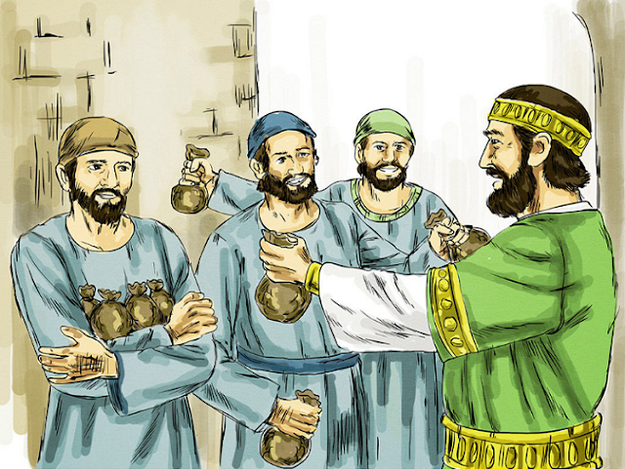
We are made in the image of God.
He bestowed upon us many talents.
How will we use these gifts to spread the Good News of Jesus?
Word of God
I want to give each of you something, according to your ability. (Handing 5 coins to servant #1) Here, take these 5 coins. (Then handing 2 coins to servant #2) Here you take these 2 coins. (Then handing 1 coin to servant #3) And you, take this one coin. I must go on a long journey, but I will return some day. (Master walks away)

Slide 8
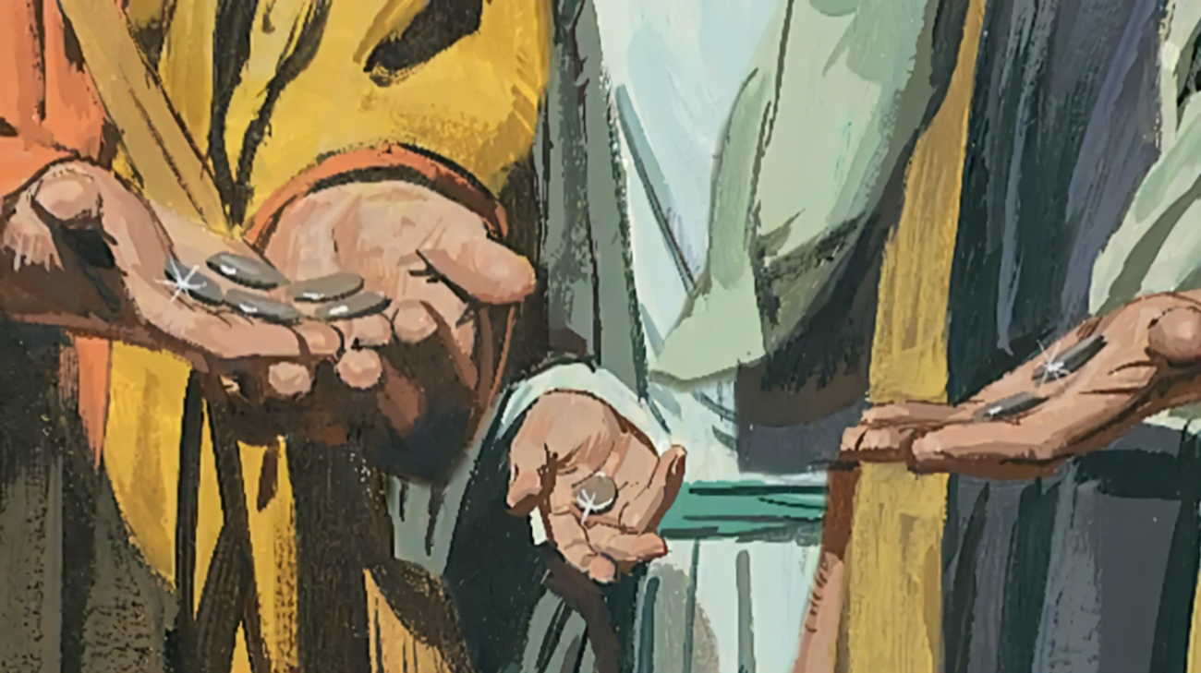
We are made in the image of God.
He bestowed upon us many talents.
How will we use these gifts to spread the Good News of Jesus?
Word of God
Servant 1 | I know what I will do with my 5 coins. I will start a business and help people all over town. I'm sure my business will do very well.

Slide 9
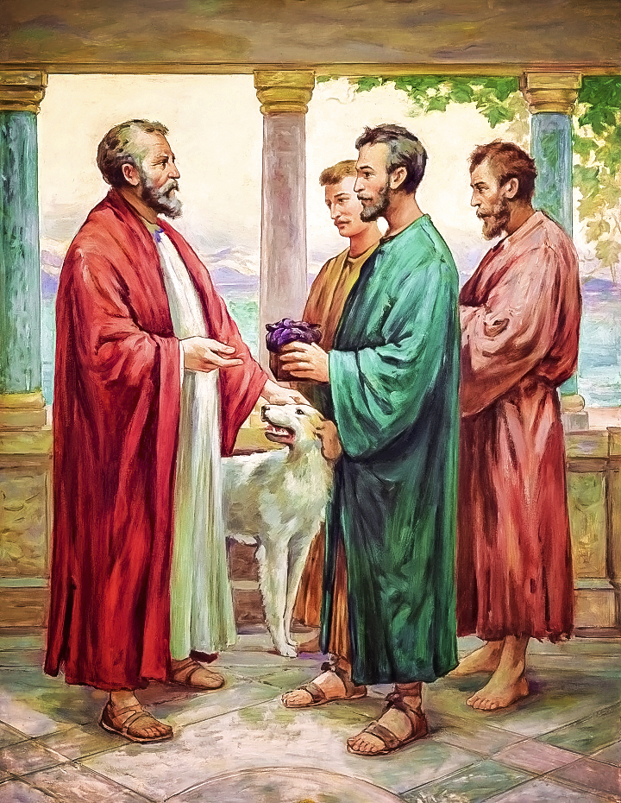
We are made in the image of God.
He bestowed upon us many talents.
How will we use these gifts to spread the Good News of Jesus?
Word of God
Servant 2 | I know what I will do with my 2 coins. I will invest them and earn much interest.

Slide 10
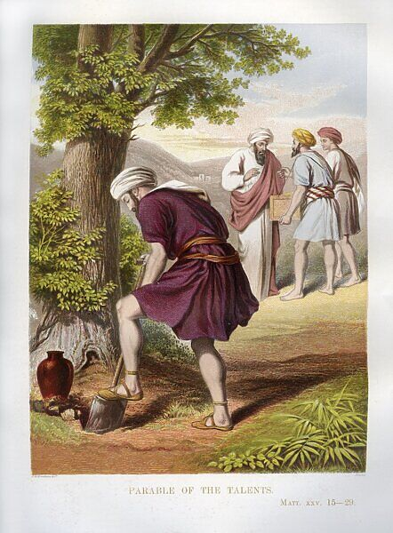
We are made in the image of God.
He bestowed upon us many talents.
How will we use these gifts to spread the Good News of Jesus?
The Word of God
Servant 3 | I know what I will do. I do not want to lose my coin, so I will bury it in the backyard, so nobody will steal it.

Slide 11
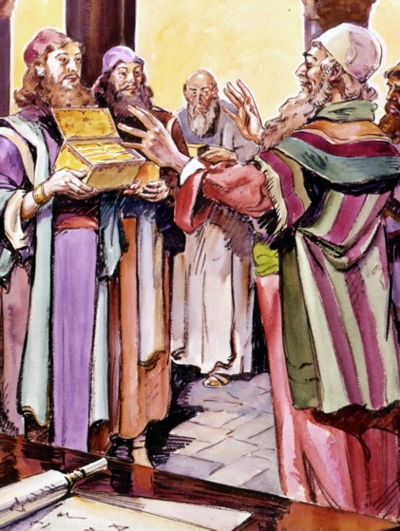
We are made in the image of God.
He bestowed upon us many talents.
How will we use these gifts to spread the Good News of Jesus?
The Word of God
The Master returned home
(Looking at servant #1) Well tell me, what have you done with the 5 coins I gave you so long ago?
Look, you trusted me with 5 coins and I built a nice business using them. See, here are 5 more coins, 10 in all.
Well done good and faithful servant. You have been faithful with a few things. I will put you in charge of many things. Come share in my happiness. (Then look at servant #2) Well tell me, what have you done with the 2 coins I gave you so long ago?

Slide 12
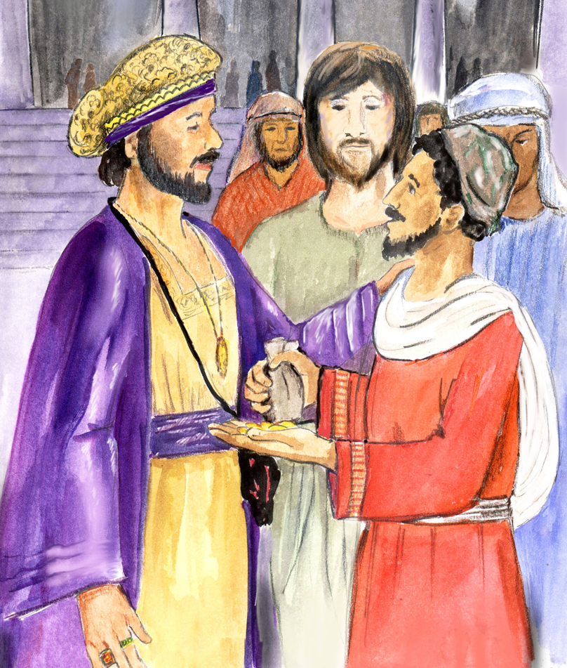
We are made in the image of God.
He bestowed upon us many talents.
How will we use these gifts to spread the Good News of Jesus?
Thee Word of God
Servant 2 | Look, you trusted me with 2 coins, and I have invested them. Look here I have gained two more, 4 in all.
Master | Well done good and faithful servant. You have been faithful with a few things. I will put you in charge of many things. Come share in my happiness. (Then looking at servant #3) Well tell me, what have you done with the 1 coin I gave you so long ago?

Slide 13
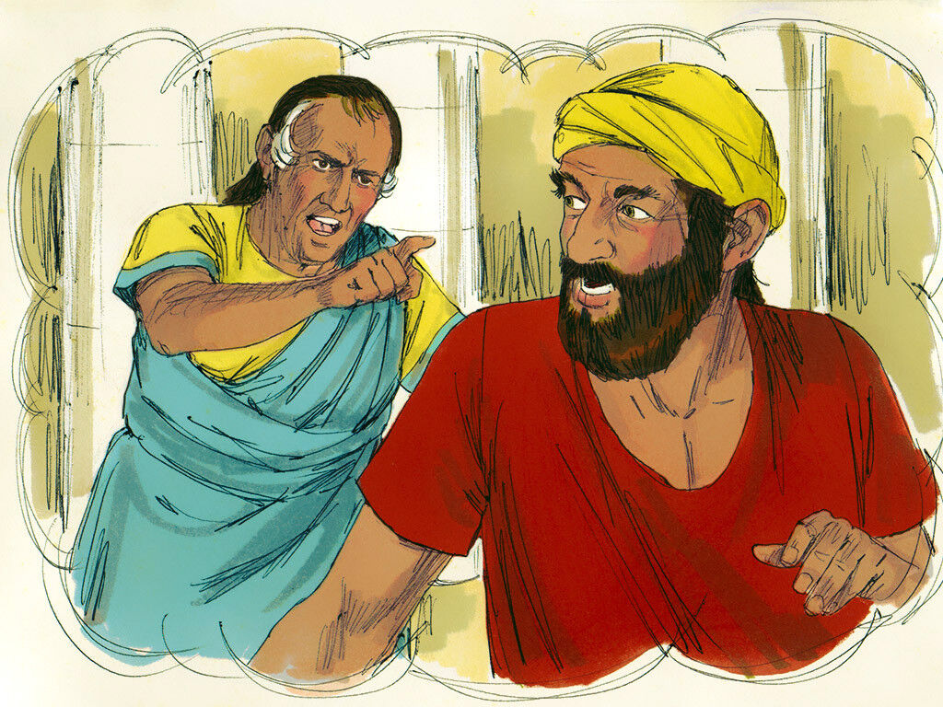
We are made in the image of God.
He bestowed upon us many talents.
How will we use these gifts to spread the Good News of Jesus?
The Word of God
The third servant said, “I was very afraid because you are a hard man, using what others have, so I hid the money where nobody could find it, so here it is. The master replied, “You wicked, good for nothing, lazy servant! If you knew I expected more back than what I gave, you should have at least put the coin in the bank in order to earn interest. Everyone who uses what he has will be given even more, but anyone who does not use what is given to him, it will be taken away. So now give your coin to the servant who has 10 coins and live in darkness.”

Slide 14
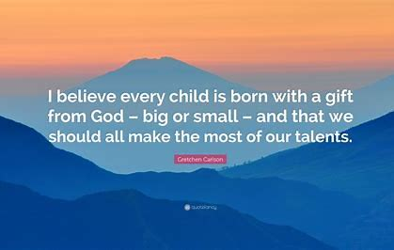
We are made in the image of God.
He bestowed upon us many talents.
How will we use these gifts to spread the Good News of Jesus?
Response to the Word of God
Reader: We turn to God our Creator now to give thanks for making each one of us to be like God and ask God to hear our prayers.
Reader: We give thanks for our talents and qualities.
May we use them for the service of others.
Lord, hear us
Lord, graciously hear us.
Reader: We give thanks for our uniqueness and differences. Help us to treat everybody we meet as children of God.
Lord, hear us
Lord, graciously hear us.
Reader: St. Paul urged us to be joyful.
Help us to pray with grateful hearts knowing how much God loves us.
Lord, hear us
Lord, graciously hear us.

Slide 15
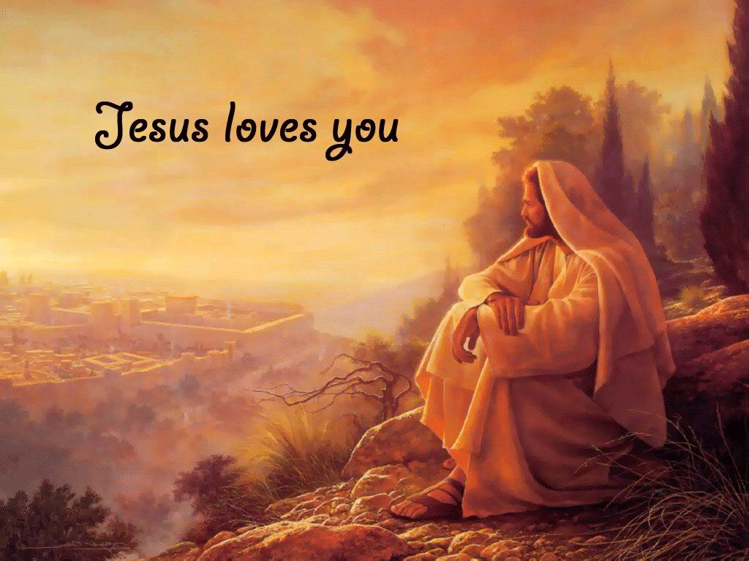
We are made in the image of God.
He bestowed upon us many talents.
How will we use these gifts to spread the Good News of Jesus?
Going Forth
Every night before you go to bed for the next few days want you to try to remember the qualities and talents you have used that day and give thanks to God for them. Now let us now end our time of prayer together by praising God who made us all to be like God as we say:
All: Glory be to the Father
And to the Son and to the Holy Spirit
As it was in the beginning is now and ever shall be world without end Amen.

Slide 16
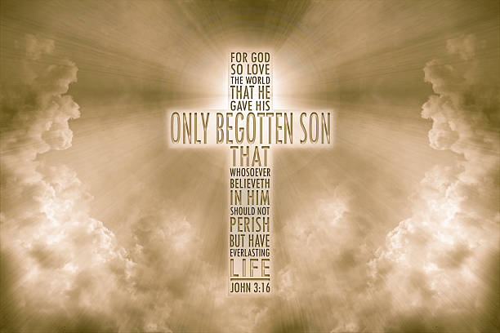
We are made in the image of God.
He bestowed upon us many talents.
How will we use these gifts to spread the Good News of Jesus?
Going Forth
Help us, Lord, to walk our special paths kindly and courageously in a manner that enriches all whom we meet on our life's journey. May our way be bright, safe and joyous! In living each day, guided by You, may we create a noble life, be of help to many others and leave behind lasting achievements and an inspiring legacy. All this we pray to You, Amen

Slide 17
We are made in the image of God.
He bestowed upon us many talents.
How will we use these gifts to spread the Good News of Jesus?
Gather
Closing Hymn: This little light of mine, I’m going to let it shine.

