Slide 1

Key Stage Two Collective Worship 2023
Theme: Always have faith in God

Slide 2

Key Stage Two Collective Worship 2023
Theme: Always have faith in God
Gather
Hymn: Do not be afraid
Welcome: Today Jesus warns us that life will be difficult. The world will face wars and disasters, but we mustn't lose hope. We must trust in God who will guide us and save us.

Slide 3
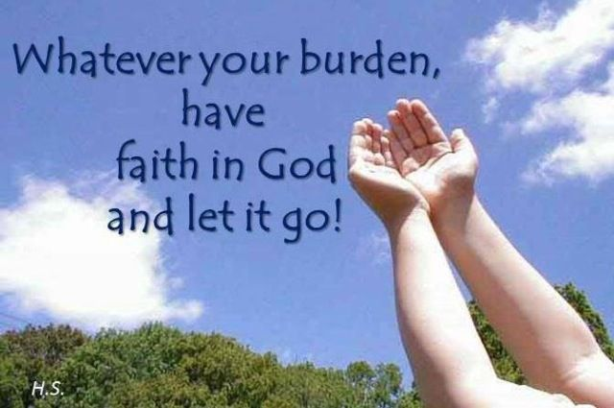
Key Stage Two Collective Worship 2023
Theme: Always have faith in God
Gather: Opening prayer - All:
All: Yn enw’r Tad a Mhab a Ysbryd Glan. Amen.
All-powerful God, nothing is greater than your love, so may we trust in you whatever difficulties and challenges we face. Amen.
All: Yn enw’r Tad a Mhab a Ysbryd Glan. Amen.

Slide 4
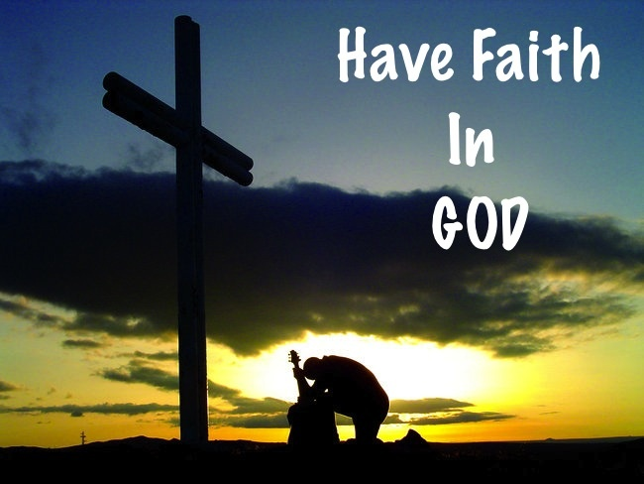
Key Stage Two Collective Worship 2023
Theme: Always have faith in God
The Word of God
Gospel acclamation: everyone sings the acclamation together.
Leader: The Lord be with you.
All: And with your Spirit
Leader: A reading from the Holy Gospel according to Luke.
All: Glory to you o Lord. (Cross forehead, lips and heart)

Slide 5
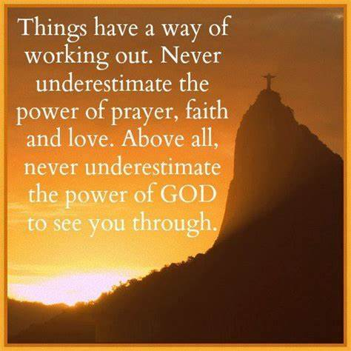
Key Stage Two Collective Worship 2023
Theme: Always have faith in God
Gospel: Luke 21:5-19
Some of the disciples were talking about the Temple, how beautiful it looked with its fine stones and the gifts offered to God. Jesus said, “All this you see—the time will come when not a single stone here will be left in its place; everyone will be thrown down.”
“Teacher,” they asked, “when will this be? And what will happen in order to show that the time has come for it to take place?”

Slide 6

Key Stage Two Collective Worship 2023
Theme: Always have faith in God
Jesus said, “Be on guard; don't be deceived. Many men, claiming to speak for me, will come and say, ‘I am he!’ and, ‘The time has come!’ But don't follow them. Don't be afraid when you hear of wars and revolutions; such things must happen first, but they do not mean that the end is near.”

Slide 7
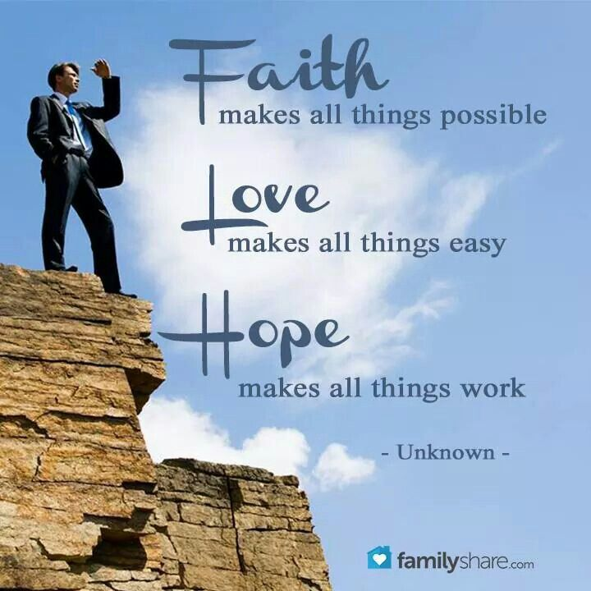
Key Stage Two Collective Worship 2023
Theme: Always have faith in God
He went on to say, “Countries will fight each other; kingdoms will attack one another. There will be terrible earthquakes, famines, and plagues everywhere; there will be strange and terrifying things coming from the sky. Before all these things take place, however, you will be arrested and persecuted; you will be handed over to be tried in synagogues and be put in prison; you will be brought before kings and rulers for my sake. This will be your chance to tell the Good News.

Slide 8
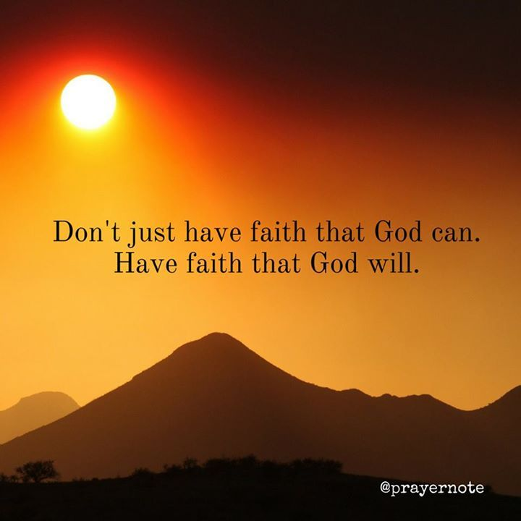
Key Stage Two Collective Worship 2023
Theme: Always have faith in God
Make up your minds beforehand not to worry about how you will defend yourselves, because I will give you such words and wisdom that none of your enemies will be able to refute or contradict what you say. You will be handed over by your parents, your brothers, your relatives, and your friends; and some of you will be put to death. Everyone will hate you because of me. But not a single hair from your heads will be lost. Stand firm, and you will save yourselves.
Pause
The word of the Lord
All: Praise to you Lord Jesus Christ

Slide 9
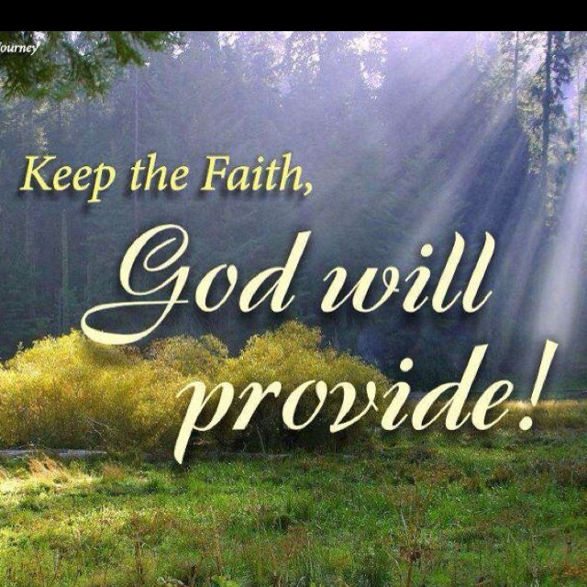
Key Stage Two Collective Worship 2023
Theme: Always have faith in God
Response to the Word of God
Jesus was with his disciples in the temple. He told them that the temple would one day be destroyed and that there would be wars, earthquakes, and people hungry for food.
Can you think of places in the world today where there are wars, earthquakes and people are hungry for food?

Slide 10
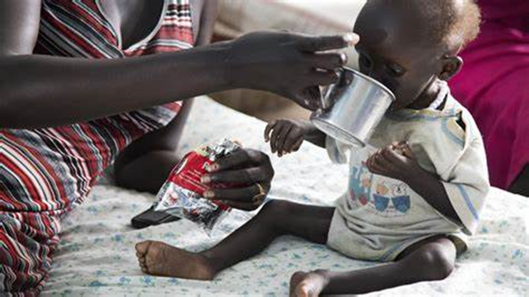
Key Stage Two Collective Worship 2023
Theme: Always have faith in God
Here is one example:
In Kenya, Ethiopia, Somalia and South Sudan, up to 20 million people are facing extreme hunger. The situation is so bad that people are being forced to spend their life-savings or to leave their homes.
Through local Church aid workers, CAFOD is helping these families to get the emergency food and clean water that they need.

Slide 11
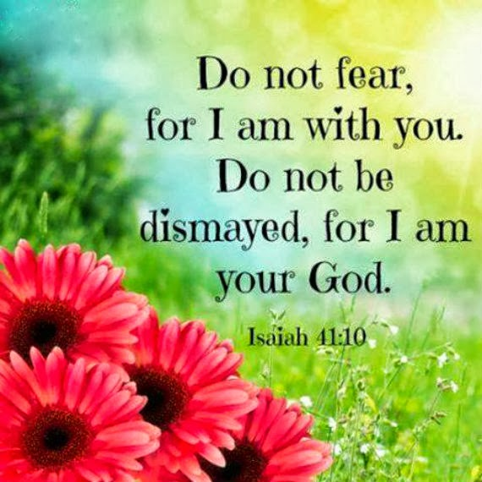
Key Stage Two Collective Worship 2023
Theme: Always have faith in God
Jesus told the disciples not to be afraid. He promised that he would be with them always and that they wouldn't be harmed if they put their trust in him.
Jesus is with us always, even in the hardest times. Often Jesus comes to us in the people who help us.
Next time you hear about an earthquake, flood or drought on the news what will you do to help the people affected? How will you help them to know that they haven’t been forgotten and that Jesus is always with them?

Slide 12
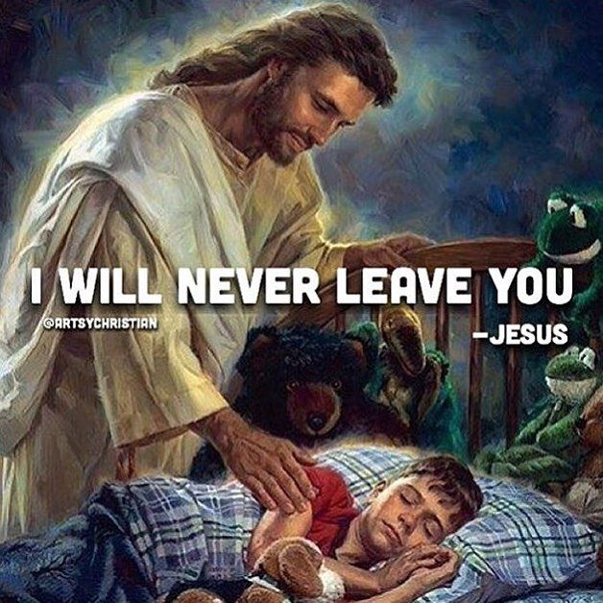
Key Stage Two Collective Worship 2023
Theme: Always have faith in God
Response to the Word of God
Bidding Prayers
We pray together:
We pray for the Church: that it may support and welcome all people, especially those among us who are poor. Lord in your mercy...
Response:clywed ein gweddi (Hear our prayer)

Slide 13
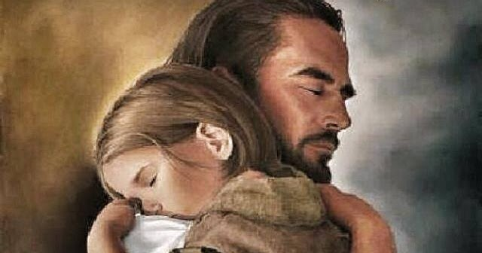
Key Stage Two Collective Worship 2023
Theme: Always have faith in God
We pray for our brothers and sisters in every country: that they may know that they are not forgotten as we do our best to help our neighbours around the world. Lord in your mercy...
Response:clywed ein gweddi (Hear our prayer)

Slide 14
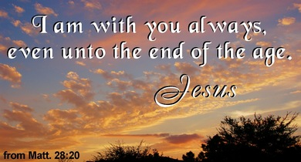
Key Stage Two Collective Worship 2023
Theme: Always have faith in God
We pray for our parish, family and friends: that with God’s help we may support each other in all things, especially when life is difficult. May we give each other hope. Lord in your mercy...
Response:clywed ein gweddi (Hear our prayer)

Slide 15
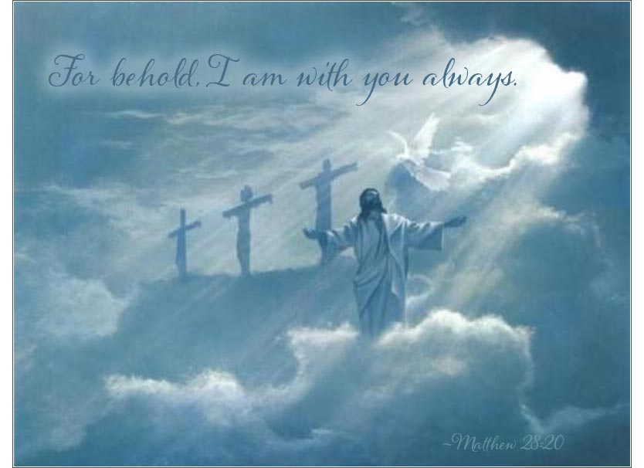
Key Stage Two Collective Worship 2023
Theme: Always have faith in God
Go Forth
Closing prayer: Jesus, help us to put our faith and trust in you at all times. May we not be afraid but instead believe that you will always keep us safe. Amen.
Let us conclude our prayer service today with the prayer God our Father gave us

Slide 16
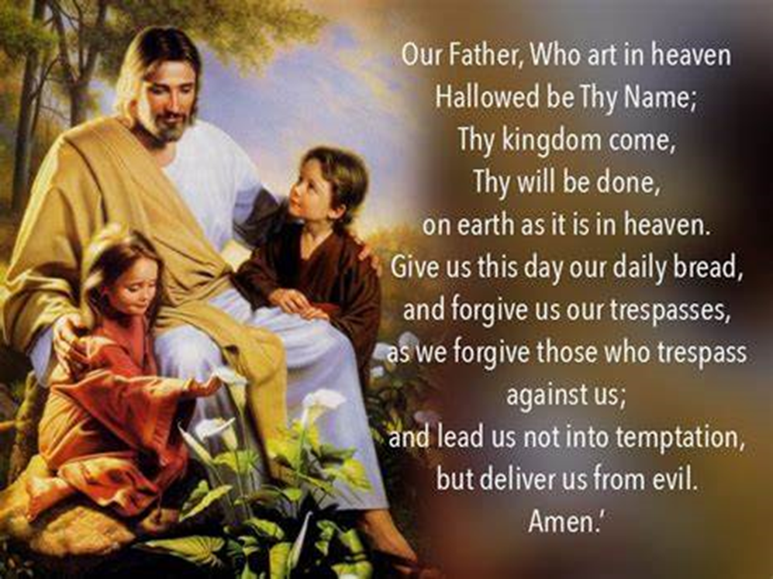
Key Stage Two Collective Worship 2023
Theme: Always have faith in God

Slide 17
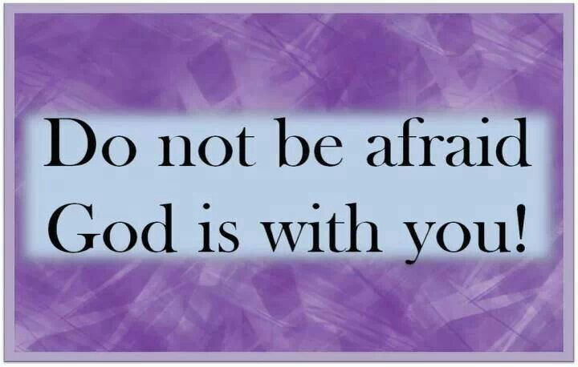
Key Stage Two Collective Worship 2023
Theme: Always have faith in God
Closing Hymn: Do not be afraid…

