Slide 1
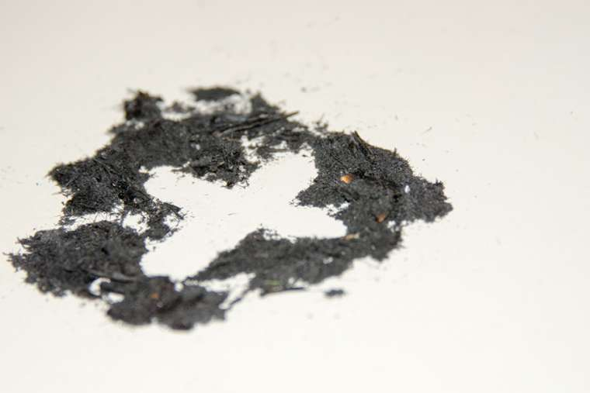
Ash Wednesday Mass
St Joseph’s RC Primary School
Wednesday 22nf February 2023

Slide 2

Opening Hymn:
Bind us Together
Bind us together, Lord,
bind us together
with cords that cannot be broken;
bind us together, Lord,
bind us together,
O bind us together with love.
There is only one God,
there is only one King,
there is only one Body -
that is why we sing:

Slide 3
Bind us together, Lord,
bind us together
with cords that cannot be broken;
bind us together, Lord,
bind us together,
O bind us together with love.
Made for the glory of God,
purchased by His precious Son.
Born with the right to be free:
Jesus the victory has won.

Slide 4
Bind us together, Lord,
bind us together
with cords that cannot be broken;
bind us together, Lord,
bind us together,
O bind us together with love.
We are the family of God,
we are His promise divine,
we are His chosen desire,
we are His glorious new wine.

Slide 5
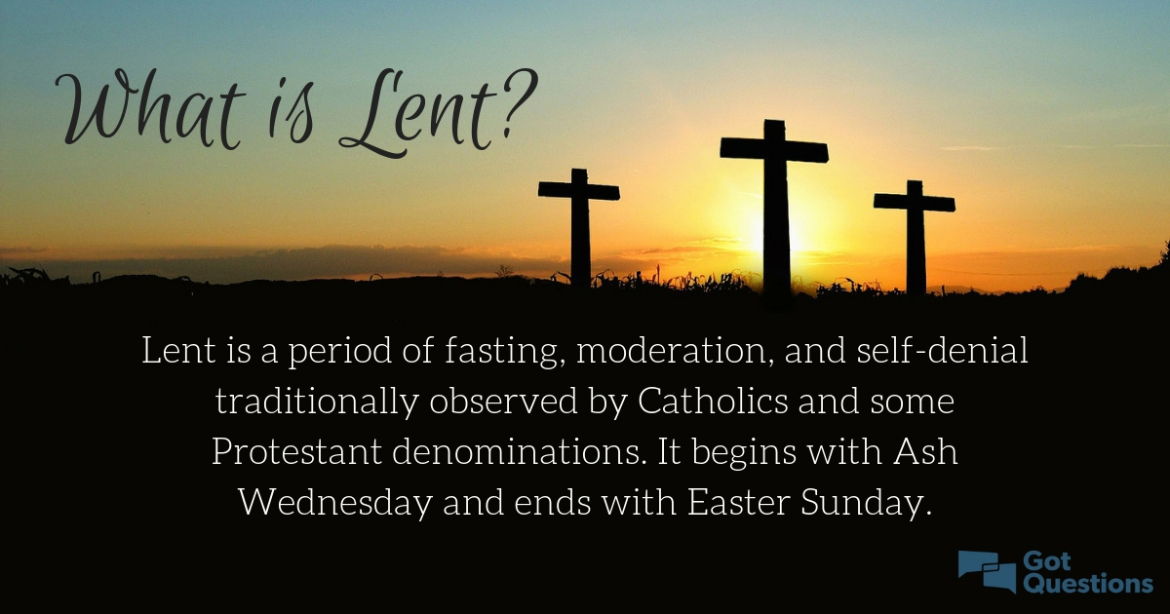
Gather / Introduction:
Reader: Ash Wednesday begins our forty day season of Lent that leads to Easter. On Ash Wednesday, we come together like the people of the Old Testament.
Reader: This is to remind ourselves that we don’t always follow God’s ways and need to ask God for His mercy and forgiveness.

Slide 6
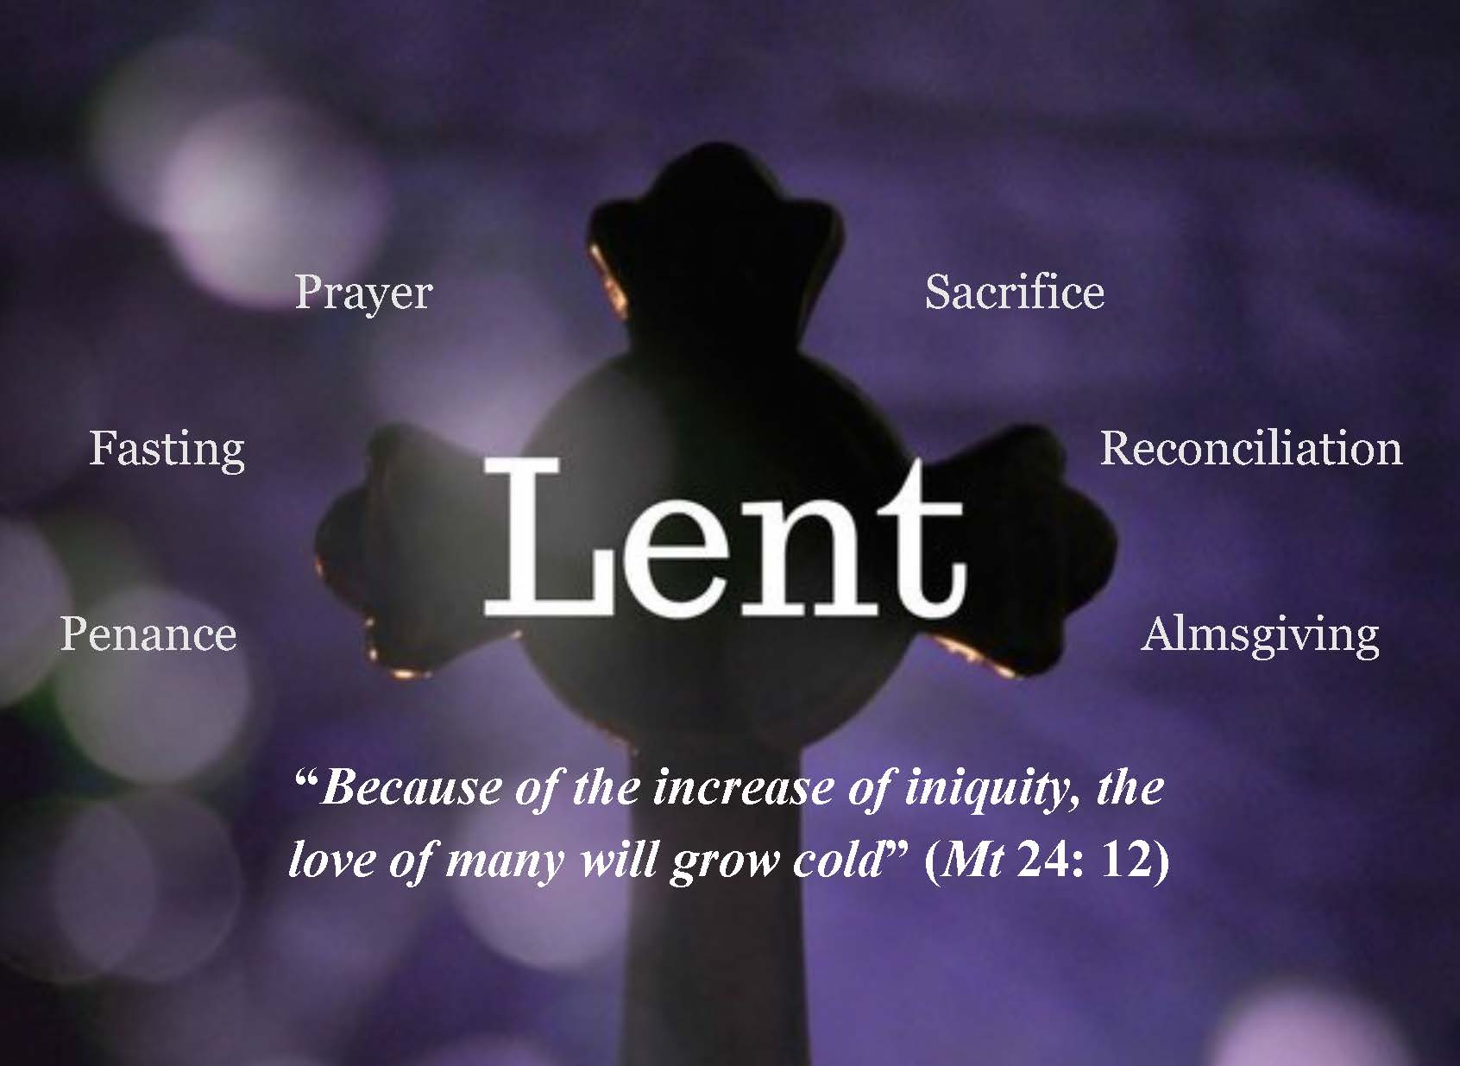
Bonnie: Like God’s people in the time of the prophets, we wear ashes to show that we want to turn away from whatever keeps us from God, and to have a change of heart, so that we can live in right relationship with God and each other.

Slide 7

Reader: On Ash Wednesday, the priest or person giving out ashes rubs them on our forehead in the shape of a cross while saying:
Repent and believe in the Gospel
Or
Turn away from sin and believe in the Gospel.
For Catholics, Ash Wednesday is also a day of fasting and abstaining from meat (like Good Friday).

Slide 8

Reader: Fasting reminds us that food alone cannot make us happy. We must also be fed with prayer, with God’s Word and by meeting Jesus in the Sacraments, especially the Reconciliation and Eucharist (the Mass). The small sacrifices we make during Lent make room in our hearts to welcome the risen Jesus at Easter. And so with this in mind, we begin our Ash Wednesday Mass.

Slide 9
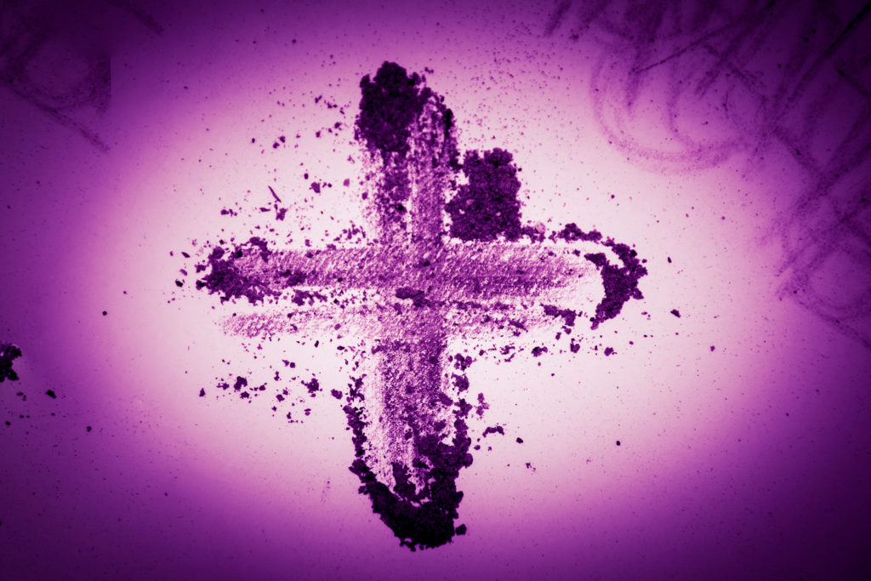
Greeting:
Reader: The grace of our Lord Jesus Christ, and the love of God, and the communion of the Holy Spirit be with you all.
All: And with your spirit.
Penitential Act
Reader: Brethren (brothers and sisters), let us acknowledge our sins, and so prepare ourselves to celebrate the sacred mysteries.

Slide 10
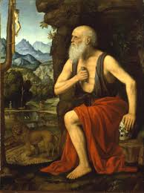
Penitential Act
I confess to almighty God
And to you my brothers and sisters,
That I have greatly sinned,
In my thoughts and in my words,
In what I have done and in what I have failed to do,
(and strike your breast as you say)
Through my fault, through my fault,
Through my most grievous fault;
Therefore I ask blessed Mary ever Virgin,
All the Angels and Saints,
And you my brothers and sisters,
To pray for me to the Lord our God

Slide 11
Gather: Opening Prayer
Let us pray
God our Father, as we begin this holy season of Lent, help us to see that your merciful love is with us always, even when we wander far from you. We ask you to change our hearts that we might become better followers of your Son Jesus. With the help of your grace, may our prayers and sacrifices over the next forty days lead us to welcome Him in each other, in the poor, sick and lonely so that together, we can greet Him as one family at Easter. We make this prayer through Christ our Lord. Amen.
Now let us listen to the word of God.

Slide 12
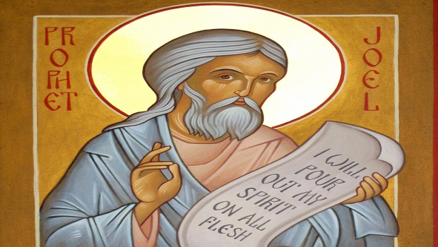
The Word of God: FIRST READING
Reader: A reading from the prophet Joel:
“But even now,” says the Lord,
“Repent sincerely and return to me with fasting and weeping and mourning.
Let your broken heart show your sorrow; tearing your clothes is not enough.
Come back to the Lord your God.
He is kind and full of mercy;
He is patient and keeps his promise;
He is always ready to forgive and not punish.”
PAUSE
The word of the Lord.
Response: Diolch i Ti O Dduw

Slide 13
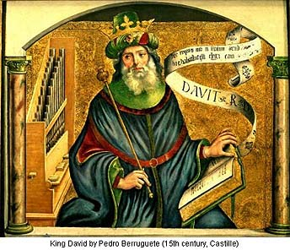
The Response to the Word of God
Reader: The Response is: “Be merciful, O Lord, for we have sinned.”
ALL: Be merciful, O Lord, for we have sinned.
Be merciful to me, O God,
Because of your constant love.
Because of your great mercy, wipe away my sins!
And make me clean.
Response: Be merciful, O Lord, for we have sinned.
Reader: I recognise my faults;
I am always conscious of my sins.
I have sinned against you –only against you-
And have done what is wrong in your sight.
Response: Be merciful, O Lord, for we have sinned.

Slide 14
The Responsorial Psalm
Reader: Create in me a clean heart, O God,
And put a new and right spirit within me.
Do not cast me away from your presence,
And do not take your holy spirit from me.
Response: Be merciful, O Lord, for we have sinned.

Slide 15
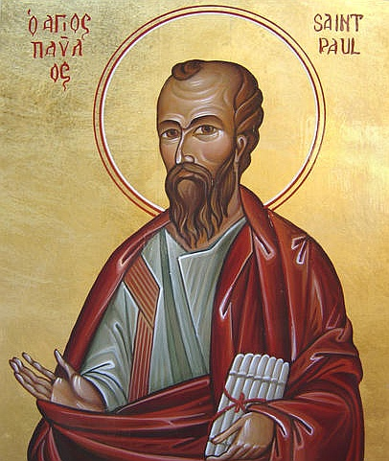
Second Reading
Reader: A reading from the letters of St Paul to the Corinthians.
“Brothers and sisters, we are ambassadors for Christ, as if God were appealing through us. We implore you on behalf of Christ, be reconciled to God. For our sake he made him to be sin who did not know sin so that we might become the righteousness of God in him.
Working together, then, we appeal to you not to receive the grace of God in vain. For he says: ‘In acceptable time, I heard you, and on the day of salvation, I helped you.
Behold, now is a very acceptable time; behold, now is the day of salvation.
PAUSE
The word of the Lord.
Response: Diolch i Ti O Dduw

Slide 16
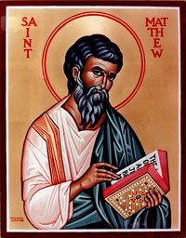
Reader: The Lord be with you
All: and with your Spirit
Gospel
A reading from the holy gospel according to Matthew.
Response (all): glory to you o lord.
Jesus said to his disciples, “Make certain you do not perform your religious duties in public so that people will see what you do. If you do these things publicly, you will not have any reward from your Father in heaven.

Slide 17
“So when you give something to a needy person, do not make a big show of it, as the hypocrites do in the houses of worship and on the streets. They do it so that people will praise them. I assure you, they have already been paid in full. But when you help a needy person, do it in such a way that even your closest friend will not know about it. Then it will be a private matter. And your Father, who sees what you do in private, will reward you.

Slide 18
“When you pray, do not be like the hypocrites! They love to stand up and pray in the houses of worship and on the street corners, so that everyone will see them. I assure you, they have already been paid in full. But when you pray, go to your room, close the door, and pray to your Father, who is unseen. And your Father, who sees what you do in private, will reward you.

Slide 19
“AND WHENEVER YOU FAST, DO NOT PUT ON A SAD FACE AS THE HYPOCRITES DO. THEY NEGLECT THEIR APPEARANCE SO THAT EVERYONE WILL SEE THAT THEY ARE FASTING. I ASSURE YOU, THEY HAVE ALREADY BEEN PAID IN FULL. WHEN YOU GO WITHOUT FOOD, WASH YOUR FACE, AND COMB YOUR HAIR, SO THAT OTHERS CANNOT KNOW THAT YOU ARE FASTING –ONLY YOUR FATHER, WHO IS UNSEEN, WILL KNOW. AND YOUR FATHER, WHO SEES WHAT YOU DO IN PRIVATE, WILL REWARD YOU.”
THE GOSPEL OF THE LORD.
PAUSE
RESPONSE: PRAISE TO YOU LORD JESUS CHRIST.

Slide 20

RESPONSE TO THE Word OF God:
Reader: O Jesus, you place on our forehead the sign of your saving Cross. Help us to turn from wrong and to be true to the gospel in which you teach us to live and to follow your holy example.
Pause
Reader: Lord, in your mercy,
Response: Gweddia drosom ni
Reader: We pray for the pupils’ of our school,
let the giving of ashes today help us not to dwell on wanting material things. Let us try to give more attention to helping and giving to others and not just thinking of ourselves.
Pause
Reader: Lord, in your mercy,
Response: Gweddia drosom ni

Slide 21
Prayers of the Faithful:
Reader: We pray for the Church community,
let them not neglect the grace they have received, but turn again to the Lord in reverent prayer and repentance.
Pause
Reader: Lord, in your mercy,
Response: Gweddia drosom ni
Reader: We pray for those who have departed this life, Let us remember their kind spirit and thoughtful actions and not forget the joy they brought to us.
Pause
Reader: Lord, in your mercy,
Response: Gweddia drosom ni

Slide 22
Prayers of the Faithful:
Reader: We ask Mary our Mother to help us to be loving and understanding as we follow and share the ‘Good News’ of Jesus.
Hail Mary ……
Reader: In a moment of silent prayer let us all pray for our own intentions.

Slide 23

Going Forth
Reader: Let us pray
All: O God, pour out your spirit upon us who bow before your majesty and by your mercy may we merit the rewards you promise to us who do penance. We make this prayer through Christ our Lord. Amen.

Slide 24
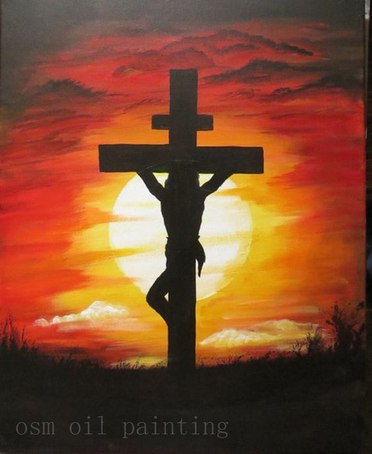
Final Hymn: God forgave my Sin
God forgave my sin in Jesus' name.
I've been born again in Jesus' name
And in Jesus' name I come to you
To share his love as he told me to.
He said 'Freely, freely you have received;, freely, freely give.
Go in my name, and because you believe others will know that I live.

Slide 25
All pow'r is giv'n in Jesus' name
in earth and heav'n in jesus name
And in Jesus' name I come to you
To share his pow'r as he told me to.
He said 'Freely, freely you have received;, freely, freely give.
Go in my name, and because you believe others will know that I live.

Slide 26
God gives us life in Jesus' name
he lives in us in Jesus' name
And in Jesus' name I come to you
To share his peace as he told me to.
He said 'Freely, freely you have received;, freely, freely give.
Go in my name, and because you believe others will know that I live.

Slide 27


