Slide 1
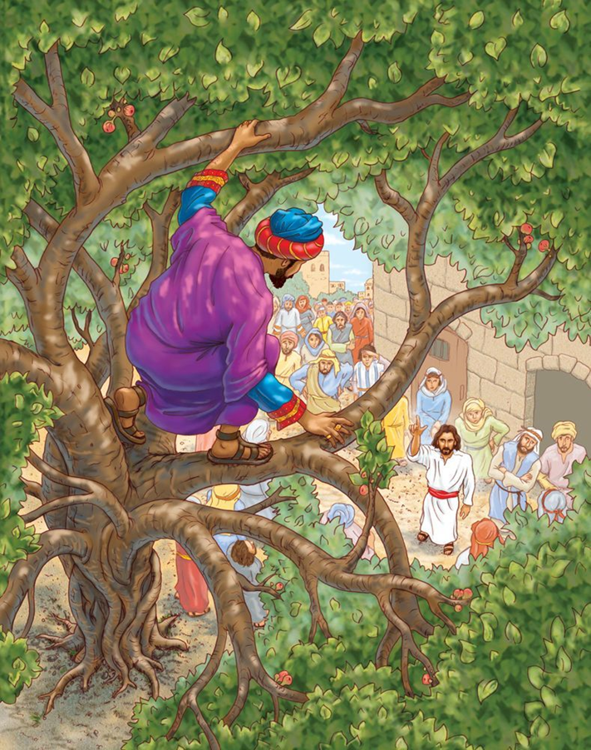
Gweddiwn / Prayer Service Key Stage Two
Seeking forgiveness when we have done wrong
Zaccaheus

Slide 2
Gweddiwn / Prayer Service Key Stage Two
Seeking forgiveness when we have done wrong
Zaccaheus
Opening Hymn
Kum Ba Yah, My Lord, Kum Ba Yah!
Kum Ba Yah, My Lord, Kum Ba Yah!
Kum Ba Yah, My Lord, Kum Ba Yah!
O Lord, Kum Ba Yah!
Someone’s Laughing, Lord, Kum Ba Yah!
Someone’s Laughing, Lord, Kum Ba Yah!
Someone’s Laughing, Lord, Kum Ba Yah!
O Lord, Kum Ba Yah!
Someone’s Crying, Lord, Kum Ba Yah!
Someone’s Crying, Lord, Kum Ba Yah!
Someone’s Crying, Lord, Kum Ba Yah!
O Lord, Kum Ba Yah!
Someone’s Praying, Lord, Kum Ba Yah!
Someone’s Praying, Lord, Kum Ba Yah!
Someone’s Praying, Lord, Kum Ba Yah!
O Lord, Kum Ba Yah!
Someone’s Singing, Lord, Kum Ba Yah!
Someone’s Singing, Lord, Kum Ba Yah!
Someone’s Singing, Lord, Kum Ba Yah!
O Lord, Kum Ba Yah!
Kum Ba Yah, My Lord, Kum Ba Yah!
Kum Ba Yah, My Lord, Kum Ba Yah!
Kum Ba Yah, My Lord, Kum Ba Yah!
O Lord, Kum Ba Yah!

Slide 3
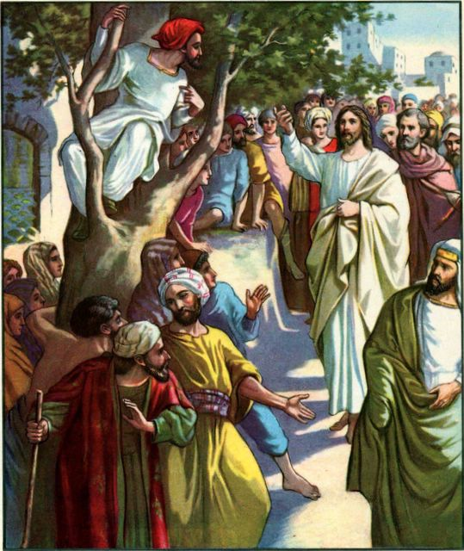
Gweddiwn / Prayer Service Key Stage Two
Seeking forgiveness when we have done wrong
Zaccaheus
Gather
Hymn: Seek ye first the kingdom of God.
Gather
Welcome: Today Jesus stays at the house of Zacchaeus – a tax collector – and shows us that everyone is loved. Let’s find out more…

Slide 4
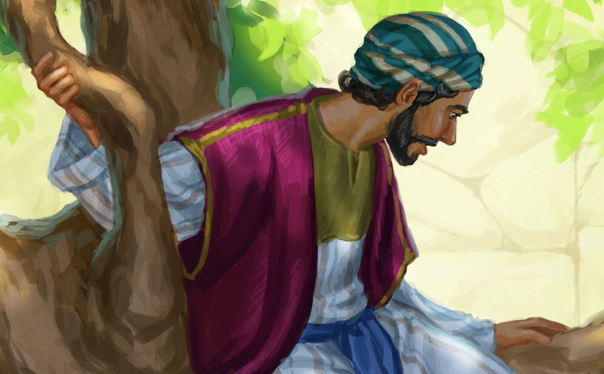
Gweddiwn / Prayer Service Key Stage Two
Seeking forgiveness when we have done wrong
Zaccaheus
Gather: Opening Prayer
All: Yn enw’r Tad a Mhab a Ysbryd Glan. Amen
Saving God, you welcome everyone into your Kingdom. Help us to be welcoming to everyone that we meet. Amen.
All: Yn enw’r Tad a Mhab a Ysbryd Glan. Amen

Slide 5
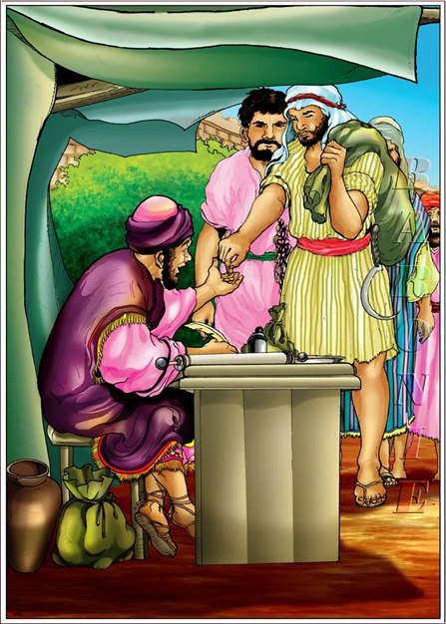
Gweddiwn / Prayer Service Key Stage Two
Seeking forgiveness when we have done wrong
Zaccaheus
The Word of God
Zaccaheus the cheating tax collector
Gospel acclamation: sung
The Lord be with you.
All: And with your Spirit.
A reading from the Holy Gospel according to Luke.
All: Glory to you o Lord. (Cross forehead, mouth and heart)

Slide 6
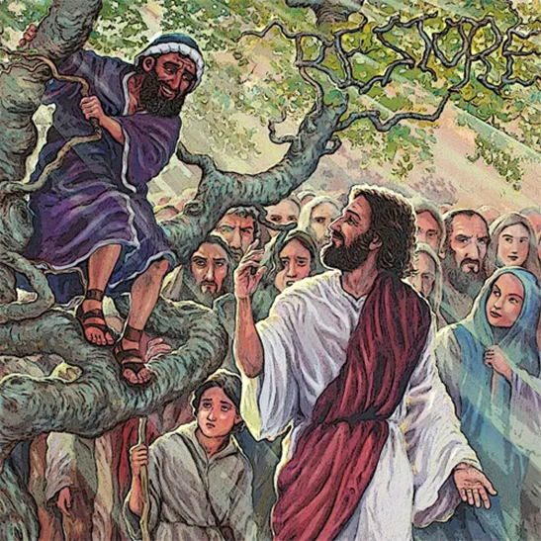
Gweddiwn / Prayer Service Key Stage Two
Seeking forgiveness when we have done wrong
Zaccaheus
The Word of God
Jesus went on into Jericho and was passing through. There was a chief tax collector there named Zacchaeus, who was rich. He was trying to see who Jesus was, but he was a little man and could not see Jesus because of the crowd. So he ran ahead of the crowd and climbed a sycamore tree to see Jesus, who was going to pass that way. When Jesus came to that place, he looked up and said to Zacchaeus, “Hurry down, Zacchaeus, because I must stay in your house today.”

Slide 7
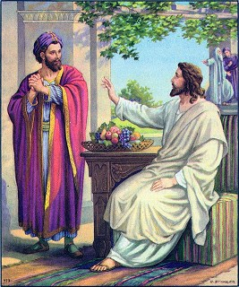
Gweddiwn / Prayer Service Key Stage Two
Seeking forgiveness when we have done wrong
Zaccaheus
The Word of God
Zacchaeus hurried down and welcomed him with great joy. All the people who saw it started grumbling, “This man has gone as a guest to the home of a sinner!”
Zacchaeus stood up and said to the Lord, “Listen, sir! I will give half my belongings to the poor, and if I have cheated anyone, I will pay back four times as much.”
Jesus said to him, “Salvation has come to this house today, for this man, also, is a descendant of Abraham. The Son of Man came to seek and to save the lost
The word of the Lord
All: Thanks be to God.

Slide 8
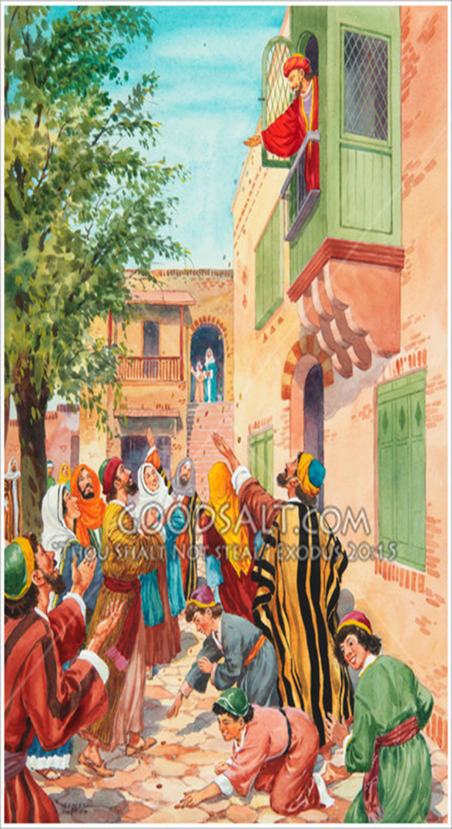
Gweddiwn / Prayer Service Key Stage Two
Seeking forgiveness when we have done wrong
Zaccaheus
Reflection on the Word of God
While Jesus was in Jericho, a man called Zacchaeus who was very rich from being a tax collector wanted to meet him. Zacchaeus was so short and there was such a big crowd that he had to climb a tree in order to see Jesus.
Jesus told Zacchaeus that he wanted to have dinner at his house. The crowds were cross because they thought Zacchaeus was a sinner – a person who was not always good and kind. Zacchaeus really wanted to change his life but didn't know how to do it without someone helping him. He believed that Jesus was the only one who could help.

Slide 9
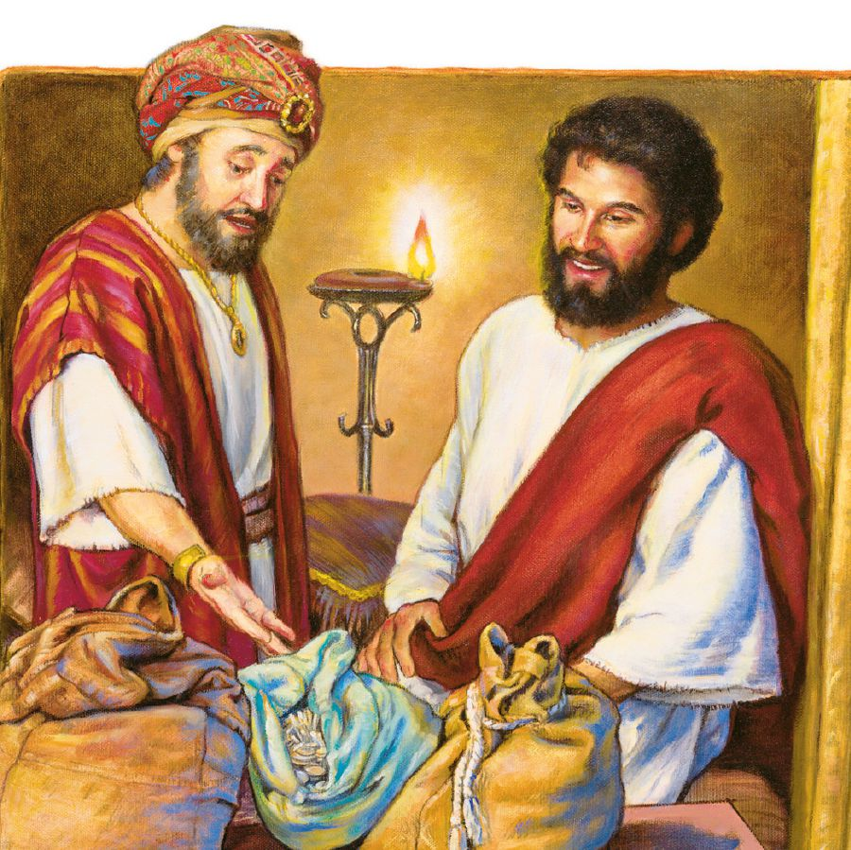
Gweddiwn / Prayer Service Key Stage Two
Seeking forgiveness when we have done wrong
Zaccaheus
Do you think having lots of money makes people happy? Why or why not?
Having enough money to get food and drink and have somewhere to live is really important, but if money is all we have that won’t make us happy. We also need family and friends. People who care about us and love us. We need to feel part of a community and play our part in caring for others. We need God.
Zacchaeus was rich. But he wasn’t happy. He knew that he was missing something in his life. He knew that Jesus was special and hoped that by following Jesus, he could become happier.

Slide 10
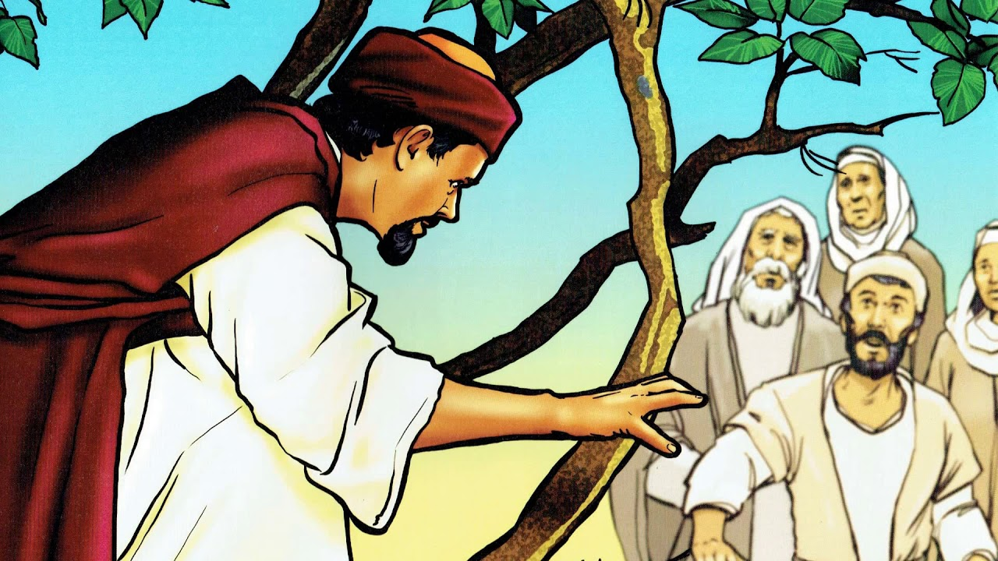
Gweddiwn / Prayer Service Key Stage Two
Seeking forgiveness when we have done wrong
Zaccaheus
Jesus looked at this man who was looking for him. Jesus had a way of seeing straight into the heart. Jesus could see that Zacchaeus wanted to change. Zacchaeus changed his life because of Jesus. Zacchaeus wanted to have better relationships with everyone he knew and with God. Zacchaeus promised to give away half of his things to those who were poor and to pay back the money he had taken unfairly from other people. He was trying to make things right. Zacchaeus welcomed Jesus into his home and into his heart.

Slide 11
Gweddiwn / Prayer Service Key Stage Two
Seeking forgiveness when we have done wrong
Zaccaheus
Response to the WordResponse to the Word
Bidding Prayers
Jesus is ready to help us change today and always so we pray together...
We pray for the Church: that it may be a place where everyone is welcome and inspire a change in the lives of all those who hear its message. Lord in your mercy... All: clywed ein gweddi.
We pray for our brothers and sisters in every country: that they may have their fair share of the good things God has given for all. Lord in your mercy...
All: clywed ein gweddi.
We pray for our parish, family and friends: that through God’s help we may make changes so that all people may live together in peace. Lord in your mercy... All: clywed ein gweddi.

Slide 12
Gweddiwn / Prayer Service Key Stage Two
Seeking forgiveness when we have done wrong
Zaccaheus
Closing Prayer / Go forth
All: Yn enw’r Tad a Mhab a Ysbryd Glan. Amen
Welcoming Lord, come and stay with us. Fill our hearts with your love. Help us to show kindness and mercy to everyone we meet. Amen.
All: Yn enw’r Tad a Mhab a Ysbryd Glan. Amen

Slide 13
Gweddiwn / Prayer Service Key Stage Two
Seeking forgiveness when we have done wrong
Zaccaheus
Kum Ba Yah, My Lord, Kum Ba Yah!
Kum Ba Yah, My Lord, Kum Ba Yah!
Kum Ba Yah, My Lord, Kum Ba Yah!
O Lord, Kum Ba Yah!
Someone’s Laughing, Lord, Kum Ba Yah!
Someone’s Laughing, Lord, Kum Ba Yah!
Someone’s Laughing, Lord, Kum Ba Yah!
O Lord, Kum Ba Yah!
Someone’s Crying, Lord, Kum Ba Yah!
Someone’s Crying, Lord, Kum Ba Yah!
Someone’s Crying, Lord, Kum Ba Yah!
O Lord, Kum Ba Yah!
Someone’s Praying, Lord, Kum Ba Yah!
Someone’s Praying, Lord, Kum Ba Yah!
Someone’s Praying, Lord, Kum Ba Yah!
O Lord, Kum Ba Yah!
Someone’s Singing, Lord, Kum Ba Yah!
Someone’s Singing, Lord, Kum Ba Yah!
Someone’s Singing, Lord, Kum Ba Yah!
O Lord, Kum Ba Yah!
Kum Ba Yah, My Lord, Kum Ba Yah!
Kum Ba Yah, My Lord, Kum Ba Yah!
Kum Ba Yah, My Lord, Kum Ba Yah!
O Lord, Kum Ba Yah!

