Slide 1
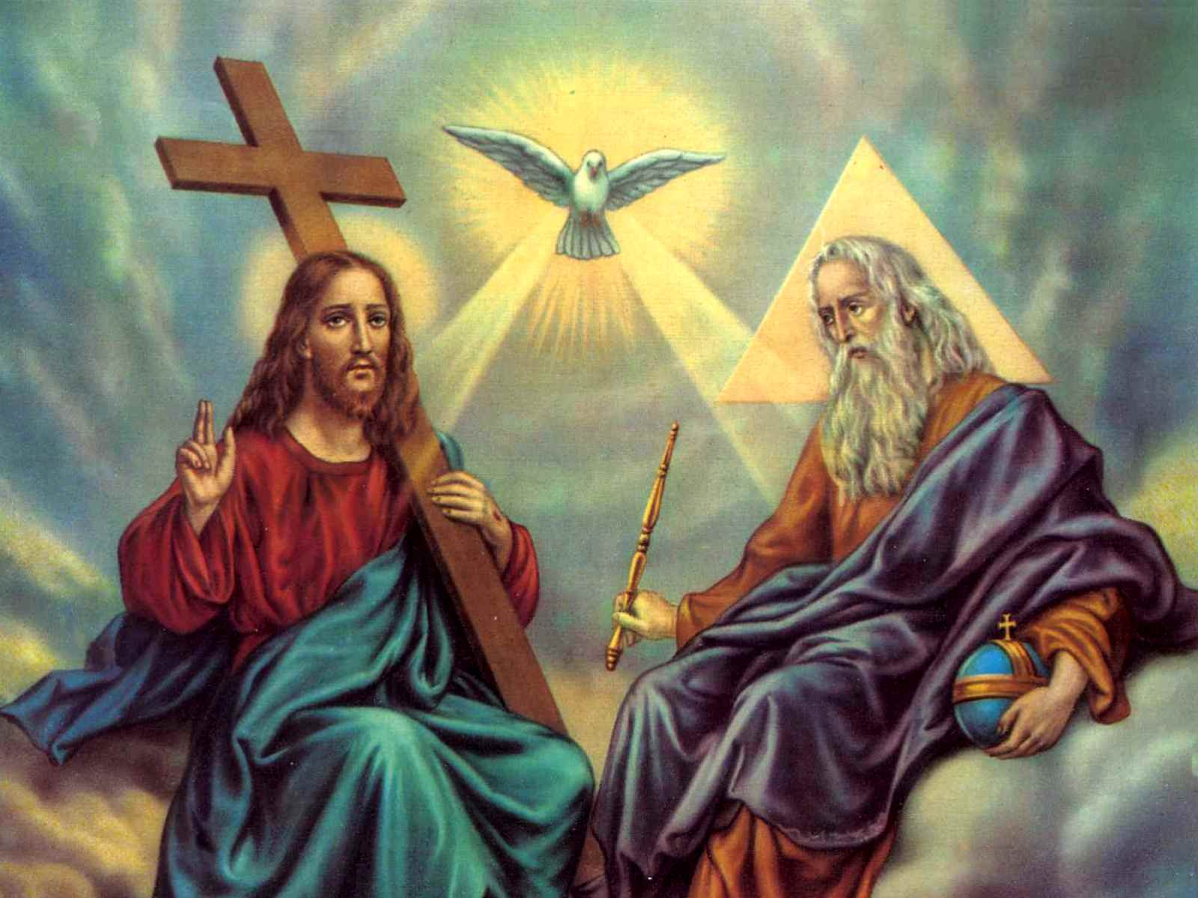
Holy Trinity Collective Worship KS 2
January 2023

Slide 2
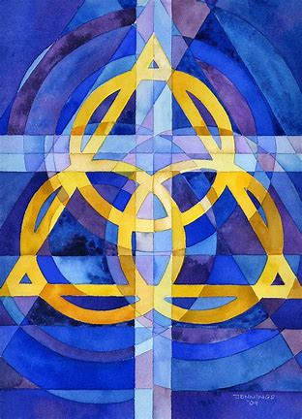
Holy Trinity Collective Worship KS 2
January 2023
Gather / Opening Hymn
Our God Saves

Slide 3
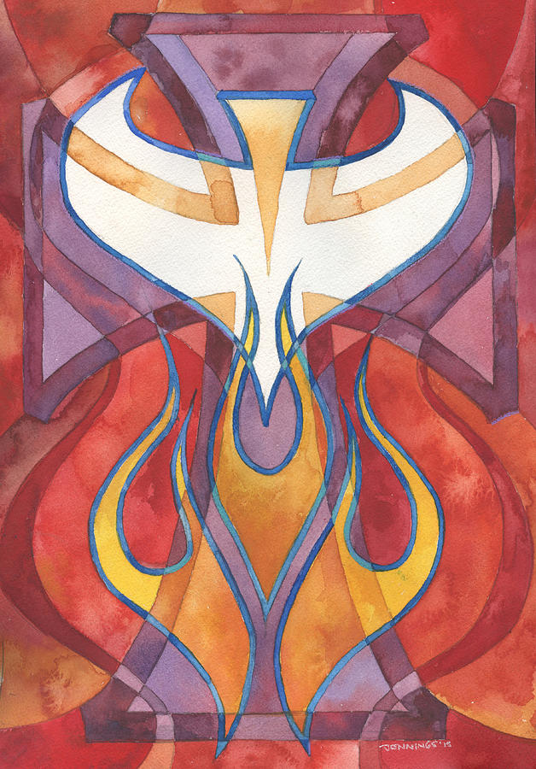
Holy Trinity Collective Worship KS 2
January 2023
Gather
Welcome
Reader: Today we hear how much God loves the world and everything in it. Let’s listen to find out more.
Opening prayer:
Generous, giving God, you loved the world so much you sent us your Son Jesus to show us how to live. Help us to show our love for the world too, respecting and protecting it so that all people can enjoy it now, and in the future. Amen.

Slide 4
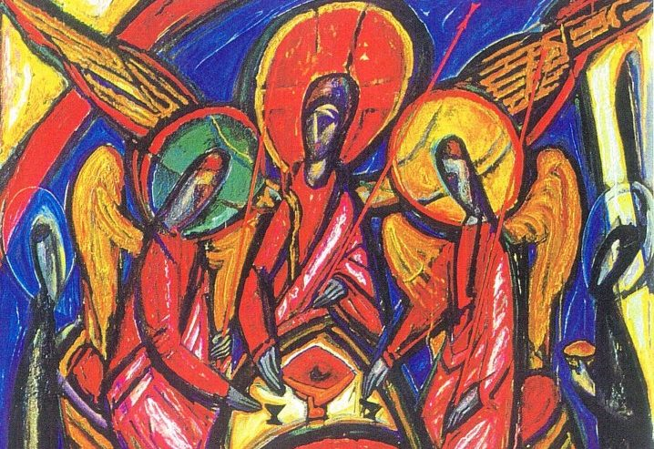
Holy Trinity Collective Worship KS 2
January 2023
Gather
Blest be God the Father, and the Only Begotten Son of God, and also the Holy Spirit: for he has shown us his merciful love.
All: In the name of the Father and of the Son, and of the Holy Spirit.
Amen.
The grace of our Lord Jesus Christ, and the love of God, and the communion of the Holy Spirit be with you all.
R. And with your spirit.

Slide 5
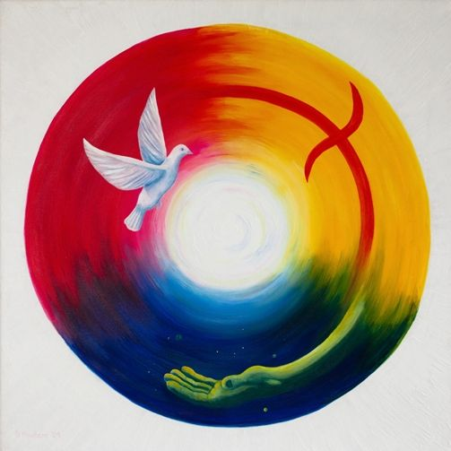
Holy Trinity Collective Worship KS 2
January 2023
Gather
Let us a Saint Joseph Community acknowledge the bad choices we have made.

Slide 6
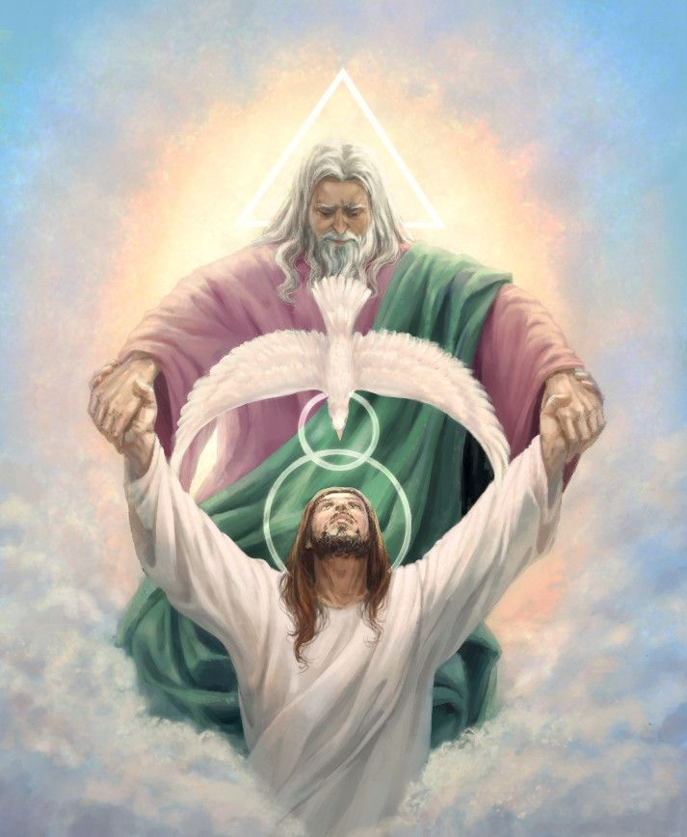
Holy Trinity Collective Worship KS 2
January 2023
Gather: Penitential Rite
I confess to almighty God and to you, my brothers and sisters, that I have greatly sinned in my thoughts and in my words, in what I have done and in what I have failed to do, They strike their breast:
through my fault, through my fault, through my most grievous fault; therefore I ask blessed Mary ever-Virgin, all the Angels and Saints, and you, my brothers and sisters, to pray for me to the Lord our God.

Slide 7
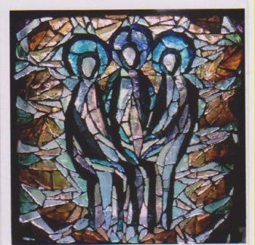
Holy Trinity Collective Worship KS 2
January 2023
The Word of God
Exodus 34:4b–6, 8–9
Early in the morning Moses went up Mount Sinai as the Lord had commanded him, taking along the two stone tablets.
Having come down in a cloud, the Lord stood with Moses there and proclaimed his name, “Lord.” Thus the Lord passed before him and cried out, “The Lord, the Lord, a merciful and gracious God, slow to anger and rich in kindness and fidelity.” Moses at once bowed down to the ground in worship. Then he said, “If I find favour with you, O Lord, do come along in our company. This is indeed a stiff-necked people; yet pardon our wickedness and sins, and receive us as your own.”
The word of the Lord.
All: Thanks be to God

Slide 8
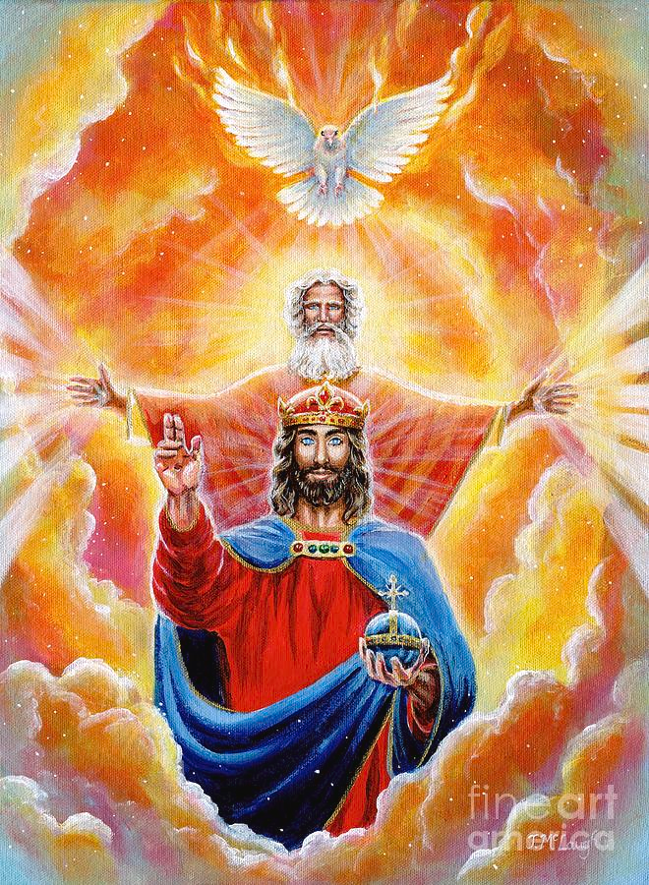
Holy Trinity Collective Worship KS 2
January 2023
The Word of God: Gospel Reading
ALLELUIA
All: Glory to the Father, the Son, and the Holy Spirit: to God who is, who was, and who is to come.
GOSPEL: John 3:16–18
God so loved the world that he gave his only Son, so that everyone who believes in him might not perish but might have eternal life. For God did not send his Son into the world to condemn the world, but that the world might be saved through him. Whoever believes in him will not be condemned, but whoever does not believe has already been condemned, because he has not believed in the name of the only Son of God.
The Word of the Lord.
All: Praise to you Lord Jesus Christ.

Slide 9
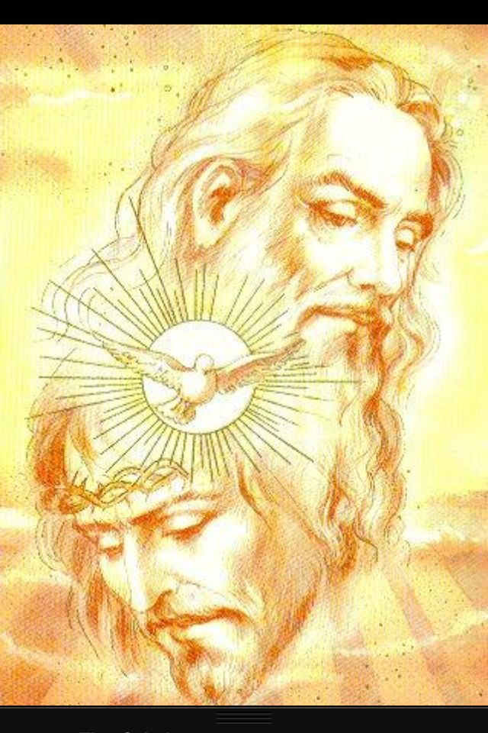
Holy Trinity Collective Worship KS 2
January 2023
Reflection on the Word of God
Today we learn that God loved the world so much that he sent his only Son, Jesus, into the world so that we might have eternal life. God loves the world - all the people, plants, animals, birds, earth and everything else in it very, very much. And God wants us to love the world too. We are called to show our love for the world and for all the people who live in it, for all the birds, flowers, trees and animals, for everything that God has created. Sometimes, we think that because we are young we can’t make a difference in the world. You may think that you have to wait to grow up until people will listen to you. Do you think that is true? We all have a responsibility to look after the world and all that is in it, to love it and care for it. Perhaps you already show how you love the world in the way you treat it? Do you recycle? Walk when you can instead of taking the car? Switch things off when you’re not using them? What else do you do to show your love for the world? What new thing will you do this week to show your love for the others and for the world?

Slide 10
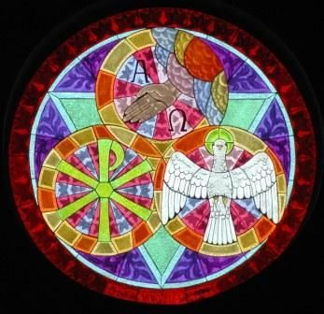
Holy Trinity Collective Worship KS 2
January 2023
Response to the Word of God
Intercessions
We pray to God, who loves the world:
We pray for world leaders: that they may make wise decisions for the good of all people and for the earth. Lord, in your mercy… All: clywed ein gweddi.
We pray for all people, especially those who are poor: that they may know that they are loved by God and that together we will all show our love for the world and each other. Lord, in your mercy…All: clywed ein gweddi.
We pray for our parish, family and friends: that we may be inspired to show our love for all and do all that we can to respect and protect God’s wonderful world. Lord, in your mercy… All: clywed ein gweddi.

Slide 11
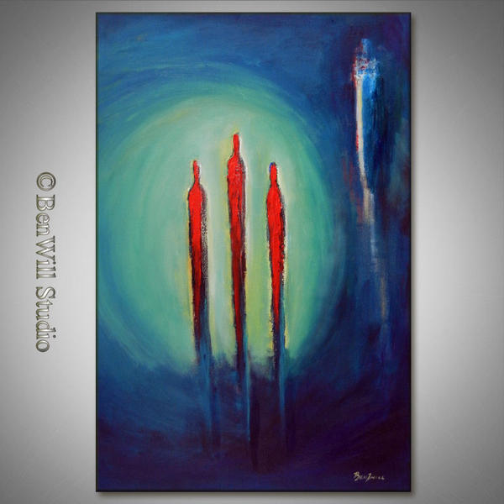
Holy Trinity Collective Worship KS 2
January 2023
Go Forth
Closing prayer: God of love, teach us how to love the world as you do. Help us to care for and respect the environment so that we may all live in harmony together, now and in the future. Amen.

Slide 12
Holy Trinity Collective Worship KS 2
January 2023
Gather / Opening Hymn
Our God Saves

