Slide 1

Reception New Starter Meeting
2025-2026
St Joseph's Catholic Primary School
Ysgol Gatholig Joseff Sant.
We grow together in God’s love as we pray, learn and play
Dyn ni’n tyfu gyda ‘n gilyddd mewn cariad Duw wrth i ni weddio, dysgu a chwarae

Slide 2

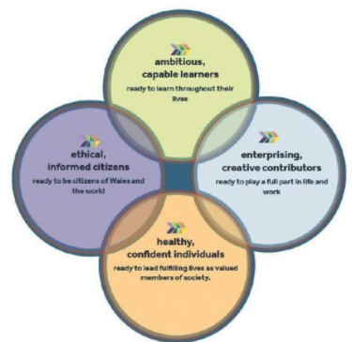
What will my child learn?
The Foundation Phase Curriculum will include the following areas of learning:
Catholic Religious Education
Health and Well-being
Literacy Language and Communication
Mathematics and Numeracy
Expressive Arts
Humanities
Science and Technology

Slide 3
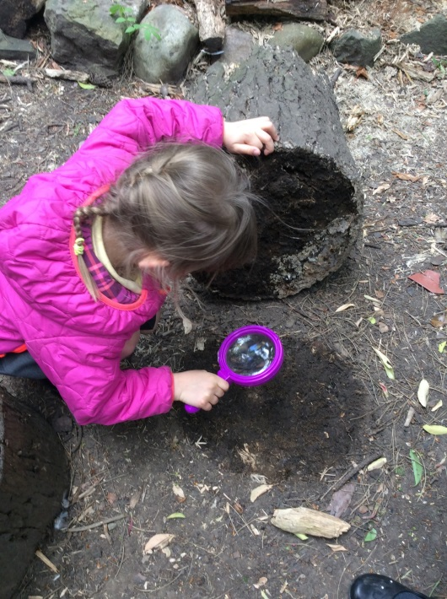
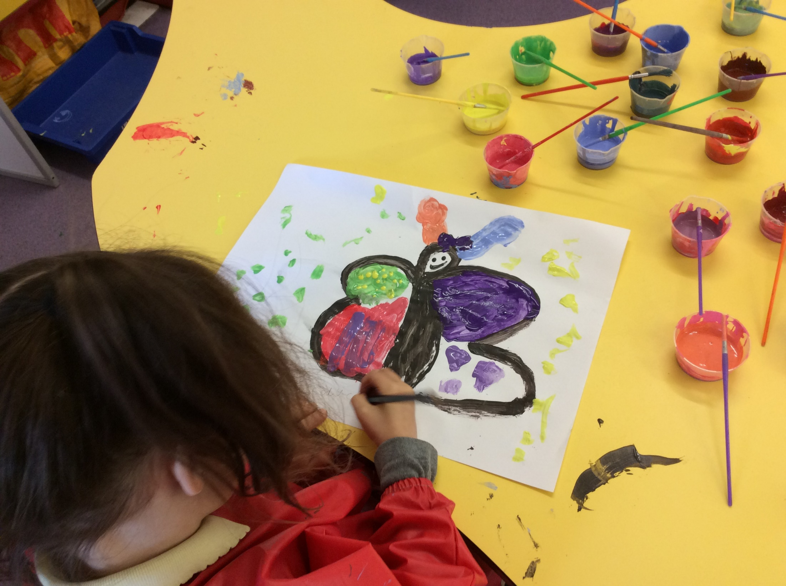
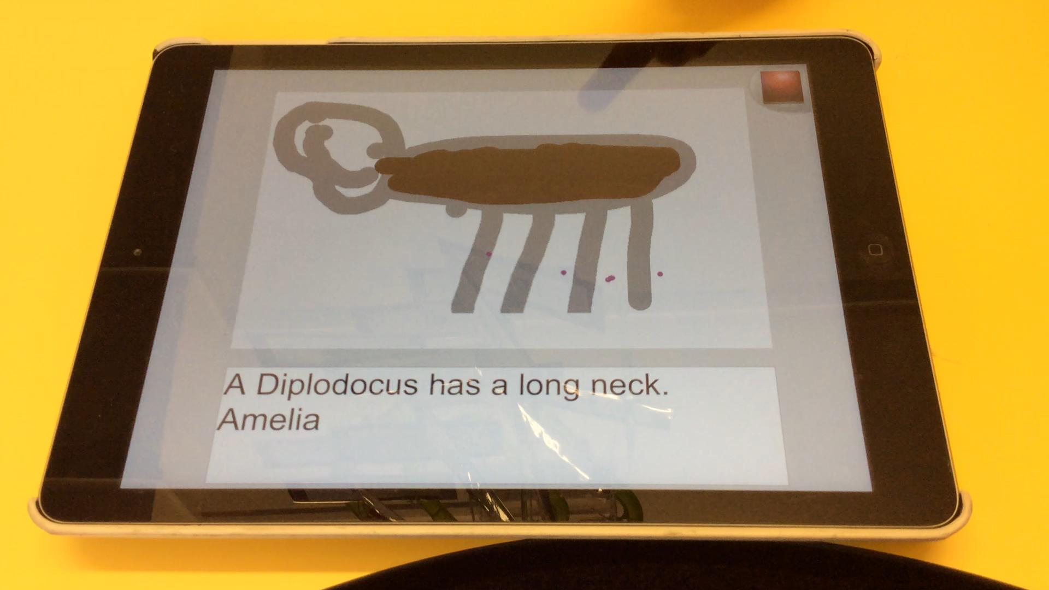
How will my child learn?
At St. Joseph's we provide opportunities for children to learn in many different ways, both indoor and outdoors, these include:
investigation and problem solving
research and finding out
individual, paired, group or whole class activities
asking and answering questions
use of iPads
visits to places of educational interest / visitors to school
role-play
designing and creative activities
participation in physical activity

Slide 4
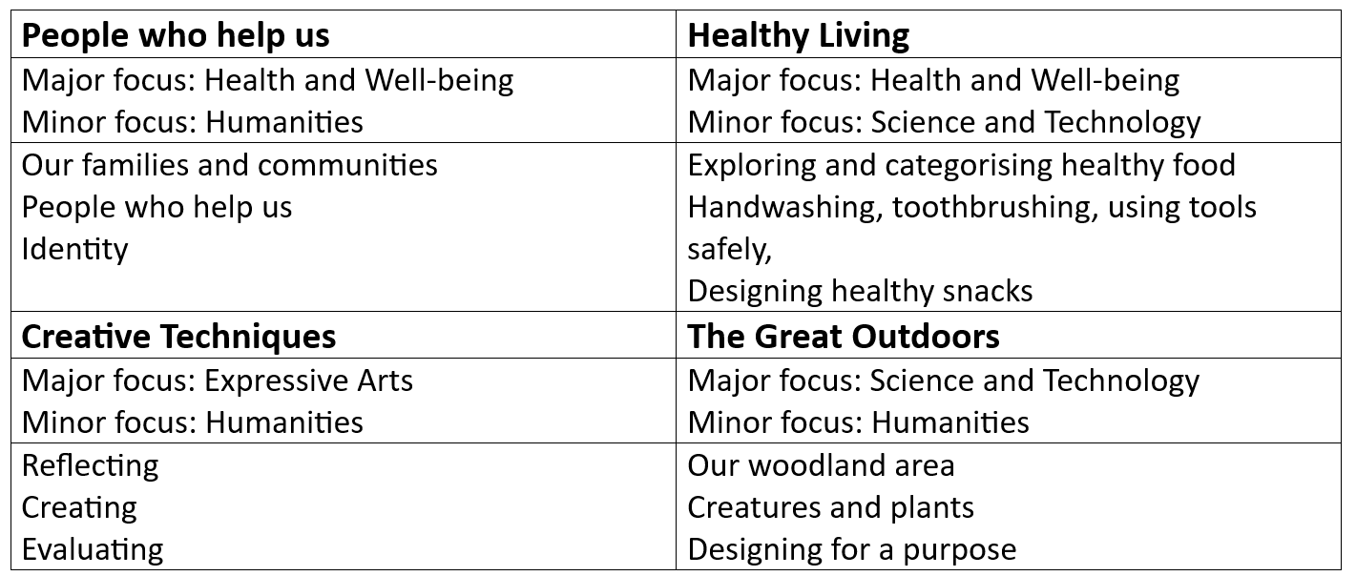
Contextual based learning

Slide 5


Religious Education
At St Joseph’s we aim to deliver a curriculum which is grounded in the teachings of the Catholic faith and the Liturgical year is reflected in the life and activities of the school throughout the year.
The school follows the Catholic Religious Education program: Religious Education Directory: To Know You More Clearly.
Throughout the academic year the children will cover 6 themed topics.
Two and half hours is dedicated to RE each week.

Slide 6

Home-School–Parish Links
Fr Scanlon and Fr Jose are regular visitors to our school.
Regular school celebrations take place with open invitations to the parish community, e.g. class Masses, whole school Family masses, services of Reconciliation, Advent service, May procession etc.
Children are encouraged to remember those in need, arranging and organising fundraising activities, supporting Fairtrade and Cafod and donating to collections for various charities.
Termly meetings to discuss children’s progress with child’s class teachers.

Slide 7
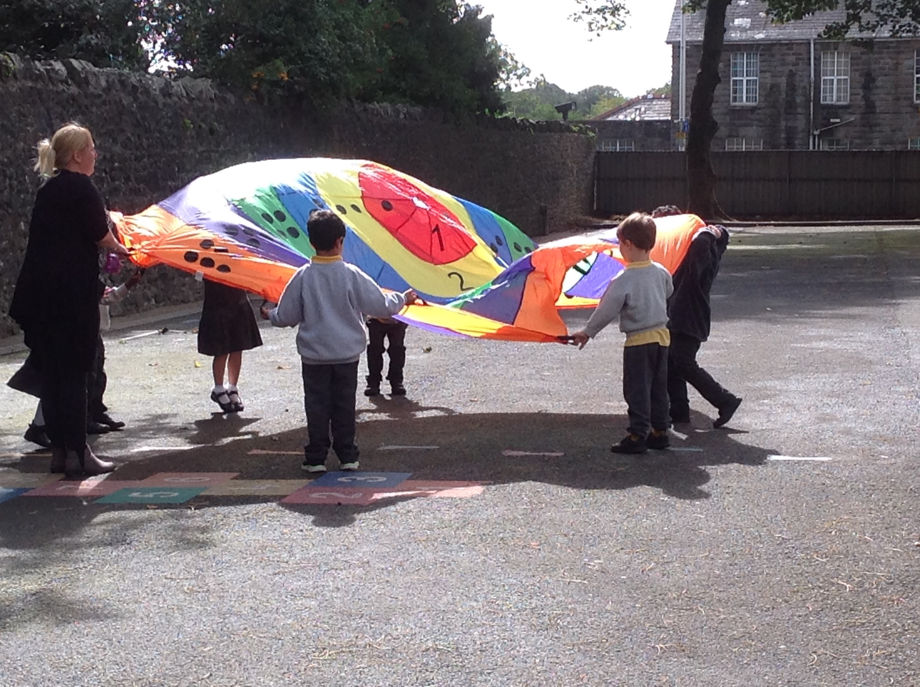
Physical Education
The school will notify you of the chosen day for PE at the start of term.
The children are to change into PE kit in school. This consists of black/blue shorts, leggings or joggers, white t-shirt and trainers. Please bring this into school with all items clearly labelled.
If your child wears earrings, please take them out before they come to school or put tape/a plaster over them. Only stud earrings are allowed, no hoops at all, for safety reasons.
If your child cannot participate in PE – we kindly ask you to inform the school.

Slide 8
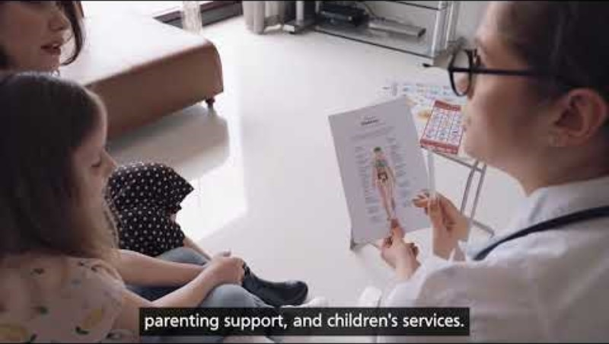
School Nurse
https://youtu.be/-_goO80d_W0

Slide 9
How can I get my child ready for school?
Can your child ……
dress/undress themselves?
Use the toilet unassisted and show good personal hygiene?
recognise numbers; count to at least 10?
recognise colours and simple shapes?
make marks; recognise and/or write their name?
recognise and sound letters
use child friendly scissors?

Slide 10
Homework
Books are sent home each week – please read with your child at least 3-4 times a week.
Weekly homework consisting of Literacy or Numeracy.
The school also has websites - we use; Bugclub for reading, Mathletics for mathematics, Letterjoin for handwriting and Hwb for IT Activities.
Homework bags are sent home on a Friday – to be returned on Wednesday of the following week.

Slide 11
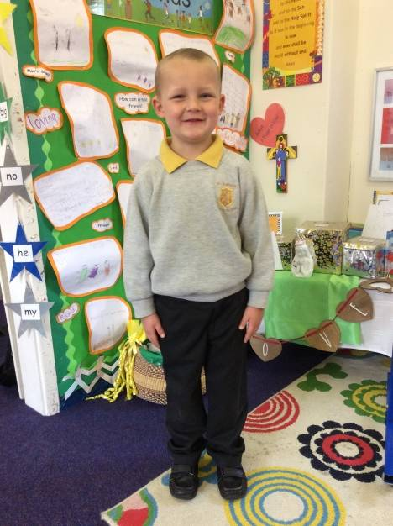
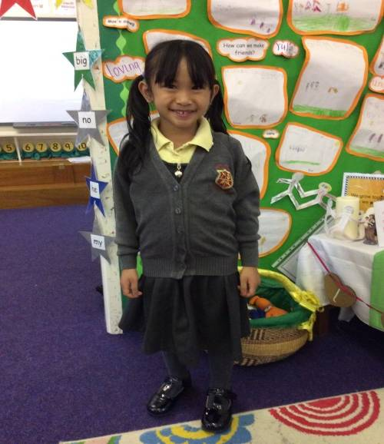
Uniform
Boys are to wear
Grey sweatshirt/ fleece
Gold polo shirt
Grey trousers/ joggers/shorts
Black shoes
Girls are to wear
Grey sweatshirt/ fleece/cardigan
Gold polo shirt
Grey trousers/ skirt
Grey pinafore dresses
Black shoes
Yellow and white gingham summer dress
Please LABEL all items of clothing!

Slide 12
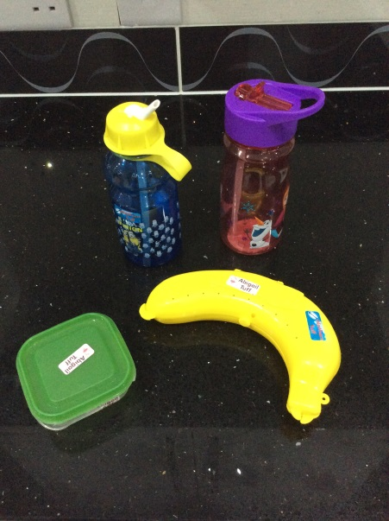
Snacks and Drinks
Playtime Snacks/Drinks
St Joseph’s is a Healthy School
We discourage the eating of sweets or chocolate at all times
Unfortunately, Birthday cakes cannot be distributed in school.
Mid-morning/playtime snack – fruit or vegetables.
Water
Pupils may bring clear water bottles from home
We encourage pupils to drink water during lessons and throughout
the school day.
Water bottles must be taken home for cleaning each night.
Please LABEL all items!

Slide 13
School Lunches
All children in the Reception class are entitled to free school meals. However, all meals must be booked online via Parentpay.
In order to be able to book school meals you must register with Parentpay. Your child’s parentpay login details will be given to you in a letter, once your child is on our SIMS system at our school. The letter gives you instructions on how to set up a Parentpay Account and your unique log in details. The website is www.parentpay.com
Packed Lunches
Hygiene routines are promoted by all staff
All children are encouraged to have washed their hands before having lunch
All children are encouraged to sit relatively quietly while eating their lunch

Slide 14
Absence and Lateness
It is YOUR responsibility to ensure your child attends school
Your child MUST be in school on time
You must telephone the school by 8.45am, on the first day of absence, if your child is going to be off school for a legitimate reason
If child continues to be absent after day 3 ie: from day 4 –medical evidence must be provided to support absence. This can be appointment card from doctor or medication prescription. If not provided then absence will be marked unauthorised and could end up with fixed penalty
Any medical appointments MUST be accompanied by an appointment card/letter. No evidence means unauthorised absence and again, could be fixed penalty
If your child is late, the Heathfield Road entrance is to be used and they must be signed in at the school office. Late arrivals will be recorded on the pupil’s attendance records
Lateness causes disruption in classes
Repeated lateness or absences could result in warning letter being sent home to the parents. If attendance does not improve, then contact will be made by us to the Education Welfare Service and a fixed penalty may be incurred
The school is always happy to help
For any further advice, please contact the school on:- Tel: (029) 20 621625

Slide 15

Communication
As you can appreciate, the school office is extremely busy all the time. Therefore, the school office is open to parents between the hours of 8.45am and 9.15am and then 3pm to 3.30pm. Unless there is an emergency or you have been contacted by school
We also communicate through Class Dojo. This enables the school to contact parents directly, or to send group/class messages. All parents will receive a unique code which connects them to Dojo.

Slide 16
Future Arrangements…
Monday 30th June
Children to attend a transition morning/afternoon 08.55 -11.25/ 1.00pm – 3.30pm
Monday 1st, Tuesday 2nd, Wednesday 3rd September 2025
These are now INSET days, your child will not attend school on these days.
Thursday 4th and Friday 5th September 2025
Children to attend school from 08.55am and to be picked up at 2.00pm.
Pupils who have been with us in Nursery will already have a ParentPay account so can book school dinners. If you are new to St Joseph’s and would like your child to have a hot lunch please inform the school secretary for the first week and this will be provided. Your ParentPay account will then be set up. If you do not wish your child to have a hot lunch, please provide them with a packed lunch.
From Monday 8th September onwards, the children are to attend school all day – 8.55am – 3.30pm

Slide 17

Parent Council & Parents’ Association
Parent council (PC)aims:
  To give parents a voice and increase their active involvement in decision-making
  To develop a partnership between the school and parents in order to support and promote the pupil’s learning and bring about change
  We meet once per half term
Parents’ Association (PA) aims:
  To raise money through a range of activities and to strengthen the school community for pupils, their families and staff
  To provide and engage in activities which support the school
  To consider suggestions from parents, staff and children as to how the funds should be spent
  To keep events as cost effective as possible to enable all families to join in
We’d love to have representation from all classes, so please consider joining one or both groups.
To join our merry band, please contact the school office.

Slide 18

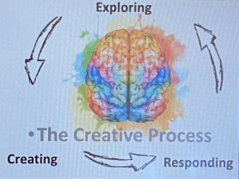
Any Questions…

