Slide 1

Remembrance Sunday Sul y Cofio Cynulliad y Dosbarth - Gwynno Sant

Slide 2
Gather Cody Capri and Jonas: Croeso cynnes i staff, theuluoedd a plant i’r gwasanaeth Dosbarth Gwynno. Cody – Capri and Jonas: A warm welcome to staff, families and childen to the Dosbarth Gwynno assembly

Slide 3
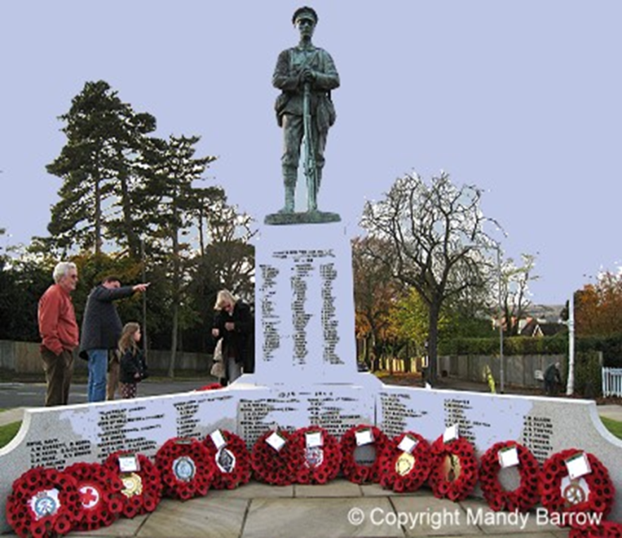
Gather Taylor and Phoebe: Today we come together as a Saint Joseph’s community to remember that November is the time of the year when we wear a red poppy in memory of those who sacrificed their lives for us during wars.

Slide 4
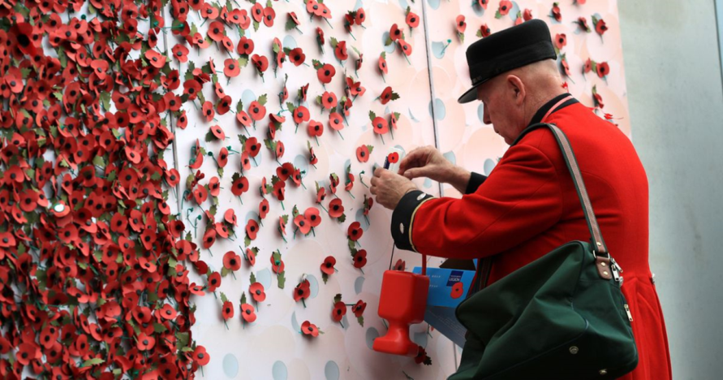
Gather What is Remembrance Day? T and Bella: Remembrance Day is on 11 November. It is a special day set aside to remember all those men and women who were killed during the two World Wars and other conflicts. At one time the day was known as Armistice Day and was renamed Remembrance Day after the Second World War. Jonas and Nancy: Remembrance Sunday is held on the second Sunday in November, which is usually the Sunday nearest to 11 November. Special services are held at war memorials and churches all over Britain.

Slide 5
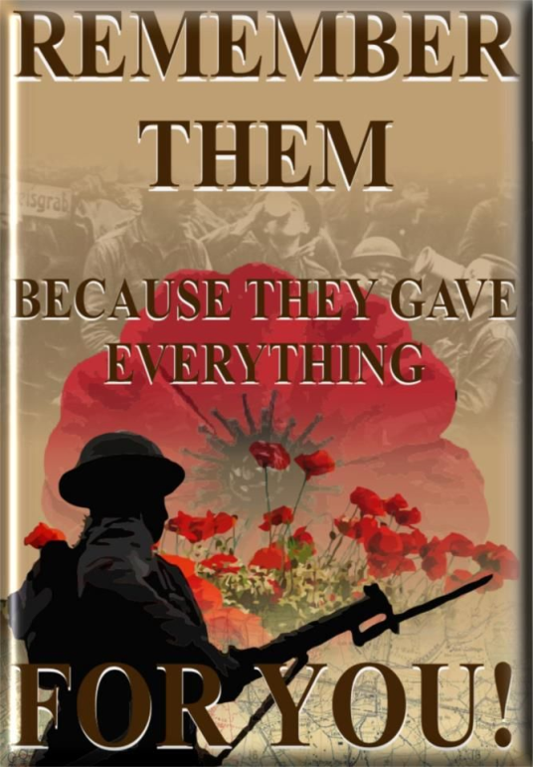
Gather Tom and Richa: The eleventh hour of the eleventh day of the eleventh month marks the signing of the Armistice, on 11th November 1918, to signal the end of World War One. At 11 am on 11 November 1918 the guns of the Western Front fell silent after more than four years continuous warfare.

Slide 6
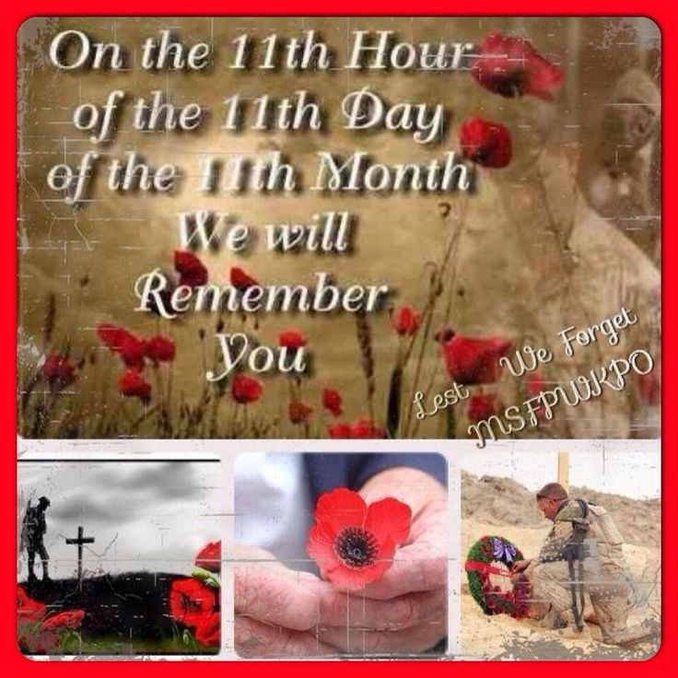
Gather Bernice and Isabella: The "Last Post" is traditionally played to introduce the two minute silence in Remembrance Day ceremonies. It is usually ' played on a bugle. (In military life, 'The Last Post' marks the end of the day and the final farewell.)

Slide 7
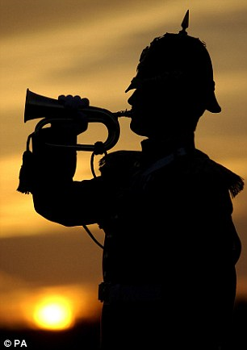
Gather Bernice and Isabella: As we gather together let us remember those who have given their life for us! Let us too fall silent in an act of remembrance for those who made it possible to enjoy the lives we have today. We ask you to close your eyes and observe a one minute silence for all those who have lost their lives in conflict around the world. Last Post Plays

Slide 8
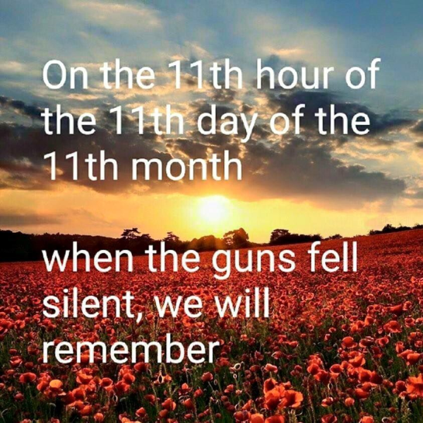
Gather Opening Prayer Bernice and Isabella: Please joinn Dosbarth Gwynno in our opening Prayer Yn enw’r Tad a Mhab a Ysbryd Glan We meet together in the presence of God. Offering this holy sacrifice of the Mass and an act of Remembrance for all those who have made the ultimate sacrifice. As a part of that we commit ourselves to work in penitence and faith for reconciliation between the nations, that all people may, together, live in freedom, justice and peace. Yn enw’r tad a Mhab a Ysbryd Glan

Slide 9
Gather Opening Hymn Mahin and Aron Let us join together as a faith community to sing this hymn of remembrance, ‘I watch the sunrise ...’

Slide 10

I watch the sunrise lighting the sky,
Casting its shadows near.
And on this morning,
Bright though it be,
I feel those shadows near me.
But you are always close to me,
following all my ways.
May I be always close to you,
following all your ways Lord.

Slide 11
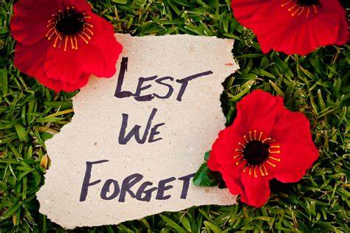
I watch the sunlight shine through the clouds,
Warming the earth below.
And at the midday life seems to say,
I feel your brightness near me.
For you are always close to me,
following all my ways.
May I be always close to you,
following all your ways Lord.

Slide 12
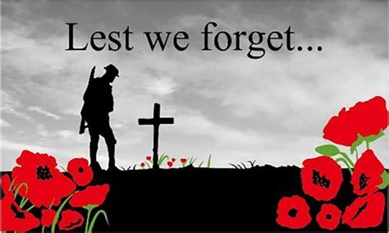
I watch the sunset, fading away,
Lighting the clouds and sea.
And as the evening, closes its eyes,
I feel your presence near me.
Yes, you are always close to me
following all my ways.
May I be always close to you,
following all your ways Lord.

Slide 13
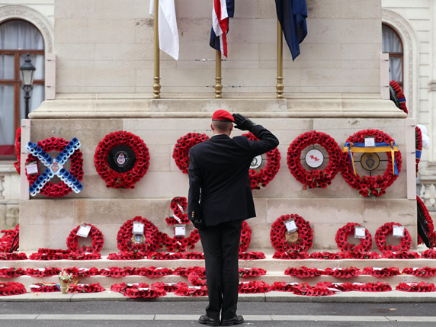
The Word of God – The First Reading Vernon: Hear these words from the New Testament to help us understand why we are called to remembrance by Christ. Machan and Sarah Rose: A reading from the the Gospel of John: Peace I leave with you; my peace I give to you. I do not give to you as the world gives. Do not let your hearts be troubled, and do not let them be afraid. Charlie and Mahin The wisdom from above is first pure, then peaceable, gentle, willing to yield, full of mercy and good fruits, without a trace of partiality or hypocrisy. And a harvest of righteousness is sown in peace for those who make peace. Sacchin and Aron This is the message we have heard from him and proclaim to you, that God is light and in him there is no darkness at all. 1 John 1:5 Pause The word of the Lord, All: Thanks be to God

Slide 14
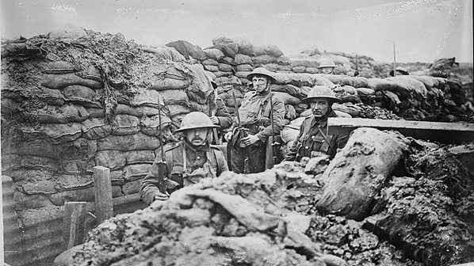
The Word of God The Responsorial Psalm Leo: The response is, I will walk in the presence of the Lord in the land of the living. All: I will walk in the presence of the Lord in the land of the living. Patrick: Gracious is the Lord and just; Yes, our God is merciful. I will walk in the presence of the Lord in the land of the living. All: I will walk in the presence of the Lord in the land of the living. Kaeban: The Lord keeps the little ones; I was brought low and God saved me. All: I will walk in the presence of the Lord in the land of the living.

Slide 15

The Word of God The Responsorial Psalm PHOEBE I believed, even when I said, “I am greatly afflicted”; I said in my alarm, “No man is dependable”. All: I will walk in the presence of the Lord in the land of the living. Francisco: Precious in the eyes of the Lord Is the death of his faithful ones. O Lord, I am your servant, You have loosed my bonds. All: I will walk in the presence of the Lord in the land of the living.

Slide 16
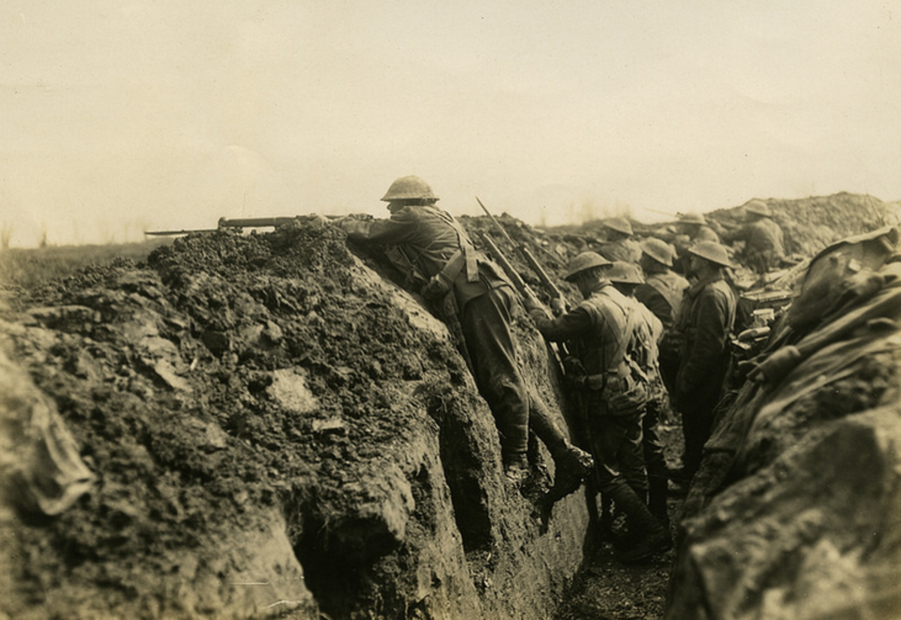
The Word of God Gospel Acclamation Bella: The Lord be with you All and with your Spirit Bella: A reading from the Holy Gospel according to Matthew All: Glory to you o Lord. (Cross, forehead, mouth and heart)

Slide 17
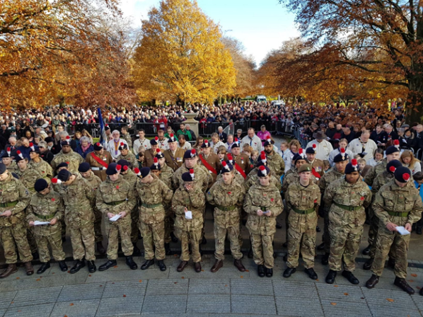
The Word of God Gospel Reading Bernice: When Jesus saw the crowds, he went up the mountain, and after he sat down his disciples came to him. Then he began to speak, and taught them, saying: "Blessed are the poor in spirit, for theirs is the kingdom of heaven. T: "Blessed are those who mourn, for they will be comforted. "Blessed are the meek, for they will inherit the earth. Phoebe:"Blessed are those who hunger and thirst for righteousness, for they will be filled. Richa: "Blessed are the merciful, for they will receive mercy. Kaeban: "Blessed are the pure in heart, for they will see God.

Slide 18
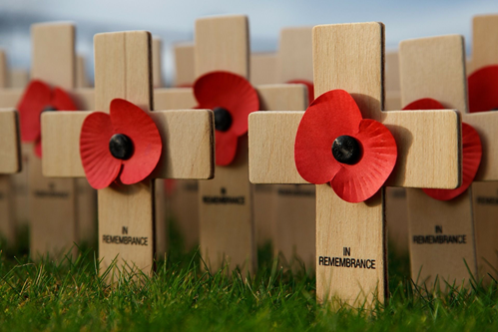
The Word of God Gospel Reading Vernon: 7 "Blessed are the peacemakers, for they will be called children of God. San: "Blessed are those who are persecuted for righteousness' sake, for theirs is the kingdom of heaven. Cody Capri: "Blessed are you when people revile you and persecute you and utter all kinds of evil against you falsely on my account. Rejoice and be glad, for your reward is great in heaven, for in the same way they persecuted the prophets who were before you.” Pause The Gospel of the Lord ALL: Thanks be to God

Slide 19
Response to The Word of God Bidding Prayers Phoebe: Let us pray for all who suffer as a result of conflict, and ask that God may give us peace: Response: Clywed ein gweddi Patrick: for the service men and women who have died in the violence of war, each one remembered by and known to God; May God give peace Response: Clywed ein gweddi Tom: God give peace for those who love them in death as in life, offering the distress of our grief and the sadness of our loss; May God give peace Response: Clywed ein gweddi

Slide 20
Response to The Word of God Bidding Prayers Sarah Rose: God give peace for all members of the armed forces who are in danger this day, remembering family, friends and all who pray for their safe return; May God give peace Response: Clywed ein gweddi Joen: God give peace for civilian women, children and men whose lives are disfigured by war or terror, calling to mind in penitence the anger and hatreds of humanity; May God give peace God give peace Response: Clywed ein gweddi

Slide 21
Response to The Word of God Bidding Prayers Sarah Rose: Godfor all who bear the burden and privilege of leadership, political, military and religious; asking for gifts of wisdom and resolve in the search for reconciliation and peace. May God give peace Response: Clywed ein gweddi God give peace O God of truth and justice, we hold before you those whose memory we cherish, and those whose names we will never know. ALL +Rest eternal grant unto them, O Lord and let light perpetual shine upon them 9 May they rest in peace and rise in glory

Slide 22
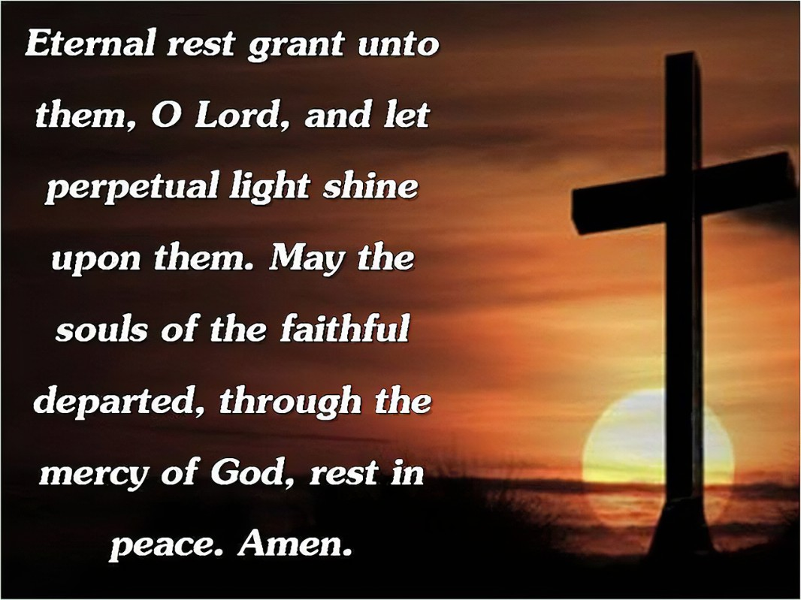
Sacchin: Let us say the prayer of eternal rest for all those people in the past who have lost their lives in conflict. ALL

Slide 23
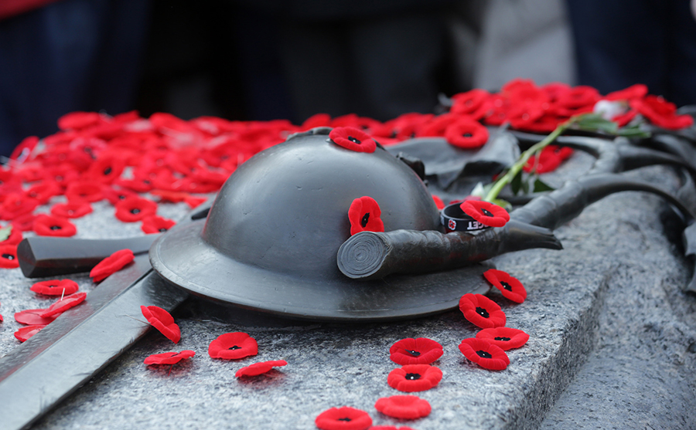
Go Forth / Mission / Rejoice Act of Commitment Jonas: Let us commit ourselves to responsible living and faithful service. The response is ‘we will’ / Byddwn ni Stanley: Will you strive for all that makes for peace? All: We will / Byddwn ni Stanley: Will you seek to heal the wounds of war? All: We will / Byddwn ni Charlie: Will you work for a just future for all humanity? All: We will / Byddwn ni

Slide 24
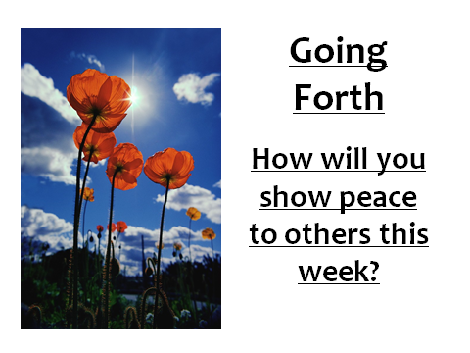
Reflection In a moment of silence let us think how each one of us will show peace to others this week.

Slide 25
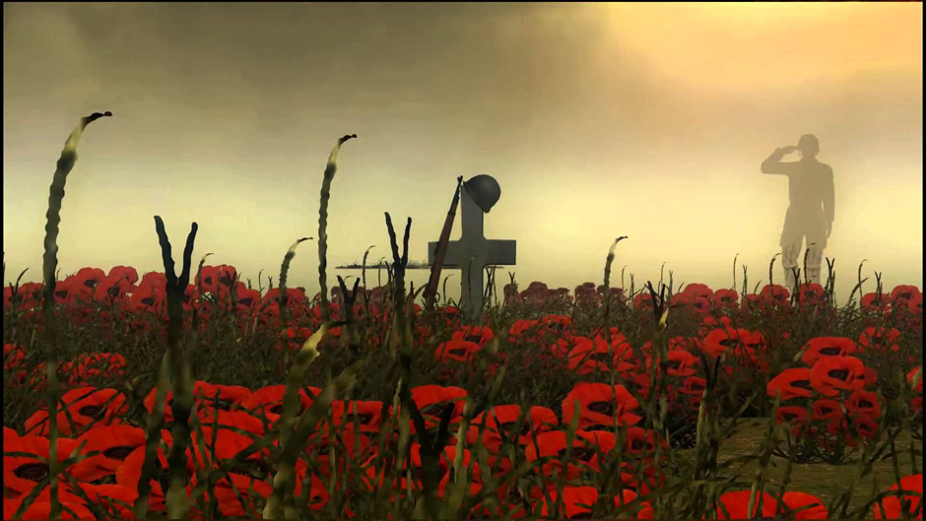
Closing Prayer Aron: Let us say the following prayer for Remembrance Day as a faith community. Yn enw’r Tad, a Mhab a Ysbryd Glan, Amen Merciful God, we offer to you the fears in us that have not yet been cast out by love: May we accept the hope you have placed in the hearts of all people, And live lives of justice, courage and mercy; through Jesus Christ our risen Redeemer. Amen Yn enw’r Tad, a Mhab a Ysbryd Glan, Amen

Slide 26
I watch the sunrise lighting the sky,
Casting its shadows near.
And on this morning,
Bright though it be,
I feel those shadows near me.
But you are always close to me,
following all my ways.
May I be always close to you,
following all your ways Lord.

Slide 27
I watch the sunlight shine through the clouds,
Warming the earth below.
And at the midday life seems to say,
I feel your brightness near me.
For you are always close to me,
following all my ways.
May I be always close to you,
following all your ways Lord.

Slide 28
I watch the sunset, fading away,
Lighting the clouds and sea.
And as the evening, closes its eyes,
I feel your presence near me.
Yes, you are always close to me
following all my ways.
May I be always close to you,
following all your ways Lord.

