Slide 1
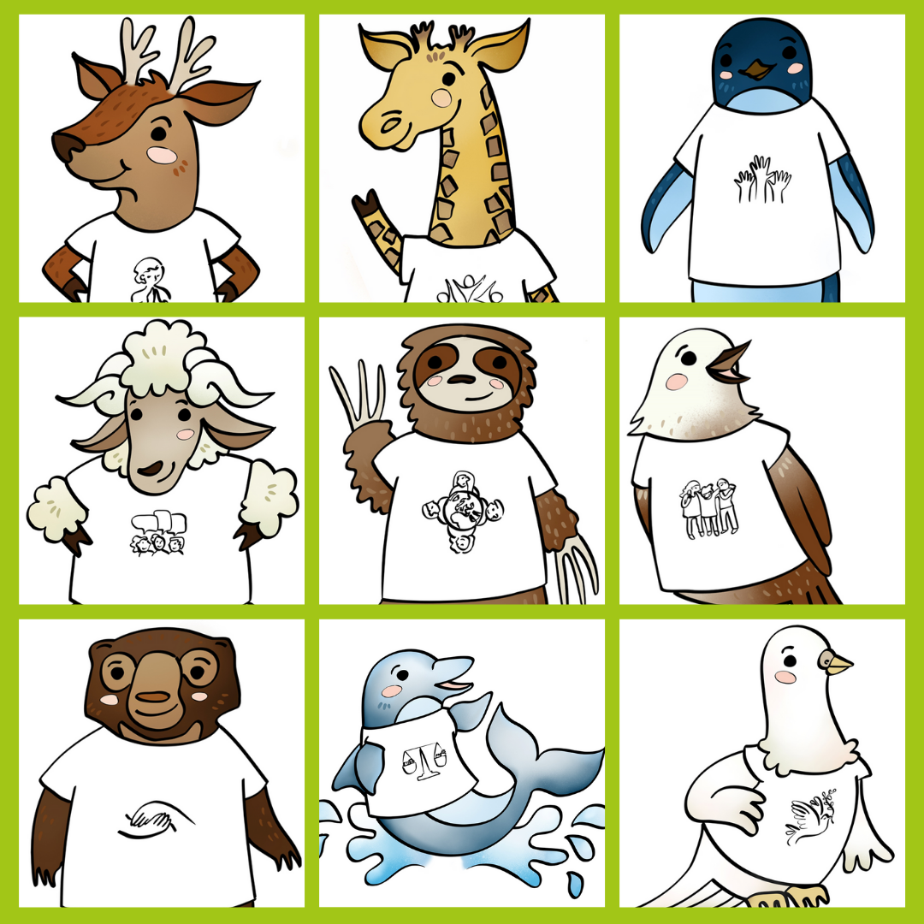
Catholic Social Teaching prayers for Primary schools

Slide 2
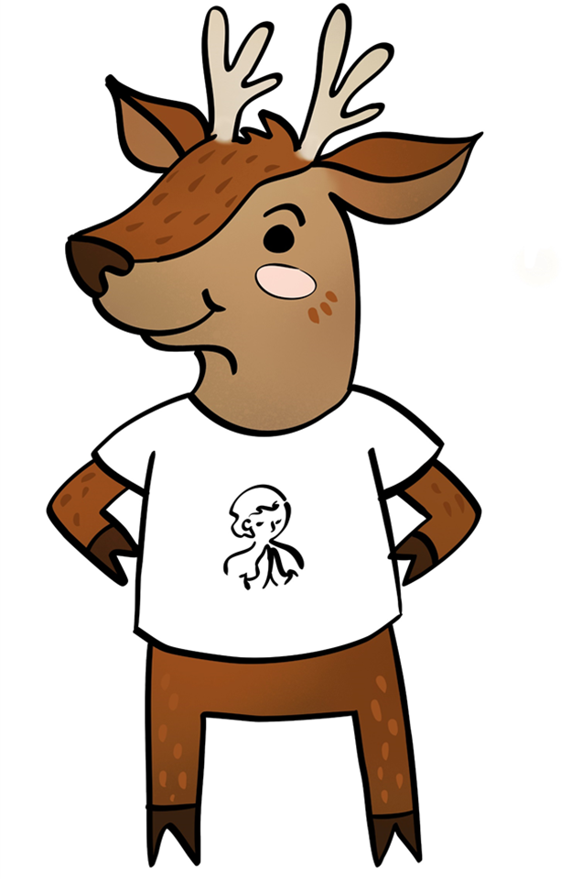
We believe
Everyone is special
(Human Dignity)
Luc the Deer

Slide 3
Loving God,
We believe that each person is special because God made us all.
Help us try to make sure all people are treated with respect and have what they need because God made them too.
Lord in your mercy
Hear our prayer
Luc the
Deer
Everyone is special
(Human Dignity)

Slide 4
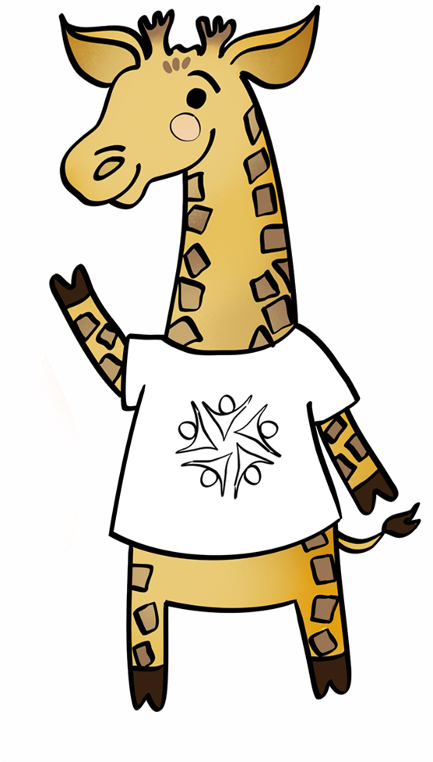
We believe in
Chikondi
the Giraffe
Thinking of
everyone
(The Common Good)

Slide 5
Loving God,
We believe that we are all brothers and sisters.
Help us to think about what is good for everyone, not just ourselves.
Lord in your mercy
Hear our prayer
Chikondi
the Giraffe
Thinking of everyone
(The Common Good)

Slide 6
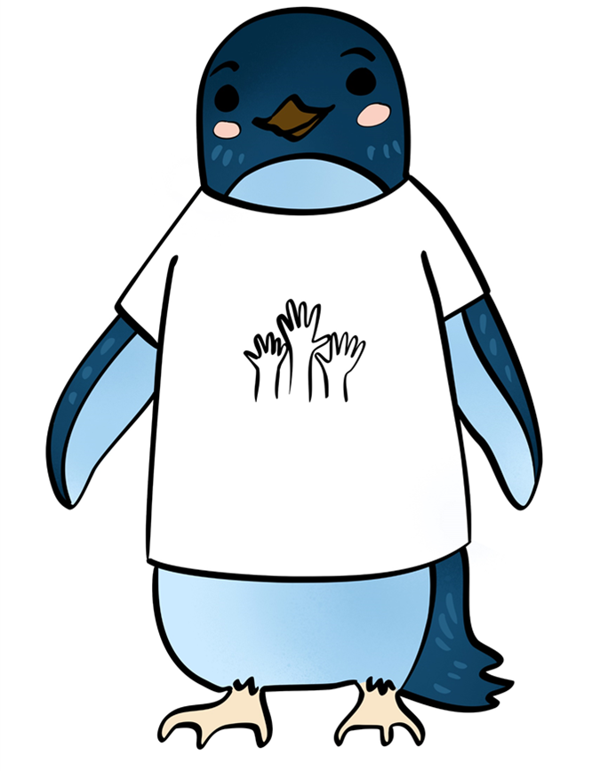
We believe in
Patariki
the Penguin
Taking part
(Participation)

Slide 7
Patariki
the Penguin
Loving God,
We believe that everyone has special gifts and talents.
Thank you for the gifts you have given us.
Help us to make sure everyone can use the talents you gave them.
Lord in your mercy
Hear our prayer
Taking part
(Participation)

Slide 8
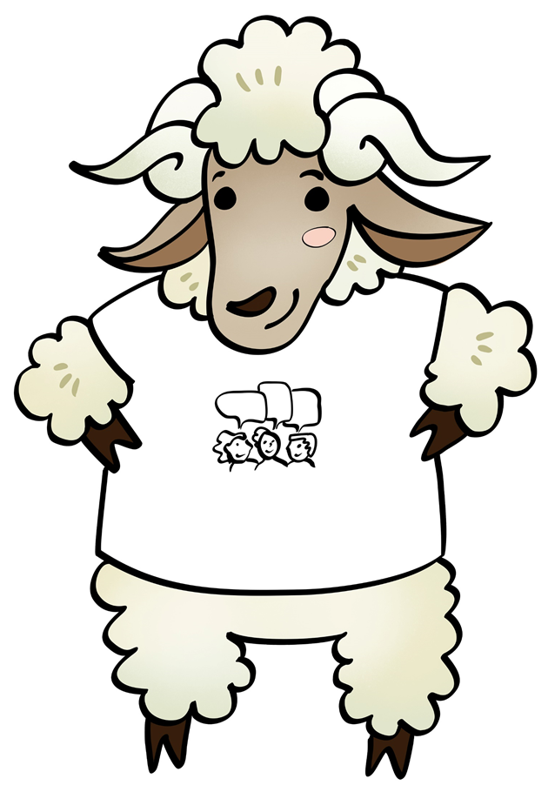
Sid
the
Sheep
We believe
Everyone
should have
a say
(Subsidiarity)

Slide 9
Sid
the
Sheep
Loving God,
We believe that people who make decisions should listen to everyone.
Help us make sure everyone is treated fairly and can have a say.
Lord in your mercy
Hear our prayer
Everyone should
have a say
(Subsidiarity)

Slide 10
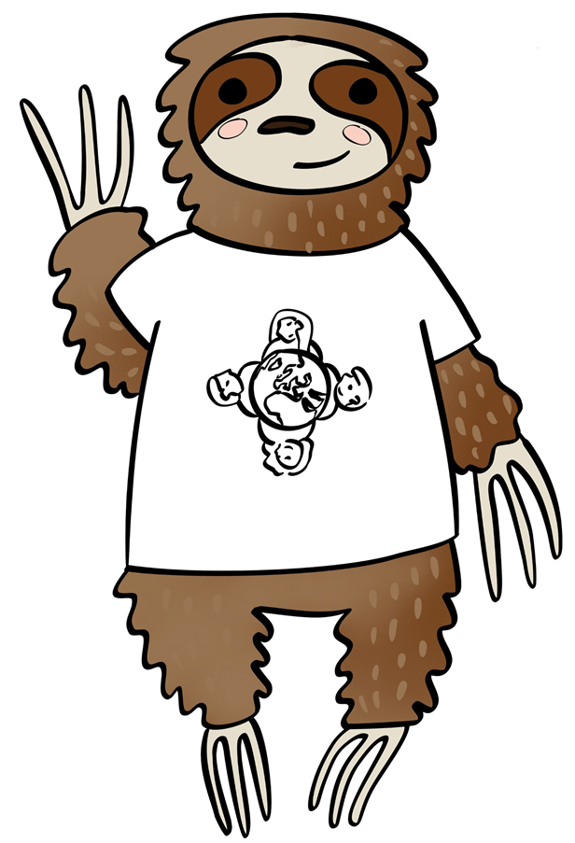
Sofia
the Sloth
We believe in
Caring for
God’s gifts
(Stewardship)

Slide 11
Sofia
the Sloth
Loving God,
We believe that the world is for everyone.
We thank you for the gift of Creation.
Help us to take care of the planet and all people who live on it.
Lord in your mercy
Hear our prayer
Caring for God’s gifts
(Stewardship)

Slide 12
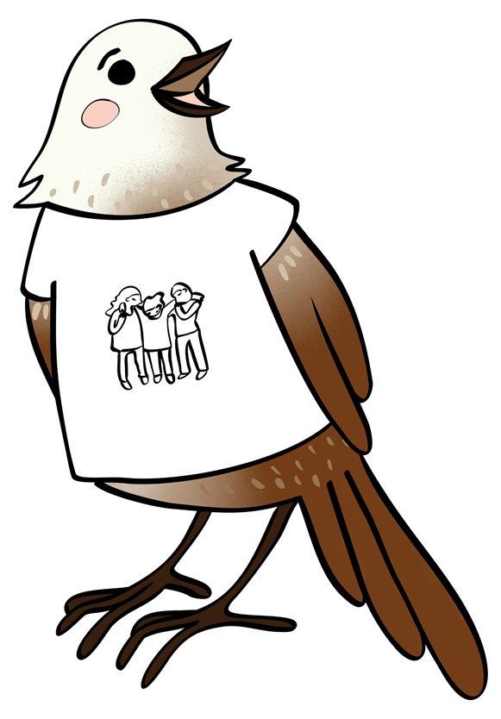
Poppy
the
Pōpokotea
We believe in
Putting people
in most
need first
(Option for the Poor)

Slide 13
Poppy
the
Pōpokotea
Loving God,
We believe that when we serve the poor we serve you.
Help us to take special care of those people most in need.
Lord in your mercy
Hear our prayer
Putting people
in most need first
(Option for the Poor)

Slide 14
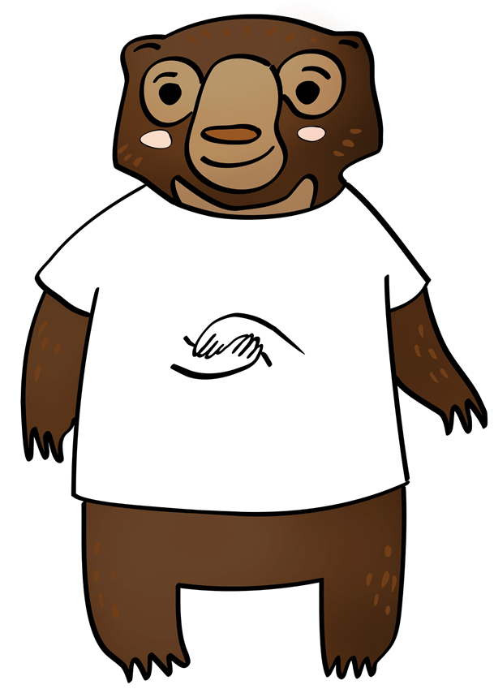
Shristi
the
Sun bear
We believe in
Showing we care
(Solidarity)

Slide 15
Shristi
the
Sun bear
Loving God,
We believe that we are one big human family.
Help us to reach out to people who are suffering or sad, showing them the love you have shown
to us.
Lord in your mercy
Hear our prayer
Showing we care
(Solidarity)

Slide 16
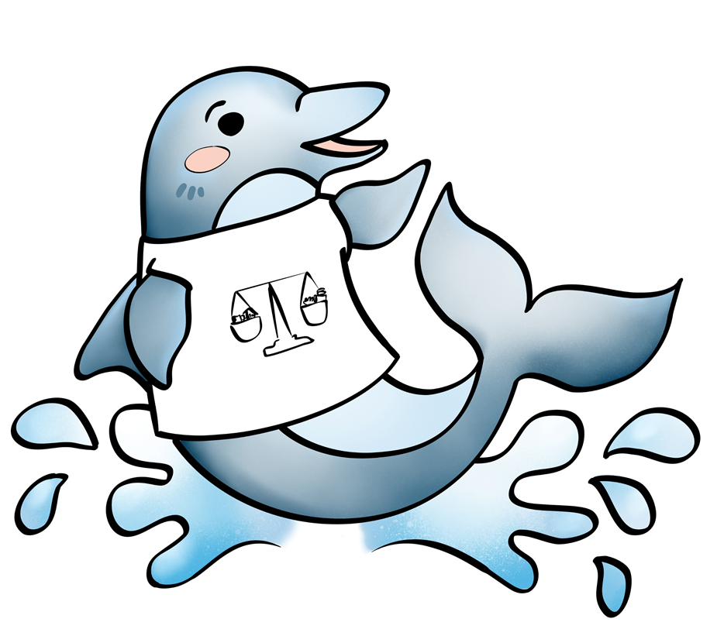
DJ
the Dolphin
We believe in
Sharing fairly
(Distributive Justice)

Slide 17
DJ
the
Dolphin
Loving God,
We believe that the gifts of the world should be shared fairly.
Help us to always be grateful for what we have and share generously with others.
Lord in your mercy
Hear our prayer
Sharing fairly
(Distributive Justice)

Slide 18
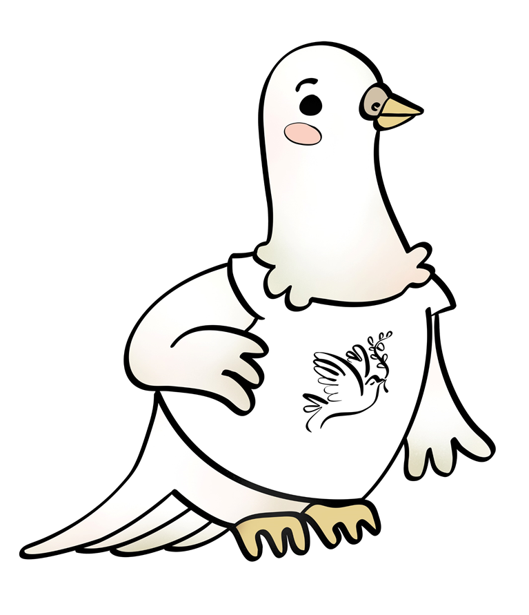
We believe in
Daisy
the Dove
Being peacemakers
(Promoting Peace)

Slide 19
Loving God,
We believe you want to bring your peace to our homes, our communities and our world.
Help us to be peacemakers, listening to and loving each other.
Lord in your mercy
Hear our prayer
Daisy
the Dove
Being peacemakers
(Promoting Peace)

Slide 20
We believe in
Catholic Social Teaching

