Slide 1
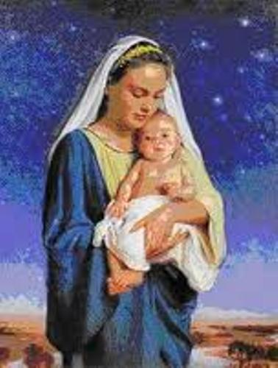
The Month of May is dedicated to Mary the Mother of Jesus

Slide 2
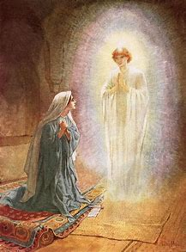
The Blessed Virgin Mary
Joseph: Today we are going to be learning about Mary the mother of Jesus and why the month of May is dedicated to her.
Kyliesha: We will begin by watching the events of the Annunciation, when Mary was told she was going to be the mother of Jesus and to help us when we celebrate a prayer service that will remind us of her importance in our Catholic faith.

Slide 3
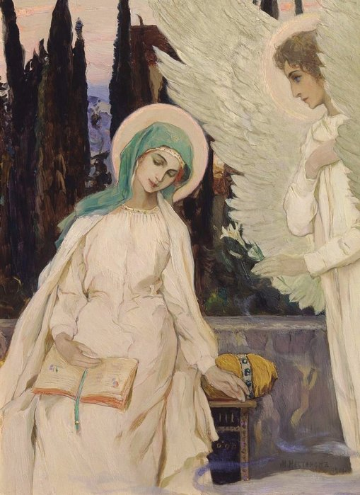
The Annunciation
V

Slide 4
We worked collaboratively to think of words that we thought best described Mary. They were:
Wonderful
Amazing
Holy a servant of God
Good
Wise
Perfect mother

Slide 5
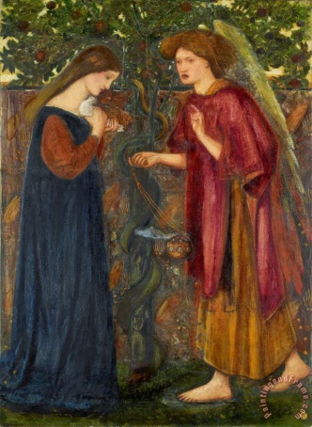
Collective Worship
Gather
.Sherina: Let us begin with the sign of God’s love: o
All: Yn enw’r Tad a Mab a Ysbryd Glan. Amen.
Emilia: - Opening Prayer:
Today Lord we celebrate and we honour Mary who followed your will all her life. She said “yes” to what God asked of her. Mary is a model of faith for all of us.
All: We honour you, Mary, as the Mother of God and our mother too. Amen.

Slide 6
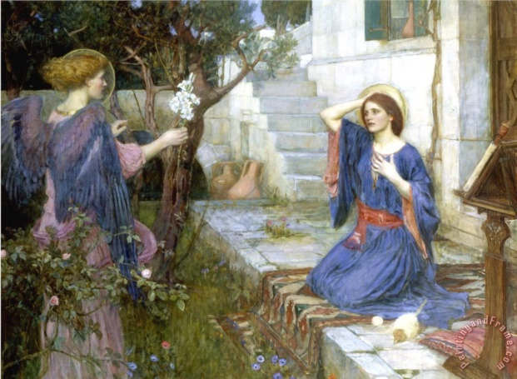
Fia: The Word of God
Gospel Reading
A reading from the Holy Gospel according to Luke (1: 26-38)
All: Glory to you o Lord (Cross yourself on the forehead, mouth and heart)

Slide 7
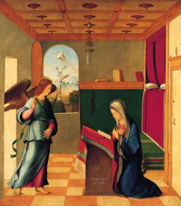
Charlie , jens and Imogen:
The angel came to Mary and said,
Sam: “Peace be with you! The Lord is with you and has greatly blessed you!”
Charlie , jens and Imogen:
Mary was deeply troubled by the angel’s message. The angel said to her,
Sam: “Don’t be afraid, Mary; God has been gracious to you. You will become pregnant and give birth to a son, and you will name him Jesus. He will be great and will be called the Son of the Most High God.

Slide 8
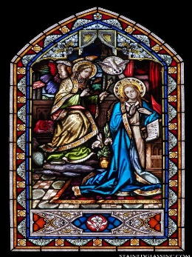
Mary said to the angel,
Ava: “How, then, can this be?”
Charlie , Jens and Imogen:
And the angel answered,
Sam: “The Holy Spirit will come on you, and God’s power will rest on you. For this reason the holy child will be called the Son of God.
Charlie , jens and Imogen:
Mary said,
Ava: “I am the Lord’s servant, may it happen to me as you have said”.
Pause
The Gospel of the Lord.
All: Praise to you, Lord Jesus Christ.

Slide 9
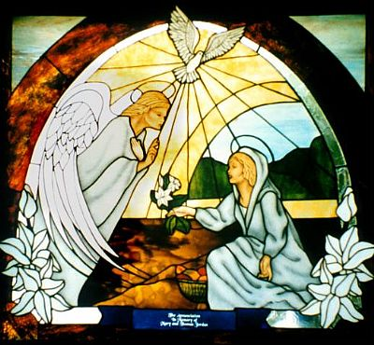
Response to the Word of the Lord
We ask Mary for her prayers that she may intercede with God for us. The response is
Praise to you, Lord Jesus Christ.
All: Praise to you, Lord Jesus Christ.
Mary was the Mother of Jesus. May we also bring Jesus into the world for others. RESPONSE
All: Praise to you, Lord Jesus Christ.

Slide 10
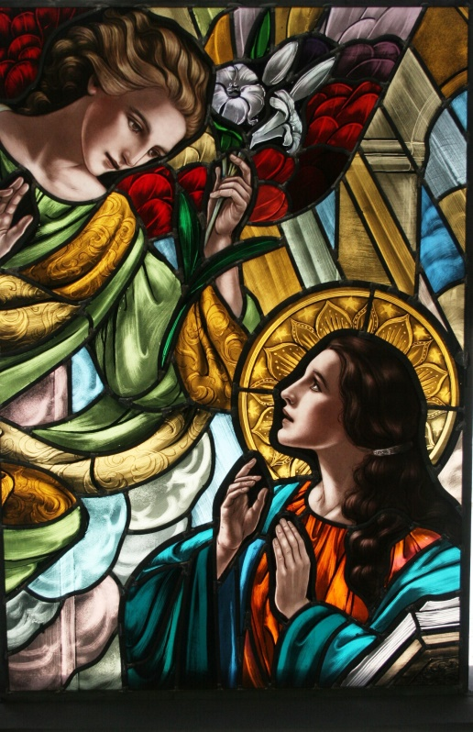
Mary gave the glory to God through her life. May we give praise to God in all we do. RESPONSE.
All: Praise to you, Lord Jesus Christ.
Mary was a person of courage. May we do what we know is right. RESPONSE
All: Praise to you, Lord Jesus Christ.

Slide 11
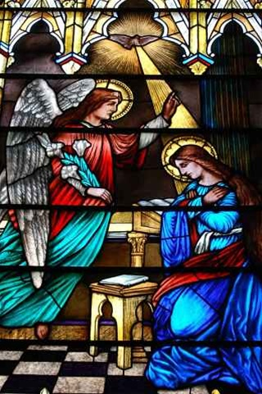
Go Forth
Let us go forth and try to follow the strength, bravery and holiness shown by the Virgin Mary at the Annunciation by saying her special prayer
Dwylo ar hyd a llygaid a gau – hand together eyes closed
Hail Mary…..

Slide 12
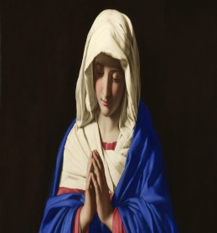
Closing Prayer
Mary was always faithful to God’s will. She was faithful at the stable in Bethlehem, she was faithful on the flight to Egypt, and she was faithful at the foot of the cross. We should follow her example and be faithful to God’s will in our lives.
All: Father, help us to do your will even when it is difficult. Help us to be like Mary and respond YES to what He asks of us. We ask this through our Lord Jesus Christ and your Holy Spirit. Amen.
We end our liturgy with the sign of the cross.
All: Yn enw’r Tad a Mab a Ysbryd Glan Amen.

Slide 13
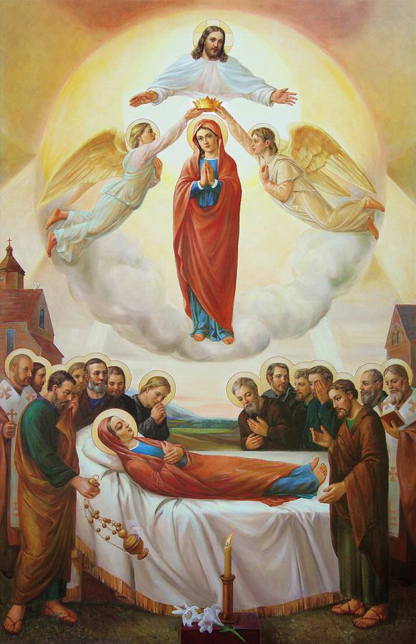
Mary is special because …..
She is a model to mothers
She was born without sin
She was truly holy
She was totally dedicated to
protecting
Jesus during his time on earth,
She was present at his death and
witnessed the risen Jesus after
his crucifixion
At her Assumption, her death, Mary , like her Son Jesus risen from the dead, and taken bodily to heaven.

Slide 14

Group One / Grwp Un | Group Two / Grwp Dau | Group Three / Grwp Tri
Group One Your task is to create a circle thinking map to show the different words that you think best describe Mary the mother of Jesus. Work with your shoulder partner and then your group to help you. | Group two Your task is to make linked with the qualities of Mary and to reflect on when this has happened in your life and how it made you feel. | Group Three Your tasks is to Write a group prayer asking Mary to intercede (help us) Ms. Houston has written key words and phrases to help you write this prayer.
.

Slide 15
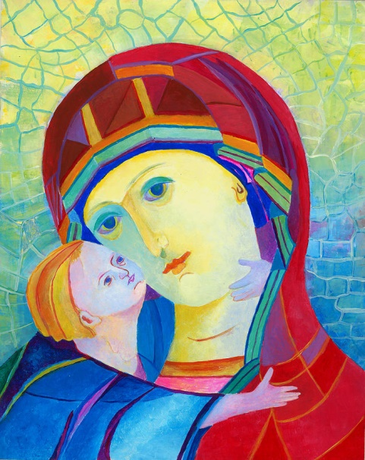
Plenary: Reflecting on my learning
What have I learnt today ?
On your whiteboards I want you to think about the word you chose to explain your feelings about Mary and choose another that show how your learning in the lesson has helped you to understand more about the importance of Mary in our Catholic faith.
I

Slide 16
Closing Prayer
Mary was always faithful to God’s will. She was faithful at the stable in Bethlehem, she was faithful on the flight to Egypt, and she was faithful at the foot of the cross. We should follow her example and be faithful to God’s will in our lives.
All: Father, help us to do your will even when it is difficult. Help us to be like Mary and respond YES to what He asks of us. We ask this through our Lord Jesus Christ and your Holy Spirit. Amen.
We end our liturgy with the sign of the cross.
All: Yn enw’r Tad a Mab a Ysbryd Glan Amen.

