Slide 1


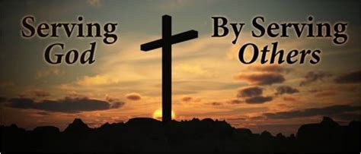
Gather: We are called to serve
We gather as one … … …
Let us join our hands and make the sign of the cross.
‘ In the name of the Father and of the Son and of the Holy Spirit. Amen’

Slide 2

Gather: We are called to serve
Opening Prayer
Father in Heaven,
ever-living source of all that is good,
keep me faithful in serving You.
Help me to drink of Christ's Truth,
and fill my heart with His Love
so that I may serve You in faith
and love and reach eternal life.
In the Sacrament of the Eucharist
You give me the joy of sharing Your Life.
Keep me in Your presence.
Let me never be separated from You
and help me to do Your Will. Amen.

Slide 3
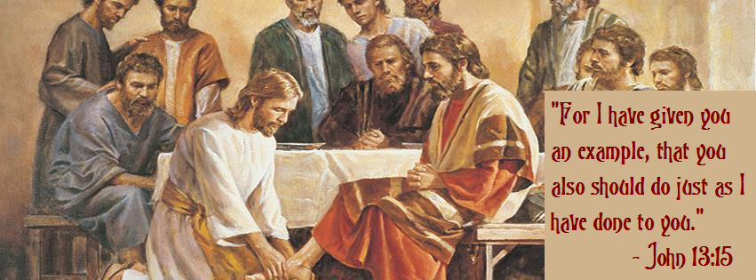
Gather: We are called to serve
Opening Hymn: Blessed Assurance
Blessed Assurance
Blessed assurance, Jesus is mine!
Oh, what a foretaste of glory divine!
Heir of salvation, purchase of God,
Born of His Spirit, washed in His blood
Chorus:
This is my story, this is my song,
Praising my Saviour all the day long;
This is my story, this is my song,
Praising my Saviour all the day long.

Slide 4

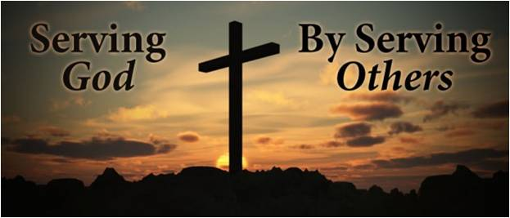
Gather: Called to Serve
We think about the ways in which we are called to serve others. Making sure you are fully prepared for your future and for the world of work is key to this, as is your response to God’s call to each one of us to serve.
What is our mission this week?
Our mission is to think about how God calls us to serve others. Can we take time this week to act in ways that help those in need? Do we give enough time in prayer to listen to God’s call to each one of us?

Slide 5

The Word of the Lord
Gospel reading
A reading from St. Mark’s Gospel
After six days Jesus took Peter, James and John with him and led them up a high mountain, where they were all alone. There he was transfigured before them. His clothes became dazzling white, whiter than anyone in the world could bleach them. And there appeared before them Elijah and Moses, who were talking with Jesus.
Peter said to Jesus, “Rabbi, it is good for us to be here. Let us put up three shelters—one for you, one for Moses and one for Elijah.” Then a cloud appeared and covered them, and a voice came from the cloud: “This is my Son, whom I love. Listen to him!” Suddenly, when they looked around, they no longer saw anyone with them except Jesus. As they were coming down the mountain, Jesus gave them orders not to tell anyone what they had seen until the Son of Man had risen from the dead. 10 They kept the matter to themselves, discussing what “rising from the dead” meant.
The Word of the Lord Response: Thanks be to God
Lord Jesus, as we go about our daily routines this week help us to see your glory in the people we work with, our neighbours and friends as well as those we find hard to get on with. In all our conversations help us to listen carefully, not only to what others are saying, but also to what you are saying in each encounter. Lord, in your mercy….Hear our prayer

Slide 6

Reflection on the Word of God
Confidence
We focus today on the value of confidence. Confidence means feeling sure of yourself and your abilities — not in an arrogant way, but in a realistic, secure way. Confidence isn't about feeling superior to others. It's a quiet inner knowledge that you're capable. That confidence is rooted in the belief that we are all made in God’s image and are all called to love God and love others.
Lord, sometimes I forget who I am in you and start looking to the world to tell me who I am. On the days when my confidence is fading fast, build me up again. Remind me of the simple truth that confidence can only be found in chasing after you. I can walk around confident knowing I am loved and made in your image. Help me remember these things.
Lord, in your mercy…Hear our prayer

Slide 7
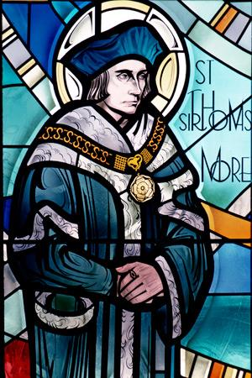
Response to the Word: We Reflect Together
God’s Servant First
As St.Thomas More got older he went to Oxford University because he felt called to become a lawyer. When he finished at Oxford he went to work in London. He stayed with some monks and wondered if he would like to give his life to God as a monk. Thomas was torn between serving God and serving people. He decided to do both: he would be a lawyer serving people, but he would serve God by being honest and good.
We are all called to be God’s servant in whatever work we may do.
Lord, you call us to your service and continue your saving work among us.
Send your Spirit to make us strong in faith and active in good works.
Give us strength and joy in serving you as followers of Christ.
Lord, in your mercy…Hear our prayer

Slide 8
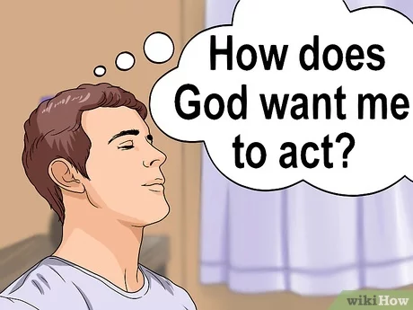
We Reflect Together
Regardless of where you are on your path of faith there are plenty of ways you can serve God every day. From actively going out of your way to serve Him, to simply having love in your heart and being a good person; serving God can be done in almost every aspect of your life.
Lord, help us to make wise choices in our lives so that in all that we do we are serving You and others.
Lord, in your mercy….Hear our prayer
Lord, we remember that serving You can be as simple as helping out someone with a small task or favour, and doesn’t have to be a big grand gesture. Help us to put others before ourselves.
Lord, in your mercy….Hear our prayer

Slide 9

Go Forth
One thing that we have seen all over the world during the pandemic is that kindness is prevailing in uncertain times. People have come together to sing on balconies in Italy, others have set up groups to offer support to the elderly or vulnerable - like collecting groceries or calling them for a chat. We have heard stories of people having virtual movie nights and creating choreographed dances over video chat to share with the world.
Get involved with acts of kindness:
Call a friend that you haven’t spoken to for a while.
Tell a family member how much you love and appreciate them.
Make a cup of tea for someone you live with.
Help with a household chore at home.
Tell someone you know that you are proud of them.
Tell someone you know why you are thankful for them.
Send someone you know a picture of a cute animal.
Spend time playing with your pet.
Reach out to call a friend or family member who you haven’t spent much time with.
Donate to a charity.

Slide 10
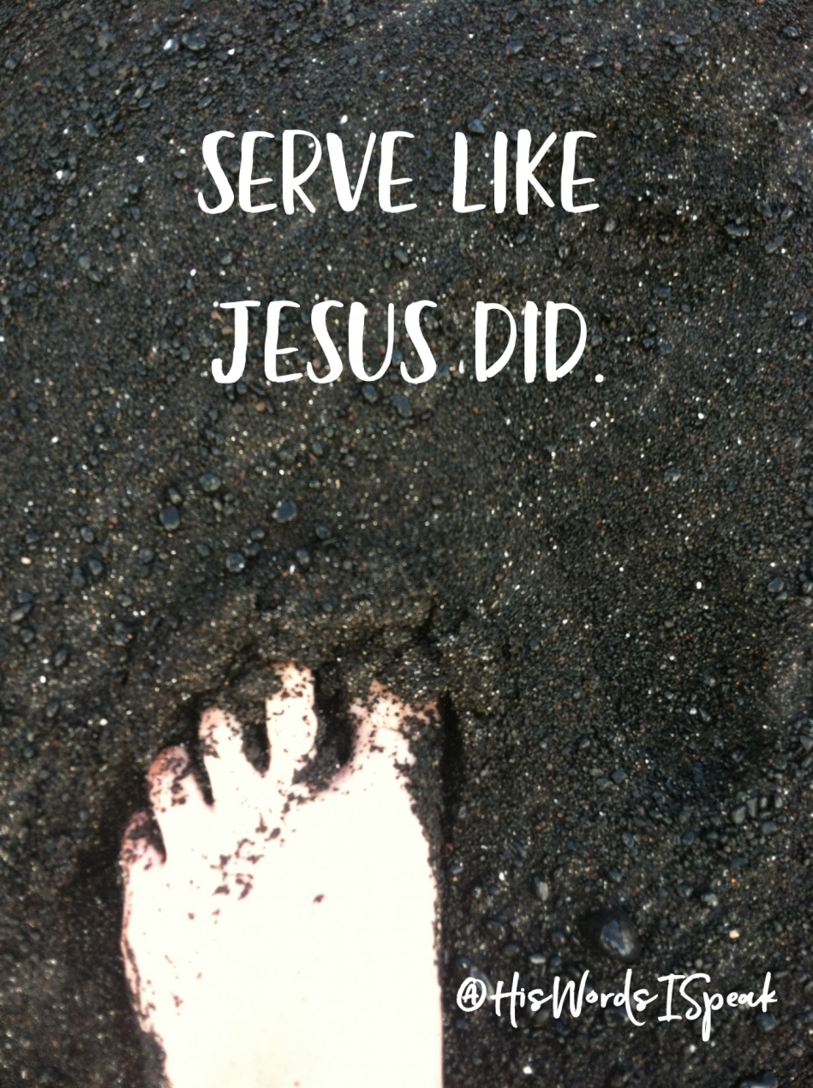
Go Forth: Closing Prayer
Lord, show us what we should do this Lent.
Remind us to pray to You, to thank You, to love You,
to hear from You each and every day in Lent.
Lord, in your mercy….Hear our prayer.
Lord, pour out your Spirit upon us and lead us to walk alongside one another in solidarity and love. Together may we reshape the world.
Lord, in your mercy…Hear our prayer.
Lord, lead us to make a change to our own lives so that all your people may flourish. Grant us the courage to stand up for what is right and to call on others to do the same.
Amen

Slide 11
Gather: We are called to serve
Opening Hymn: Blessed Assurance
Blessed Assurance
Blessed assurance, Jesus is mine!
Oh, what a foretaste of glory divine!
Heir of salvation, purchase of God,
Born of His Spirit, washed in His blood
Chorus:
This is my story, this is my song,
Praising my Saviour all the day long;
This is my story, this is my song,
Praising my Saviour all the day long.

