Slide 1



Gather: caring for each other
We gather as one … … …
Let us join our hands and make the sign of the cross.
‘ In the name of the Father and of the Son and of the Holy Spirit. Amen’

Slide 2
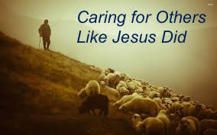
Gather: caring for each other
Opening Prayer
Dear God,
There are so many people in this world who are in need. Please show us how we can help. Use us Lord for Your glory and use us to be a blessing to others. I pray You would show us how to use our resources to help others. Give us eyes to see those who are in need. I pray that our marriages are used for a great purpose of drawing hearts back to You through generosity in Jesus' name AMEN!

Slide 3
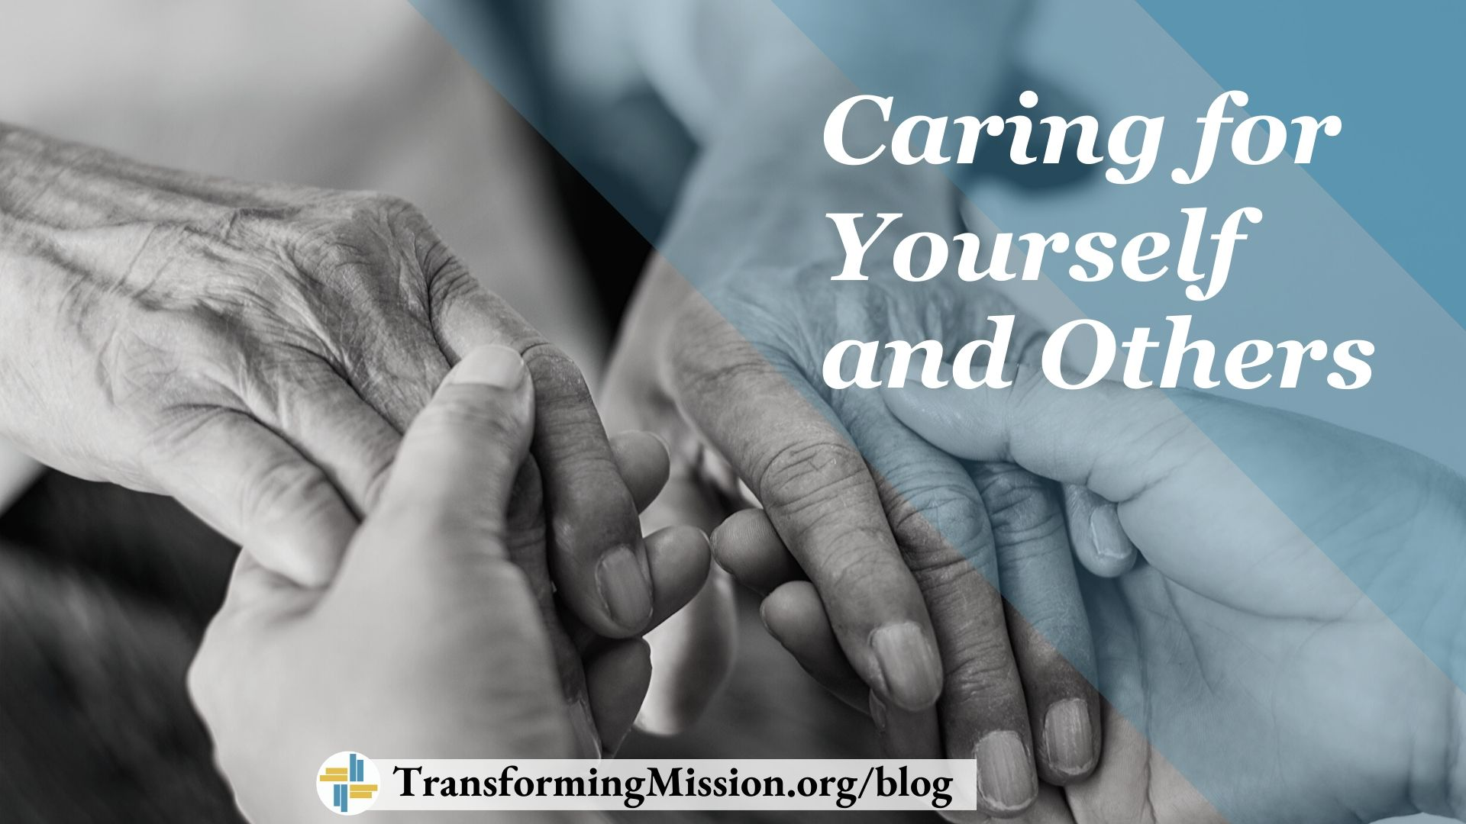
Gather: caring for each other
Opening Hymn: Here I am Lord

Slide 4

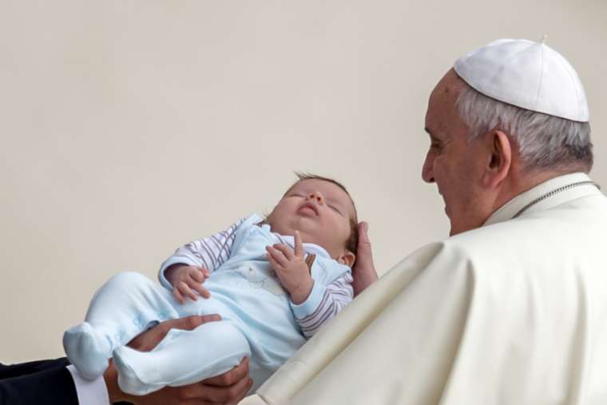
Gather: Care of each other
In 2001 Pope Francis’ call for us to, and throughout our lives, to spread a culture of care as a path to peace. He said:
What is our mission this week?
The first generation of Christians shared what they had, so that no one among them would be in need and strove to make their community a welcoming home, concerned for every human need and ready to care for those most in need. Our mission this week is to support each other by showing care and concern for those we live with.
“The culture of care … calls for a common, supportive and inclusive commitment to protecting and promoting the dignity and good of all, a willingness to show care and compassion…may we strive daily, in concrete and practical ways, to form a community composed of brothers and sisters who accept and care for one another.”

Slide 5

The Word of the Lord
Gospel Reading
A reading from St. John’s Gospel
John was standing with two of his disciples, and as he watched Jesus walk by, he exclaimed, “Look, here is the Lamb of God!” The two disciples heard him say this, and they followed Jesus. When Jesus turned and saw them following, he said to them, “What are you looking for?” They said to him, “Rabbi, where are you staying?” He said to them, “Come and see.” They came and saw where he was staying, and they remained with him that day.
The Word of the Lord Response: Thanks be to God
Lord, just as the disciples’ hearts were converted and they left everything to follow you, help us to be open to your call, to change our ways of thinking and work for true peace in our world.
Lord in your mercy……….Hear our prayer

Slide 6
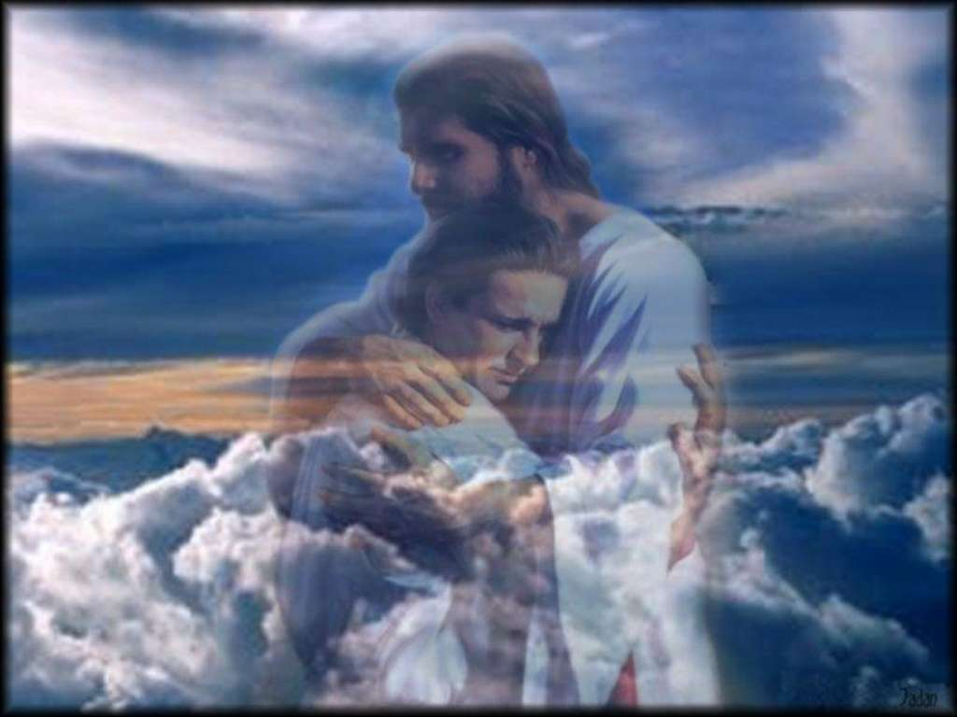
Prayer in response to the Gospel
Loving God, as I begin this day help me to live my life to the best of my ability,
To be open to those who need me,
To respond to those who love me,
To forgive those who hurt me, and,
To appreciate the world in which I live. Amen

Slide 7
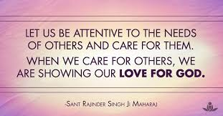
Response to the Word of God
Being attentive
We focus today on the value of being attentive. It is not always easy to really listen to the needs of others. When we listen to others’ needs, we are also called to care for them. In caring for them, we are showing our love for God.
We pray that we might be open to the Holy Spirit to help us be attentive to the needs of those around us.
Lord in your mercy…..Hear our prayer

Slide 8

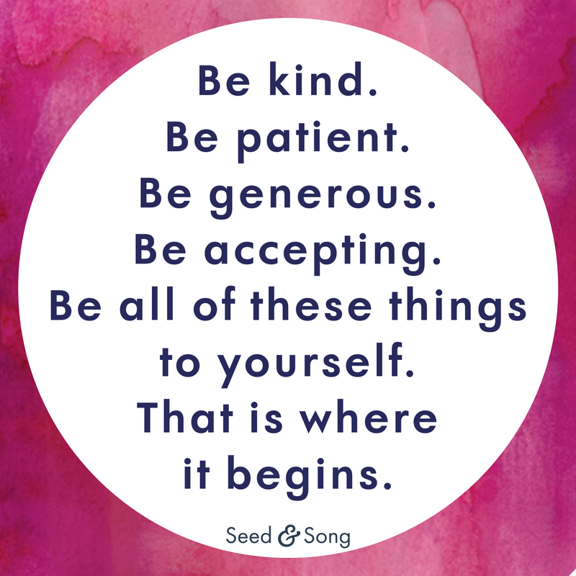
Response to the Word of the Lord
We are all made in God’s image and, sometimes, when our lives are very busy, we forget to take time to appreciate the wonder of ourselves. Jesus told us to, “love your neighbour as yourself” and gave us the Golden Rule, “Do unto others what you would have done unto you”. If we are going to grow as caring, kind and generous people, then we need to treat ourselves in the same way.
Loving God, you made us to love and be loved. Help us to care for ourselves so that we may then know how to care for others.
Lord, in your mercy…Hear our prayer.

Slide 9
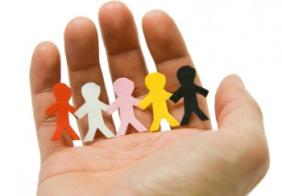
We Reflect Together
Just as God holds us in the palm of his hands, so we are called to hold others by being there for them. Let us think today of the people who we are close to. Let us be attentive to their needs today by offering a helping hand, by going that extra mile, by being generous with our time. In all of these things, we can be God’s servant first.
Lord, we pray for those who need our help today. For those who are worried, for those who feel lonely, for those who are ill. On all these people, we ask your blessing.
Lord, in your mercy…Hear our prayer.

Slide 10
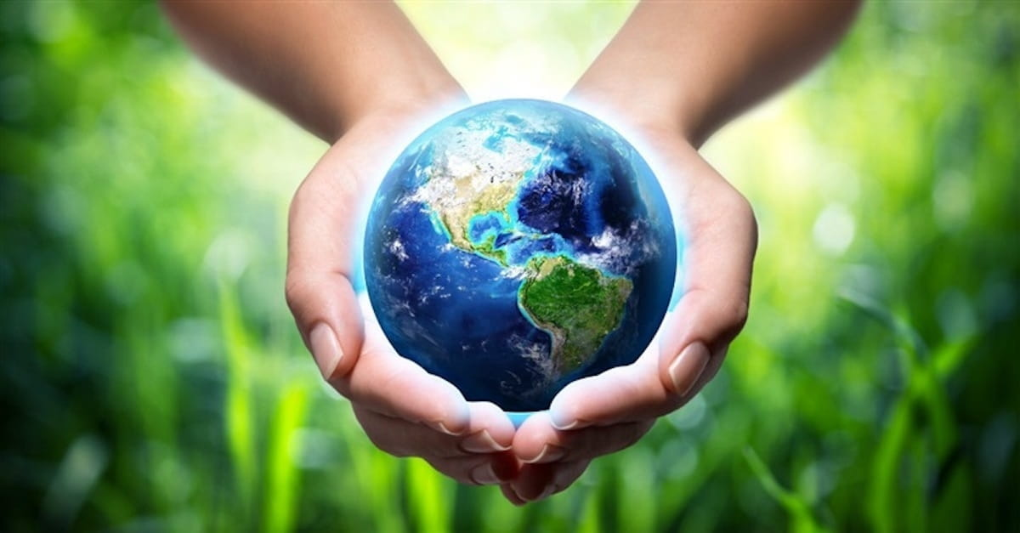
Go Forth
We show our care for others by the way we care for the earth. Pope Francis speaks of the earth as our common home, in which we all have a part to play to ensure that all people might have what they need in this generation and in the future. Some of the practical things we can do to care for the earth are: reduce, reuse, and recycle, cut down on what you throw away, conserve water, shop wisely, use long-lasting light bulbs, fund-raise for CAFOD.
Closing Prayer
Creator God, we give thanks for the beauty of the world. Open our hearts to be influenced for good and inspire us to care for our world. May we work together as brothers and sisters, building up your kingdom on earth. Amen

Slide 11
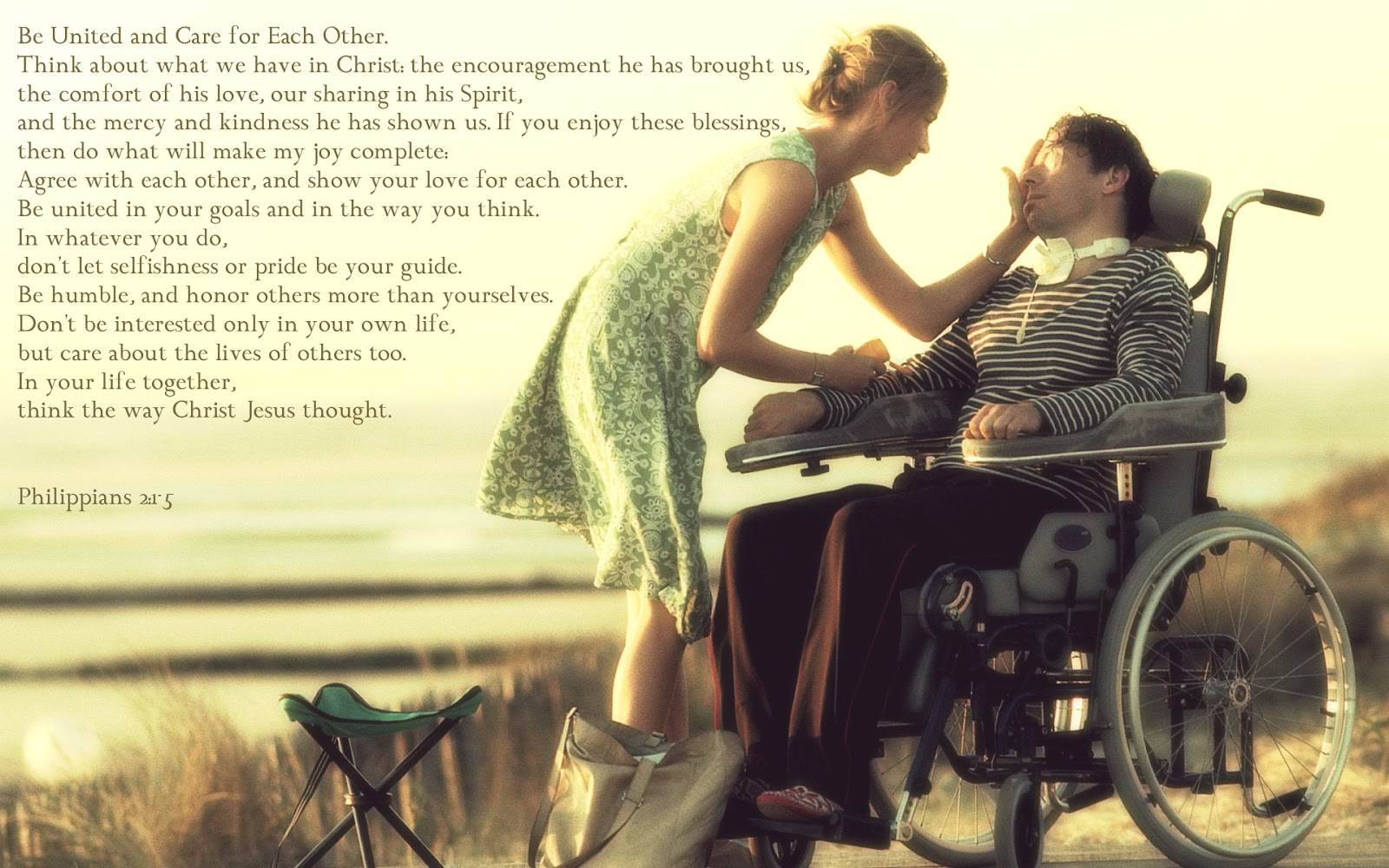
Go Forth: caring for each other
Closing Hymn: Here I am Lord

