Slide 1


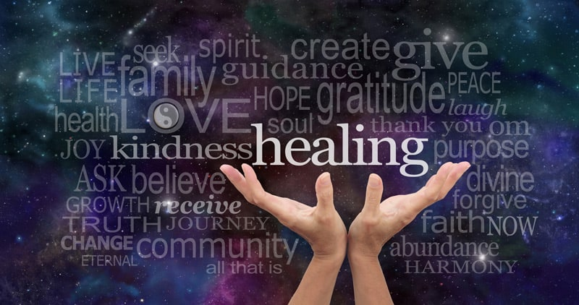
Gather: Healing
We gather as one … … …
Let us join our hands and make the sign of the cross.
‘ In the name of the Father and of the Son and of the Holy Spirit. Amen’

Slide 2
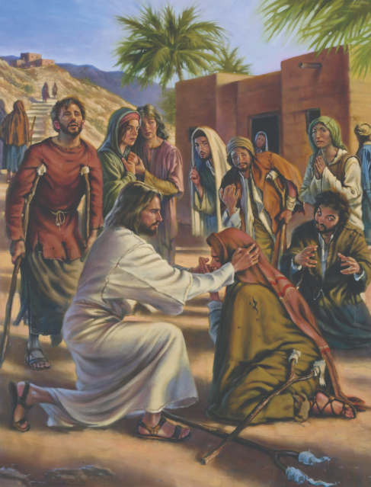
Gather: Healing
Opening Prayer
Dear Lord, You are the Just judge, Holy and True. You are the Most High God. You give us life. You hold all power in your hands. You are the Mighty one from God who carries the world, and is ruler over all the earth. You Oh Most Blessed One are the giver of life. In you are only good things. Amen.

Slide 3
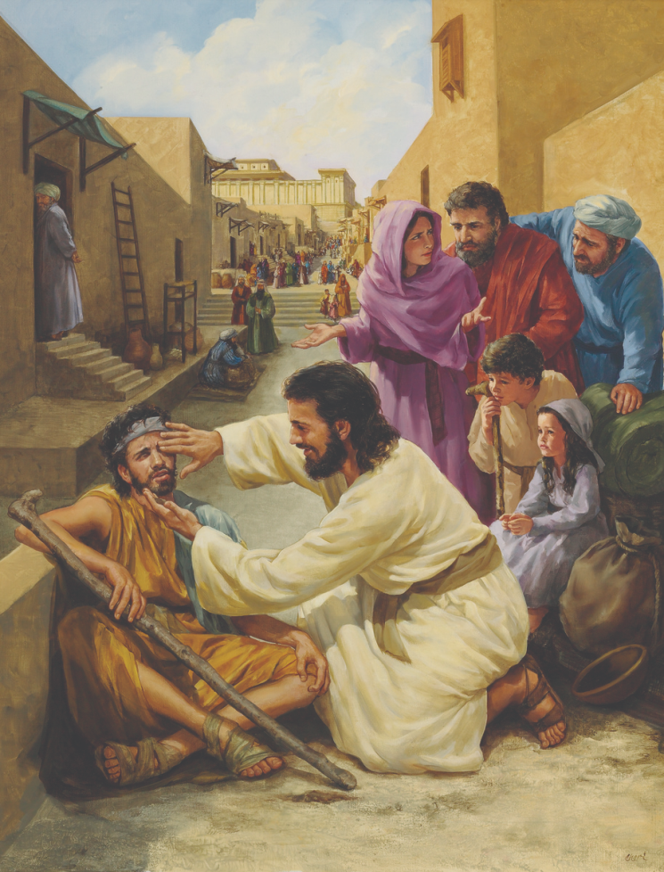
Gather: Healing
Opening Hymn: Make me a channel of your peace.
.

Slide 4

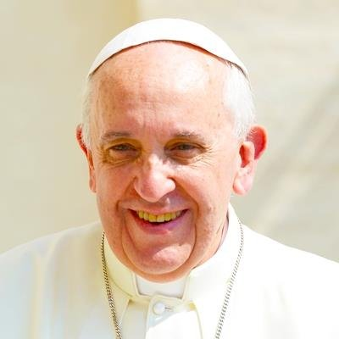
Gather Healing
Pope Francis has invited people to reflect with him on the pressing questions which the pandemic has revealed. The hope of the Pope is that these will help to shed light on today’s issues, and to contribute to the building of a future of hope for future generations.
Pope Francis challenges us:
“And so we can ask ourselves: today, in what way can we help heal our world? As disciples of the Lord Jesus, who is the physician of our souls and bodies, we are called to continue His work, work of healing and salvation, in a physical, social and spiritual sense.”
What is our mission this week?
Our mission this week is to put Pope Francis’ words into action: “It is my desire that everyone reflect and work together, as followers of Jesus who heals, to construct a better world, full of hope for future generations”. What can we do to help construct a better world?

Slide 5

The Word of the Lord
Gospel Reading
A reading from St. Mark’s Gospel
Jesus went into the synagogue and began to teach. The people were amazed at his teaching, because he taught them as one who had authority, not as the teachers of the law. Just then a man in their synagogue who was possessed by an impure spirit cried out, "What do you want with us, Jesus of Nazareth? Have you come to destroy us? I know who you are—the Holy One of God!” “Be quiet!” said Jesus sternly. “Come out of him!” The impure spirit shook the man violently and came out of him with a shriek. The people were all so amazed that they asked each other, “What is this? A new teaching—and with authority! He even gives orders to impure spirits and they obey him.” News about him spread quickly over the whole region of Galilee.
The Word of the Lord Response: Thanks be to God
We pray for healing for all those who are suffering in our world today, especially because of the effects of the pandemic.
Lord in your mercy……….Hear our prayer

Slide 6
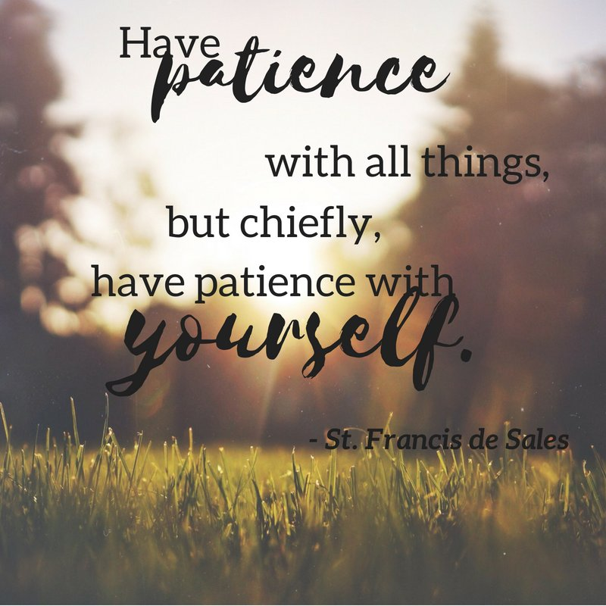
Response to God’s Word
Patience
We focus today on the value of patience. Sometimes we can lose patience not just with others but with ourselves. As St. Francis de Sales points out, it is important that we are kind to ourselves by having patience with ourselves. This is particularly important just now when we are living in challenging times. If we can be patient with ourselves, it can also help us to be patient with those around us.
Loving God.
We pray for the gift of patience, that we might be kind to ourselves and to others even when we might feel frustrated and challenged by circumstances. We pray that putting our trust in You will be a source of comfort.
Lord, in your mercy…..Hear our prayer

Slide 7
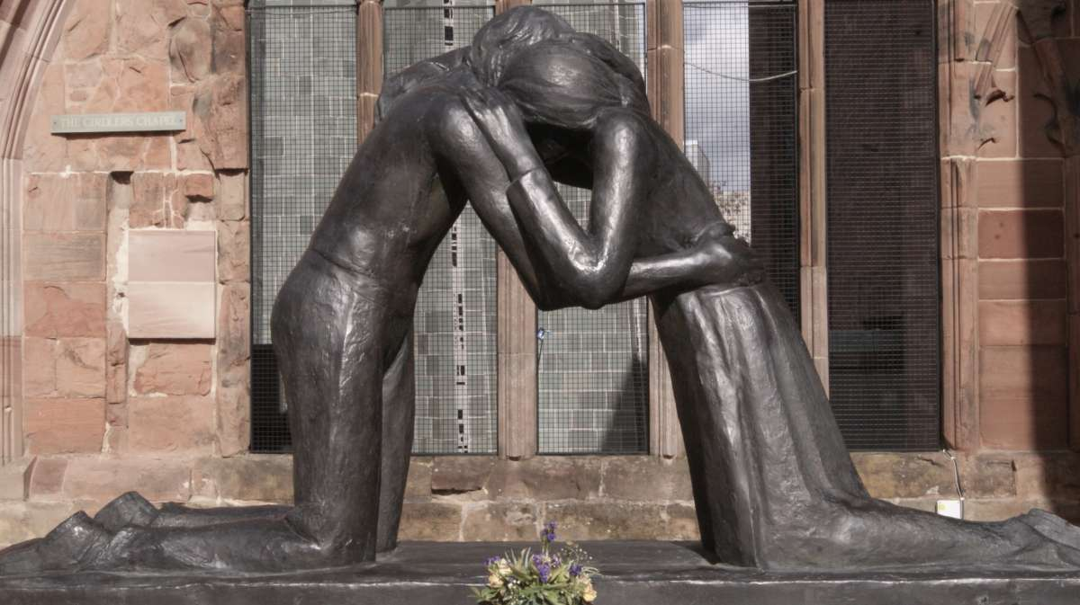
We Reflect Together
Healing and reconciliation are a central part of Christianity, following the example and teaching of Jesus. If there is to be healing in our world of division and injustice, then there also has to be reconciliation - the process of two people or groups in a conflict agreeing to make amends or come to a truce. Reconciliation also involves a change in the relationship between God and humankind or person and person. It assumes there has been a breakdown in the relationship, but now there has been a change to one of harmony and peace.
Let us pray today for reconciliation in our world. May we be ready to forgive others and be forgiven when we have hurt others. Lord, in your mercy…Hear our prayer.

Slide 8
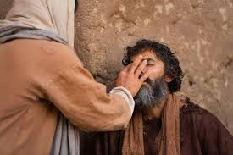
We Reflect Together
Jesus went out of his way to heal those who were sick. We think today of all those in our world who devote themselves to looking after the sick, especially at the moment during the pandemic. We take a moment to give thanks for all those working in the NHS and in social care.
We think about the many patients and individuals who use the NHS.
Lord, bless these people.
We pray for healing and health for everyone accessing the NHS today.
We think, too, about the people who work in the NHS and social care: the modern-day heroes.
Lord, bless these people.
Support them in their work and in their caring.
Lord, in your mercy…Hear our prayer

Slide 9

Go Forth
Loving Father,
We come to you with all our potential.
You wipe clean the slate and show us that we can start afresh.
You rejoice to forgive us when we turn to you.
Help us to forgive ourselves and others.
Help us not to hold grudges but to move forward with peace.
Teach us to reach out to those in need and speak out against injustice,
To build a world of equality and fairness, in our own lives and for all people.
We ask this through Christ our Lord. Amen.

Slide 10
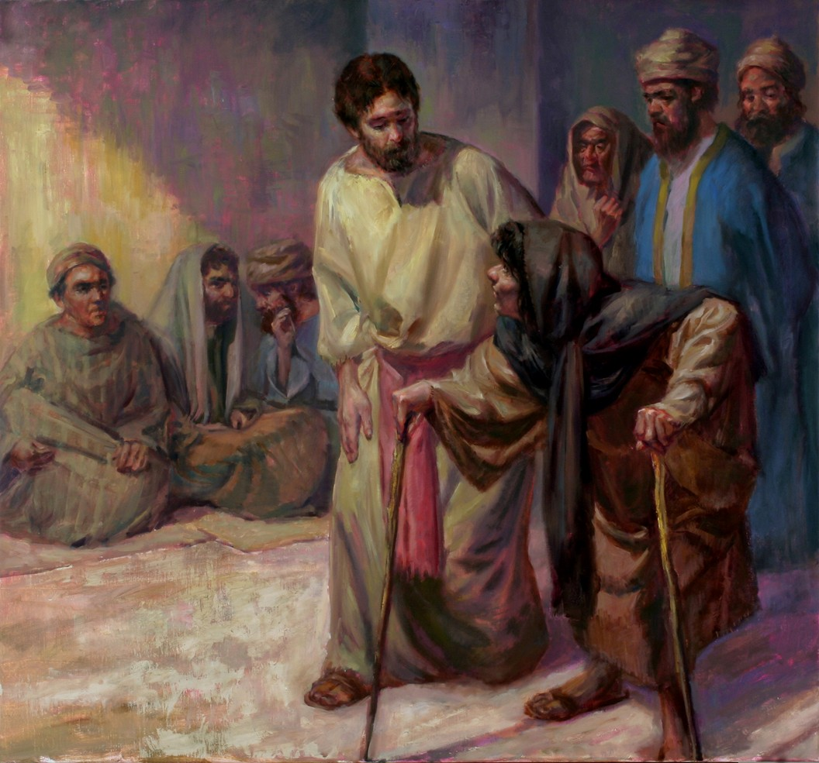
Go Forth: Healing
Closing Hymn: Make me a channel of your peace.
.

