Slide 1



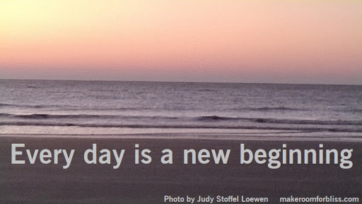
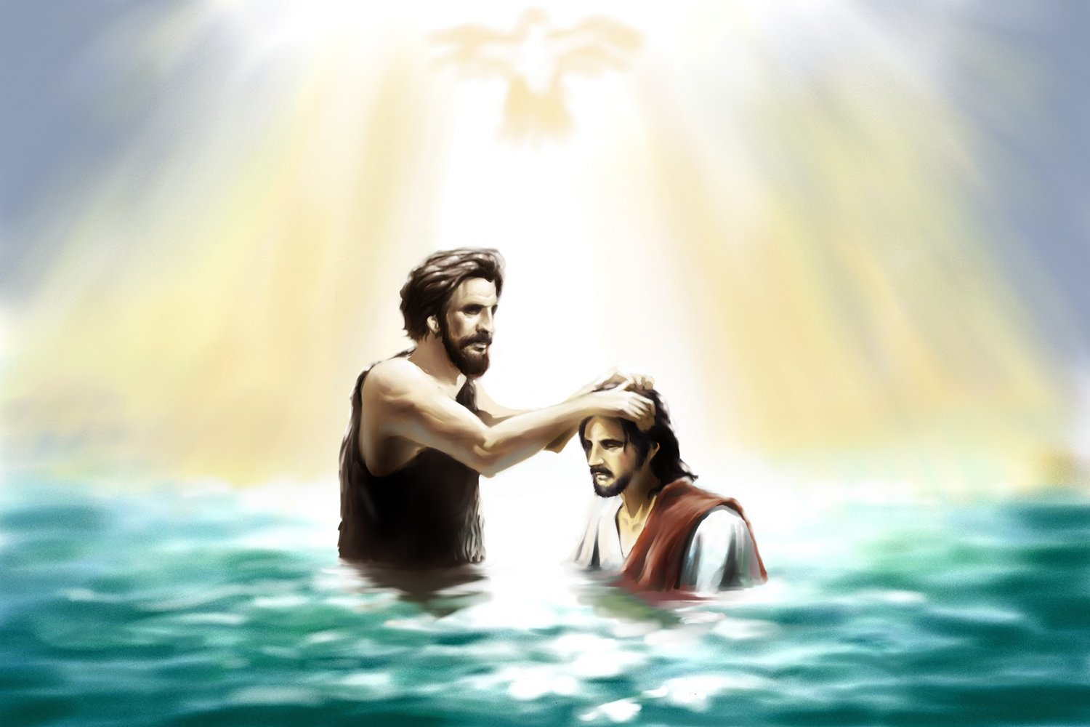
Gather: Baptism
This week we celebrate the baptism of Jesus. In this story we see
that Jesus approaches John and asks to be baptized. This moment in his life marked the beginning of his ministry – a three year journey which would lead to his eventual death and resurrection. The Holy Spirit descended on Jesus following his baptism. This was a sign that Jesus' ministry was empowered by the Spirit and would bring peace between humankind and God.
Mission Monday? What is our mission this week?
Just as Jesus was empowered by the Holy Spirit at the beginning of his ministry, so we ask that the Holy Spirit will guide us as we start this new year in difficult circumstances. Our mission this week is to think about, and put into practice, the things that will help us make a successful new beginning to this unusual term.

Slide 2
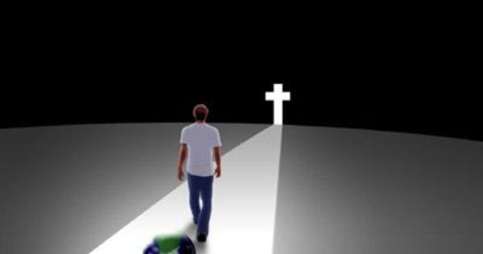
Gather Baptism
Opening Hymn: Walk in the light of the Lord

Slide 3
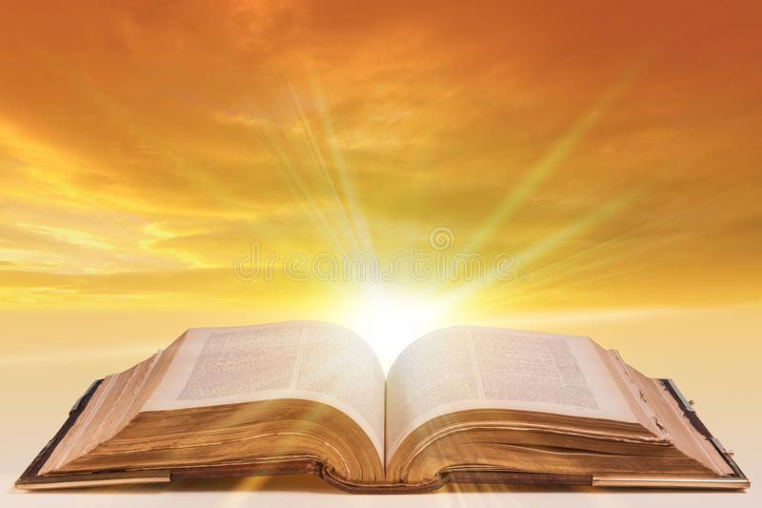
The Word of the Lord
Gospel Reading
A reading from St. Mark’s Gospel
John proclaimed, “The one who is more powerful than I is coming after me; I am not worthy to stoop down and untie the strap of his sandals. I have baptized you with water; but he will baptize you with the Holy Spirit.”
Jesus came from Nazareth of Galilee and was baptized by John in the Jordan. And just as he was coming up out of the water, he saw the heavens torn apart and the Spirit descending like a dove on him. And a voice came from heaven, “You are my Son, the Beloved; with you I am well pleased.”
The Word of the Lord Response: Thanks be to God
We pray, O Lord, for your love upon ourselves as we try to follow the example of your Son in whom you were well-pleased. Renew in us the desire to serve you and our neighbour and help us to overcome all obstacles in our dealings with each other.
Lord in your mercy……….Hear our prayer

Slide 4

Response: Reflecting on the Word of God
Discernment
We focus today on the value of discernment. As the Holy Spirit guided Jesus at his baptism, we take the opportunity at the beginning of a new year to reflect on how God can guide us in our lives.
We pray that we might be open to the Holy Spirit to help us when we find things difficult and to guide us to make the right choices.
Lord in your mercy…..Hear our prayer

Slide 5

We Reflect Together
May we recognize our calling as children of God, who have been given the gift of the Holy Spirit to share God’s Good News with others
Lord, in your mercy…….Hear our prayer.
We pray for understanding: may we learn from Jesus how to be fully human and place all our gifts and talents into God’s service.
Lord, in your mercy…..Hear our prayer

Slide 6
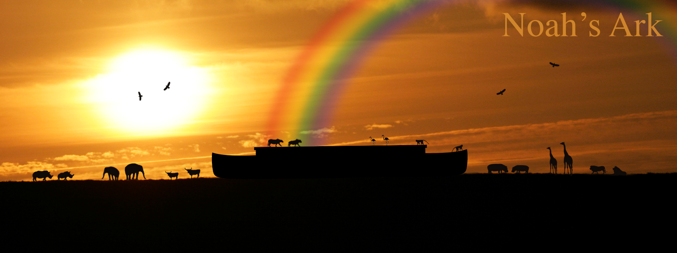
Response: We Reflect Together
In the story of Noah’s ark, the rainbow reassured Noah and his family that a flood on the same scale would never take place again. After the Flood, God made an everlasting covenant with Noah, his family, their descendants, and all the living creatures. He promised never again to destroy the earth by a flood. The rainbow was the sign of that promise – a reminder of God’s commitment to the earth. It is an assurance that God has not forgotten us and that he continues to work in this world through new beginnings.

Slide 7
Thursday: We Reflect Together
God of creation, who loves all you have made and all that has evolved,
open our eyes, that your love might be reflected in our care for the planet.
Lord, in your mercy….Hear our prayer.
We pray that we will be wise stewards of this Earth;
That we will tread lightly upon it and cherish its resources,
So that children may enjoy its riches, throughout all generations.
Lord, in your mercy….Hear our prayer.

Slide 8
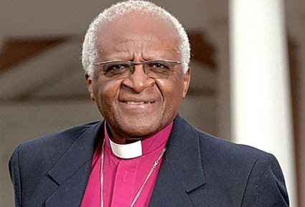
We Reflect Together
Archbishop Desmond Tutu spent many years working for
fairness for everyone in his country so that they
would all be treated equally.
He used the symbol of the rainbow to talk about a new
beginning and new hope for his people in
South Africa.
He said, “Look at your hands – different
colours representing different people. You are
the rainbow people of God. As you remember,
the rainbow in the Bible is the sign of peace
and hope.”
For everyone in South Africa, just like Noah’s
family, the rainbow was a sign of a new
beginning.
Desmond Tutu also said, “ We want peace,
prosperity and justice and we can have it
when all the people of God, the rainbow
people of God, work together.”

Slide 9
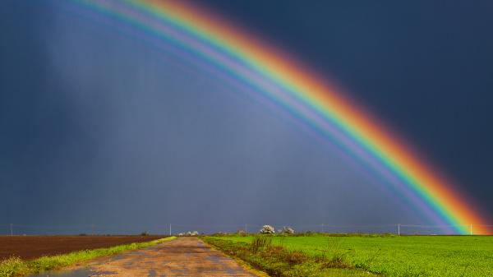
Friday: We Reflect Together
We pray for peace in our world at the beginning of this year. May weapons be put down and conflicts come to an end.
Lord, in your mercy…..Hear our prayer
We pray for a world where people have hope of better days to come and all people are treated fairly and equally.
Lord, in your mercy….Hear our prayer

Slide 10
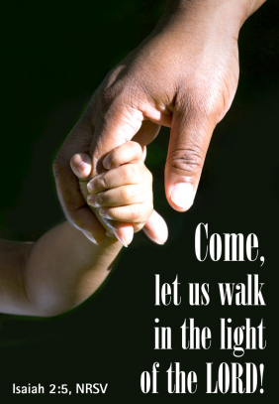
Go Forth
Closing Prayer
Dear Father God, Lord of all heaven and earth, I come humbly to Your feet today to ask for Your loving and divine intervention in my life. Lord, teach me to walk in the light. Gracious Lord, I adore you, thank You and praise Your name, for every good bounty You have given to me, each and every day of my life. Without you, I am nothing. Amen

Slide 11
Go Forth
Opening Hymn: Walk in the light of the Lord

