Slide 1


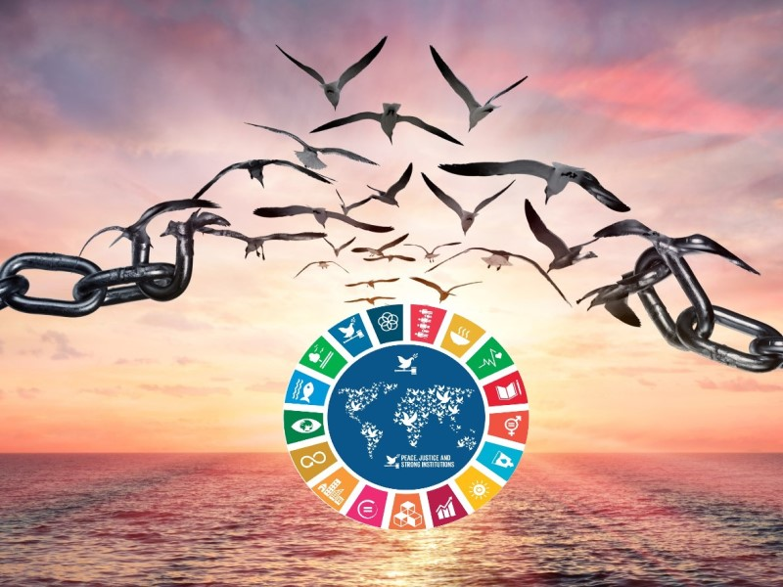

Gather Justice: Rights of the individual to be safe.
Gather: Hymn – All that I Am
Regardless of your background, race, faith or your gender we all should be treated the same, unfortunately this is not so. Pope Francis asks each and every one of us to acknowledge each others differences as blessings, and to not ignore the plight of someone when they are treated badly by others. He asks us to be committed to create a more equal society where selfishness and narrowminded ceases to exists.
What is our mission this week?
Our challenge this week is to is to accept each other as God intended them to be. It is also our mission to stand up for injustice where ever we see it so that by our we can help build a better world.
Help break the chains of injustice

Slide 2

The Word of the Lord
Gospel Reading
A reading from St Luke’s Gospel
Some of his disciples were remarking about how the temple was adorned with beautiful stones and with gifts dedicated to God. But Jesus said, “As for what you see here, the time will come when not one stone will be left on another; every one of them will be thrown down.” “Teacher,” they asked, “when will these things happen? And what will be the sign that they are about to take place?”
He replied: “Watch out that you are not deceived. For many will come in my name, claiming, ‘I am he,’ and, ‘The time is near.’ Do not follow them. When you hear of wars and uprisings, do not be frightened. These things must happen first, but the end will not come right away.”
Then he said to them: “Nation will rise against nation, and kingdom against kingdom. There will be great earthquakes, famines and pestilences in various places, and fearful events and great signs from heaven.
“But before all this, they will seize you and persecute you. They will hand you over to synagogues and put you in prison, and you will be brought before kings and governors, and all on account of my name. And so you will bear testimony to me. But make up your mind not to worry beforehand how you will defend yourselves. For I will give you words and wisdom that none of your adversaries will be able to resist or contradict. You will be betrayed even by parents, brothers and sisters, relatives and friends, and they will put some of you to death. Everyone will hate you because of me. But not a hair of your head will perish. Stand firm, and you will win life.21.5-19
Lord Jesus, give us strength and courage to follow Christ's way of love and build our lives around his teachings.
Lord, in your mercy….Hear our prayer

Slide 3
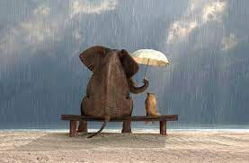
Response to the Word of God
Generosity
We focus today on the value of generosity. Generosity is a quality that's a lot like unselfishness. Someone showing generosity is happy to give time, money, food, or kindness to people in need. Generosity is a quality — like honesty and patience — that we all probably wish we had more of.
https://www.youtube.com/watch?v=7mhyRBiIp4Q
Lord, help us to be kind in heart, so that love, grace, and charity flow forth like a river. Give us a generosity that reflects your own, through Christ, our Lord. Amen.
Lord in your mercy…..Hear our prayer

Slide 4
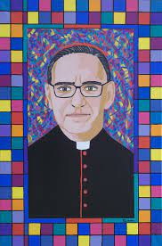
Response to the Word of God: We Reflect Together
Oscar Romero
The world today desperately needs more figures like Romero – leaders with the courage, faith and love to stand up for the poor against injustice. Romero is, in particular, an inspirational figure to hundreds of millions of Catholics around the world. He didn’t simply talk about the need to love your neighbour, but courageously named the injustices that plagued his country. He reminded us that Christ is found in people living in poverty, and that we cannot ignore the suffering of our brothers and sisters in need.
Let us pray for an end to the divisions and inequalities particularly the barriers to freedom faced by many throughout the world because of poverty; that all who have been formed in Gods image might have equality in pursuit of the blessings of creation.
Lord, in your mercy…Hear our prayer

Slide 5
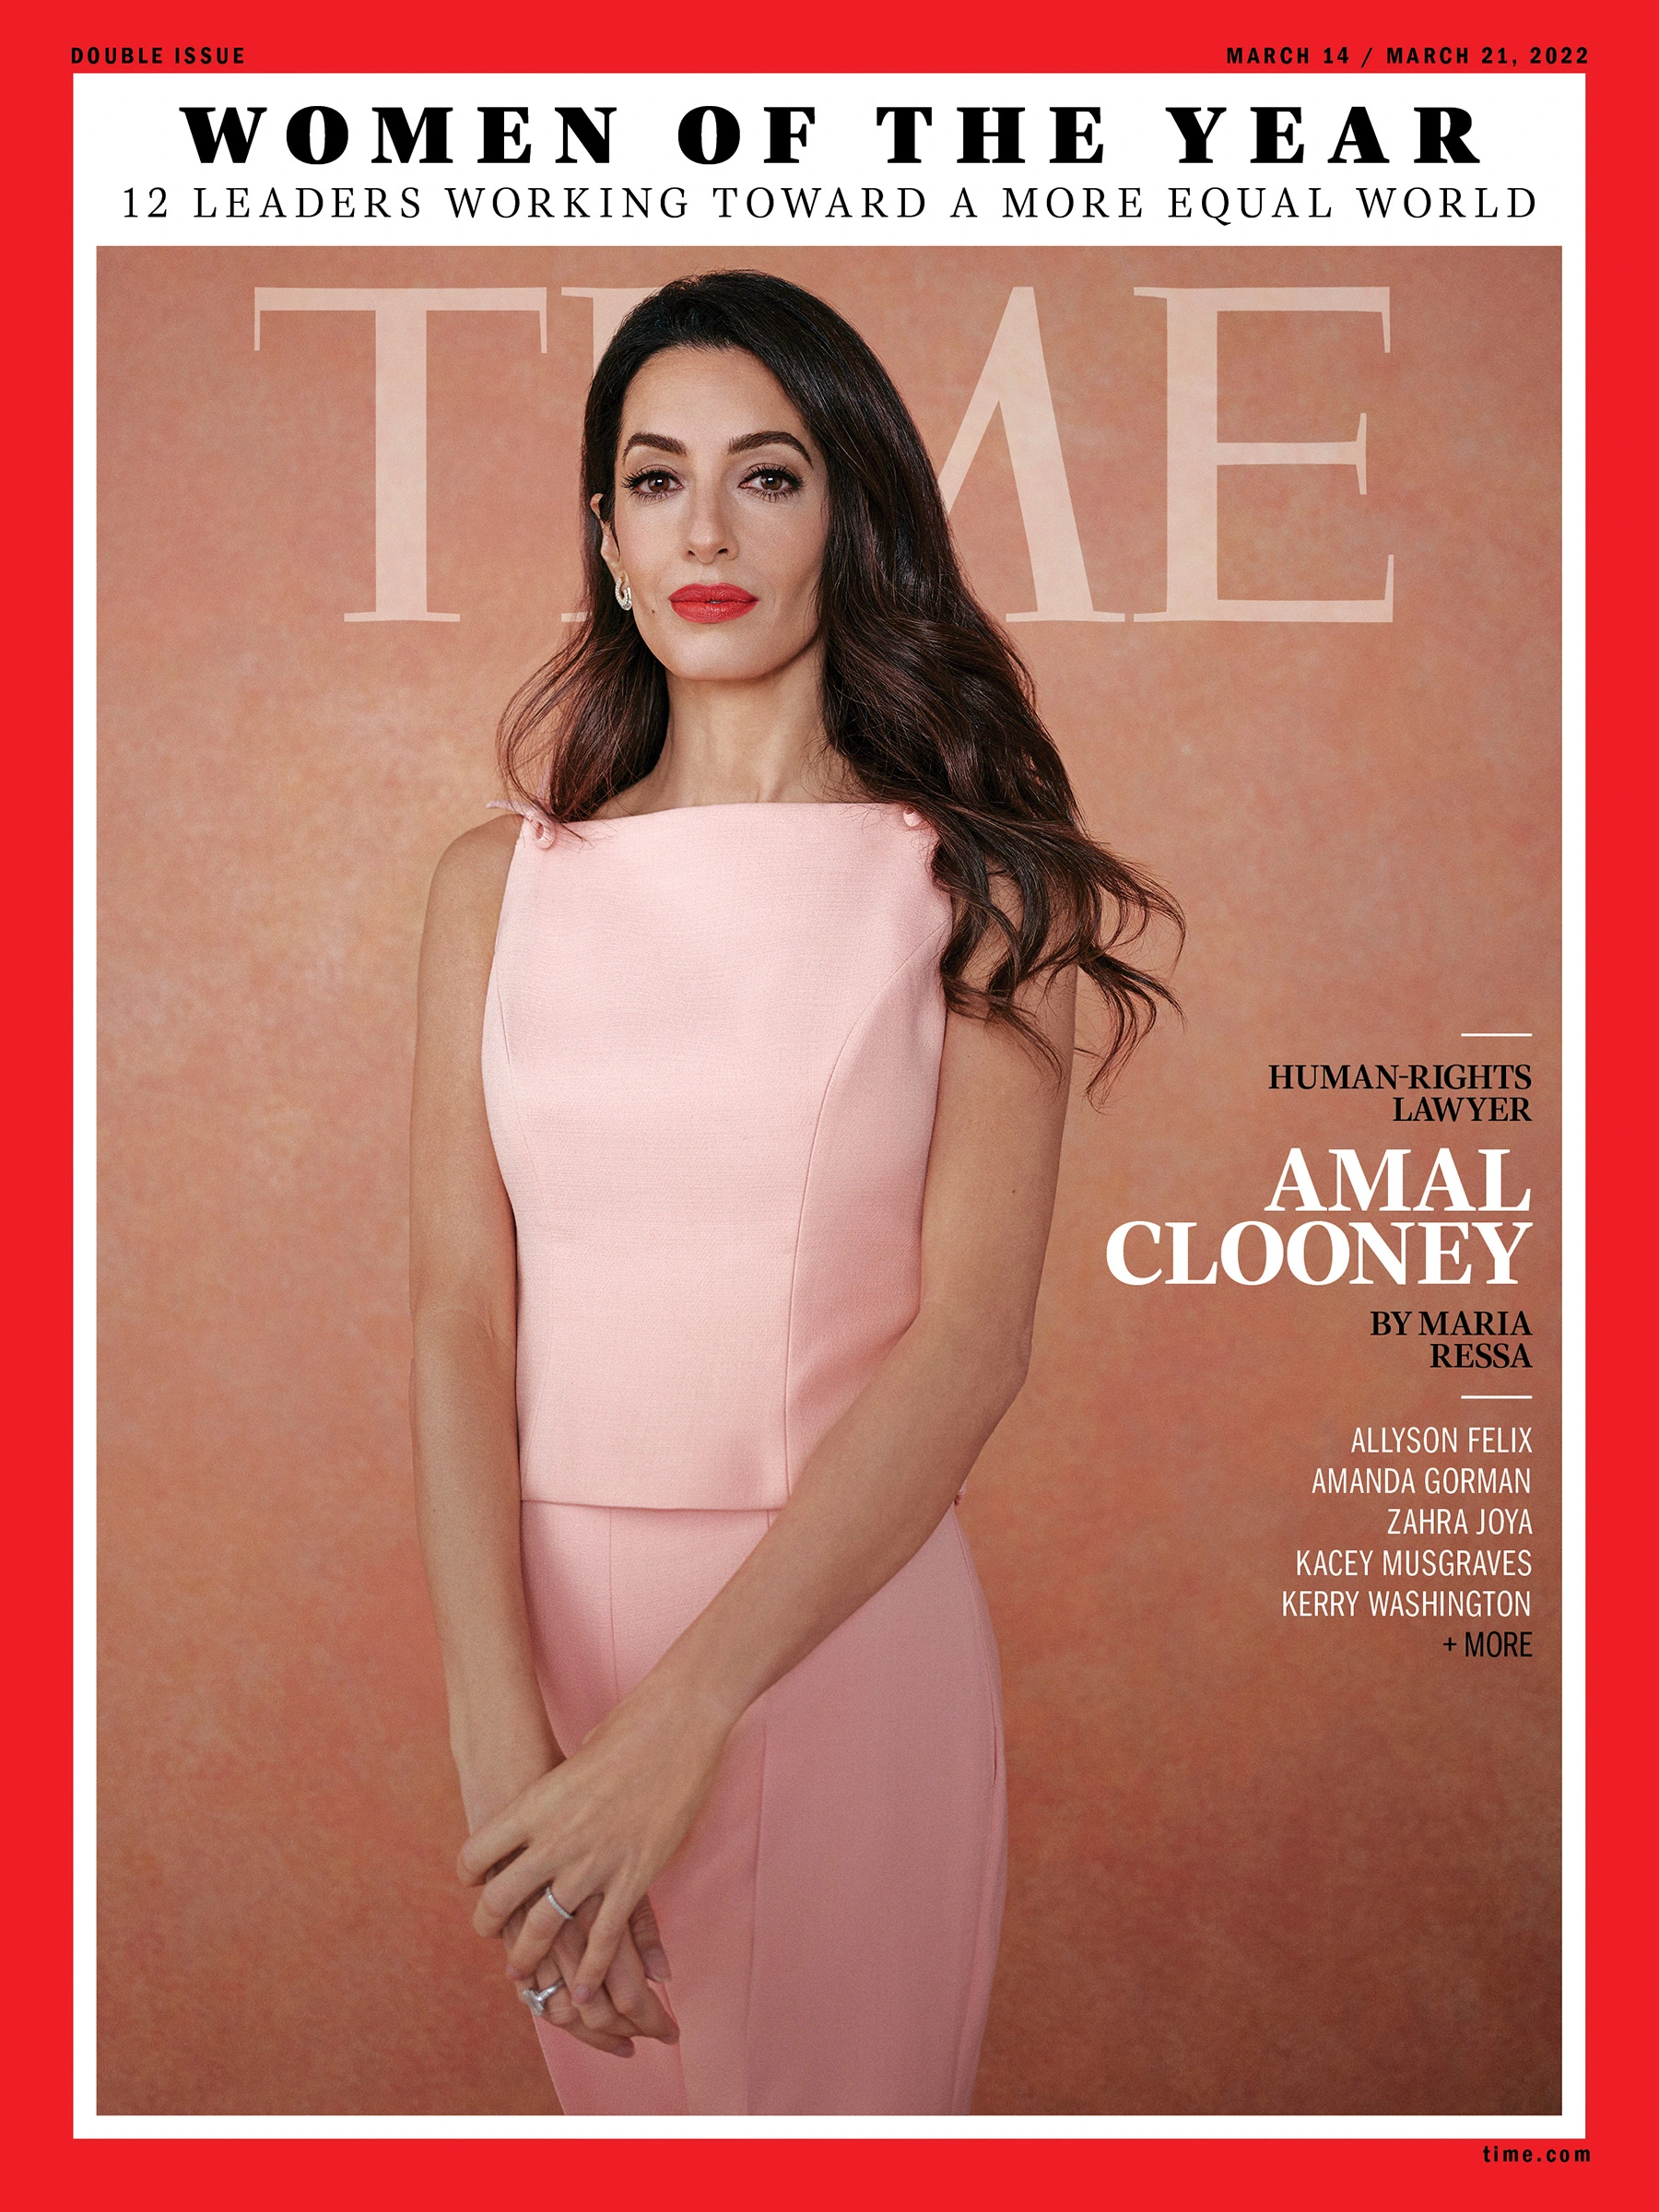
Response to the Word of God: We Reflect Together
Amal Clooney fights for human rights on an international scale
Amal Clooney has defended the rights of many people who have faced injustice. She works with some of the most vulnerable people in society. She sees some of the most horrific situations and yet sees hope.
Amal is a long-standing champion and advocate for women's rights worldwide. Amal believes that "if we keep up the fight for women's rights there is nothing we can't do" but she also reinforces and emphasizes the need for women to feel they can "stand up for each other."
She also reinforces the complexity of women's inequality and how "the challenges that women face today are completely different based on where they’re born.“ Amal is also an educator who aims to inspire the next generation to fight for human rights in the courts of law.
Lord Fill the hearts of all people with your love and the desire to ensure justice for all their brothers and sisters.
Lord, in your mercy…Hear our prayer

Slide 6
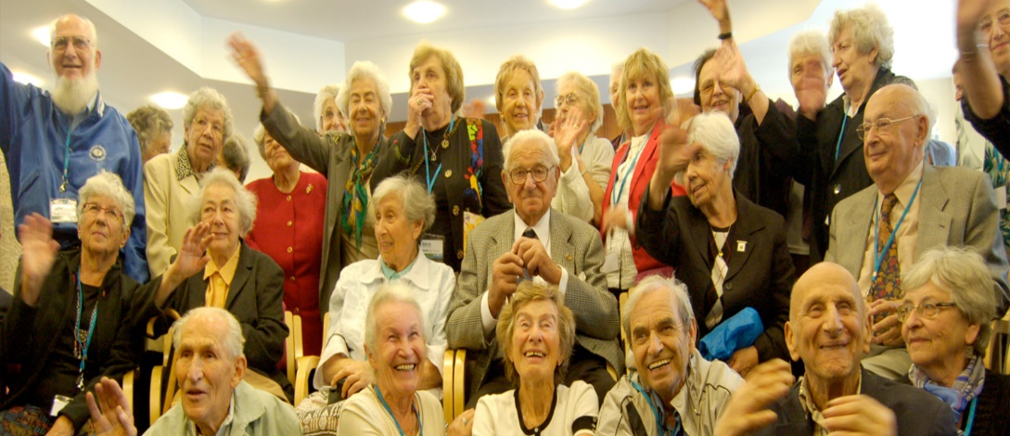
Going Forth
Nicolas Winton – justice for children
On Kristallnacht (9 and 10 November 1938), the Nazis had initiated a campaign of hatred against the Jewish population in all Nazi territories. An estimated 91 Jews were killed, 30,000 were arrested, and 267 synagogues were destroyed. Following this, the British government relaxed its immigration laws and agreed to allow in a limited number of children from Germany and Austria. This programme was known as the Kindertransport, and some 10,000 children were successfully brought to Britain. Winton asked the British government to allow some Czech children to come into the UK as well; permission was granted on the condition that each child was matched to a host family who would care for the children until they were 18, and each child had to have a guarantee of £50 paid by their family.
Winton, alongside a few volunteers – including his mother – worked tirelessly to arrange everything the children needed, including finding host families and raising funds to cover the travel expenses of the children.
Winton was able to arrange for 669 children to come to the UK over the next few months, the majority of whom were Jewish. The last train of children was scheduled to leave on 1 September 1939. It was cancelled because war broke out; Winton believed that ‘none of the 250 children on board was heard of again’, which was an awful feeling for him.
https://www.youtube.com/watch?v=6_nFuJAF5F0
Closing Prayer: God our Father protect those who’ve fled their homes, especially children. We ask in Your name to restore communities, reunite families, and repair this country.
Closing Hymn: Hymn – All that I Am

