Slide 1


Gather: Serving God
Opening Hymn: He said freely freely
We gather as one … … …
Let us join our hands and make the sign of the cross.
‘ In the name of the Father and of the Son and of the Holy Spirit. Amen’
All: Loving God, as I begin this day help me to live my life to the best of my ability,
To be open to those who need me,
To respond to those who love me,
To forgive those who hurt me, and,
To appreciate the world in which I live. Amen

Slide 2

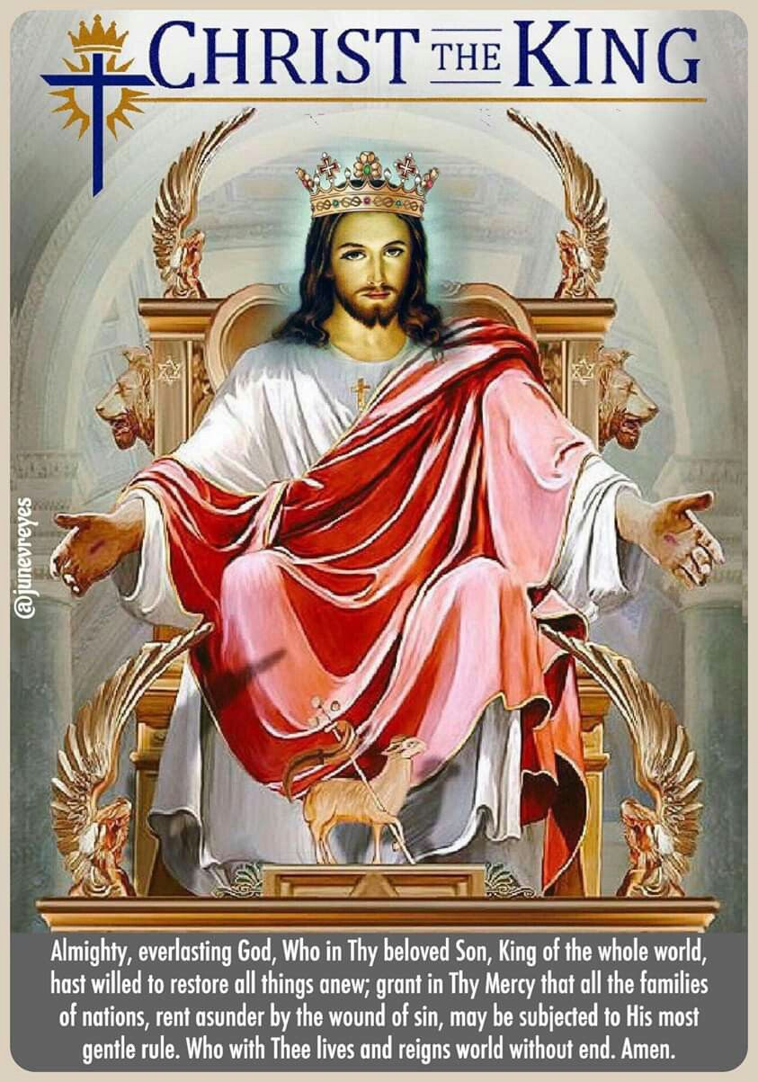
Gather: Christ the King
This week we reflect upon Christ the King, this is the day we are reminded that Jesus reigns above all earthly rulers. He tells us that his kingdom is not of this world, it is not one of costly palaces and precious jewels. In Jesus’ Kingdom there is no division between the king and his people. Christ carried the burden of all his people by taking away their sins by dying on the cross. He bore witness to the truth and died for the truth.
What is our mission this week?
Our mission this week is for us to remember the truth that Jesus is not our King if we do not listen to him, love him, serve him, and follow him. We belong to his Kingdom only when we try to walk with him, when we try to live our lives fully in the spirit of the Gospel and when that Gospel spirit penetrates every facet of our living.

Slide 3


The Word of the Lord
Gospel Reading
A reading from St Luke’s Gospel
The people stood watching, and the rulers even sneered at him. They said, “He saved others; let him save himself if he is God’s Messiah, the Chosen One.” The soldiers also came up and mocked him. They offered him wine vinegar and said, “If you are the king of the Jews, save yourself.” There was a written notice above him, which read: THIS IS THE KING OF THE JEWS. One of the criminals who hung there hurled insults at him: “Aren’t you the Messiah? Save yourself and us!” But the other criminal rebuked him. “Don’t you fear God,” he said, “since you are under the same sentence? We are punished justly, for we are getting what our deeds deserve. But this man has done nothing wrong.” Then he said, “Jesus, remember me when you come into your kingdom.” Jesus answered him, “Truly I tell you, today you will be with me in paradise.”23.35-43
Lord Jesus, give us strength and courage to follow Christ's way. Help us to live good lives so that we may come into your kingdom.
Lord, in your mercy….Hear our prayer

Slide 4
Response to the Word of God
Service
We focus today on the value of service. To engage in service, to reflect on one's own experience and that of others, and to move toward action on behalf of peace, justice, truth, reconciliation, and love. Serving others shows our dedication to God and to the well-being of others. Service doesn't just help others. It can also lead to our own spiritual growth. When we serve we not only strengthen others faith but also become better people.
God of love,
help us to use the gifts you give us
for the people who need us.
Help us to see their need and, inspired by your Son,
reach beyond ourselves, and make a difference in this world.
Lord in your mercy…..All: Hear our prayer.

Slide 5
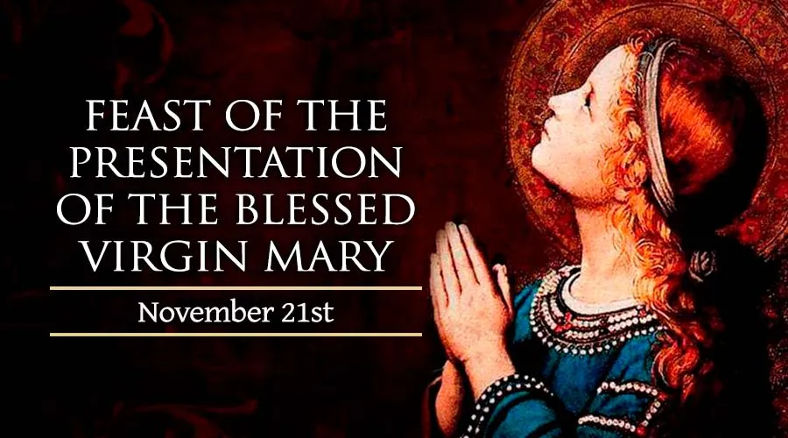
Response to the Word of God
The Feast of the Presentation of the Blessed Virgin Mary, celebrated annually on November 21st, commemorates the presentation of the Blessed Virgin as a child by her parents in the Temple in Jerusalem. Before Mary's birth, her parents received a heavenly message that they would bear a child. In thanksgiving for the God's gift of Mary's birth, they brought her to the Temple to consecrate their only daughter to The Lord. We are reminded of the service Mary would undertake, the acceptance of being the mother of Jesus. Throughout her life she showed dedication in her service to God and her son and never waivered from her task.
Lord inspire us to be servants and help others just as Mary did. Help us to have faith even when we struggle and face adversity.
Lord in your mercy…..All: Hear our prayer.

Slide 6
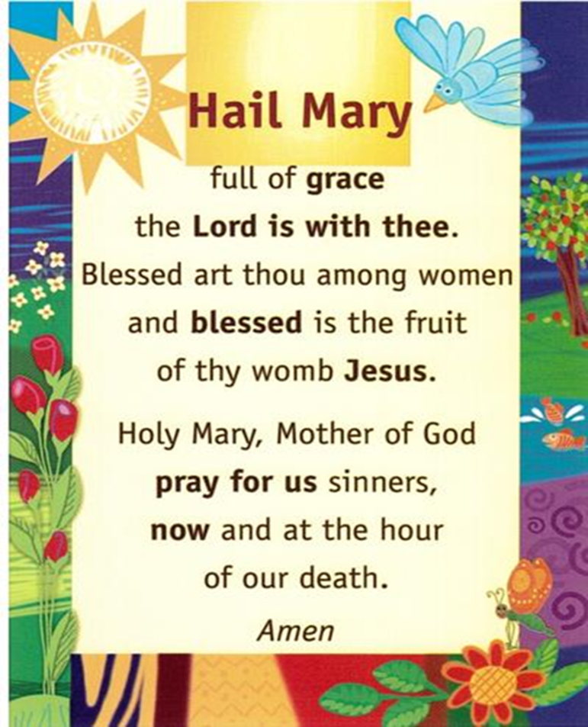
Hail Mary

Slide 7
Prayer of Reflection
Let us say pray:
Loving God, as I begin this day help me to live my life to the best of my ability,
To be open to those who need me,
To respond to those who love me,
To forgive those who hurt me, and,
To appreciate the world in which I live. Amen

Slide 8
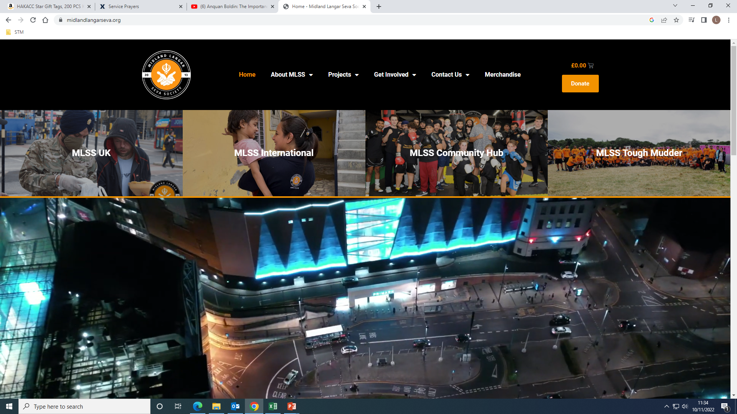


Thursday: We Reflect Together
Serving our Communities, both Local and Global
Within school students are fundraising for our local and global charities, this is an example of serving others. Year 7-9 are being ‘Gods hands and feet’ by collecting items for the Midlands Langar Seva Society. The society feeds and helps people across the West Midlands regardless of faith or background. Year 10-11 are serving others by collecting food items for the Good Sheperd Centre. The Good Sheperd centre provides for those who are less fortunate and help many with housing. Finally the Sixth Form are serving the Global community by supporting CAFOD. Students are raising money so that communities aboard can live better lives, for example helping those affected by the war in Ukraine, and supporting the COP27 (climate change summate) where CAFOD is protesting as climate change is effecting east Africa where there is drought and many are on the brink of starvation.
God our Father, Help us have eyes to see the needs around us and to respond to those needs in joy and hope.
Lord, in your mercy…Hear our prayer

Slide 9
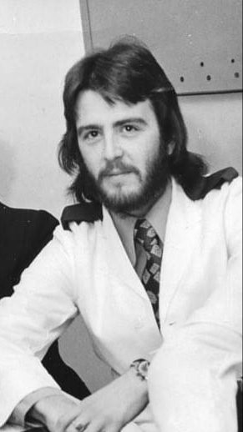
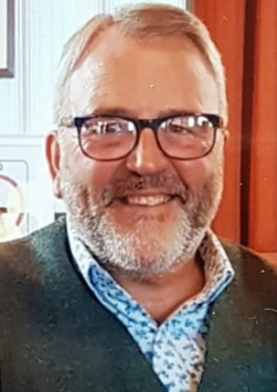
We Reflect Together on Serving Others
Gordon Lees- Serving Others
A Hartlepool man who switched army life for the NHS is celebrating 52 years of fighting for the rights of others – both as a nurse and as the Royal College of Nursing’s longest serving activist.
Gordon Lees began his career in 1970 as a 16-year-old Cadet nurse and now, five decades later, serves as an RCN rep at Tees, Esk and Wear Valleys NHS Foundation Trust (TEWV).
“There have been many highlights over the years, but one that really sticks in my memory is coming out of a theatre in London and noticing a guy looking at me,” said Gordon, who is 69 this month. “I recognised him but couldn’t place him – until he came over and introduced himself. He then told me I’d saved his life and shook my hand. It was an amazing experience.”
He made medical history by training as a general nurse at 18 – where he was one of just three men on his course, and among the first men to be trained locally
Over the years, Gordon – who still lives in Hartlepool – has worked as a clinical nurse and manager of community mental health teams, as well as with a substance misuse service.
Gordon has dedicated his whole working life to campaigning to improve both health care and working conditions. His dedication to fairness and justice for the past 52 years is something to be applauded and celebrated.
God our Father, Help all those who serve you, give them strength and courage in difficult times. Inspire me to help others also and show love and compassion to all I meet.
Lord, in your mercy…All: Hear our prayer

Slide 10
Going Forth
Closing Prayer
Loving God, as I begin this day help me to live my life to the best of my ability,
To be open to those who need me,
To respond to those who love me,
To forgive those who hurt me, and,
To appreciate the world in which I live. Amen
Closing Hymn: Bind us together Lord

