Slide 1



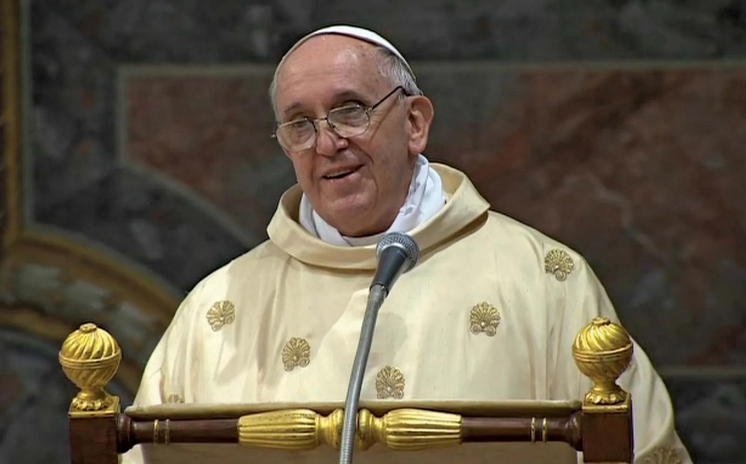
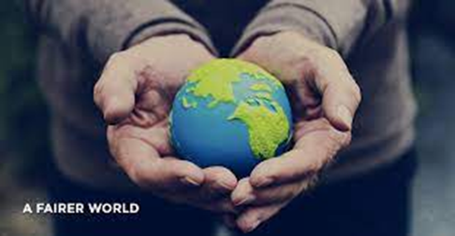
Gather: Making a Fairer World
Gather: Hymn: I will raise you up on eagle wings
Pope Francis calls for a kinder society and for us to be part of a more compassionate and caring world where everyone is included.
Millions of people across the globe face hunger and millions also live in total poverty. Even to this day, food insecurity is still an issue that is impossible to resolve. With the increased cases of unemployment, and fuel prices rising it will become more challenging for families these coming months.
Our mission this week is to think of how we can build a fairer world for everyone. There are many in our world who are prevented from fulfilling their dreams because they live in poverty or in other difficult circumstances. We think today of one thing we can do to be kind and compassionate to others.

Slide 2
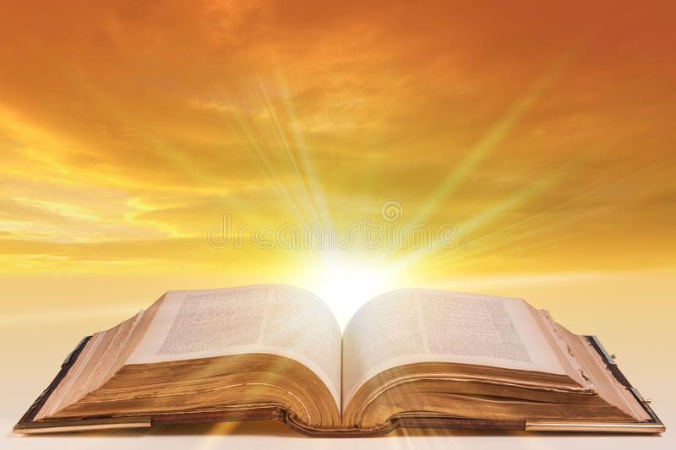
The Word of the Lord
Gospel Reading
A reading from St. Luke’s Gospel
Then Jesus told his disciples a parable to show them that they should always pray and not give up. He said: “In a certain town there was a judge who neither feared God nor cared what people thought. And there was a widow in that town who kept coming to him with the plea, ‘Grant me justice against my adversary.’ “For some time he refused. But finally he said to himself, ‘Even though I don’t fear God or care what people think, yet because this widow keeps bothering me, I will see that she gets justice, so that she won’t eventually come and attack me!’
And the Lord said, “Listen to what the unjust judge says. And will not God bring about justice for his chosen ones, who cry out to him day and night? Will he keep putting them off? I tell you, he will see that they get justice, and quickly. However, when the Son of Man comes, will he find faith on the earth?” (Lk 18.1-8) PAUSE
The Word of the Lord Response: Praise to you Lord Jesus Christ
Lord help us to never give up on what is right. Help us always to seek justice for all people and be prophetic, a voice for those who cannot be heard.
Lord in your mercy……….Hear our prayer

Slide 3
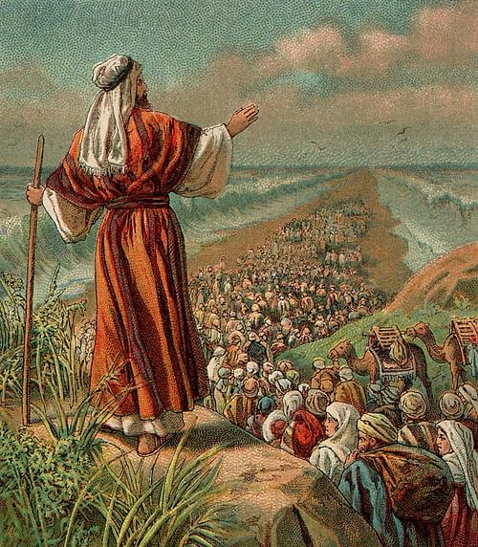
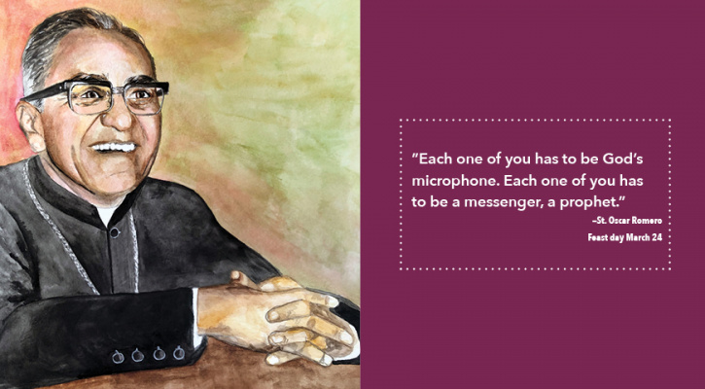
Response to the Word of God
Prophetic
We focus today on the value of being prophetic which means being
a spokesperson for God. Many individuals in the bible have been given
the task to be spokesperson for God such as Abraham and Moses. Today we have seen people who can be considered modern day spokespeople, such as Oscar Romero who asked the government in his country to lead his people out of poverty.
We pray that we might speak the words of God in all words and actions and in doing so
Lord, help us to challenge injustices and speak out for the rights of all people to be respected.
Lord in your mercy…..All: Hear our prayer

Slide 4

Response to the Word of God
Our focus today, is how can we make a difference in making life fairer for others.
We think of our own families but we also think of our global family with who we share our world. How can we make our world a fairer place for all who live in it?
We pause to give thanks for those who care for us and for those in our global family who make the world a good place for us to be.
Lord, we thank you for the world we live in. Open our eyes that we may have a sense of wonder of all that you have made. Show us how to value all who are a part of our lives this day. Lord, in your mercy…..All: Hear our prayer

Slide 5
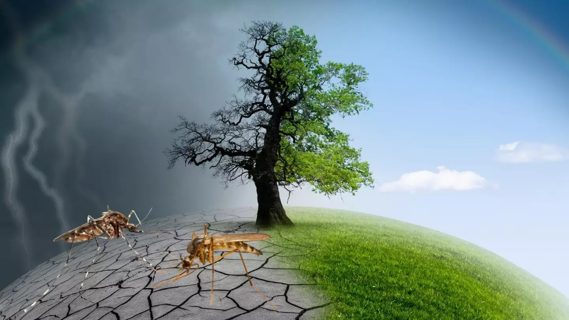
Response to the Word of God
Climate change has been affecting mankind in dangerous ways. The scientific community has already reached a consensus about this and they have been issuing warnings for years. With no significant changes in major industries and the people’s way of life, the planet’s climate may soon become unfit to live in for a lot of species. This can then collapse the global food chain and threaten the existence of humanity.
The poorer nations are the ones that will feel the effects of climate change first.
Our focus today, on the needs of people and animals around the world. We pray especially today for the needs of our world, thinking of the climate crisis, places of conflict and war, and the many people in our world who struggle to have enough food and water for their needs. What can we do today to make the world a better place?
Remember to record on your card one thing you will do.
Lord, we pray for those who struggle to have enough for their needs. Help us to make time to appreciate how our actions can make a difference to communities in our world.
Lord, in your mercy…All: Hear our prayer.

Slide 6

Go Forth
Amnesty International is a global movement of more than 10 million people who take injustice personally. They campaign for a world where everyone is treated fair and where human rights are enjoyed by all. They help stop human rights abuses by organising the public to put pressure on governments to make change. Amnesty international hold public demonstrations, letter-writing campaigns, lobbying decision-makers, make petitions and increase peoples awareness through human rights education.
Closing Prayer
All: God help us to follow your example by showing charity towards others which means means acting voluntarily with kindness or goodwill. We can do this by giving of our time, our energy, our talents to help others. We think today of something we can do to help those who are in need. Amen.

