Slide 1



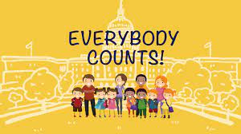
God our Father loves us all
Gather: Hymn - My God loves me
We all come from different backgrounds and have different religious and political viewpoints but we must be reminded that everybody counts and must feel valued. All people have rights, rights that everyone is entitled to, purely on the basis that they are a human being. They’ve only existed formally for around 200 years – before that, there were no real laws to ensure people were treated fairly regardless of things like age, race, and gender. Human rights conventions, declarations, and acts all attempt to guarantee that everybody counts.
What is our mission this week?
Our mission this week is to think of how we can ensure that everybody counts in our school. What can you do in the classroom to make sure all are treated fairly and respectfully? How can we use tolerance to make our world an equal place for everyone?

Slide 2
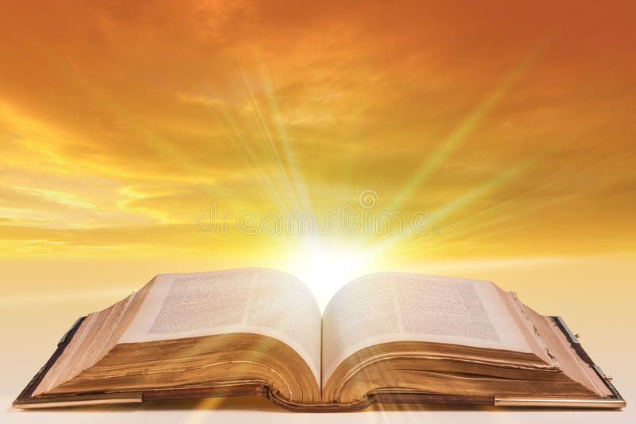
The Word of the Lord
The Lord be with you.
All: and with your spirit
A reading from St. Luke’s Gospel
All: Glory to you o lord.
Now on his way to Jerusalem, Jesus travelled along the border between Samaria and Galilee. As he was going into a village, ten men who had leprosy met him. They stood at a distance and called out in a loud voice, “Jesus, Master, have pity on us!”
When he saw them, he said, “Go, show yourselves to the priests.” And as they went, they were cleansed. One of them, when he saw he was healed, came back, praising God in a loud voice. He threw himself at Jesus’ feet and thanked him—and he was a Samaritan. Jesus asked, “Were not all ten cleansed? Where are the other nine? Has no one returned to give praise to God except this foreigner?” Then he said to him, “Rise and go; your faith has made you well.”
The Word of the Lord Response: Praise to you Lord Jesus Christ
Lord help us to show love and compassion in our world. Help us to see that all are created in your image and we are called to follow Jesus’ example and have faith in him and live out that faith min our daily lives.
Lord in your mercy……….Hear our prayer

Slide 3
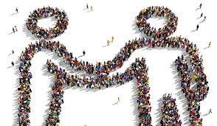
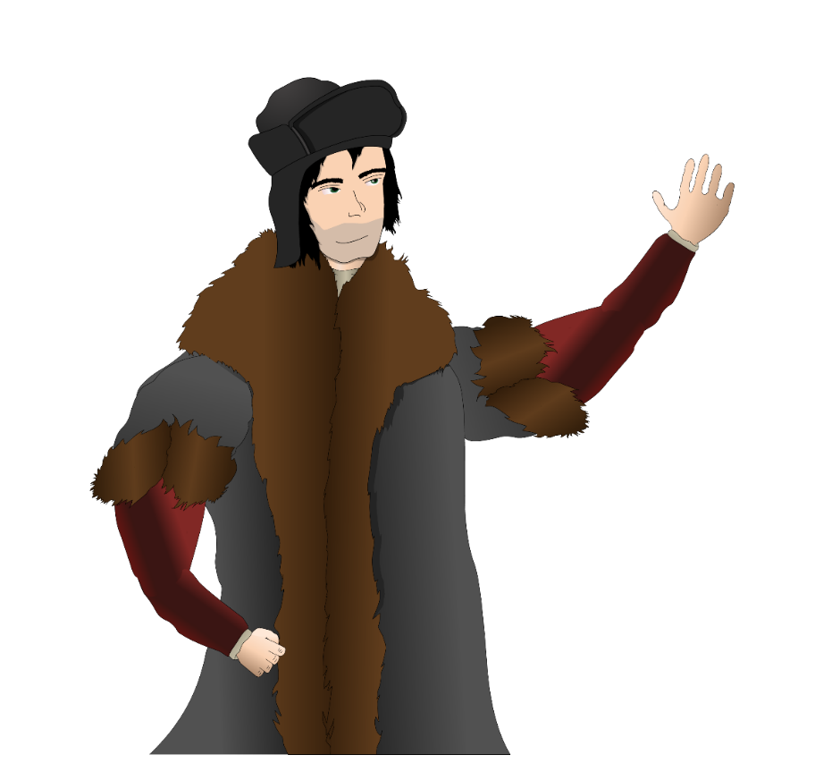
Response to the word of God.
Tolerance
We focus today on the value of tolerance. Tolerance is an important concept that helps people to live together peacefully. Tolerance also means that you don't put your opinions above those of others, even when you are sure that you are right. Tolerant people show strength in that they can deal with different opinions and perspectives. Tolerance is about respecting others.
Take time today to think about how tolerant you are?
We pray for the gift of tolerance: that through God’s grace we may be
good neighbours to each other, respecting and caring for those around us.
Lord in your mercy…..Hear our prayer

Slide 4
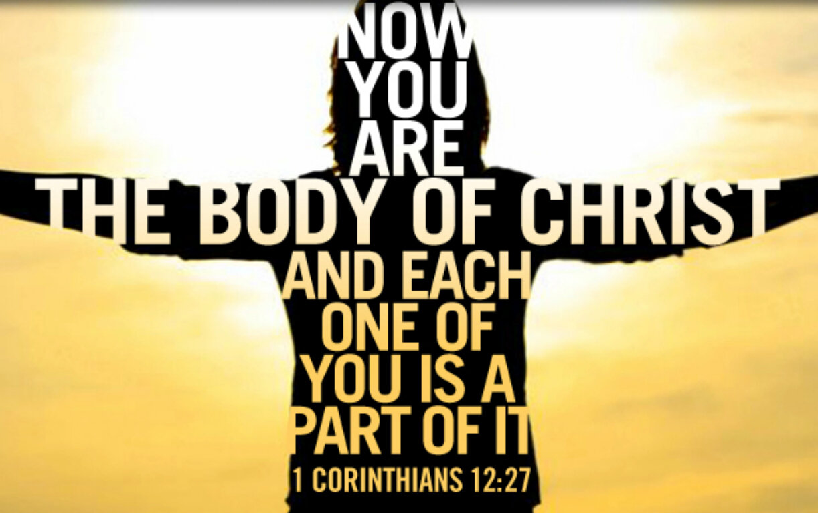
Reflection: How can we be tolerant?
The Body of Christ is not a building or specific church, but rather is a community of believers of all time since Pentecost. Each person has an important role to play as part of the body. We all have different gifts and talents given us by God.
Take a moment this morning to think about the gifts and talents you have been given………Do you use your talents to become the person God has created you to be?
Generous God, we give you thanks for the gifts and talents that you have given us. Help us to make the best use of them that we can and to serve you in all that we do.
Lord, in your mercy…Hear our prayer

Slide 5
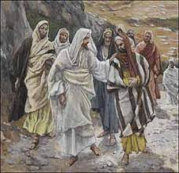
We Reflect Together
We are called by Jesus to be more tolerant. Jesus’ own disciples wanted to punish some Samaritans who didn’t welcome Jesus into the village to their differing beliefs, and in turn the disciples showed intolerance to them.
“And he sent messengers on ahead, who went into a Samaritan village to get things ready for him; but the people there did not welcome him, because he was heading for Jerusalem. When the disciples James and John saw this, they asked, “Lord, do you want us to call fire down from heaven to destroy them?” But Jesus turned and rebuked them. Then he and his disciples went to another village.”
St Luke gospel
Do we show tolerance to those we meet?
Do we show tolerance in school?
What are the qualities of tolerance?
Why is tolerance important in society?
Lord,as we work together to build your kingdom, let us be the light that leads the world to you. Teach us to be good role models to the people around us. May they see you and your love within us. Lord, in your mercy…Hear our prayer

Slide 6
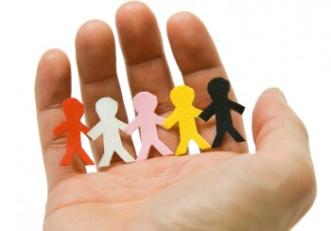
GOING FORTH
Just as God holds us in the palm of his hands, so we are called to hold others by being there for them. Let us think today of the people who we are close to. Let us be attentive to their needs today by offering a helping hand, being tolerant, by going that extra mile, by being generous with our time. In all of these things, we can build stronger communities, based on Christ’s love.
ALL: Lord, we pray for those who need our help today. For those who are worried, for those who feel lonely, for those who are ill. On all these people, we ask your blessing.
Lord, in your mercy…Hear our prayer. Closing hymn: My God Loves Me

