Slide 1



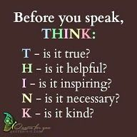
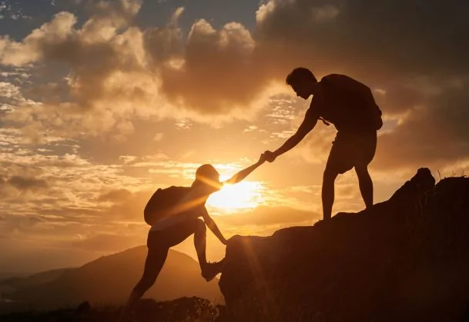
Good Samaritan - Love on another as I have loved you.
Gather: When I needed a neighbour
This week in school we aim to follow the example of the Good Samaritan who helped others in need. We focus on how we can help those in our school community.
What is our mission this week?
Our challenge this week is to be a Good Samaritan to others in school and have our efforts rewarded each day with an achievement point for enhancing the Catholic Life of our school.
Today we aim to be mindful of others’ feelings by speaking kindly and politely.

Slide 2

The Word of the Lord
The Word of God
A reading from St. Matthew’s Gospel
‘“When the Son of Man comes, it will be the same as what happened during Noah’s time. In those days before the flood, people were eating and drinking, marrying and giving their children to be married right up to the day Noah entered the boat. They knew nothing about what was happening until the flood came and destroyed them all. “It will be the same when the Son of Man comes. Two men will be working together in the field. One will be taken and the other will be left. Two women will be grinding grain with a mill. One will be taken and the other will be left. “So always be ready. You don’t know the day your Lord will come. What would a homeowner do if he knew when a thief was coming? You know he would be ready and not let the thief break in. So you also must be ready. The Son of Man will come at a time when you don’t expect him. 43.37-44
The Word of the Lord Response: Thanks be to God
We pray that, we remain alert as we await the coming of Jesus As we journey through Advent, we are offered a number of opportunities to prepare our hearts and minds for the coming of Jesus. Let us be loving and show forgiveness to one another
Let us say the Hail Mary together

Slide 3


Response to the Word of the Lord
Today we reflect on the value of tolerance. We aim to go out of our way to accept others and their views. We show this in class by listening respectfully to other people’s opinions.
Let us pray today that we may accept others as they are and listen to their views respectfully.
https://www.youtube.com/watch?v=6nPdjjhvf8c

Slide 4

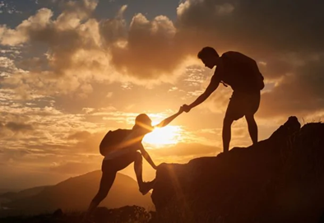
Tolerant Tuesday: We Reflect Together
Response to the Word
As we think of how we can be a Good Samaritan, we pray for all our intentions.
We give thanks for those people who accept us as we are and take time to listen to our views.
Lord in your mercy…..Hear our prayer
We pray that we might all take action to make sure that everyone in our school community is included and never feels alone.
Lord in your mercy…..Hear our prayer.
Let us say the Hail Mary together
Will you achieve an achievement point today for being ......tolerant?

Slide 5

Welcoming Wednesday: We Reflect Together
As we reflect on the theme of the Good Samaritan this week, we aim to be welcoming to everyone in our school community. We can do this by making everyone feel included in whatever we are doing.
We pray that our welcome of others may help each person in our school know that they are valued and respected.
Lord in your mercy……Hear our prayer
Will you achieve an achievement point today for being ......welcoming?
https://www.youtube.com/watch?v=k_IVyBxFQo4

Slide 6

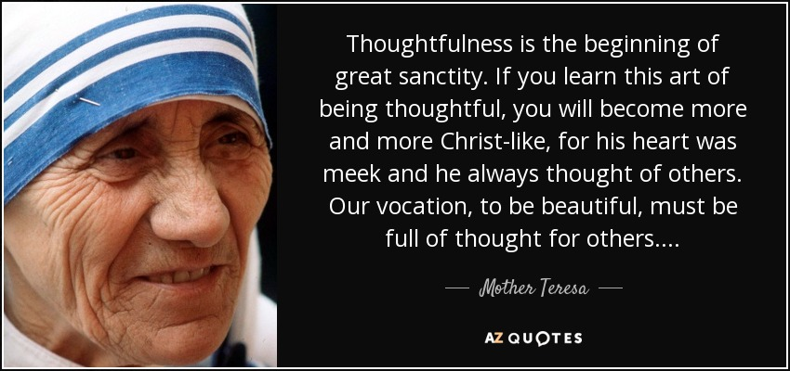
We Reflect Together
As we think of the ways we can be thoughtful, we pray for all our intentions.
We pray that we may always think of others and their needs.
Lord in your mercy……Hear our prayer
We pray that we are thoughtful in how we speak to others.
Lord in your mercy….Hear our prayer
Will you achieve an achievement point today for being ......thoughtful?

Slide 7
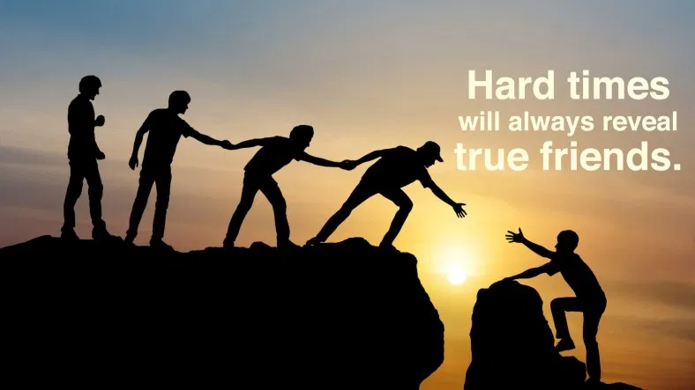
Going Forth
https://www.youtube.com/watch?v=5xtLBRdBQWU
Going Forth
We pray that we will always be a true friend to those who need us.
Lord in your mercy…..Hear our prayer
We pray that we do not take our friends for granted but that we show them how much we appreciate them.
Lord in your mercy…Hear our prayer
Will you achieve an achievement point today for being ......a true friend?
Gather: When I needed a neighbour

