Slide 1
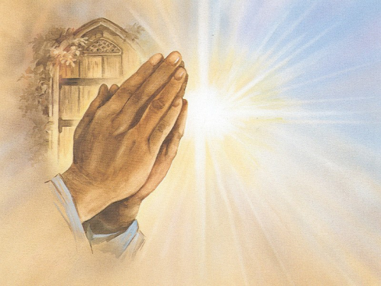
The Lord’s Prayer
Gather / Cynnull
Welcome everybody to KS2’s collective worship.
Croeso pawb i addoli ar y cyd blwyddyn pedwar.

Slide 2
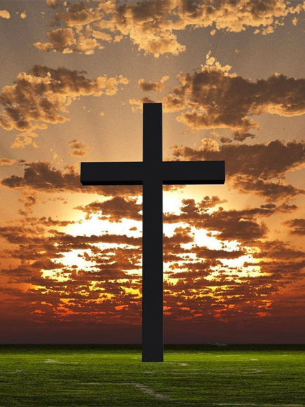
Let us pray
Gather / Cynnull
Gadewch i ni wneud arwydd y groes
Yn enw’r Tad, a’r Mab, a’r Ysbryd Glan, Amen.

Slide 3
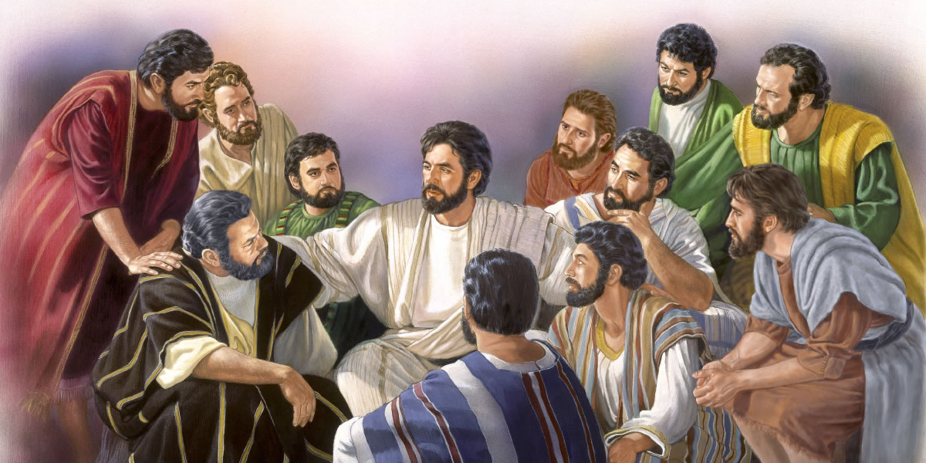
The Lord’s Prayer
The Word / Y Gair
Today we will be thinking about the importance of the Lord’s Prayer in our Christian faith.

Slide 4
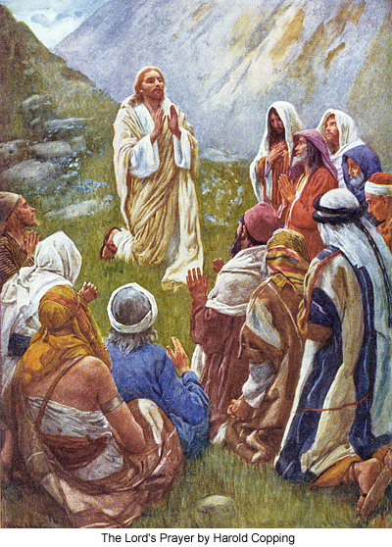
The Word / Y Gair
The Lord’s Prayer is sometimes referred to as the ‘perfect prayer’
This is because it was first said by Jesus himself when he was teaching his disciples the way to pray to God our Father.

Slide 5
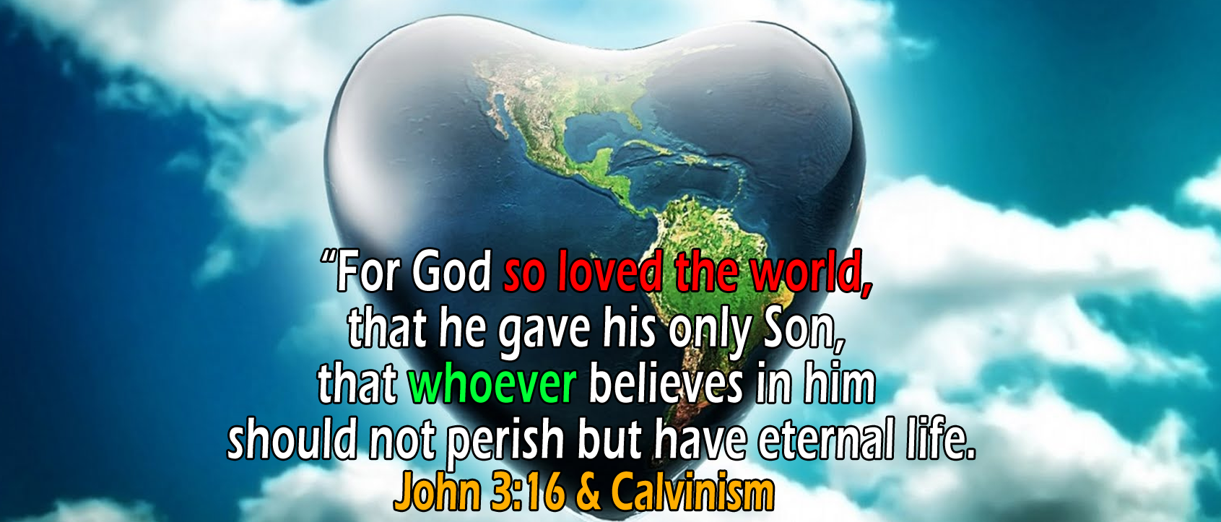
The Word / Y Gair
Gospel Acclamation
Alleluia, Allelluia
God loved the world so much than he gave his only son;
Everyone who believes in him has eternal life.
Allelluia, Allelluia

Slide 6
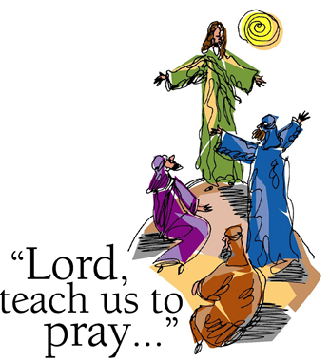
The Word / Y Gair
The Lord be with you
All: And with your spirit.
A reading from the Holy Gospel according to Luke.
All: Glory to you o Lord. (Cross your forehead, mouth and heart)
Jesus’ Teaching on Prayer
11 One day Jesus was praying in a certain place. When he finished, one of his disciples said to him, “Lord, teach us to pray, just as John taught his disciples.”
² He said to them, “When you pray, say:
“‘Father,
hallowed be your name,
your kingdom come.
³ Give us each day our daily bread.
⁴ Forgive us our sins,
for we also forgive everyone who sins against us.
And lead us not into temptation.”
The word of the Lord
All: Praise to you, Lord Jesus Christ.

Slide 7
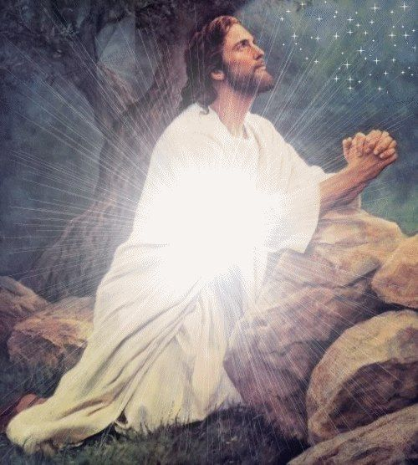
Responding to the Word / Ymateb i'r Gair
Help us to understand that ‘’Our Father who art in heaven’’ helps us to understand God is the Father of everyone.
Lord in your mercy,
All: Hear our prayer.

Slide 8
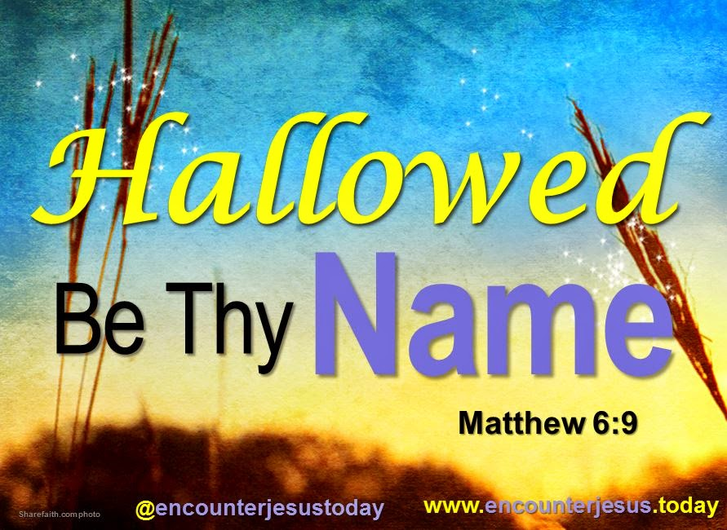
Responding to the Word / Ymateb i'r Gair
Guide us in remembering that “hallowed be thy name” means that your name is holy.
Lord in your mercy,
All: Hear our prayer.

Slide 9
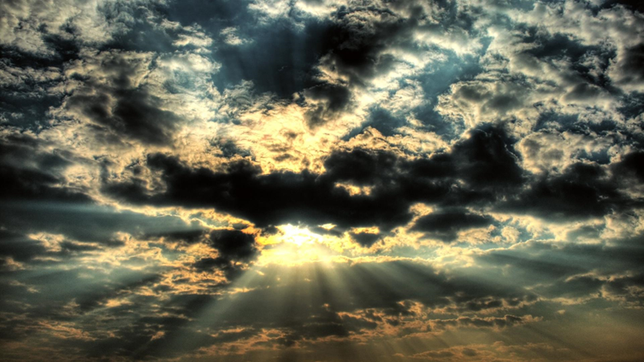
Responding to the Word / Ymateb i'r Gair
Guide us to understand that “your kingdom come” means God’s Kingdom will come to every Christian and God is their King. That they live by His commandments and let him ‘rule’ in their hearts.
Lord in your mercy,
All: Hear our prayer.

Slide 10
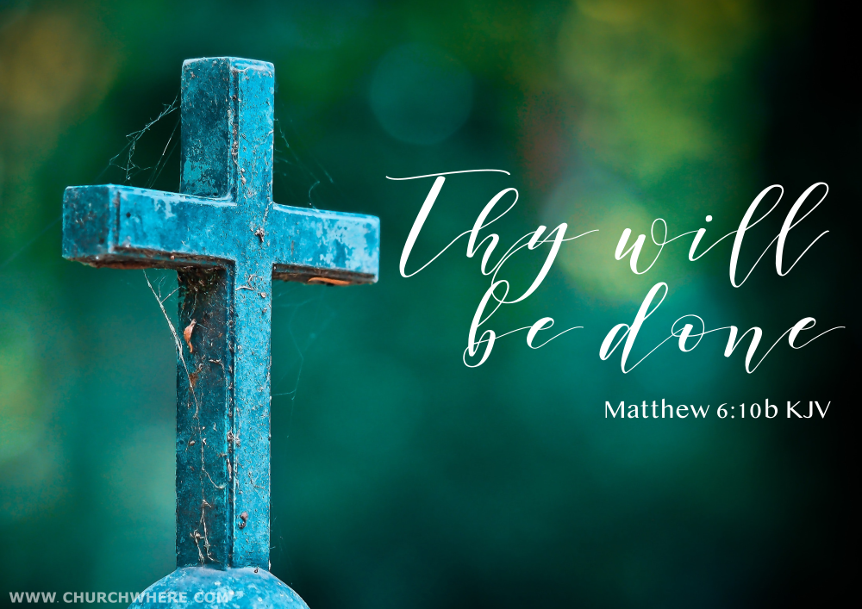
Responding to the Word / Ymateb i'r Gair
Guide us to understand than when we say the words “Thy will be done” Christians believe that they should not always do just what they want to do, but live according to God’s will. That His will is done, and not ours. Living in peace and love.
Lord in your mercy,
All: Hear our prayer.

Slide 11
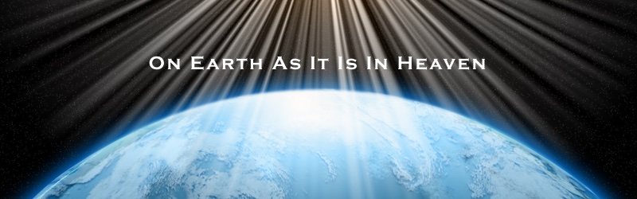
Responding to the Word / Ymateb i'r Gair
Guide us to understand than when we say the words “on earth as it is in heaven” we are being asked to appreciate that heaven is a beautiful, loving, caring and perfect place, and that life on earth would be wonderful if it could be more like that in daily life.
Lord in your mercy,
All: Hear our prayer.

Slide 12
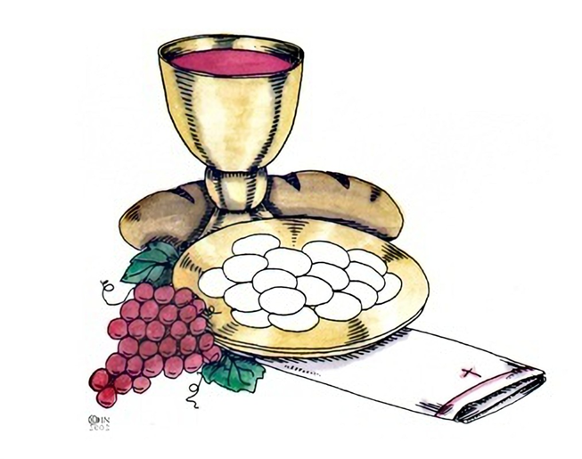
Responding to the Word / Ymateb i'r Gair
Guide us to understand than when we say the words “Give us this day our daily bread” that we are asking God our Father for the food and nourishment of the body, but also the need to ‘feed’ our minds and spirits. We are asking for spiritual growth and to ‘feed’ our spirits through prayer and reading the Bible. Help us to trust God to give us what we need.
“Lord in your mercy,
All: Hear our prayer.

Slide 13
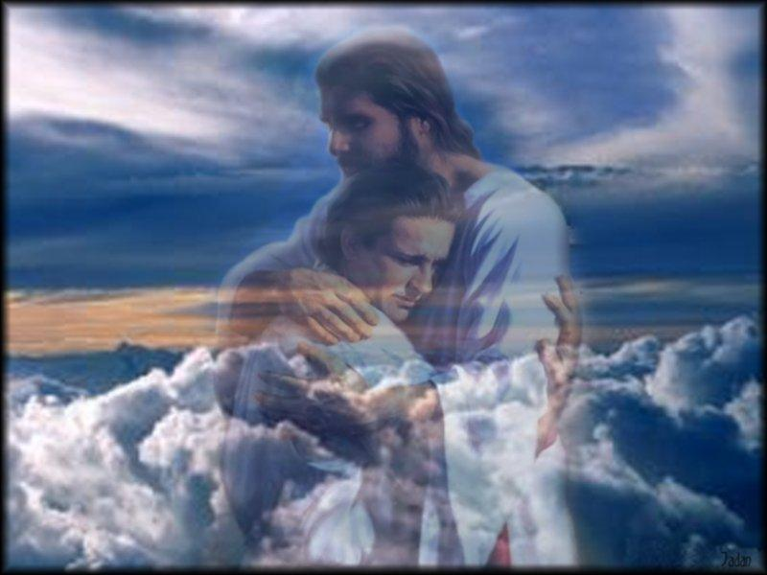
Responding to the Word / Ymateb i'r Gair
Guide us to understand than when we say the words “And forgive us our trespasses” we are asking for God’s forgiveness when we have
done wrong or made bad choices.
“Lord in your mercy,
All: Hear our prayer.

Slide 14
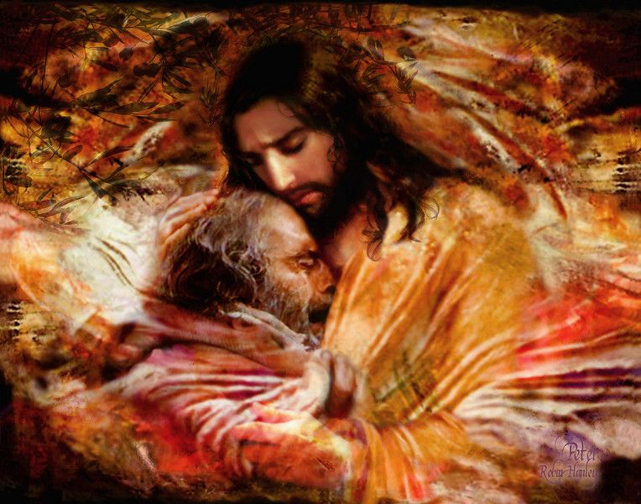
Responding to the Word / Ymateb i'r Gair
Guide us to understand than when we say the words “As we forgive those whose trespass against us” that not only can Christians ask God for forgiveness, they must also learn to forgive people who have upset or hurt them. People cannot forget forgiveness without letting go of anger, grudges and unpleasant thoughts about others.
“Lord in your mercy,
All: Hear our prayer.

Slide 15
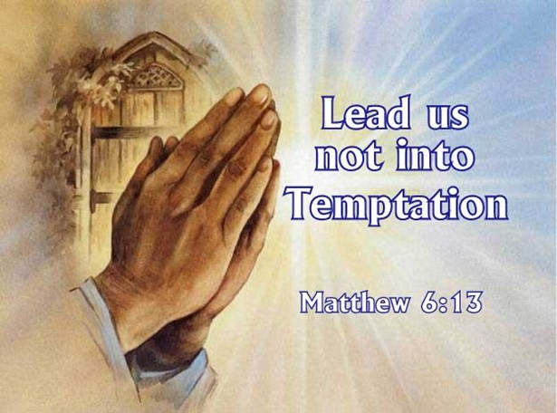
Responding to the Word / Ymateb i'r Gair
Guide us to understand than when we say the words “And lead us not into temptation” that when tempted to make a bad choice in what we say or do, no one should say, 'God is tempting me.' For God cannot be tempted by evil, nor does he tempt anyone. We should try as hard as we can to make good choices and live out Jesus’s example to us.
“Lord in your mercy,
All: Hear our prayer.

Slide 16
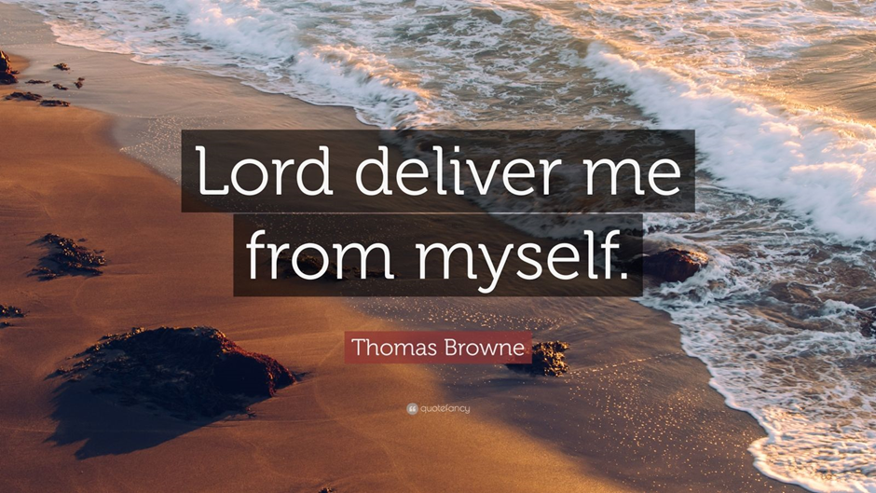
Responding to the Word / Ymateb i'r Gair
Guide us to understand than when we say the words “But deliver us from evil “ that evil is anything that leads a person away from God, it can get in the way of a good relationship with God and others. Christians ask God for protection from evil.
Lord in your mercy,
All: Hear our prayer.

Slide 17
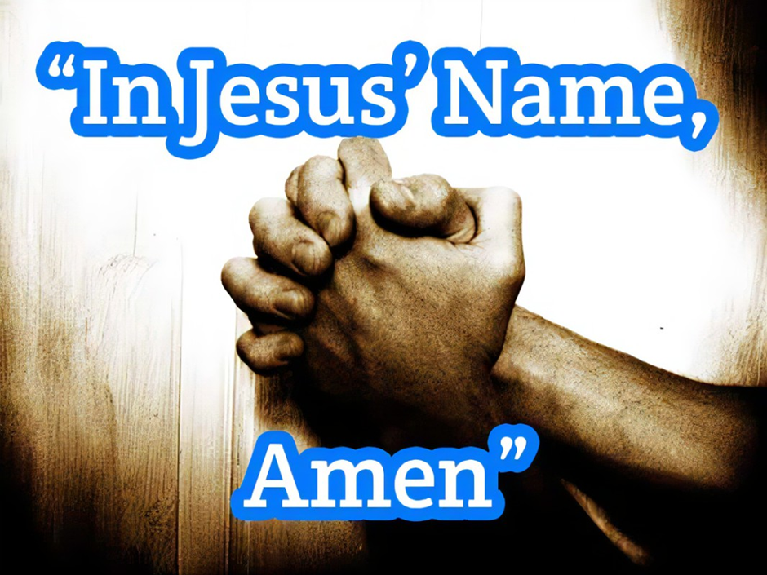
Responding to the Word / Ymateb i'r Gair
Guide us to understand than when we say the words “Amen” that this word means ‘So be it’. It is a form of blessing at the end of the prayer.
Lord in your mercy,
All: Hear our prayer.

Slide 18
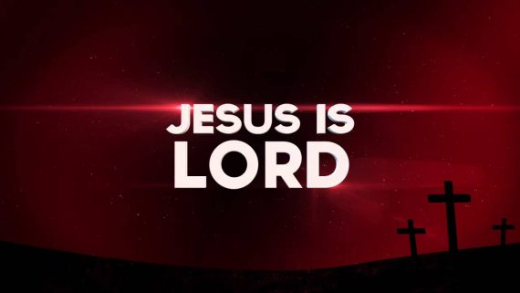
Going Forth / Wrth Symud Ymlaen
We thank you Lord for the gift that is ‘The Lord’s Prayer’. Help us to find time every day to say this most ‘perfect prayer’ so that we are guided to live and follow your holy example each day of our lives.

Slide 19
Going Forth
We thank you Lord for the gift that is ‘The Lord’s Prayer’. Help us to find try every day to say this most ‘perfect prayer’ so that we are guided to live and follow your holy example each day of our lives. Gweddïwn
Mae’n Amser Gweddi.
Dwylo ynghyd, llygaid ar gau.

Slide 20
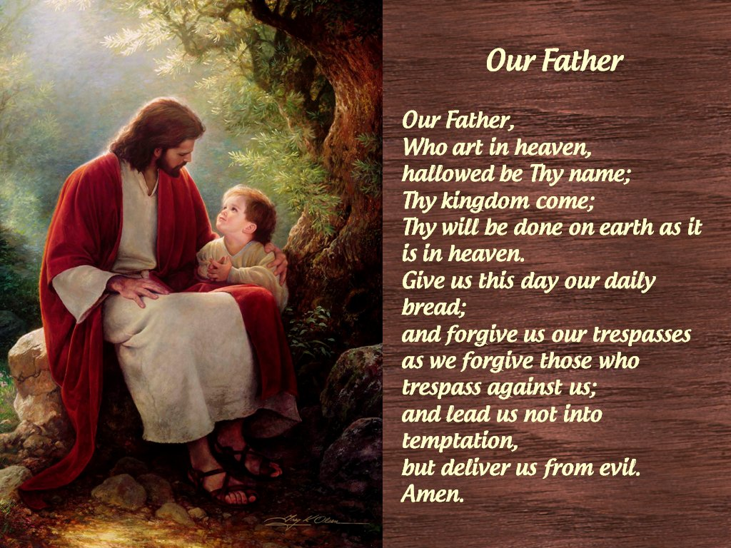
Going Forth
Let us as a faith community end our collective worship by saying together ‘The Lord’s Prayer.’

Slide 21
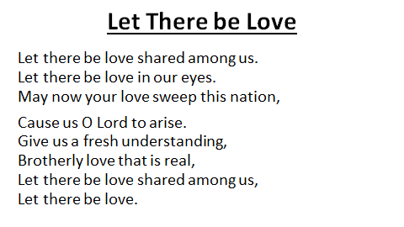
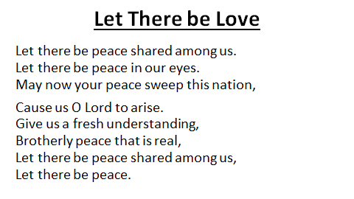
Going Forth
Let us come together as a school community and sing ‘let there be loved shared among us.

