Slide 1
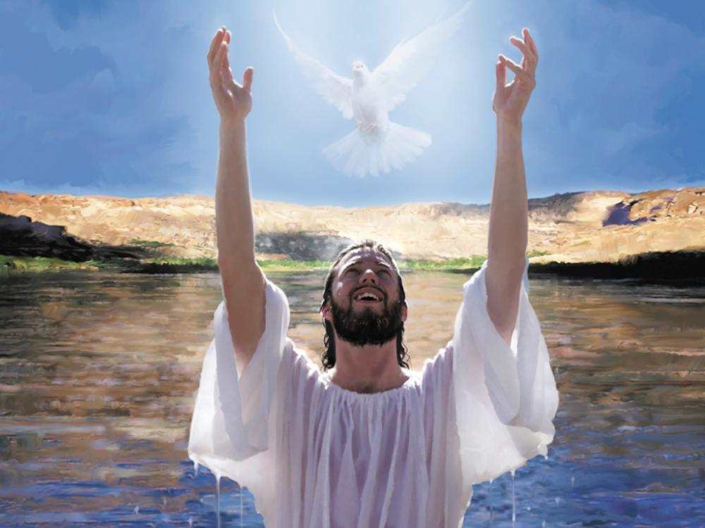
Promises
Gathering Together

Slide 2
Jacob Bux and Imogen Morgan:
Please listen to our opening song ‘Standing on the promises of God.’

Slide 3
Standing on the promises of Christ my King,
Through eternal ages let His praises ring,
Glory in the highest, I will shout and sing,
Standing on the promises of God.
  Refrain:
  Standing, standing,
  Standing on the promises of God my Savior;
  Standing, standing,
  I’m standing on the promises of God.

Slide 4
!
Standing on the promises that cannot fail,
When the howling storms of doubt and fear assail,
By the living Word of God I shall prevail,
Standing on the promises of God.
Standing on the promises I now can see
Perfect, present cleansing in the blood for me;
Standing in the liberty where Christ makes free,
Standing on the promises of God.
Standing on the promises of Christ the Lord,
Bound to Him eternally by love’s strong cord,
Overcoming daily with the Spirit’s sword,
Standing on the promises of God.
Standing on the promises I cannot fall,
List’ning every moment to the Spirit’s call,
Resting in my Savior as my all in all,
Standing on the promises of God.

Slide 5
Samuel Morgan and Kyliesha Henry:
At our baptism we receive a baptismal candle and the whole congregation is asked to renew the promises that were made on their behalf to follow the example OF God and to bring us up within the Christian faith.

Slide 6
Samuel T and Ryan
We light a candle to show that God is with us. We ask you to gather with us to repeat the promises that were made at our baptisms.

Slide 7
Emilia: Do you reject Satan?
SCHOOL COMMUNITY: I do.
Callum: And all his works?
SCHOOL COMMUNITY: I do.
Jovanna: And all his empty promises?
SCHOOL COMMUNITY: I do.
Ethan Ho: Do you believe in God, the Father Almighty, creator of heaven and earth?
SCHOOL COMMUNITY: I do.

Slide 8
Izaak: Do you believe in Jesus Christ, his only Son, our Lord, who was born of the Virgin Mary , was crucified, died, and was buried, rose from the dead, and is now seated at the right hand of the Father?
SCHOOL COMMUNITY: I do.
Fia: Do you believe in the Holy Spirit, the holy Catholic church, the communion of saints, the forgiveness of sins, the resurrection of the body, and life everlasting?
SCHOOL COMMUNITY: I do.

Slide 9
SCHOOL COMMUNITY: I do.
Joel: God, the all-powerful Father of our Lord Jesus Christ has given us a new birth by water and the Holy Spirit, and forgiven all our sins. May he also keep us faithful to our Lord Jesus Christ for ever and ever
SCHOOL COMMUNITY: Amen.
Each child reads a promise they have made as part of their spiritual learning on the topic of ‘Promises’

Slide 10

Gospel Acclamation – To be sung
Gospel Procession – Ruben and Imogen

Slide 11
The story of the Baptism of Jesus
A Reading from the Gospel of Mark
All: Glory to you o Lord.
Charlie: There once was a man named John the Baptist, who actually was one of Jesus’ cousins. He became a preacher and was telling others to ask for forgiveness for things they had done wrong. He wanted to help others change their lives so they could become like a brand new person inside.
Kayliesha: He was doing this not to be better than Jesus, but to help Jesus. By preaching to others to feel bad for their mistakes, to ask for forgiveness, and by teaching that they needed God in their life he was preparing the people to hear from Jesus himself.

Slide 12

Francis: For food he ate insects like locusts (which are kind of like grasshoppers) and he would find some wild honey to eat with them. Remember John wanted to live a simple life, he felt like God was all he needed. Nothing else was more important.

Slide 13
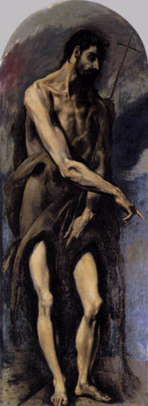
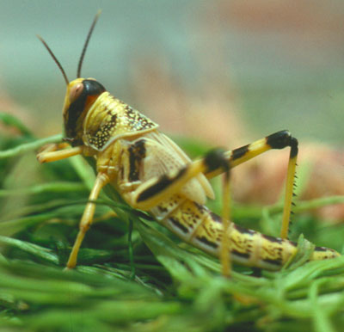
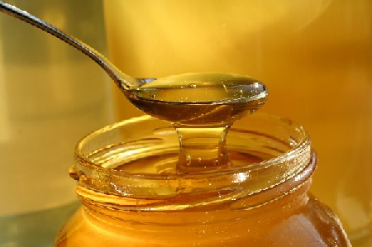
John the Baptist had an urgent Message
Imogen: John was Jesus’ cousin.
Sam: John was passionate about the need for people to give up their past wickedness and make a fresh start and could be quite rude to people who he thought needed to change their ways.
John spent all his time travelling and preaching this message. He didn’t really look after himself and had to survive on locusts and honey.

Slide 14
http://www.youtube.com/watch?v=sM90zBhg0DQ
A clip from Jesus of Nazareth
John the Baptist preaches his message

Slide 15
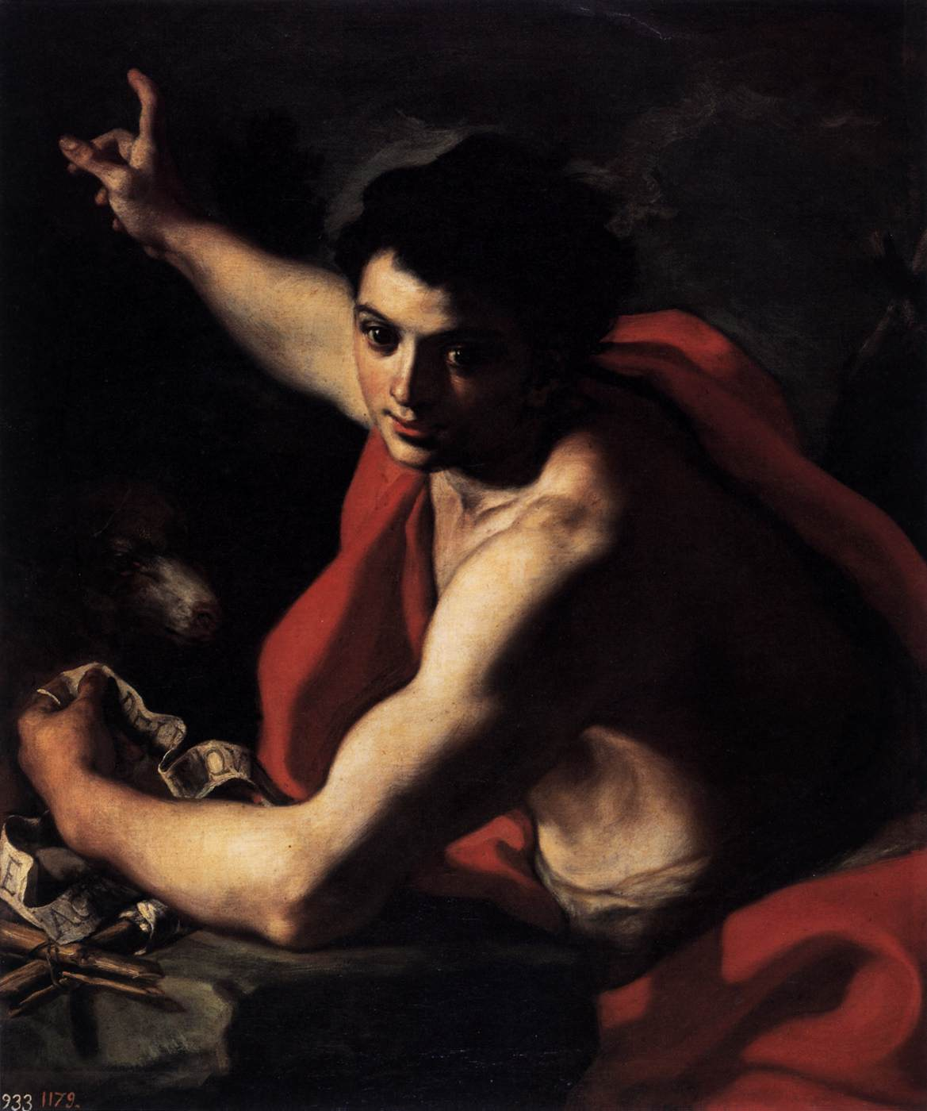
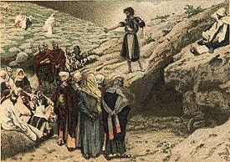
Ethan: Because he preached with such conviction and urgency, many people wondered if he could be the Messiah.
Joel: John denied this and said that he was just a messenger sent to prepare them.
…A voice crying in the wilderness, “Prepare the way of the Lord.” Isaiah

Slide 16
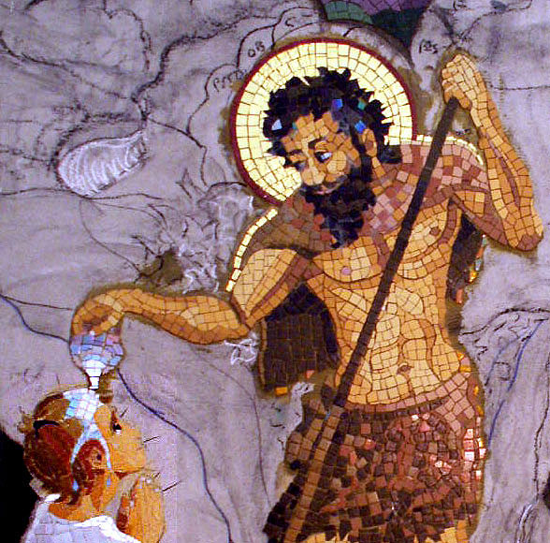
Fia: John thought people should do something special to show that they wanted to lead a Godly and good life.
Jens: Making promises wasn’t enough – it had to be public and symbolic. He asked people to be baptised.
Jesmine: The word ‘baptised’ comes from the Greek meaning ‘immersing’; an act of cleansing in water.

Slide 17
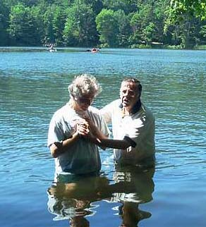
Repentance + Baptism
Ethan S. The idea that people can say sorry for their sins is known as repentance. It means that people promise to try and change their thoughts, words and actions to be forgiven.
Ava: John used to take people to the river Jordan and duck them under the water as a sign that they had changed. The water was symbolic that they had literally washed away their sin and past life.
Callum: John believed that if people made this promise publically, they were far more likely to stick to their promise to try and be better people. Because John Baptised so many people he became known as John the Baptist.

Slide 18
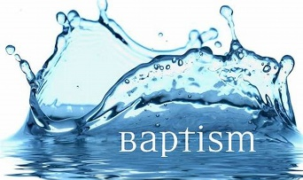
Jovanna: When a Christian believes in God, baptism is a way of showing others that they believe in Him and want to live their life the way they believe God wants.
Sherina: Christians believe it's like having a bath to make themselves clean on the inside. When a Christian get baptized it's a special way of showing that they understand that they have and need God's forgiveness.

Slide 19
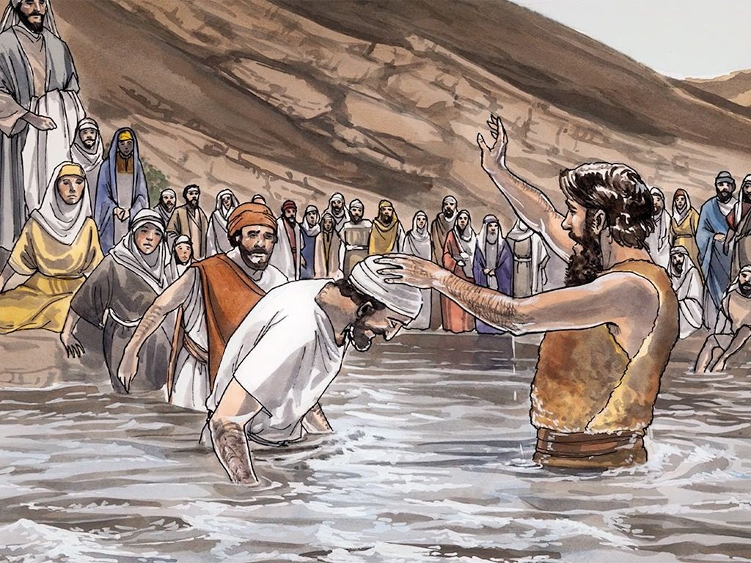
Samuel: John the Baptist said, “I baptise you with water, but one day, someone is going to come, who will baptise you with the Holy Spirit instead.”

Slide 20
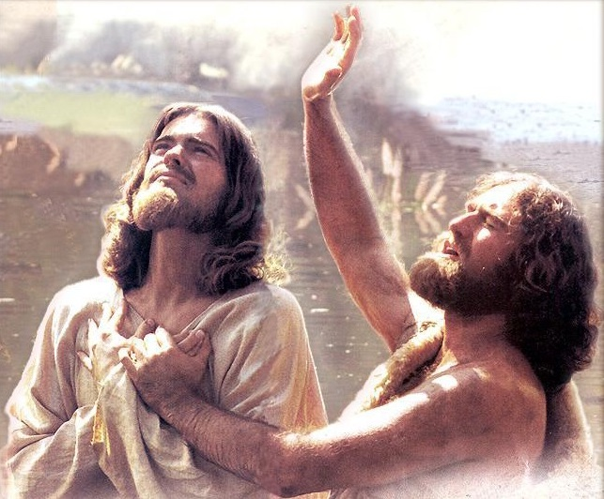
Jacob B.: John continued to preach and baptize people until one day Jesus came by to be baptized.
Lexi: John didn't know what to say, all he knew was that how could he, just a regular person baptize Jesus the Saviour of the world.

Slide 21
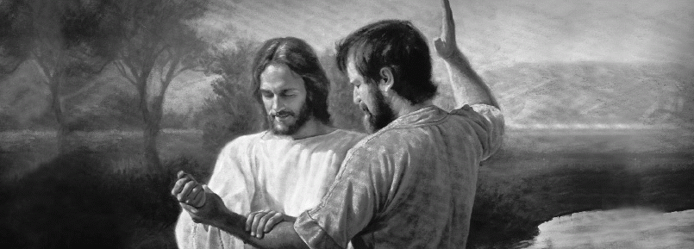
Joseph: One day Jesus came to his cousin John and asked to be baptised. John knew that there was something very special about Jesus and said that he wasn’t even good enough to touch Jesus’ feet.
Samuel: John was reluctant to Baptise Jesus – a good man without sin and said, “I should be Baptised by you!” Jesus told him to Baptise him though so he went ahead with it.
Matthew 3.13

Slide 22
http://www.youtube.com/watch?v=_CVXBCfdrF8
A clip from Jesus of Nazareth
John baptises Jesus

Slide 23
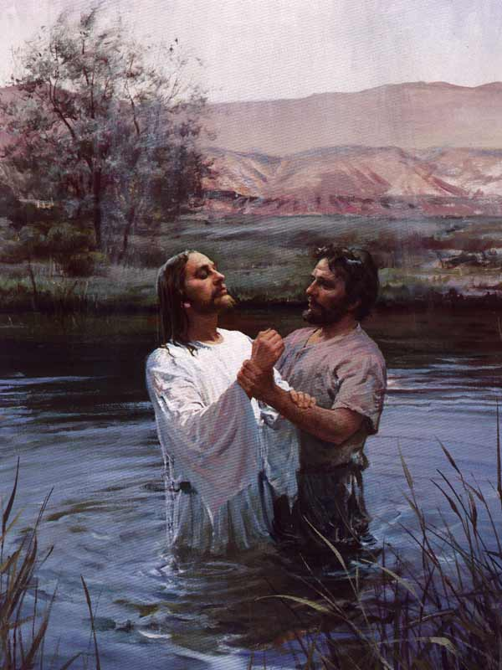
Luiza: Why do you think that Jesus insisted on being Baptised?

Slide 24
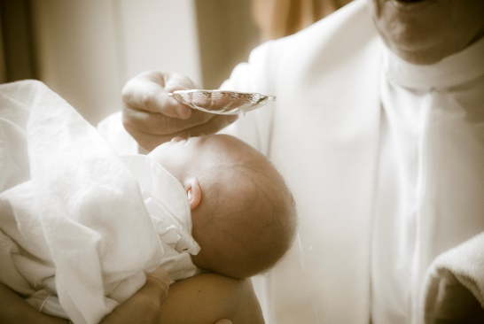
Ava: Jesus wanted to us to be baptised to wash away our wrong doings and to welcome us into the family of God.

Slide 25
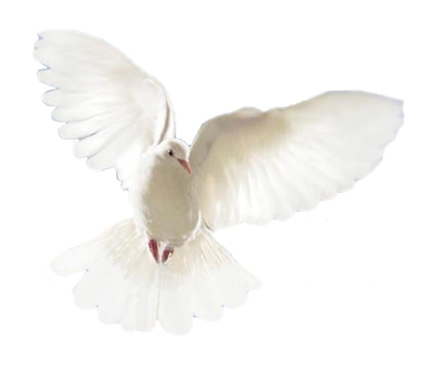
Caleb: When Jesus came up from the water John heard the Voice of God saying: "This is my beloved son, in whom I am well pleased."
Joel: The Bible says that God’s spirit of peace came in the form of a white dove.
Ethan: This event has great significance in Jesus’ life because from that moment – Jesus realised that he was God’s chosen one – and that he had his own message to bring to mankind.

Slide 26
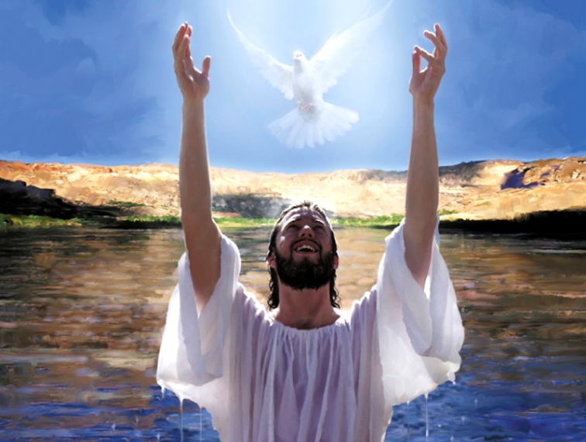

Slide 27
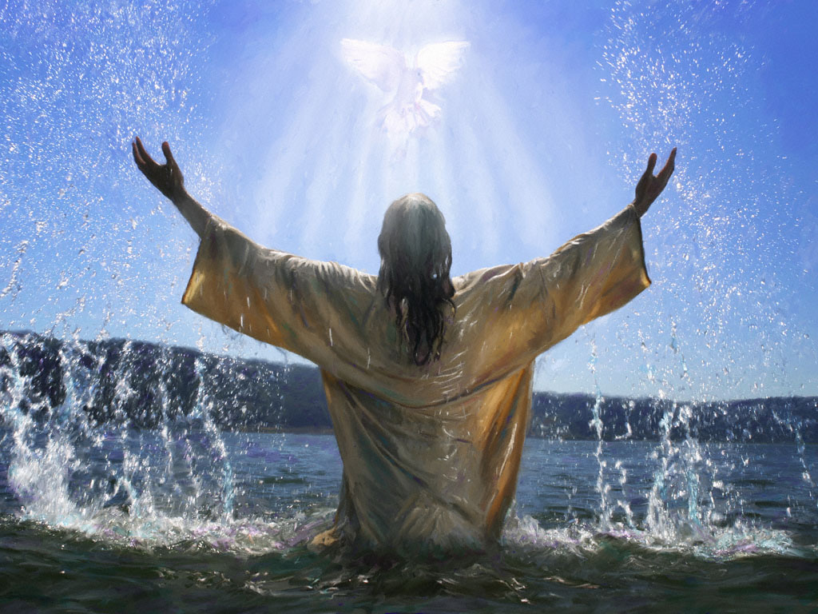

Slide 28
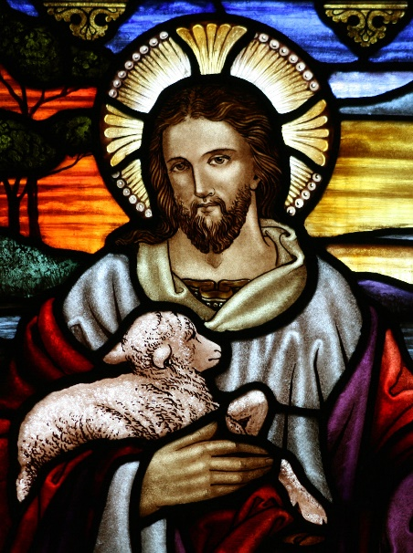
Imogen: The Word of the Lord
All: Thanks be to God

Slide 29
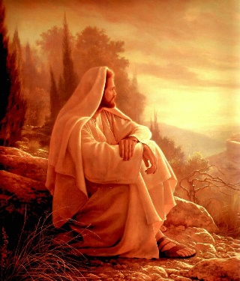
Charlie: Inspired by the words of St Mark, who knew that it is not always easy to be loving, let us ask God to help us to keep our promises by sending the Holy Spirit to support us.
Jesmine The response is “Lord, help me to show love.”
All: “Lord, help me to show love.”

Slide 30
Izzak: When I am impatient or unkind/R
All: “Lord, help me to show love.”
Jacob J.: When I am jealous/R
All: “Lord, help me to show love.”
Lexi: When I am boastful or conceited/ R
All: “Lord, help me to show love.
Fia: When I am rude or selfish/R
All: “Lord, help me to show love.”

Slide 31
Kyleisha: When I take offence or am resentful/R
All: “Lord, help me to show love.
Ava: When I tell lies or gossip about others/R
All: “Lord, help me to show love.
Samuel M : Let us take (join) hands to show that we are friends with one another as Jesus asked us to be. Then say together the prayer that Jesus taught his followers..“Our Father…”

Slide 32
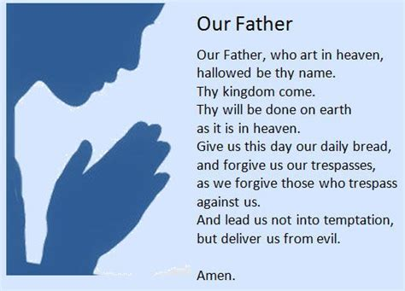

Slide 33
Joel: Before we sing our closing hymn, let us remember now make a silent promise to try live like Jesus for the rest of the day and ask his help if we need it.
Final hymn: “Abba, Father”

Slide 39
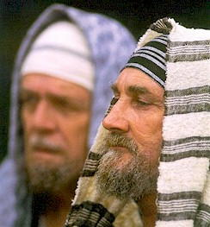
Waiting for the Messiah
At the time of Jesus, the Jewish people were waiting hopefully for the arrival of the Messiah.
Whilst the Essenes, Pharisees, Sadducees and Zealots had different expectations of what this man would be like, they agreed that the Messiah would be special and sent from God.

Slide 40
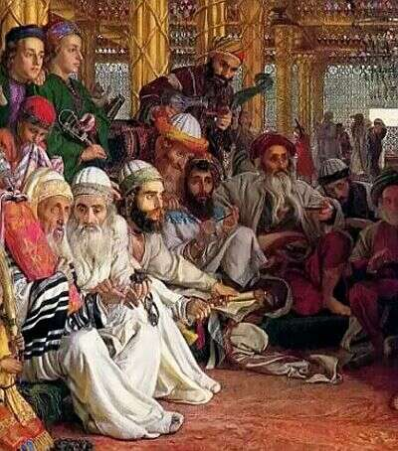
This Messiah would hopefully drive out to the Romans and free Palestine from Roman rule.
The Jews would know who the Messiah was because a messenger would come before him, whose job was to prepare the people for the Messiah.

Slide 41
John the Baptist had an urgent Message
Who was he? John was Jesus’ cousin.
John was passionate about the need for people to give up their past wickedness and make a fresh start and could be quite rude to people who he thought needed to change their ways.
John spent all his time travelling and preaching this message. He didn’t really look after himself and had to survive on locusts and honey.

Slide 42
http://www.youtube.com/watch?v=sM90zBhg0DQ
A clip from Jesus of Nazareth
John the Baptist preaches his message

Slide 43
Because he preached with such conviction and urgency, many people wondered if he could be the Messiah.
John denied this and said that he was just a messenger sent to prepare them.
…A voice crying in the wilderness, “Prepare the way of the Lord.” Isaiah

Slide 44
John thought people should do something special to show that they wanted to lead a Godly and good life.
Making promises wasn’t enough – it had to be public and symbolic. He asked people to be baptised.
The word ‘baptised’ comes from the Greek meaning ‘immersing’; an act of cleansing in water.

