Slide 1
Dysgu Proffesiynol Iaith Gymraeg
Welsh Language Professional Learning

Slide 2
Yr Wyddor
The Alphabet
a
apple
b
balloon
c
cat
ch
loch
d
dog
dd
then
e
when
f
very
ff
off
g
good
ng
bang
h
house
i
seen
tin
j
Jones
l
lion
ll
Llanelli
m
magic
n
not
o
orange
p
parrot
ph
photo
r
rice
rh
Rhian
s
sock
t
tackle
th
think
u
seen
tin
w
cool
y
jump
tin
seen

Slide 3
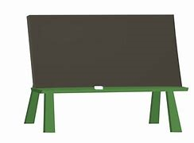

Llafariaid - Vowels
a
e
ae =
ai =
au = eye/a
ei =
eu =
i
o
u
heulog
w
si = sh
y

Slide 4
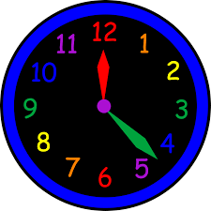
Cyfarchion - Greetings
Bore da Good morning
Prynhawn da Good afternoon
Noswaith dda Good evening
Nos da Good night
Bore da Mrs Morris Good morning Mrs Morris
Bore da blant Good morning children
Bore da bawb Good morning everyone
Bore da Jack Good morning Jack

Slide 5

Cyflwyno’ch hun – Introducing yourself
Sut wyt ti? How are you?
Hapus Happy
Trist Sad
Da iawn diolch Very well thank you
Gweddol So-so
Bendigedig Brilliant
Ofnadwy! Terrible!
Wedi blino Tired
A ti? And you?
Pwy wyt ti? Who are you?
Beth ydy dy enw di? What’s your name?
… ydw i. I’m …

Slide 6
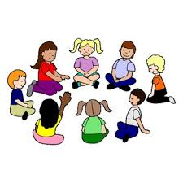
Gorchmynion Commands
Dewch i mewn Come in
Edrychwch Look
Gwrandewch Listen
Dewch i eistedd Come and sit down
Eisteddwch Sit down
Eisteddwch yn dawel Sit quietly
Eisteddwch mewn cylch Sit in a circle
Sefwch Stand
Sefwch mewn llinell Stand in a line
Sefwch wrth y drws Stand at the door
Cerddwch Walk

Slide 7
Amseroedd y dydd Times of the day
Mae hi’n amser chwarae It’s playtime
Mae hi’n amser cinio It’s lunch time
Mae hi’n amser gwasanaeth It’s assembly time
Mae hi’n amser llaeth It’s time for milk
Mae hi’n amser snac It’s snack time
Mae hi’n amser tacluso It’s time to tidy up
Mae hi’n amser peintio It’s time to paint
Mae hi’n amser canu It’s singing time
Mae hi’n amser golchi dwylo It’s time to wash hands
Mae hi’n amser stori It’s story time
Mae hi’n amser darllen It’s time to read
Mae hi’n amser mynd adre It’s home time

Slide 8











Lliwiau - Colours
red
blue
yellow
green
coch
glas
melyn
gwyrdd
orange
purple
pink
oren
porffor
pinc
brown
grey
black
white
brown
llwyd
du
gwyn

Slide 9
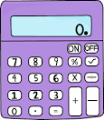
Rhifau - Numbers
0 dim 10 deg 20 dau ddeg
1 un 11 un deg un 30 tri deg
2 dau 12 un deg dau 40 pedwar deg
3 tri 13 un deg tri 50 pump deg
4 pedwar 14 un deg pedwar 60 chwech deg
5 pump 15 un deg pump 70 saith deg
6 chwech 16 un deg chwech 80 wyth deg
7 saith 17 un deg saith 90 naw deg
8 wyth 18 un deg wyth 100 cant
9 naw 19 un deg naw

Slide 10
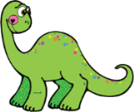



Cyfri - Counting
Sawl un? How many?
Sawl tedi? How many teddies?
Sawl un sydd yma? How many are here?
Sawl car sydd yma? How many cars are here?
Sawl … sydd yn y set? How many … are in the set?

Slide 11
Gofyn am bethau – Asking for things
Ga i … os gwelwch yn dda? Please may I have …?
Ga i’r … os gwelwch yn dda? Please may I have the …?
Cei / Na chei Yes you can/No you can’t
Dyma ti Here you are
Wrth gwrs Of course
Diolch Thank you
Diolch yn fawr Thank you very much
Ga i fynd i’r tŷ bach os gwelwch yn dda? Please may I go to the toilet?
Cei / Na chei Yes you can/No you can’t
Yn gyflym! Quickly!

Slide 12
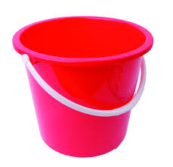
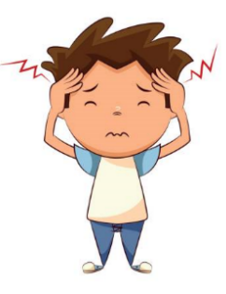


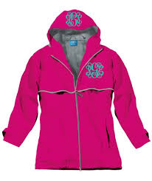

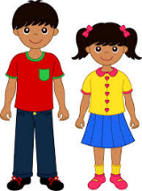

Oes ... gyda ti? – Have you got …?
Oes … gyda ti? Have you got [a]…?
Oes / Nac oes Yes I have/No I haven’t
Oes, mae … gyda fi. Yes, I have got [a] …
Nac oes, does dim … gyda fi. No, I haven’t got [a] …

Slide 13





Mynegi hoffter – Expressing likes
Beth wyt ti’n hoffi? What do you like?
Dw i’n hoffi ... I like ...
Dw i ddim yn hoffi … I don’t like …
Wyt ti’n hoffi …? Do you like …?
Ydw / Nac ydw Yes, I do / No, I don’t

Slide 14




Answering Yes/No
Ga i falŵn pinc? May I have a pink ballon? Cei/Na chei
Oes car coch gyda ti? Do you have a red car? Oes/Nac oes
Wyt ti eisiau pêl glas? Do you want a blue ball? Ydw/Nac ydw
Adjectives usually follow the noun in Welsh, eg
car coch pensil melyn pêl glas balŵn pinc

Slide 15
Ga i …?
Cei / Na chei
Oes …?
Oes / Nac oes
Wyt ti …?
Ydw / Nac ydw

Slide 16



Y Tywydd The Weather
Sut mae’r tywydd heddiw? How is the weather today?
Mae hi’n braf It’s fine
Mae hi’n heulog It’s sunny
Mae hi’n boeth It’s hot
Mae hi’n gymylog It’s cloudy
Mae hi’n oer It’s cold
Mae hi’n wyntog It’s windy
Mae hi’n stormus It’s stormy
Mae hi’n niwlog It’s foggy
Mae hi’n bwrw glaw It’s raining
Mae hi’n bwrw eira It’s snowing

Slide 17
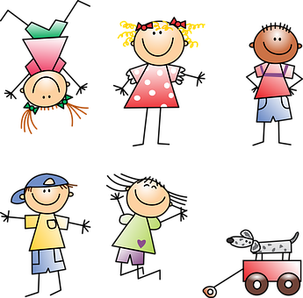
Gemau Iard
Playground Games

Slide 18
Dewch i chwarae!
Come and play!
Beth am chwarae …?
What about playing …?
Barod?
Ready?

Slide 19
Da iawn!
Well done!
Lwcus!
Lucky!
Dim ots!
Never mind!

Slide 20

Faint o’r Gloch, Mr Blaidd?
One pupil is chosen to be Mr Blaidd. Mr Blaidd stands at one end of the playing area with his/her back to the other pupils who are at the other end.
The pupils ask Faint o’r gloch Mr Blaidd? (What’s the time Mr Wolf?). Mr Blaidd answers a time, eg tri o’r gloch (three o’clock);
The pupils take the appropriate number of steps forward towards Mr Blaidd as quietly as they can! This is repeated until Mr Blaidd answers Amser cinio! (Lunch time!) and turns to try and catch one of the other pupils who must run back to the starting point
If a pupil is caught, they must join Mr Blaidd and help him to catch his next meal!

Slide 21
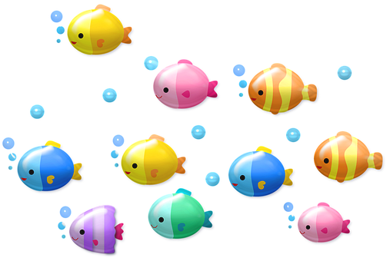
Pysgota
Three or four pupils stand in the middle of the playing area and join hands forming a net. Secretly they decide on a number between one and ten.
They hold their hands up in the air and begin to count – un, dau, tri, pedwar … (one, two, three, four …) and while they’re counting the other pupils run in and out like fish swimming in and out of the net.
When the pupils forming the net reach the number they decided upon they bring their hands down.
Any fish caught in the net must become part of the net and the game
begins again.

Slide 22

Gêm yr Enfys
One pupil is chosen to be on it. The other pupils form pairs and hold hands.
The pupil who is on it chases the pairs and when he/she tags them (either partner can be tagged) calls out Mae hi’n heulog (It’s sunny). The pair who has been tagged must stop running and join both hands to form a rainbow.
Rainbows can be freed by other pairs running through them and calling Mae hi’n bwrw glaw (It’s raining).
The game ends when all the pairs are rainbows!

Slide 23
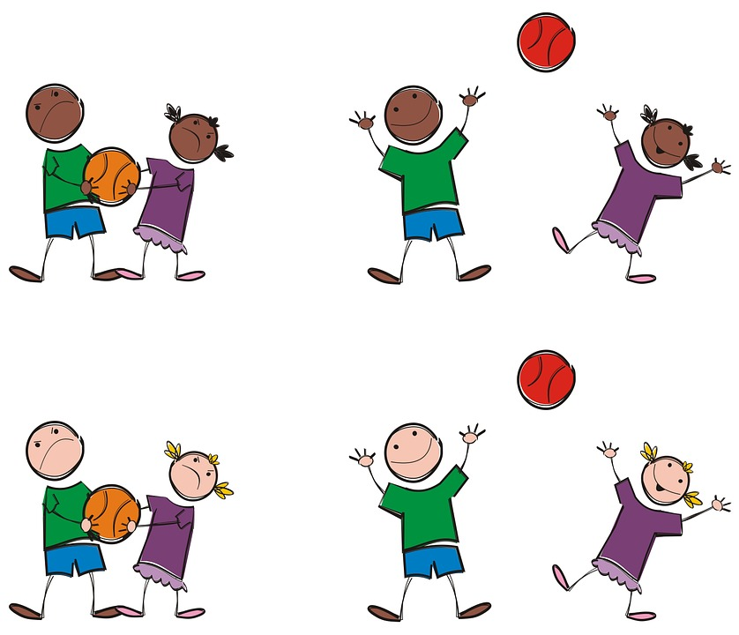
Ga i’r bêl os gwelwch yn dda?
One pupil stands with their back to the other pupils who are standing in a line.
The pupil throws a ball or bean bag over their shoulder for one of the pupils in the line to catch.
All the pupils in the line put their hands behind their backs and the pupil who threw the ball has three chances to guess who is holding the ball by asking Ga i’r bêl os gwelwch yn dda? (Please may I have the ball?)
The pupils answer, Na chei (No you can’t) or Cei! Dyma ti (Yes you can!
Here you are).

Slide 24
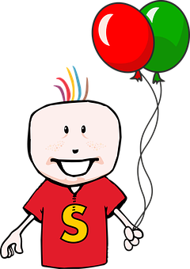
Coch, Gwyn a Gwyrdd
Everyone stands in a circle and is designated a colour – coch, gwyn, gwyrdd, coch … Someone calls a colour and everyone who is that colour walks clockwise around the outside of the circle.
The caller shouts adre! (home!) and they continue to walk until they reach their original space. The first one back becomes the caller.
Instead of adre! the caller could shout trowch! (turn around!) and pupils would need to change direction before they return to their original space.
Any type of vocabulary could be used to play this game.

Slide 25
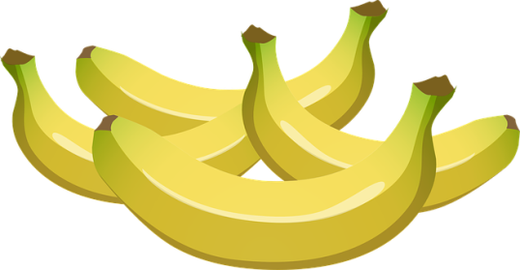
Un, Dau, Tri Banana
Pupils stand in a close circle and all put their fists in the middle and one pupil is chosen to be the counter.
All the pupils chant or sing –
Un, dau, tri banana One, two, three bananas
pedwar, pump, chwech banana four, five, six bananas
saith, wyth, naw banana seven, eight, nine bananas
deg banana melyn! ten yellow bananas!
The pupil chosen as the counter taps each fist in turn as the song is sung and whoever is tapped last is asked – Sawl banana wyt ti eisiau? (How many bananas do you want?) That pupil chooses a number between one and ten.
The counter then taps the fists around the circle that many times and whoever’s fist is tapped last must put that hand behind their back;
The game continues until there is only one pupil remaining with a fist in the circle and they are the winner.

Slide 26

Doctor, Doctor!
One pupil is chosen to be the doctor and must stand with his/her back to the rest of the pupils.
The other pupils join hands to form a circle and must jumble themselves into a knot but must not break the circle to do so.
When they’re ready they shout – Doctor, doctor! Dewch yn gyflym! (Doctor, doctor! Come quickly!)
The doctor then tries to untangle the knot by giving the instructions ewch o dan (go under) and ewch dros ben (go over)

Slide 27
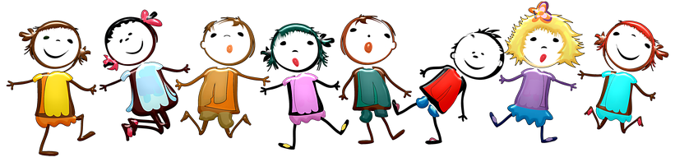
Un Dau Tri, Bant â Ni!
Everyone stands in a line one behind the other and places a hand on the shoulder of the person in front.
The pupil at the back of the line calls out – un dau tri, bant â ni! (one two three, off we go!).
The pupil at the front of the line then chases and tries to tag the pupil at the back but the line must remain intact at all times!
If the tag is successful, the pupil at the head of the line moves to the back and the game starts again.

Slide 28
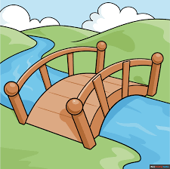
Pont y Fro
Two pupils make a bridge. The rest of the children sing …
Mae Pont y Fro yn cwympo lawr The … bridge is falling down
yn cwympo lawr, yn cwympo lawr. is falling down, is falling down.
Mae Pont y Fro yn cwympo lawr The … bridge is falling down
un, dau, tri! one, two, three!
Whilst singing, the pupils pass under the bridge.
The pupil to be trapped on the word ‘tri’ makes the bridge with one other person.

Slide 29
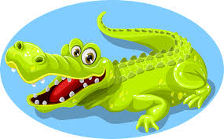
Ga i groesi’r afon?
The aim of the game is to cross the river without getting caught by the crocodile.
One pupil is chosen as the crocodile. The rest the of the pupils say ‘Ga i groesi’r afon?’ The crocodile replies with ‘Cei, os wyt ti’n gwisgo …’ Yes, if you are wearing … A colour is then stated.
If the pupils are wearing that particular colour they are free to cross. If they are not wearing that colour then they have to run to the other side of the river, without getting caught. If they are caught, they then become a crocodile.
The winner is the last pupil not to be caught.

Slide 30

Diolch yn fawr!

