Slide 1


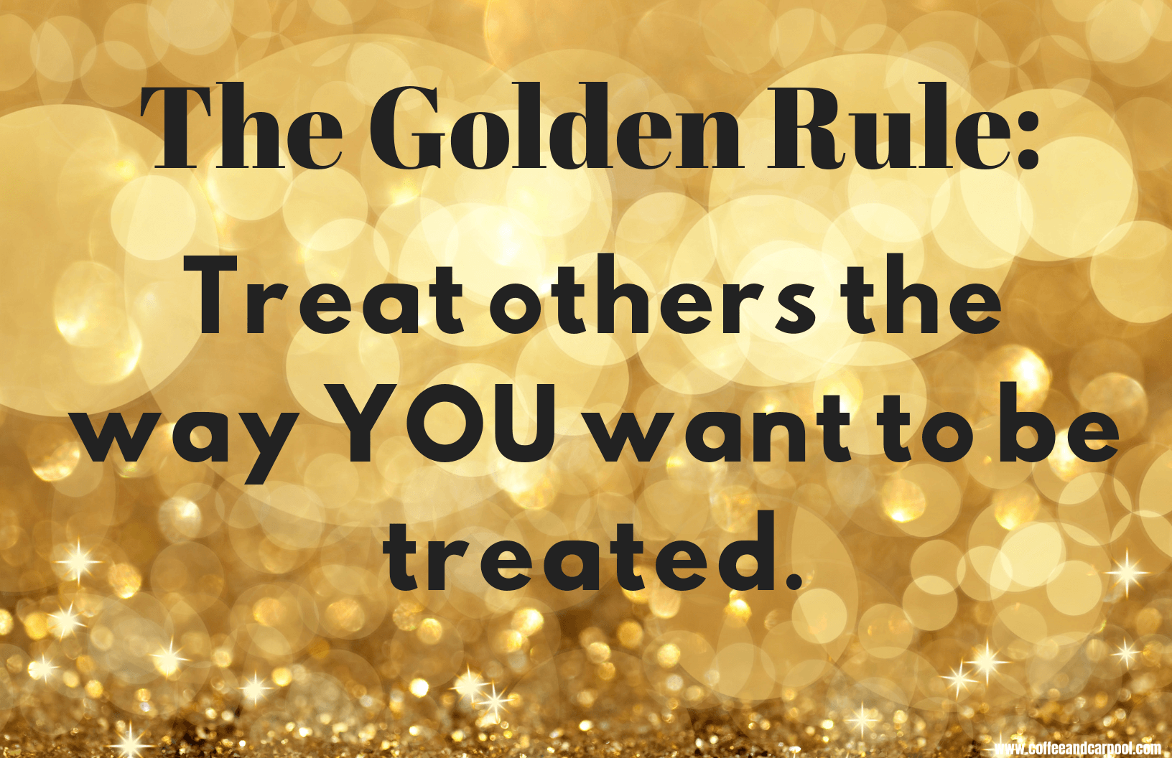
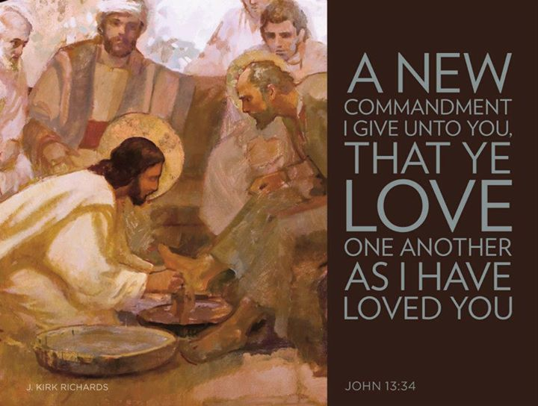
Gather: The Golden Rule
We gather as one … … …
Let us join our hands and make the sign of the cross.
‘ In the name of the Father and of the Son and of the Holy Spirit. Amen’

Slide 2
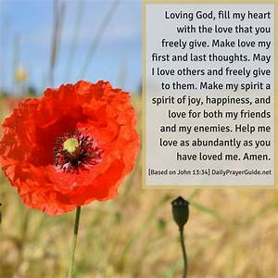
Gather: The Golden Rule
Opening Prayer:

Slide 3
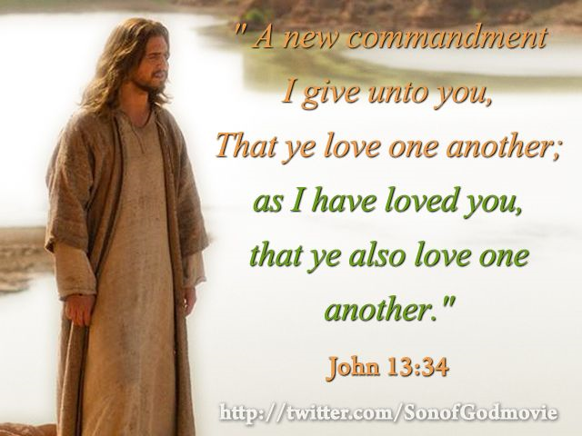
Gather: The Golden Rule
Opening Hymn: Walk in the light of the Lord

Slide 4

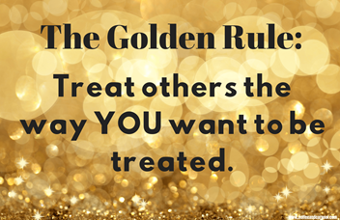
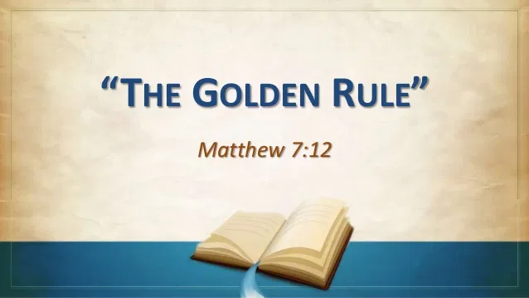
Gather: The Golden Rule
Many cultures and religions throughout history hold in their value system some form of the Golden Rule: "So in everything, do to others what you would have them do to you" (Matt 7:12). This is how Jesus defined it in what is known as the Sermon on the Mount, a collection of Jesus' most important teachings. The Golden Rule is a call to immediate and positive action for the purpose of helping others. The Golden Rule says to treat others the way you want to be treated regardless of how they treat you. This might seem like a tall order … and it is. Living by the Golden Rule is not about what we get. It's about what we give.
What is our mission this week?
Our mission this week is to actively practise the Golden Rule. Since we want to be respected, we aim to genuinely respect others' points of views and ideas; to listen to them without judgment. As we want to be encouraged, supported, and complimented, we will go out of our way to make others feel good about their efforts and help them if they need it.

Slide 5
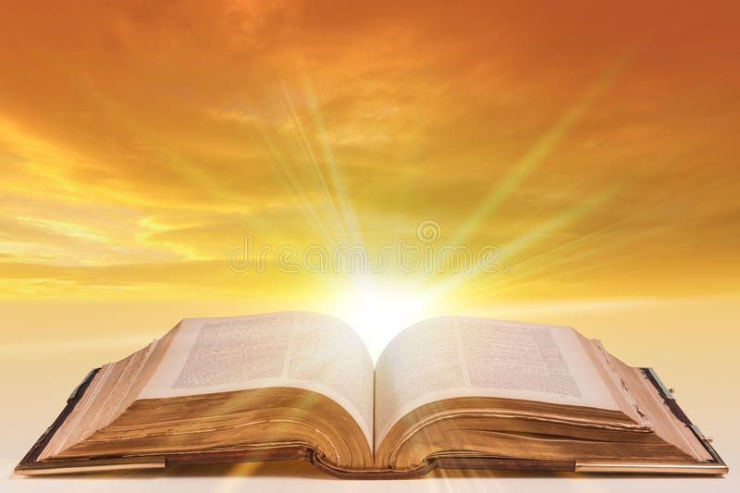
The Word of the Lord
Gospel Reading
A reading from St. John’s Gospel
As the Father has loved me, so have I loved you. Now remain in my love. If you keep my commands, you will remain in my love, just as I have kept my Father’s commands and remain in his love. I have told you this so that my joy may be in you and that your joy may be complete. My command is this: Love each other as I have loved you. Greater love has no one than this: to lay down one’s life for one’s friends. You are my friends if you do what I command. I no longer call you servants, because a servant does not know his master’s business. Instead, I have called you friends, for everything that I learned from my Father I have made known to you.This is my command: Love each other.
The Word of the Lord Response: Thanks be to God
Lord, We pray that you will keep us mindful of your great command to, "treat others as we want to be treated" and that you will help us find ways to apply that principle in our daily lives.
Lord, in your mercy….Hear our prayer

Slide 6

Response to the Word of God
Mutual Respect
We focus today on the value of mutual respect. Mutual Respect means we might not always agree with other people, but we show respect for their thoughts and feelings. We can give respect to others and we can expect other people to show us respect. Good relationships are built on this. Respect means 'to value someone highly for what they say or do' or 'to treat people politely and thoughtfully, to show we value them.'
Lord, help me to be respectful of others even though sometimes I disagree with them. Help me to live my life in a way that shows I value others for who they are.
Lord in your mercy…..Hear our prayer.

Slide 7
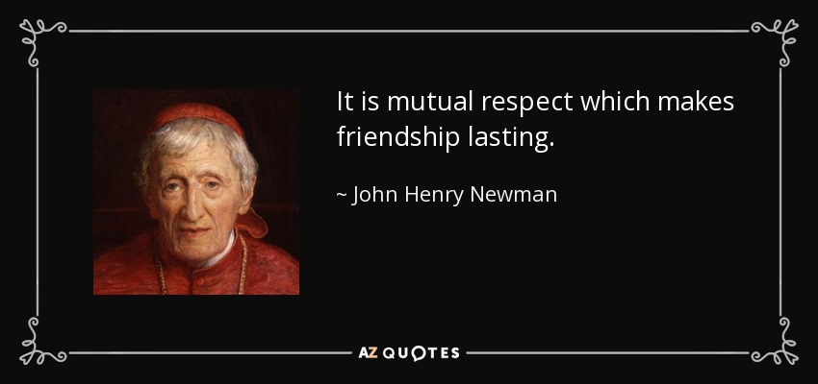
We Reflect Together
St. John Henry Newman
Saint John Henry Newman died a Cardinal of the Catholic Church, honoured internationally, but it was his ability to touch and enlighten the hearts of so many, from so many different walks of life, that makes him an example to follow. A deeply spiritual man he was always available to people, rich and poor. Newman visited Bilston during the second cholera outbreak of 1849 and ministered to the sick. His love of God and the poor was central to his life and work. When he died, the streets of Birmingham were lined with thousands whose lives he had touched and inspired.
As St John Henry Newman prayed so we pray:
Lord, Shine through me, and be so in me that every soul I come in contact with may feel your presence in my soul.
Lord, in your mercy….Hear our prayer

Slide 8
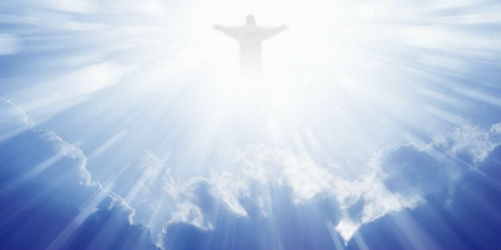
Ascension Thursday
Ascension Day is traditionally celebrated on the 40th day after Easter Sunday. It commemorates Jesus’ ascension into heaven. 40 days after the resurrection, Jesus and his disciples went to the Mount of Olives, near Jerusalem. The Bible says Jesus promised the disciples that they would soon receive the Holy Spirit, and asked them to remain in Jerusalem until the Spirit had come. As he blessed them he began to ascend into heaven to take his seat at the right hand of God. The Ascension is meaningful to Christians as it signifies the end of Jesus’ work on earth and allowed him to prepare a place for followers in heaven while sending His Spirit to help us continue His work on earth.
O God of earth and sky, as Jesus came among us in Bethlehem to raise us up to heaven,
so today we recall his departing from us at Jerusalem to be in all places.
Though he is hidden from our sight, enable us to continue His work by the power and grace of the Holy Spirit.
Lord,in your mercy….Hear our prayer

Slide 9
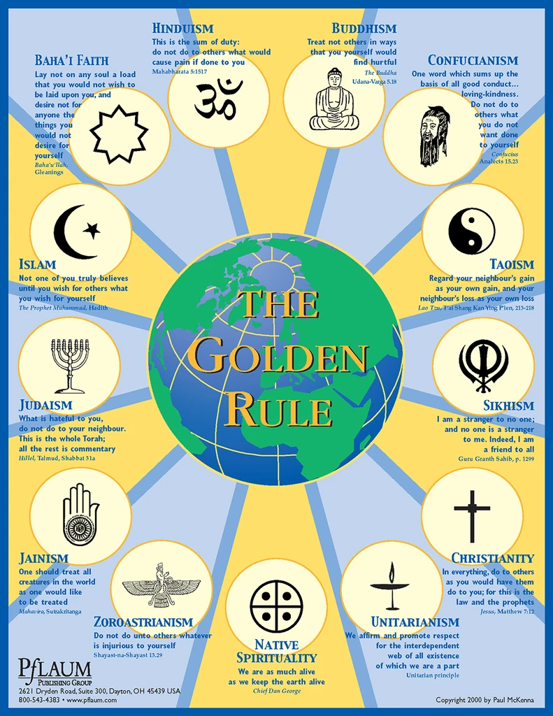
Friday: We Reflect Together
The Golden Rule is not just a Christian teaching but is present in all religions.
Sikhism teaches that, “I am a stranger to no one and no one is a stranger to me. I am a friend to all”.
Hinduism states: “Do not do to others what would cause pain if done to you”.
Islam teaches: “Not one of you truly believes until you wish for others what you wish for yourself”.
Judaism states: “What is hateful to you, do not do to your neighbour”.
Lord, help us to place ourselves in the shoes of another person and show understanding and compassion towards them.
Lord, in your mercy…Hear our prayer
Lord, help us not to be blind to the needs and troubles of others. Let us look to help even before we are asked.
Lord, in your mercy….hear our prayer

Slide 10
Going Forth
Let us say the Morning Offering together:
Loving God, as I begin this day
help me to live my life to the best of my ability,
To be open to those who need me,
To respond to those who love me,
To forgive those who hurt me, and,
To appreciate the world in which I live. Amen

Slide 11
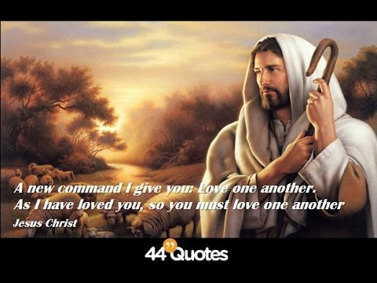
Gather: The Golden Rule
Opening Hymn: Walk in the light of the Lord

