Slide 1



Gather: Fairtrade Collective Worship 27th February 2023
We gather as one … … …
Let us join our hands and make the sign of the cross.
In the name of the Father and of the Son and of the Holy Spirit. Amen’

Slide 2
Gather: Fairtrade Collective Worship - Opening Prayer
Dear Lord, we ask your blessing on all who are involved with Fairtrade, lifting before you: producers as they grow their crops and craft their works. Bless them, we pray, in their endeavours and grant them wisdom and discernment as they make decisions about how to use the benefits of Fairtrade.Amen

Slide 3


Gather: Opening Hymn
Hymn: God the Maker of the Heavens (tune: What a Friend we have in Jesus)
God the Maker of the Heavens
And the planet that we share
Show us how to live like Jesus
Lives in gratitude and care
Make us mindful of the footprints
From the lives that we pursue
Make us partners in your mission
You are making all things new
God the Gardener of Eden
Teach us how to tend this earth
Learning from the changing seasons
Times of fallow and new birth
Lord have mercy when we’re careless
Rich resources we misuse
Use our hands to heal creation
You are making all things new
God of labour and vocation
Lord of science trade and art
Take our efforts and our passions
Make them mirrors of your heart
Every habitat and creature
Loved and valued God by you
May our lives reveal your kingdom

Slide 4


Fairtrade Fortnight at the beginning of Lent
In Fairtrade Fortnight, which coincides with the beginning of Lent, schools and families across the UK will learn about, and celebrate, the people who grow our food and drink and explore the topic of ‘Climate, Fairtrade and You’. It is an opportunity this Lent to discover how our choices as individuals can make a difference to the lives of people around the world and the planet we share. For Fairtrade producers, climate change is one of their biggest challenges. Low prices for their crops mean that they are struggling to fight back. Fairtrade gives them higher income so they can meet their everyday needs and deal with the challenges of climate change.
What is our mission this week?
Our mission this week at the beginning of Lent is to get involved in Fairtrade fortnight. Our choices are powerful. Their effects can reach far beyond us. They can help us shape the world we want. The daily decisions you make about what to eat, drink and wear affect the lives of people around the world – and the health of our planet. This Fairtrade Fortnight, we’re focusing on the choices we all make every day. Think about the vision of the world you want for farmers and workers worldwide, and the planet we share.

Slide 5

The Word of the Lord
Gospel Reading
A reading from St. Mark’s Gospel
At once the Spirit sent Jesus out into the wilderness, and he was in the wilderness forty days, being tempted by Satan. He was with the wild animals, and angels attended him.
After John was put in prison, Jesus went into Galilee, proclaiming the good news of God. “The time has come,” he said. “The kingdom of God has come near. Repent and believe the good news!”
The Word of the Lord Response: Thanks be to God
As Jesus’ words remind us, “The time has come”. In this Fairtrade fortnight, let us pray for a time when our world is fair and just. May our actions create the kind of world that we are proud to be part of.
Lord, in your mercy….Hear our prayer

Slide 6
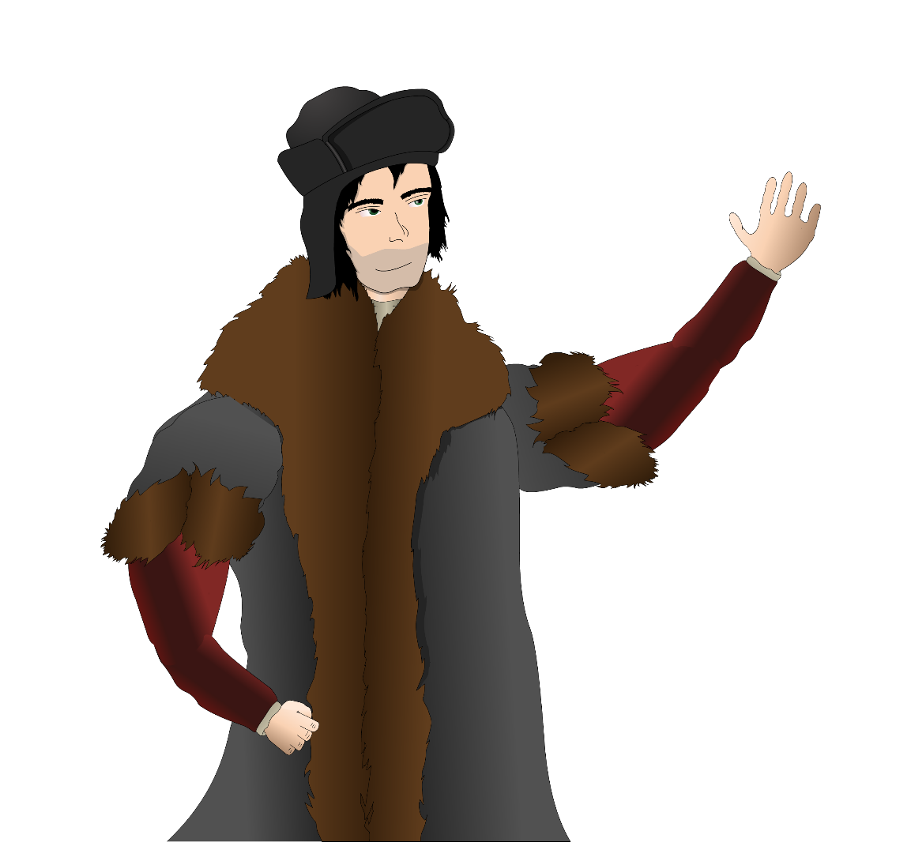
Tuesday The Morning Offering
Let us say the Morning Offering together:
Loving God, as I begin this day help me to live my life to the best of my ability,
To be open to those who need me,
To respond to those who love me,
To forgive those who hurt me, and,
To appreciate the world in which I live. Amen

Slide 7

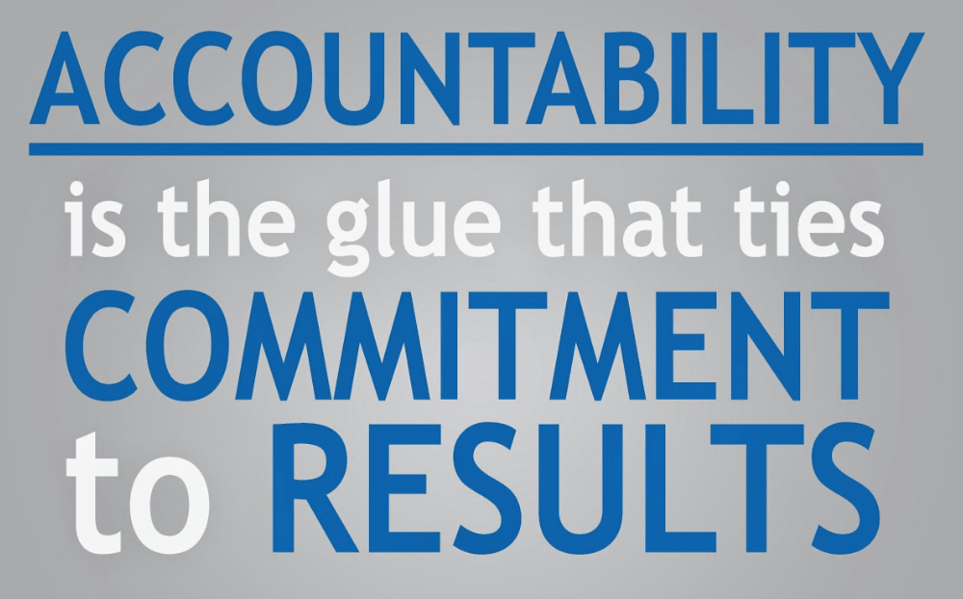

Reflection on the Word of God
Accountability
Accountability means that we show a willingness to accept responsibility for our own actions. During Fairtrade fortnight we are especially asked to think about how our actions impact on others.
Climate change is one of the most urgent challenges of all for cocoa farmers. Unpredictable weather can wreak havoc on farming communities, with problems like drought leading to low yields, or too much rain infecting cocoa trees with black pod disease. Fairtrade is supporting farmers to tackle these issues. We can support Fairtrade in this work by buying Fairtrade chocolate and realising that consumers’ choices affect the lives of farmers and workers overseas.

Slide 8

Response to the Word of God
Accountability
Lord, we ask your blessing on all who are involved with Fairtrade,
those who import and retail Fairtrade goods.
Grant them, we pray, a genuine commitment to fairer trade for all.
We pray for all of us who shop where Fairtrade goods are for sale.
Grant us an understanding of the impact of our choices.
Lord, in your mercy….Hear our pray

Slide 9

We Reflect Together
Share your vision of the world you want
As part of Fairtrade fortnight, young people are being invited to share their vision of the world they want for farmers and workers worldwide and the planet we share. Create your vision for the world you want, for the planet and everything on it, to celebrate Fairtrade Fortnight 2023.

Slide 10
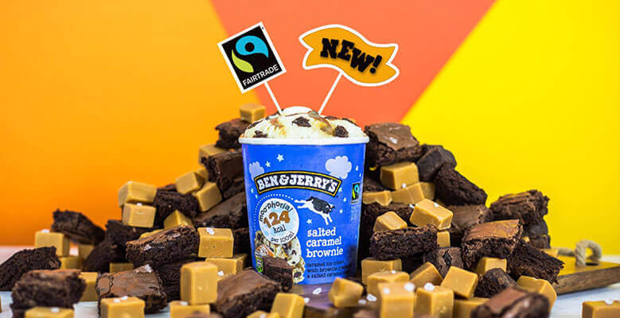
We Reflect Together
Creator God,
You call us to a neighbourly love
That is generous in practical ways,
That doesn’t leave by the roadside
Those harmed by sin and greed
But goes out of its way
To bring healing.
Help us to see
How neighbours near and far
Are suffering, their resources stolen
By unjust people and systems.
And fill us, we pray, with your Spirit,
That we may be inspired
To go further each day in using our gifts
Of time and faith and talent
Lovingly
In ways that challenge injustice
And renew life.
Amen

Slide 11

Response: We Reflect Together
Lord, help us to make wise choices in our lives so that our world is a place where everyone has enough for their needs.
Lord, in your mercy….Hear our prayer
Lord, be close to those who struggle to provide for their families because of a world where not all people have equal opportunities. May we always strive to work for justice.
Lord, in your mercy….Hear our prayer
Watch this video with lots of ideas of how we can change the world: https://www.youtube.com/watch?v=sm5oo9KuLQw

Slide 12

Go Forth
Celebrities back Fairtrade
More magical than Hermione Granger, actress and UN Ambassador
Emma Watson is a real life wizard. She even started up a separate
Instagram account to follow her sustainable high fashion journey with credentials for all the clothing she wears, especially during a press tour. An advocate for all things sustainable fashion and beauty, Emma Watson shows that fashion to everyday wear can be sourced ethically and fairly and still be stunning.
Closing Prayer
Lord we thank you for this world which you created, which you love.
In the sweat shops that make our clothes,
Amongst the poor who produce our chocolate,
On the plantations that produce our coffee and tea,
Bring the light of justice and economic fairness,
By your grace, enable us to live in such a way that may we help
and not hinder your work of justice in the world. Amen.

Slide 13
Go Forth: Closing Hymn
Hymn: God the Maker of the Heavens (tune: What a Friend we have in Jesus)
God the Maker of the Heavens
And the planet that we share
Show us how to live like Jesus
Lives in gratitude and care
Make us mindful of the footprints
From the lives that we pursue
Make us partners in your mission
You are making all things new
God the Gardener of Eden
Teach us how to tend this earth
Learning from the changing seasons
Times of fallow and new birth
Lord have mercy when we’re careless
Rich resources we misuse
Use our hands to heal creation
You are making all things new
God of labour and vocation
Lord of science trade and art
Take our efforts and our passions
Make them mirrors of your heart
Every habitat and creature
Loved and valued God by you
May our lives reveal your kingdom

