Slide 1
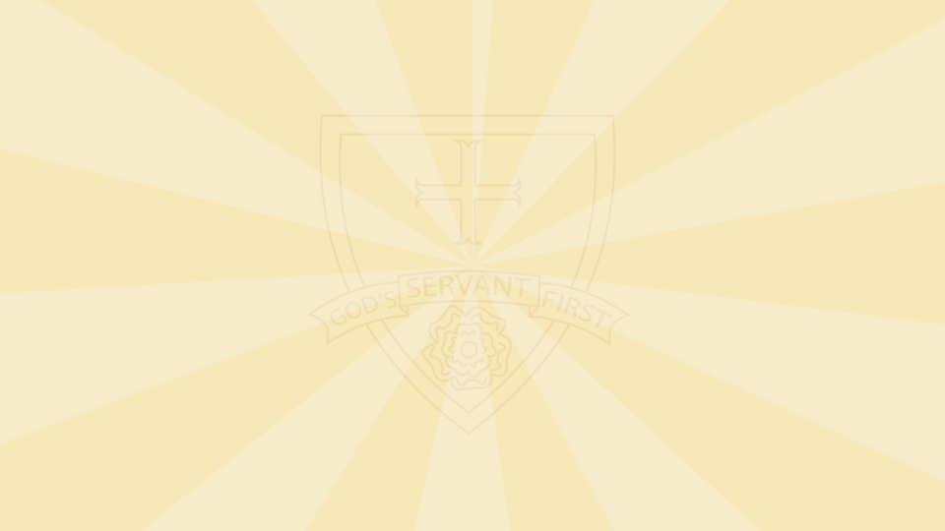

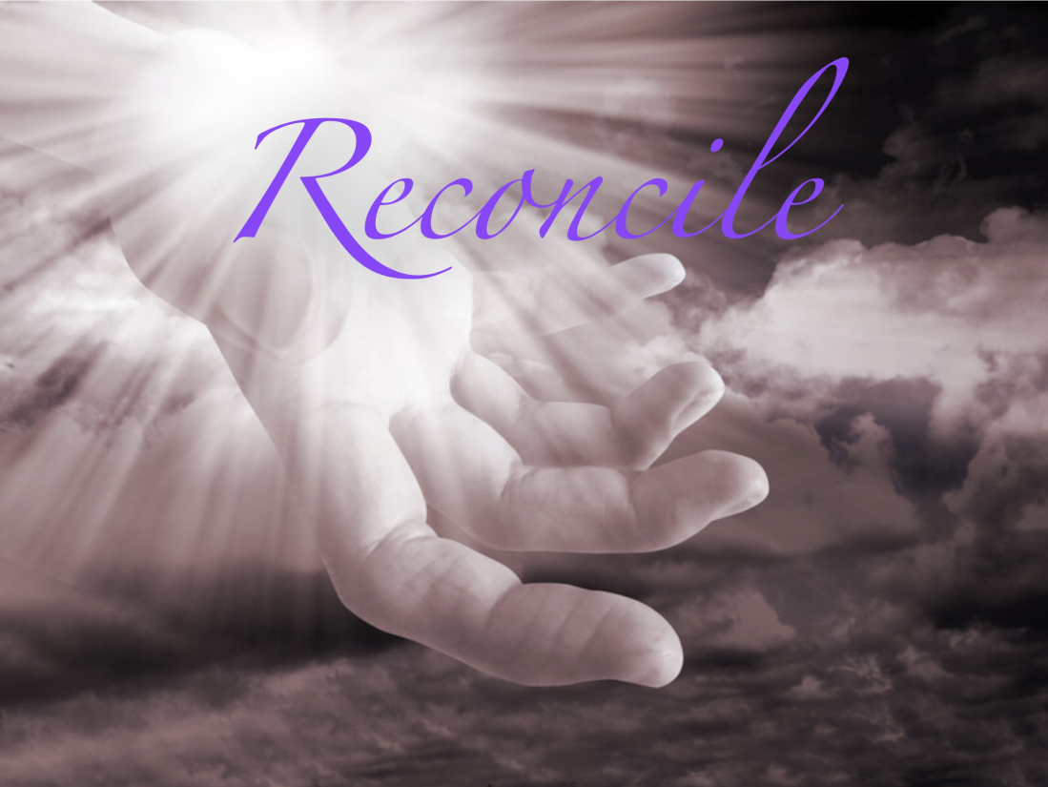
Gather: Reconciliation - Lent
We gather as one … … …
Let us join our hands and make the sign of the cross.
‘ In the name of the Father and of the Son and of the Holy Spirit. Amen’

Slide 2
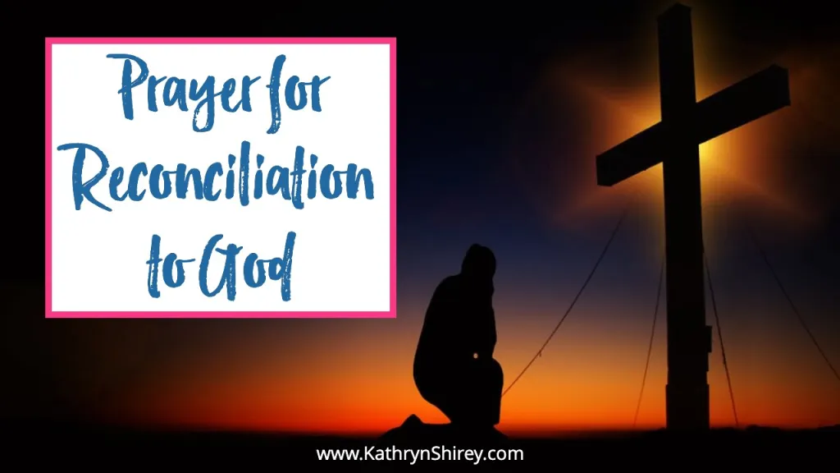
Gather: Reconciliation - Lent
Opening Prayer
Prayer for Reconciliation to God
Holy Lord, who sent your only Son to save us, I pray today to be reconciled to you. For if anyone is in Christ, he is a new creation. The old has gone, the new has come. I pray to live in Christ, to let go of my worldly desires and instead follow where Jesus leads. May I be made new in Christ, to be reconciled to you, O Father, and be forgiven of my sins through your great mercy and grace. Amen.

Slide 3
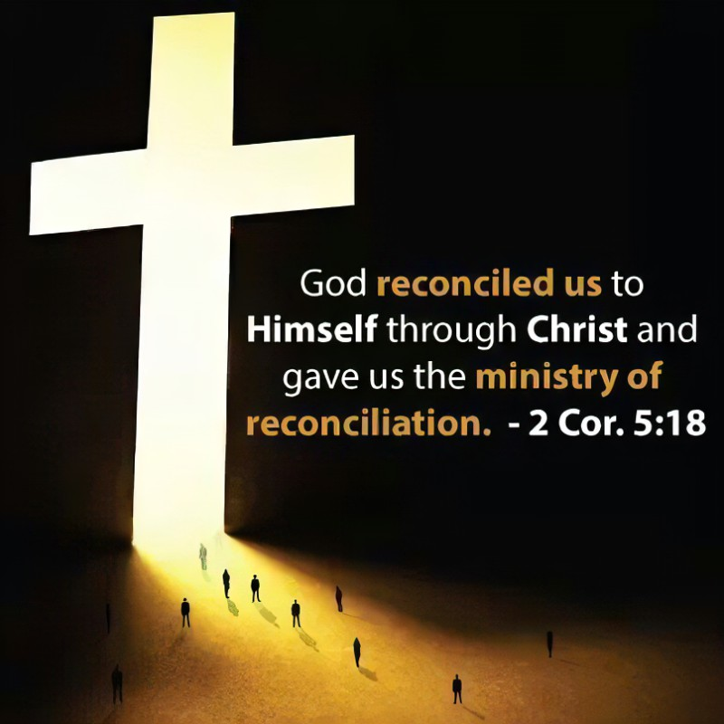
Gather: Reconciliation - Lent
Opening Hymn: Raise me up on eagle wings

Slide 4


Gather
As we continue to journey through Lent, we are asked this week to think about the need for reconciliation in our lives and in our world. Reconciliation means ‘to be at peace again’. The Catholic sacrament of reconciliation offers the opportunity to find God’s forgiveness. In turn, those who receive it, are called to forgive others.
What is our mission this week?
Our mission this week is to think about the need for reconciliation in areas of our own lives and in our world. How can we be peacemakers at home, at school and in our world? What can we do to show that we are prepared to forgive those who might have hurt us and be forgiven by those we might have hurt?

Slide 5
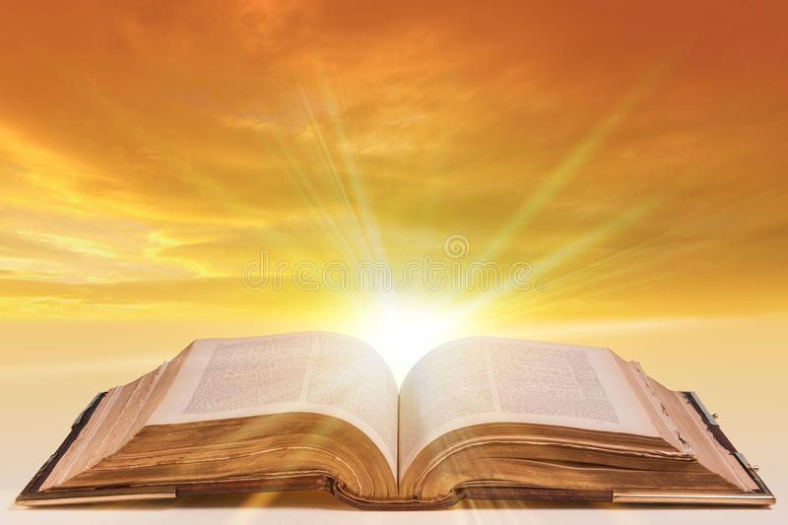
The Word of the Lord
Gospel Reading
A reading from St. John’s Gospel
For God so loved the world that he gave his one and only Son, that whoever believes in him shall not perish but have eternal life. For God did not send his Son into the world to condemn the world, but to save the world through him. Whoever believes in him is not condemned, but whoever does not believe stands condemned already because they have not believed in the name of God’s one and only Son. This is the verdict: Light has come into the world, but people loved darkness instead of light because their deeds were evil. Everyone who does evil hates the light, and will not come into the light for fear that their deeds will be exposed. But whoever lives by the truth comes into the light, so that it may be seen plainly that what they have done has been done in the sight of God.
The Word of the Lord Response: Thanks be to God
Lord Jesus, as we go about our daily routines this week, help us to lead lives that reflect Your light and truth. Give us the courage to forgive those who may have hurt us and to ask forgiveness of those we may have hurt. May our actions and words bring Your peace to the world.
Lord, in your mercy….Hear our prayer

Slide 6
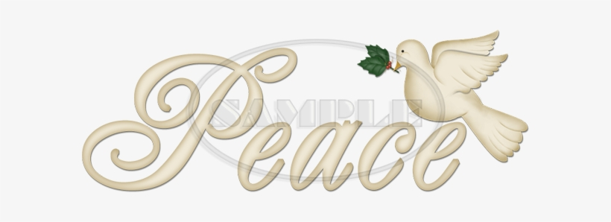
Response to the Word of God
Peace
We focus today on the value of peace. Peace in the Bible has to do with ending hostility between people and forging new relationships of unity. Jesus is our peace in the sense that he mends broken relationships.
St. Paul says, "Christ is the source of our peace." Jesus is the one who keeps the peace. If we wish to live without conflict among people, if we wish to live peaceful lives in community with others, then we must live by following the example of Jesus.”
Lord Jesus Christ, you are our peace. You have come to bring peace among people, to erase hostility, to enable human beings to live together with love, justice, and peace. May we live today in your peace, seeking to be a peacemaker in all of our relationships, bringing peace to our world.
Lord, in your mercy….Hear our prayer

Slide 7
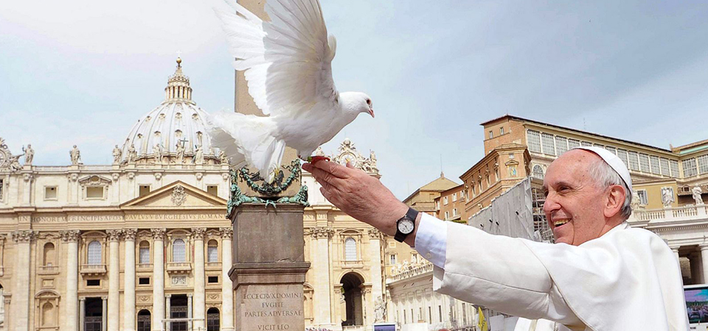
Response to the Word: We Reflect Together
Pope Francis’ World Peace Day Message
The message this year from Pope Francis focuses on the need for us to care for each other if we want to build a peaceful world and “combat the culture of indifference, waste and confrontation”.
This idea of justice, love and care is found in the Bible, in the life of Jesus and in Church teaching. The Pope calls on us to live out these values and to be “peacemakers …prepared to work boldly and creatively” towards reconciliation.
Lord,
May we all work together and play our part in creating a world of compassion, peace and justice.
May we always remember that everyone we meet is our brother or sister. May we learn how to care for them and show that we accept them for who they are.
Grant us the courage to challenge injustice and become peacemakers.
Lord, in your mercy…Hear our prayer

Slide 8
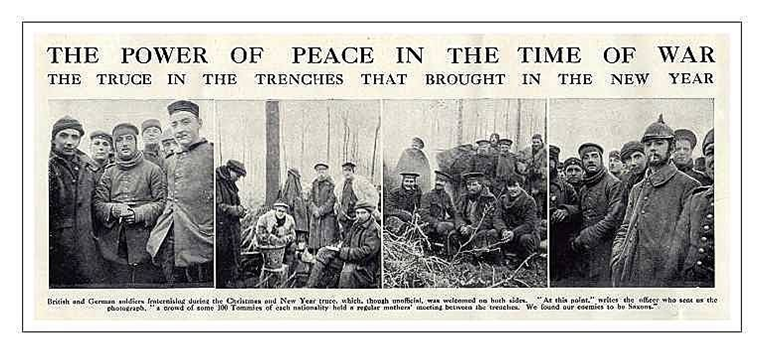
Response to the Word: We Reflect Together
This slide shows German and British soldiers in World War 1 in No Man's Land, on the Western Front. On a frosty Christmas Eve 1914, when soldiers were thinking of family at home, something amazing happened. It is described by a British soldier writing a letter on Christmas Day to a friend:
“Last night the Germans lit up their trenches and started calling across merry Christmas. We responded in the same way and then we started singing songs to one another, carols etc. All shooting had stopped. We walked about the tops of the trenches and called out to one another. Then some of our chaps walked out and met some of the Germans half way, wishing each other a merry Christmas, shook hands and said they would not fight today.”

Slide 9

Thursday: We Reflect Together
Lord, help us to think about reaching out across divides. Give us the courage to be a friend to someone who needs us, for when we do this sort of thing we are building peace.
Lord, in your mercy….Hear our prayer
Lord, may our words and actions promote friendship, respect and peace between all faiths and all people in our world.
Lord, in your mercy….Hear our prayer

Slide 10
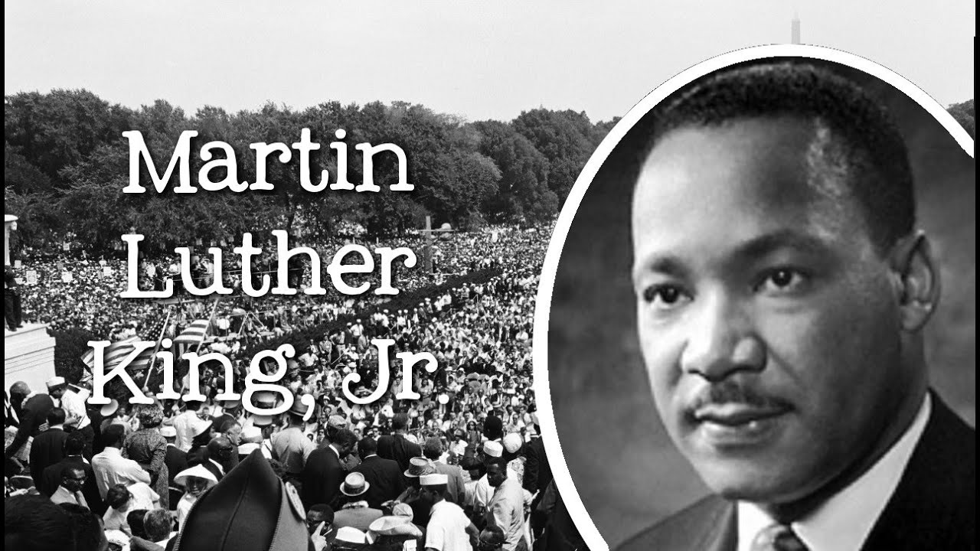
Friday: We Reflect Together
Peace can only come about when we learn to treat each other as brothers and sisters and recognise our shared vocation as children of God. Martin Luther King’s words still ring true today: ”We must all learn to live together as brothers and sisters or we will all perish together as fools. Whatever affects one directly affects all indirectly. For some strange reason I can never be what I ought to be until you are what you ought to be. And you can never be what you ought to be until I am what I ought to be. This is the way God’s universe is made; this is the way it is structured.
To return hate for hate does nothing but intensify the existence of evil in the universe. Someone must have sense enough and religion enough to cut off the chain of hate and evil, and this can only be done through love.”

Slide 11
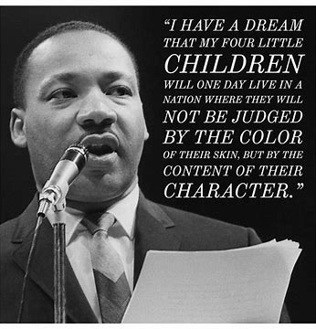
Response to the Word: We Reflect Together
We pray for all those who seek peace, reconciliation and fullness of life for all people.
Grant them courage and determination to work for your peace, relying on your Spirit and power. We pray for ourselves that your peace may become more present in us.
Lord, in your mercy…..Hear our prayer
We pray that we can show through the way we live, through our actions and words,
that peace is possible.
Lord, in your mercy….Hear our prayer

Slide 12

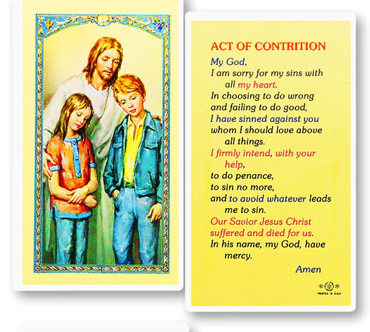
Go Forth: Reconciliation - Lent
Closing Prayer:

Slide 13
Gather: Reconciliation - Lent
Opening Hymn: Raise me up on eagle wings

