Slide 1


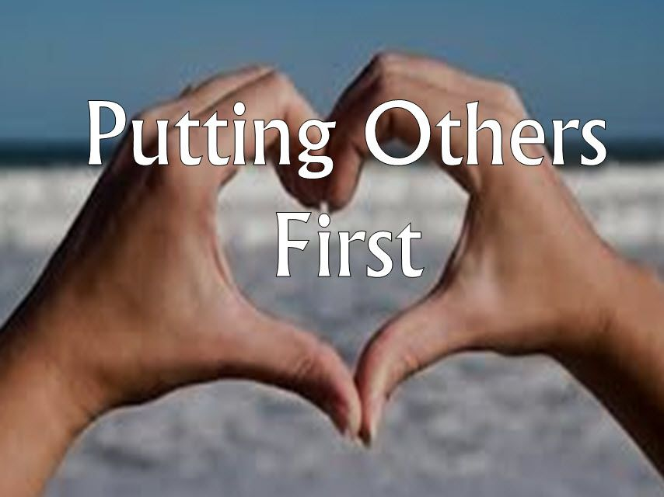
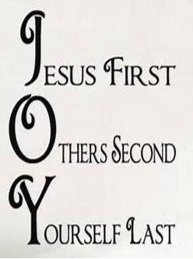
Gather: Putting Others First
We gather as one … … …
Let us join our hands and make the sign of the cross.
‘ In the name of the Father and of the Son and of the Holy Spirit. Amen’

Slide 2

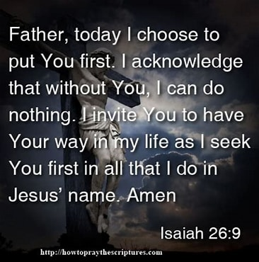
Gather: Putting Others First
Opening Prayer

Slide 3
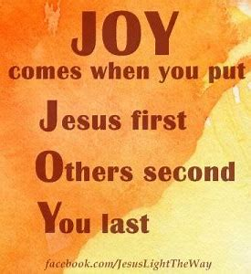
Gather: Putting Others First
Opening Hymn: Make me a channel of your peace

Slide 4


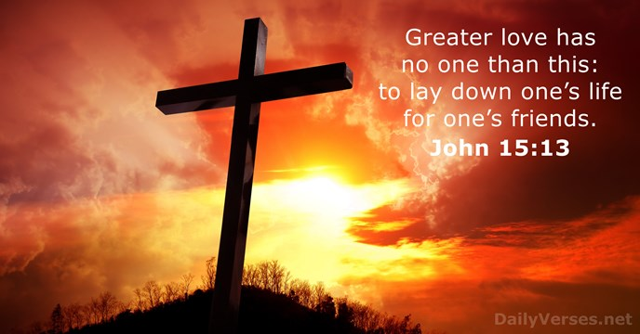
Gather: Lent - Putting others first
As we move nearer to Easter, we reflect this week on putting others first. We take our inspiration at Easter from the example of Jesus, who gave his life so that we might enjoy life to the full in God’s presence. Jesus’ sacrifice encourages us to make sacrifices for others and to make a difference to the world in which we live.
What is our mission this week?
Our mission this week is to think about how we can put others first in our every day lives. To follow the example of the Good Samaritan where we all take the opportunity to think about those less fortunate than ourselves.

Slide 5

The Word of the Lord
Gospel Reading
A reading from St. John’s Gospel
Jesus replied, “The hour has come for the Son of Man to be glorified. Very truly I tell you, unless a kernel of wheat falls to the ground and dies, it remains only a single seed. But if it dies, it produces many seeds. Anyone who loves their life will lose it, while anyone who hates their life in this world will keep it for eternal life. Whoever serves me must follow me; and where I am, my servant also will be. My Father will honour the one who serves me.
The Word of the Lord Response: Thanks be to God
God of love, bring us back to you. Send your Spirit to make us strong in faith and active in good works.
Lord, in your mercy….Hear our prayer.
Lord, you call us to your service and continue your saving work among us.
May your love never abandon us.
Lord, in your mercy….Hear our prayer.

Slide 6

Tuesday National day of reflection
Today marks the third anniversary of the UK lockdown and has been dedicated as a National Day of Reflection. The charity, Marie Curie, is asking everyone to reflect on the year that we have been through, support those who have suffered, and hope for a brighter future. The Bishops of England and Wales have also asked that we mark the day as a day of prayer. This annual day will give us all time to pause and think about this unprecedented year, and support each other through our actions and our prayer in the days to come.
Let us pause in the midst of life to remember…. there is always light, if only we’re brave enough to see it. If only we’re brave enough to be it. (Amanda Gorman)
We pray for all who are affected by coronavirus, through illness or isolation or anxiety, that they may find relief and recovery.
Lord, in your mercy…Hear our prayer

Slide 7

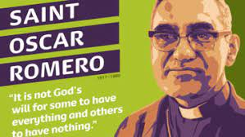
Response to the Word: We reflect together
24th March St Oscar Romero feast day
Oscar Romero was Archbishop of San Salvador, the capital of El Salvador in Central America. He lived at a time of terrible oppression and violence, when many people in the church were targeted because their commitment to the poor led them to speak out against injustice. After years of persecution and threats Romero was assassinated on 24 March 1980. He is remembered for his courage, his faith and, above all, his great love for the poor, putting their needs before his own. Recognizing him as “a martyr for the faith”, Pope Francis made him a saint in 2018.
Spirit of hope, work within us, just as you worked in Saint Oscar Romero,
so that we too may work for justice and spread the Good News, by living out the Gospel.
Lord, in your mercy….Hear our prayer

Slide 8
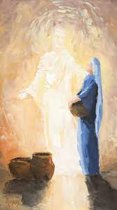
Response to the Word: We Reflect Together
25th March The Annunciation
The feast of the Annunciation marks the visit of the angel Gabriel to Mary, during which he told her that she would be the mother of Jesus, the Son of God. It is marked on 25th March each year and celebrates Mary’s freely given acceptance of the task of being the Mother of God. Her saying ‘Yes’ to God gives us an inspiring example of how we too can put God first in our lives, by responding with faith to His call to each one of us.
God our Father,
Give us the inspiration and help of Mary on our journey through Lent.
Give us the grace to be faithful to what you are calling us to do.
Give us what we need to be your servant.
Let Mary guide us in the path to peace in our world.
Lord, in your mercy….Hear our prayer.

Slide 9
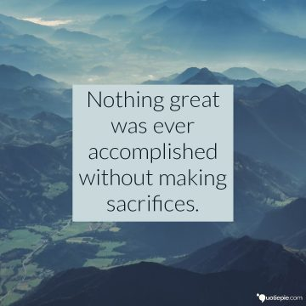
Response to the Word.
Sacrifice
We focus today on the value of sacrifice. We think of the sacrifice that Jesus made by giving up his life for others. We take a moment to think about the things we could give up – our time, our social media, our phones - in order to be more present to others. We think, especially during Lent, of what we could sacrifice in order to give to those who are in need. We think of the Lent collections in school to which we can contribute as a way of helping others.
Merciful God,
You gave your only Son to be both a sacrifice for us
and an example of godly life.
Help us gladly to receive all that he has done for us
and show us how to follow in his footsteps.
Lord, in your mercy…Hear our prayer

Slide 10
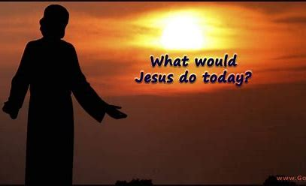
Go Forth
Closing Prayer
Loving God, as I begin this day help me to live my life to the best of my ability,
To be open to those who need me,
To respond to those who love me,
To forgive those who hurt me, and,
To appreciate the world in which I live. Amen

