Slide 1

Dosbarth St. Gwynno
Athrawes: Mrs D. Houston

Slide 2


Our Mission Statement
Ein Datganiad Cenhadaeth
We grow together in God's love as we pray, learn and play
Dyn ni'n tyfu gyda'n gilydd mewn cariad Duw wrth i ni weddio, dysgu a chwarae
Our visions and values are at the core of everything we do. They underpin our teaching and learning, and provide an environment which prepares our pupils as confident, happy citizens.
Our Vision statement (Please refer to the school website for this information.)

Slide 3

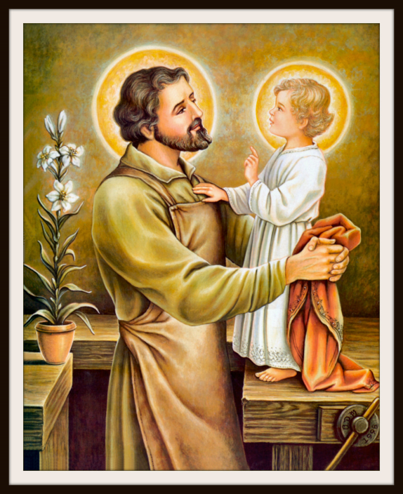
Religion / Crefydd
Religion is a core subject in Saint Joseph’s RC Primary School and leads our ethos, teaching and learning.
We have now commenced a new RE Scheme of Work, ‘See Clearly,’ in January 2024.
The topic being studied is ‘Jerusalem to Galilee.’

Slide 4
Religion: Collective Worship in Saint Joseph’s RC Primary SchoolCrefydd:
Addoli ar y Cyd yn Ysgol Gynradd Gatholig Joseff Sant
Monday / Dydd Llun: Headteacher Assembly
Tuesday / Dydd Mawrth: Class Worship
Wednesday: Progression Step One and Two Collective Worship (Progression Step Three Class Collective Worship - Gweddiwn)
Thursday/ Dydd Iau Progression Step Three Collective Worship (Progression Step One Class Collective Worship - Gweddiwn.)
Please see Mass and Assembly timetable on the school website and Classdojo for those collective Worships parents are invited to.
A series of Masses held throughout the year at Saint Joseph’s Church as well as class Masses in the school and on feast days.
Merit Assembly: Week one led by Criw Cymraeg and week two delivered by staff.
Class Meditation takes place everyday in all classes at 1.30 pm.
Class altars changed according to the new RE topic and the liturgical year and include the key words for the topic in English and Welsh.
Faith / Virtue Tree: All classes will have an example of this where children record how they are going to try and achieve a specific set of Virtues. Our current Virtues are Compassionate and Loving.

Slide 5

Meet the Staff / Cwrdd â'r Staff
We have many new parents in the school and not all parents will know who all the staff are in Saint Joseph’s are. A list below outlines who they are:
Mrs Riordan: Headteacher
Mrs Wheeler: Deputy Headteacher
Mr Cobb: Senior Management Team
Ms Tuff: Senior Management Team
Ms Kates: Class Teacher
Ms. Beynon: Class Teacher
Mrs Evans: Class Teacher and PPA
Mrs Zabaneh: Class Teacher
Mr Mansfield Class Teacher
Mrs Houston: Class Teacher
Ms Chinnick: TA
Mrs Brooks: TA
Mrs O’Brien : LSA
Mrs Fuller: LSA
Ms Lewis: LSA
Mr Shankland: LSA
Ms Morgan: LSA
Mrs Ekstrom – Gabb: PA to the Headteacher.

Slide 6

Attendance Matters / Materion Presenoldeb
For a pupil to reach their full educational achievement, a high level of school attendance is essential. We will consistently work towards a goal of 100% attendance for all pupils. Every opportunity will be used to convey to pupils and their parents or carers the importance of regular and punctual attendance.
School attendance is subject to education law and guidance and our school attendance policy is written to reflect this legislation and the guidance produced by the Welsh Government. (See School Policies on the School Website)

Slide 7

Water and Healthy Snacks at Play Time
Dŵr a Byrbrydau Iach ar Amser Chwarae
As part of our Health and Well –Being Policy (See the school website), we ask that children only have water to drink in school. The purpose is to prevent the consumption of sugary drinks with the obvious health implications. Children have access to water at all times in the classrooms and there is a water station available for the replenishing of water. Children are reminded of this requirement every morning by staff as they are putting their bags and coats away in the morning.
Children, who are provided with a snack at playtime, are only permitted fruit or vegetable snacks. We encourage healthy packed lunches also at dinner time for the children.

Slide 8

Curriculum Overview
Trosolwg o'r Cwricwlwm

Slide 9
Maths and Numeracy
Mental Maths Daily (Purpose to keep consolidating number skills and topics previously covered.)
Spring Topics
Number
Tally marks
Pictograms
Bar Charts
Carroll Diagrams
Venn Diagrams
Coordinates
Time 3D shape
Reasoning and problem solving a weekly activity.
Homework provided once a week.
Humanities
What makes the land of Wales Unique?
Physical Features of Wales – Rivers, Mountains
Data Handling applying rounding skills and four rules of number to investigate the physical features of wales, tourism and the use of the Welsh Language. Extend to presenting in graphs and applying number and data handling skills to draw conclusions from the data.
Learning about the origins and history of the Welsh traditional costume.
Temperature and rainfall in Wales. (Focus: Cardiff)
The history of the Welsh Love Spoon. (what do the symbols mean?
Map reading skills: coordinates, position, using an atlas and scale.
Mary Jones and the first Welsh Bible. (Planning attached to Classdojo for more information.
Expressive Arts
Performing traditional Welsh Songs from a score – Heno Heno , Hen Wlad fy’n Hadau and Llundain yn Llosgi.
Performing as an orchestra these Welsh traditional songs. To use tuned percussion.
The work of the Welsh artist Ruth Jens – Menywod Cymraeg.
The work of the Welsh artist who focuses on depicting the landscapes of Wales, focusiing primarily on her work depicting landmarks of Cardiff.
Skills: line and mark, colour, shape, pattern and tone.
Using line and mark skills to present their own portrait of the Welsh National Costume.
PE: These lessons are delivered by Ms. Westgarth.
Language, Literacy and Communication
Guided Group Reading: In the autumn term, the focus was on non fiction genres of writing. This will continue with such texts as ‘The National Parks of Wales’, but will be extended to narratives, myths and legends and identifying these genres of writing. These are all shared with parents on the Classdojo platform and will be in some cases used for the purposes of homework.
Independent writing tasks:
Letter writing
Summary Writing
Dictionary and punctuation skills
Weekly spelling on the first 200 common usage words as well as patterns that follow a certain criteria e.g. ‘ies’.
Descriptive writing,
Retell of Welsh legends
Telling a story from the point of view of another character.
Homework provided regularly.
Reading heard on a Friday – new book issued if your child can read the text from the previous week.
Health and Well-Being
Miss Westgarth
Science and Technology
IT Research skills
Designing and making a Welsh
Love spoon.
To learn how to create a PPT to demonstrate learning on the Welsh Love Spoon.
To be able to apply learning in Expressive Arts to code using a Microsoft Music app to play the songs learnt as part of Expressive Arts.
To use word processing skills to explain their learning in the coding project.

Slide 10
Class Committees Within Saint Joseph’s R.C. Primary School
Pwyllgorau Dosbarth yn Ysgol Gynradd Gatholig Joseff Sant
There are several child led committees within Saint Joseph’s Primary School representing all classes. There are regular meetings in which children can share pupil voice and have an active part in the decision process of the school. These groups meet regularly. Information about the role of each of these groups are on the school webpage under committees and include the following groups:
Senedd – Rights Respecting Ambassadors – Ms. Beynon
Crwi Cymraeg – Cymraeg Campus – Mrs Houston
Digital Leaders – Miss Westgarth
Healthy Schools – Mr Mansfield
Learning Squad – Mrs Wheeler (DHT)
Fair Trade – Mrs Tuff
Minnie Vinnies – Mrs Tuff
Eco – Mr Cobbb
Peer Mediators – Mrs Zabaneh
RE Prayer Group – Mrs Riordan – (HT)

Slide 11
Awards Achieved by our Committee Groups 2022 - 2024
In Saint Joseph’s it is important that the work of the children who represent the different committee groups is acknowledged, and as a consequence the children attempt to achieve awards to celebrate the success of their endeavours and all the children and staff in our school. These are some of the awards that are being prepared for and those we have achieved.
Rights Respecting School: 2023
Healthy Schools Award: 2022
NACE Award: 2023
Welsh Bronze Award: 2024 (Verification of the Silver Award pending for Easter 2024)
Eco Gold Award: 2024 (Pending Summer 2024)
P4C: Well being Award: 2024

Slide 12

Uniform and PE Kit
Gwisg ac Addysg Kit Gorfforol
Uniform
Boys:
Grey trousers
Yellow polo shirt
Grey jumper
Black school shoes
PE Kit
Children need to wear a white t-shirt and navy shorts/leggings/joggers and black trainers. No jewellery on PE days. Newly pierced ears will need to be covered at home with plasters.
Please remember to label everything!
Girls
Grey skirt/dress
Yellow polo shirt Grey jumper or cardigan
Summer – White and yellow check cotton dresses
Black school shoes

Slide 13
Communication /Cyfathrebiad
Dojo
- Receive messages about whole school activities as well as messages specifically for your child's class.
- Calendar of upcoming events.
- Send urgent private messages to your child’s class teacher.
Website
- Our week shows a gallery of photos of what your child has been doing that week with a short explanation.
- All other important information, including policies, after school clubs etc.
Twitter
- Your child’s teacher will post up to three tweets a week of activities they are completing.

Slide 14


Keeping your child safe is our key priority at St Joseph’s Primary
Cadw eich plentyn yn ddiogel yw ein prif flaenoriaeth yn Ysgol Gynradd Joseff Sant
Article 19 – You should not be harmed and be looked after and kept safe
If your child tells a member of school staff that they have been hurt by another adult or is going to be hurt then that member of staff has a duty to report this to the School’s Designated Safeguarding Person, Mrs Alexandra Riordan.
The Designated Safeguarding Person will sometimes need to share this information with Cardiff Children’s Services for advice and support. You may be informed that this is happening unless advised otherwise by Children’s Services.
Please understand that when we do this, we are following the Wales Safeguarding Procedures and not making any judgements about families.
“The needs of the child come first”

Slide 15


Late pick up from schools – information for parents/carers
Arriving late to collect your child from school can be extremely distressing for them.
You are expected to collect your child promptly at the end of the school day. If there is an occasion where you feel that you may be late in arriving due to traffic etc please can you contact the school office immediately?
If you are regularly late for school pick up, then school will have to address this issue with you. In the first instance we will discuss this with you and endeavour to support you if you are experiencing difficulties. If this continues, we will issue you with a warning letter outlining that regular late picks up will have a negative impact upon your child’s emotional wellbeing and if it continues then school will have to follow Local Authority Child Protection Procedures.

Slide 16



Diolch
Many thanks to all parents for attending the overview of learning and expectations in Saint Joseph’s Primary School.
Diolch yn fawr i'r holl rieni am ddod i'r trosolwg o ddysgu a disgwyliadau yn Ysgol Gynradd Joseff Sant.

