Slide 1
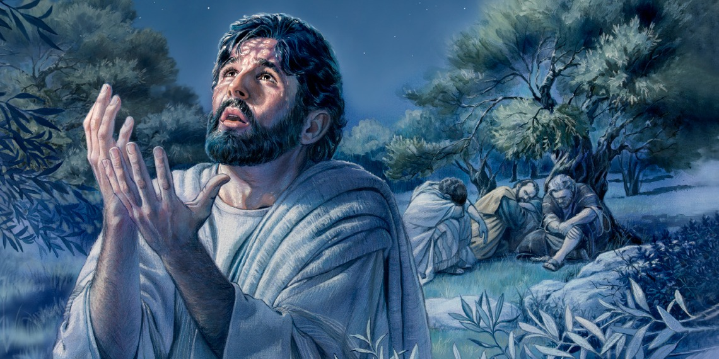
Year Four – Dosbarth Gwynno
Holy Week Worship
The Trial of Jesus

Slide 2
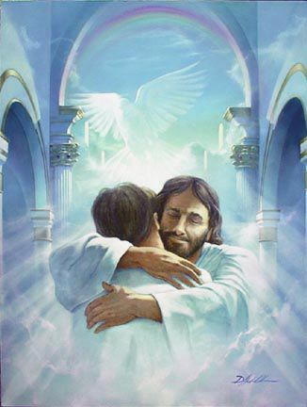
All: Jesus Remember me when you come into your kingdom.
Jesus remember me when you come into your kingdom

Slide 3
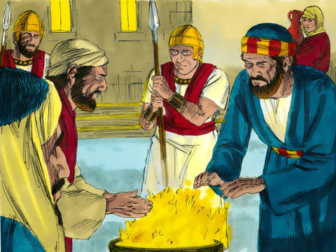
Patrick. Peter followed, right into the courtyard of the high priest and sat with the guards, warming himself by the fire. Charlie

Slide 4
All: Jesus remember me when you come into your kingdom.
Jesus remember me when you come into your kingdom

Slide 5
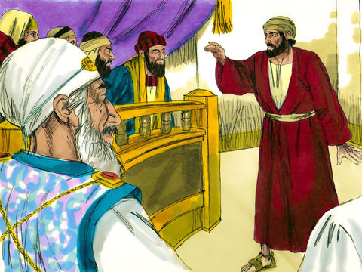
Makan: The chief priests and Jewish leaders were looking for evidence against Jesus so that they could put Him to death, but they did not find any. Many testified falsely against Him, but their statements did not agree.

Slide 6
All: Jesus Remember me when you come into your kingdom.
Jesus remember me when you come into your kingdom

Slide 7
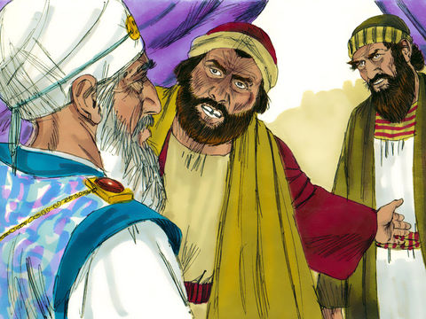
Vernon: Some claimed ‘We heard Him say, “I will destroy this temple made with human hands and in three days will build another, not made with hands.” Bernice

Slide 8
All: Jesus remember me when you come into your kingdom.
Jesus remember me when you come into your kingdom

Slide 9
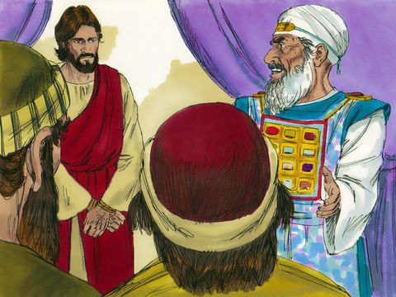
Mahin: Are you not going to answer?’ Gracie: The High Priest asked Jesus.
But Jesus remained silent. (Jesus played by Mahin)

Slide 10
All: Remember me when you come into your kingdom.
Jesus remember me when you come into your kingdom

Slide 11
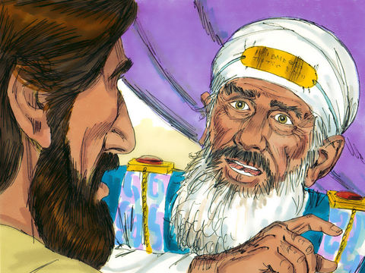
Bernice: The high priest asked Jesus, ‘Are you the Messiah, the Son of the Blessed One?’ ‘
Mahin: I am, And you will see the Son of Man sitting at the right hand of the Mighty One and coming on the clouds of heaven.’

Slide 12
All: Jesus remember me when you come into your kingdom.
Jesus remember me when you come into your kingdom

Slide 13
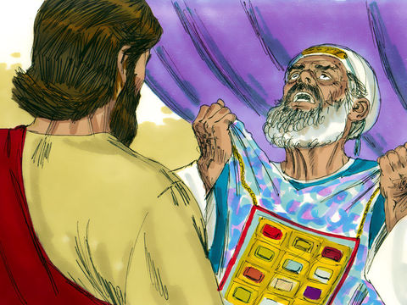
Cody - Capri: At hearing this the High Priest tore his clothes.
Bernice: ‘Why do we need any more witnesses?’ You have heard this blasphemy. What do you think?’
Cody – Capri: They shouted,
All: ‘Crucify Him! Crucify Him! Crucify Him!’

Slide 14
All: Jesus remember me when you come into your kingdom.
Jesus remember me when you come into your kingdom

Slide 15
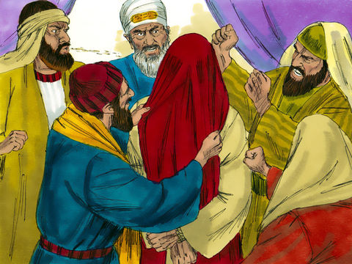
Tom: Some began to spit at Jesus. They blindfolded Him, struck Him with their fists, and said, (ALL)‘Prophesy!’ And the guards took Him and beat Him.

Slide 16
All: Jesus remember me when you come into your kingdom.
Jesus remember me when you come into your kingdom

Slide 17
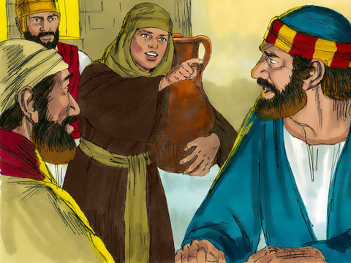
Mahira: While Peter was in the courtyard, one of the servant-girls of the high priest came by. She looked closely at Peter and said, ‘You were with that Nazarene, Jesus. (Phoebe) Peter denied it. ‘I don’t know what you’re talking about,’ (Charlie) He replied.

Slide 18
All: Jesus Remember me when you come into your kingdom.
Jesus remember me when you come into your kingdom

Slide 19
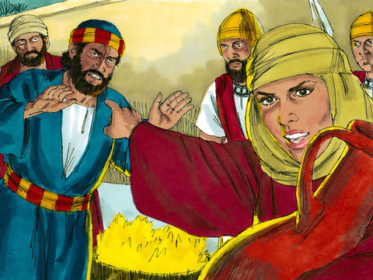
Taylor: Later, out by the gate, another girl noticed Him and said to those standing around, ‘This man was with Jesus.’(Sara Rose) Again Peter denied it, this time with an oath. ‘I don’t even know the man,’ Charlie

Slide 20
All: Jesus Remember me when you come into your kingdom.
Jesus remember me when you come into your kingdom

Slide 21
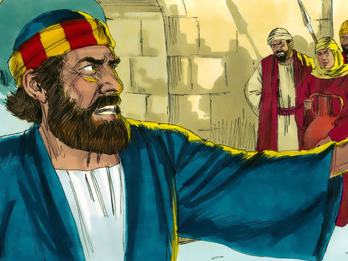
Nancy: Men who had been standing there came over to Peter and said, ‘We know you are one of His disciples, for we can tell by your Galilean accent.’ (Stanley and Jonas) Peter began to curse and swear. ‘I don’t even know the man,’ he said. Nancy: Immediately the cock crowed.

Slide 22
All: Jesus Remember me when you come into your kingdom.
Jesus remember me when you come into your kingdom

Slide 23
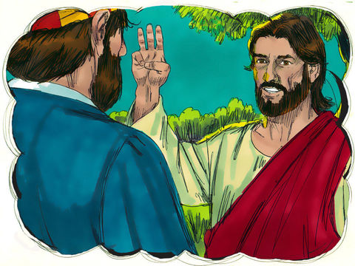
Francisco: Jesus turned round and looked at Peter. Peter remembered what Jesus had said earlier, ‘Before the cock crows, you will deny me three times.’ (Mahin)

Slide 24
All: Jesus remember me when you come into your kingdom.
Jesus remember me when you come into your kingdom

Slide 25
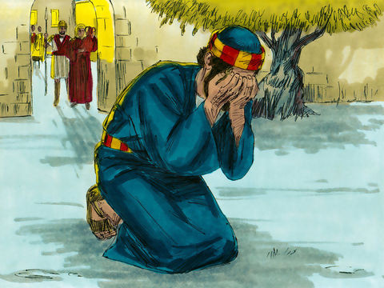
Kaeban: Peter went away and cried bitterly ..

Slide 26
All: Jesus Remember me when you come into your kingdom.
Jesus remember me when you come into your kingdom

