Slide 1
Poems about Wales

Slide 2
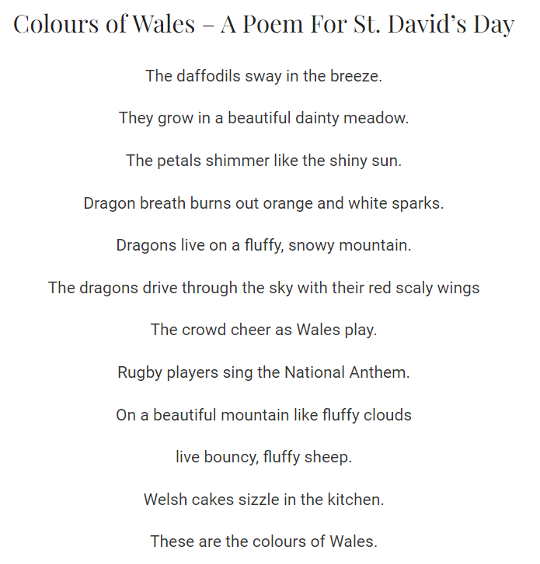

Slide 3
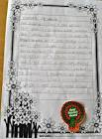

Slide 4
The Welsh Rugby
The Welsh have feelings about rugby
No other Nation can describe
They sing all their rugby songs
To keep the game alive.
We hate to lose at rugby
And cannot stand defeat
Their songs are sang much louder
As they stand out of their seats.
The Millennium Stadium
Is their National rugby ground
You need to see a Welsh rugby match
To enjoy the immense sound.
The Three Feathers as a logo
Sits right above Welsh hearts
They sing their National Anthem
Before the Rugby starts.
So come on the Welsh rugby teams
Play the game like a proper side
Because the Nation is behind you
So play the game with pride.

Slide 5
Welsh Daffodils
As you walk along the valley floor
And along the valleys hills
You will see the blooming flowers
Of the great Welsh daffodils.
They stand so tall on big long stalks
So proud to be called Welsh
The yellow petals so vibrant
Which are looking full of health.
The trumpet opens fully
To take in the fresh Welsh air
Used to represent St David's Day
And to uplift all those in care.
To go with them God made a place
Full of green mountains and the vales
And the daffodils proudly stand today
As a symbol for our Wales.

Slide 6
The Valleys
What we love about the welsh valleys
The trees that line the hillsides,
Follow the contours of the land,
From the giant Breacon Beacon peaks,
To the Porthcawl seaside sands.
Some hillsides are manmade thou,
Left over coal put into mounds,
But nature has taken over now,
Since mining has stopped underground.
Some fields are used for food crops,
When others just for grazing,
And what we love about the welsh valleys most,
The sights are always amazing.

Slide 7
Beautiful valleys
The Welsh valleys are so beautiful
Many different shades of green
For many miles on mountain tops
The fir trees can be seen
The birch trees in the summer
The grass to feed the sheep
The stingy nettles and the ferns
In the ridges which are deep
The Welsh valleys are so beautiful
But all is not what it seems at all
Some mountains as regenerated
Old tips of yesteryears coal
You need to see the scenery
To see the beauty here in Wales
Beauty is not just in the Beacons
It's in the valleys and the vales

